Slide 1

Lightning Talk Sign-Up
tiny.cc/a2pydatalightning

Slide 2
September 14, 2017

Slide 3




Acknowledgements & Sponsors

Slide 4
Important Points
Emergency exits
Speakers
Feedback
https://github.com/PyDataAnnArbor
Unless quick, hold questions until the end
We’re in a borrowed space, please clean up after yourself

Slide 5
PyData Code of Conduct
http://pydata.org/code-of-conduct.html

Slide 6
Quick Icebreaker

Slide 7


This Month in Data Science
ONNX
Open Neural Network Exchange
Notes:
A standard that will allow developers to move their neural networks from one framework to another. Caffe2, PyTorch, CNTK

Slide 8

http://www.bigdataignite.com/
September 27-29, 2017 Grand Rapids
Notes:
educational big data, IoT, and cloud computing conference in Western Michigan

Slide 9
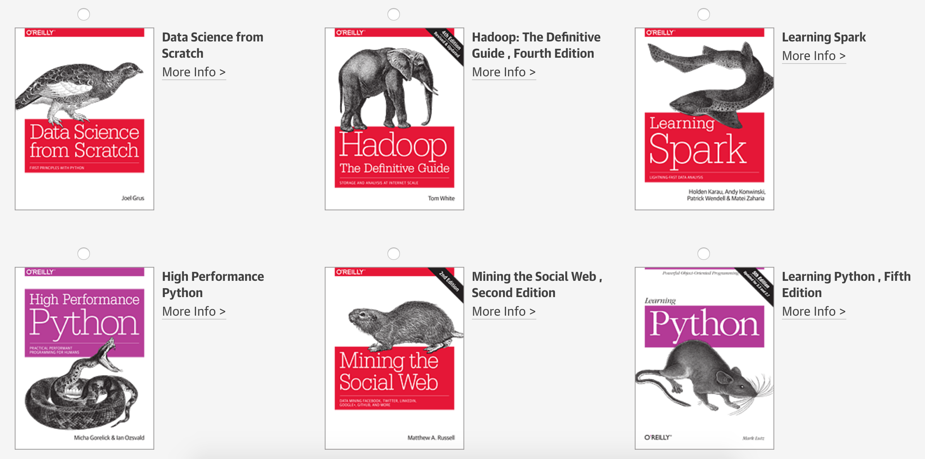
www.oreilly.com/pub/get/pydataannarbor

Slide 10
Data Scientists Data Analysts Sr Research & Developers
careers.tdameritrade.com

Slide 11

Next Event
tiny.cc/a2pydatalightning
Who: You
What: Lightning Talks
When: Tuesday, October 10, 2017 (6:00pm)

Slide 12
September 14, 2017

