Slide 1

October 9, 2018

Slide 2




Acknowledgements & Sponsors

Slide 3
Important Points
Emergency exits
Feedback
https://github.com/PyDataAnnArbor
Unless quick, hold questions until the end
We’re in a borrowed space, please clean up after yourself

Slide 4
PyData Code of Conduct
http://pydata.org/code-of-conduct.html

Slide 5
Quick Icebreaker

Slide 6
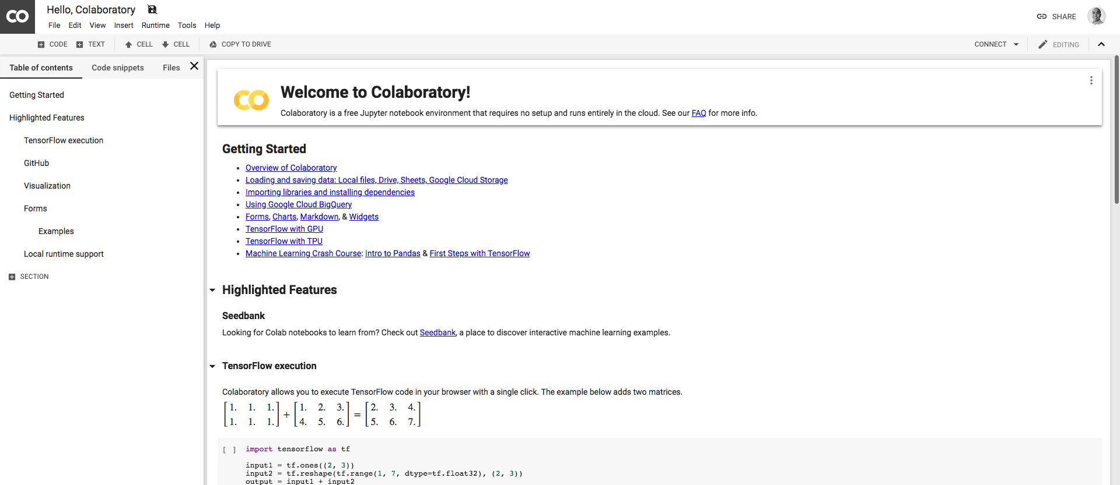
This Month in Data Science
Colaboratory - TPUs
http://colab.research.google.com

Slide 7

Next Event
Who: You!
What: Community Lightning Talks
When: Tuesday, November 13, 2018 (6:00pm)

Slide 8
Community Announcements?

Slide 9

Community Event
Who: Jiliang Tang
What: Theory & Engineering of Large E-commerce Apps
When: Monday, October 15, 2018 (6:45pm)

Slide 10
October 9, 2018

Slide 12
Data Scientist
jobs.tdameritrade.com

