Slide 1

November 13, 2018

Slide 2



Acknowledgements & Sponsors

Slide 3
Important Points
Emergency exits
Feedback
https://github.com/PyDataAnnArbor
Unless quick, hold questions until the end
We’re in a borrowed space, please clean up after yourself

Slide 4
PyData Code of Conduct
http://pydata.org/code-of-conduct.html

Slide 5
Quick Icebreaker

Slide 6
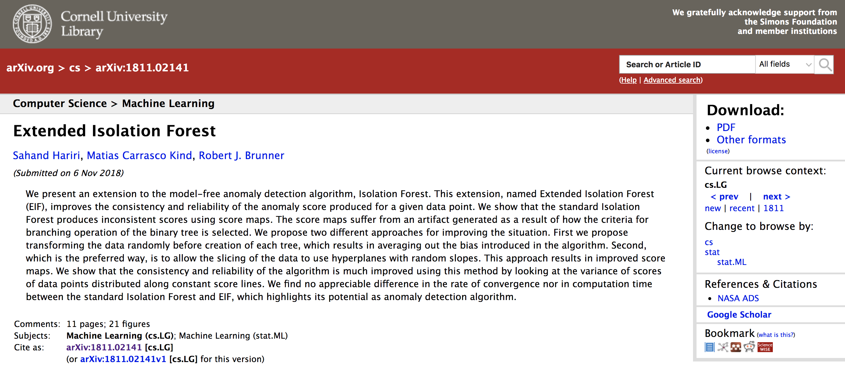
This Month in Data Science
Extended Isolation Forest for Anomaly Detection
https://github.com/sahandha/eif

Slide 7

Next Event
Who: Haitham Maya & Brandon Stange (JOOL Health)
What: Methods for Interpretable Machine Learning
When: Tuesday, December 4th, 2018 (6:00pm)

Slide 8
Researcher Developer Engineer Data Scientist
jobs.tdameritrade.com

Slide 9
Community Announcements?

Slide 10
November 13, 2018

