Slide 1

Using Machine Learning to Generate GDPR Compliant Data
“MAKE DATA MORE.”
Dr Rae Chen
Technology Consultant, PhD in Data Science
Notes:
Self-introduction

Slide 2
Today’s Agenda
Data Privacy: who controls your data and what should they do?
01
Using machine learning to protect privacy: a showcase
02
Remarks: data utilisation and data ethics
03
Notes:
Here is the agenda.

Slide 3
Data Flow
Google
A Statistics student
A large company
Alice
a social scientist
Facebook
a consulting company
You
Google Ads
Me
Statistics Office
A marketing analyst
A small business
Recruitment company
a social scientist
Data Subjects
Data Controllers
Data Processors

Slide 4
What should data controllers do?
To make their data free from privacy disclosure risks
Article 23 of GDPR states: “the controller shall implement appropriate technical … measures in an effective way in order to meet the requirements of this Regulation and protect the rights of data subjects.”
To make their data remaining analysable
No matter what privacy-protection techniques they use on the data, the final data must present the same properties as the original data.
Enough variables
Enough cases

Slide 5
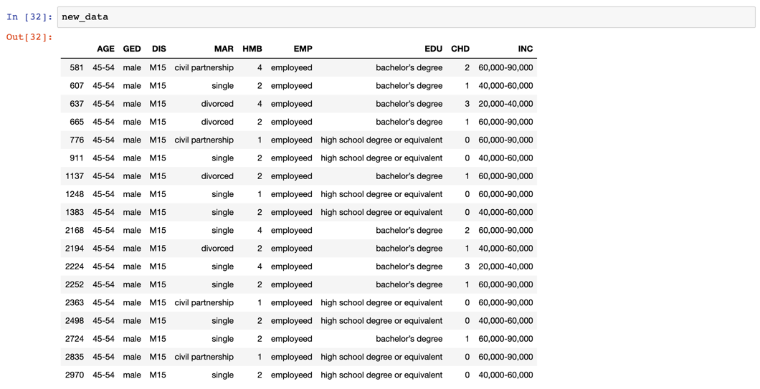
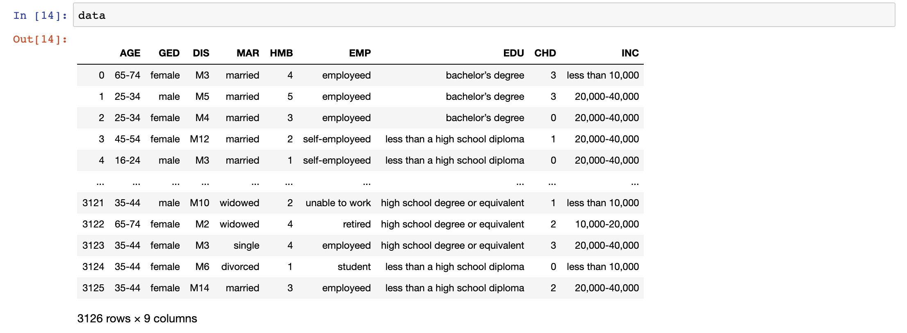
3 Risk Measures of Data Privacy
Accessibility
Uniqueness
Diversity
“The more variables the data has, the more difficult to protect it from privacy leakage.”

Slide 6

Why Machine Learning?
Traditional ways to protect privacy
Hard to capture complex associations between ALL variables
Risk-Utility paradox
Data privacy protection can be regarded as an optimisation problem
To minimise the privacy leakage risk
To maximise information utility simultaneously.
Icon made by Photo3idea_studio from www.flaticon.com

Slide 7
Why Machine Learning?
Data
Environment
Objectives
Policy
IF (environment): DO (action)
Rewards
IF (action):
DO (giving rewards)
Agility
Three components
Simulating from existing models
Heuristics
Learning ability
Output

Slide 8
Bio-ML Showcase: Using Natural Evolution to Protect Privacy
Environment
Minimise risk
Maximise utility
Policy
Selection
Rewards
Gain chance of reproduction
Reproduction
Initial Population
Evolution Simulator
Data
Result

Slide 9
Bio-ML Showcase: Reproduction
Parents
Children

Slide 10
Finding the Hidden Trade-off
Significantly reduced risk while preserving utility.
Outperform datasets protected by traditional methods
The paradox is not necessarily true.
Utopian Solution

Slide 11
Remarks: Beyond GDPR

Slide 12
Data Utilisation Levels
Data as inventory
Data as tool
Data as service
Data as inventory
Inactive
It’s there but we don’t care
Data as tool
There is schema to collect/aggregate data.
Analysable
Data as service
Data tells stories itself.
Data (Business) Intelligence
Profitable: AMAZON, GOOGLE, APPLE

Slide 13

Data Ethics
Is the technique/measure appropriate indeed?
Is the technique/measure intelligent enough?
Appropriate technical and organisational measures
Embedded in the framework of Data (Business) Intelligence
Data as Inventory
Data as tool
Data as service
(Ideally) active privacy leakage control

Slide 14
Thank you
“MAKE DATA MORE.”
LinkedIn:
Rae Chen
Personal Web:

