Slide 1
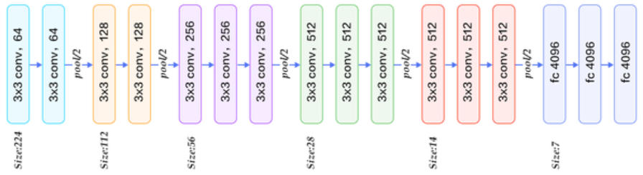
Deep Neural networks
Matrix operations y = w * x + b
Activation a = f(y)

Slide 2
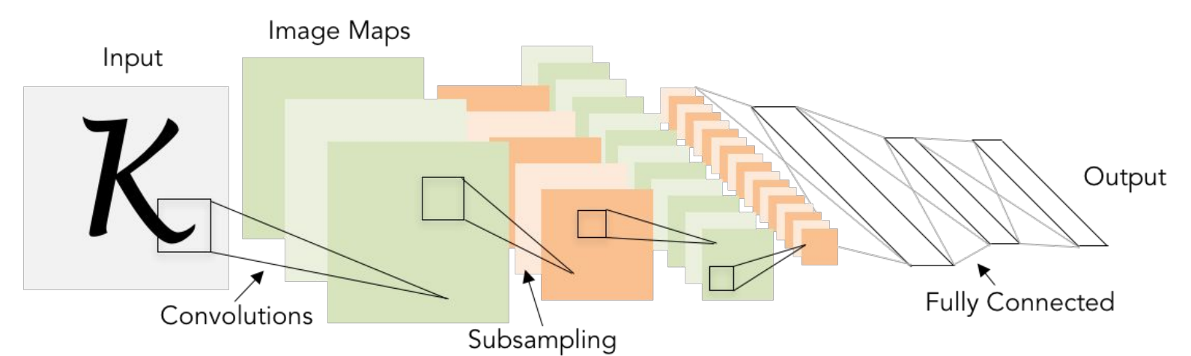
Dense

Slide 3
Input Layer
784 (28*28) units
Hidden Layer 1
128 units
Sigmoid activation
Hidden Layer 2
32 units
Sigmoid activation
Output Layer
10 units
Softmax activation

Slide 4
Cross Entropy Loss
Loss functions determine the quality of our predictions
Two conditions
True value y is either 0 or 1
Predicted value ŷ is between 0 and 1
Cross Entropy Loss = - y log(ŷ) – (1- y) log(1- ŷ)
Cross Entropy Loss with 3 Classes
 | Cat | Dog | Bird
y | 0 | 1 | 0
ŷ | 0.1 | 0.7 | 0.2
- y log(ŷ) | 0 | 0.155 | 0
- (1- y) log(1- ŷ) | 0.046 | 0 | 0.097
Sum all
classes

Slide 5
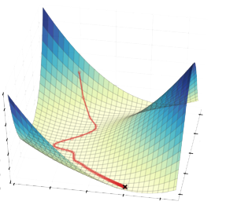
Training the Model
Backpropagation: Given a loss, how do we change the trainable weights to improve it?
Gradient descent: Choose an implementation for efficient search of minimum
Interested in Backpropagation?
First DeepLearning.ai course by Andrew Ng
offers a complete round trip in python

Slide 6
How filters work
0 | 2 | 1 | 2
1 | 1 | 2 | 2
0 | 2 | 1 | 1
0 | 2 | 1 | 1
-1 | 2 | -1
-1 | 2 | -1
-1 | 2 | -1
5
X
=
0 | 2 | 1 | 2
1 | 1 | 2 | 2
0 | 2 | 1 | 1
0 | 2 | 1 | 1
-1 | 2 | -1
-1 | 2 | -1
-1 | 2 | -1
5 | -1
X
=
Stride: step size
Padding: added zeros to keep dimensions

Slide 7
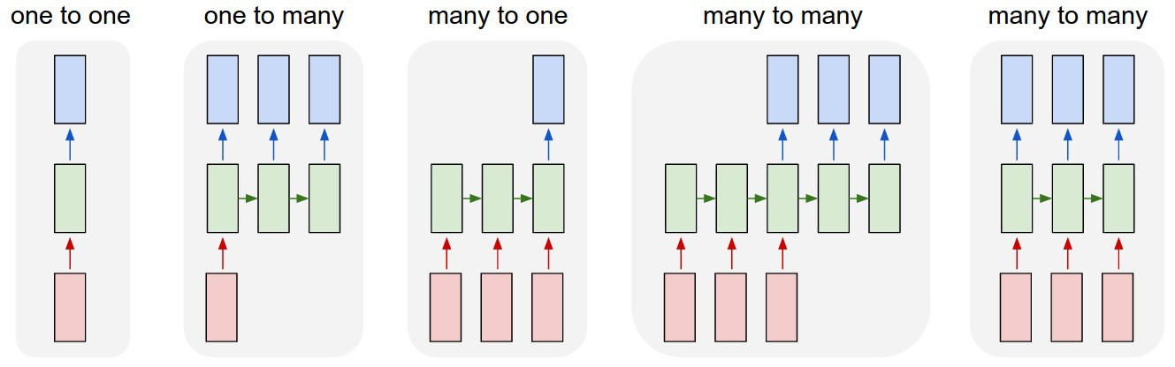
Usage of recurrent networks
Image labelling
Sequence classification (sentiment, DNA sequence)
Sequence prediction (stocks, weather)
Translation
Music generation
Time Series Forecasting

Slide 8
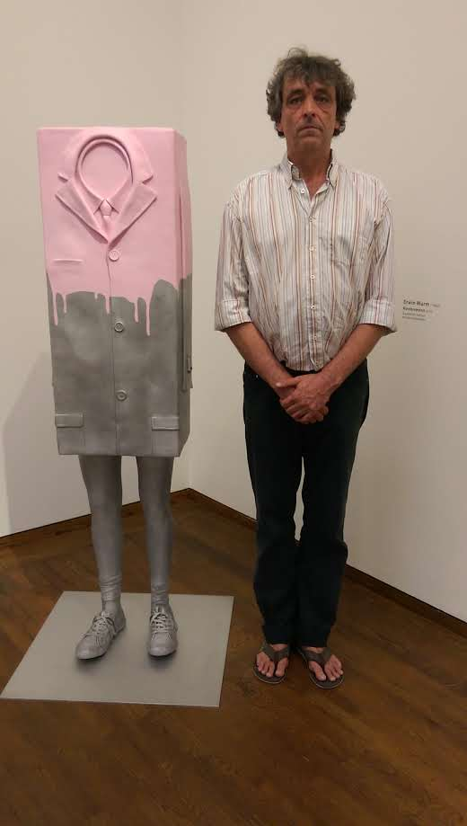
Questions ?
Thanks to Maria and Nick for the superb support while preparing this talk

