Slide 1




PY-EXPO 2026
Team Name - PYTHON SCRIPTERS
Problem Statement ID - PY019
Problem Statement Title- FLOOD PREDICTION AND ALERT SYSTEM
Domain- Web development
PS Category- Software
Industry Mentor -Sarveswaran
Student Mentor -Boomathi

Slide 2

TEAM DETAILS
S.No. | DEPARTMENT | ROLL NO | Role | NAME
1 | B.Tech-AI&DS | 25UAD227 | TEAM LEAD | RAGUL R
2 | B.Tech-AI&DS | 25UAD238 | MODEL DEVELOPER | SHALINI B
3 | B.Tech-AI&DS | 25UAD239 | FRONTEND DEVELOPER | SHANJEETHA N
4 | B.Tech-IT | 25UIT157 | RESEARCH HEAD | MADHUMITHA M
5 | B.E - MECH | 25UME111 | BACKEND DEVELOPER | DEEPAN S
6 | B.E-CSE | 25UCS208 | ARCHITECT HEAD | PRIYANKA M

Slide 3
FLOOD PREDICTION AND ALERT SYSTEM
Proposed Solution:
FloodSense AI is a Streamlit-based flood intelligence platform that uses ML, hydrological modelling, and real-time data to predict flood risk (Low / Medium / High / Critical). When a threat is detected, it automatically sends SMS alerts via Twilio to residents and displays safe evacuation routes on a live map.
How the Issue Is Solved:
Existing systems warn people only after flooding begins — and give no guidance on where to go. FloodSense AI predicts flood risk hours in advance and responds instantly with Twilio SMS alerts and safe route navigation, turning a passive warning into an actionable, life-saving response.
Creativity & Feasibility:
No existing tool combines flood prediction, Twilio SMS alerting, and safe evacuation routing in one platform. Most systems stop at the warning — we tell you what to do next. Terrain-aware ML using real DEM satellite data makes predictions geographically accurate, and it runs entirely on free, open data sources — deployable anywhere at no data cost.

Slide 4
TECHNICAL APPROACH
Machine Learning (Logistic Regression) - Model trained
Hydrological and hydraulic Model (Rational Method) - Methods
Real-time Weather API (OpenWeatherMap) - Data collection
Flask REST API - Backend
SQLite Database - Stores the data collected from Flask
Multi-channel Alert System - Gives the alert message(Twilio)
Html and css - Frontend
Methodology
The system collects real-time rainfall and river level data from wireless sensors deployed in flood-prone areas. This data is processed by a backend server, where machine learning models analyze current and historical trends to predict potential floods. When risk thresholds are exceeded, the system automatically sends alerts to users via SMS, email, and a web-based dashboard built with HTML, CSS, and JavaScript. The methodology ensures timely detection, efficient data processing, and clear communication with end-users.

Slide 5


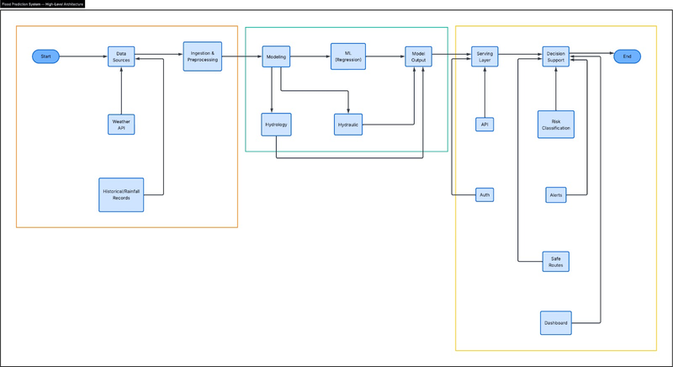
Flood prediction and Alert system
github link
flood prediction app website

