Slide 1



PY-EXPO 2026
Team Name - Py_nexus
Problem Statement ID - PY052 Problem Statement Title- Purecheck
Domain- IOT
PS Category- Software,Hardware Industry Mentor – Sriram R
Student Mentor – Anish karthick V S
Research Metor - Boomathi

Slide 2
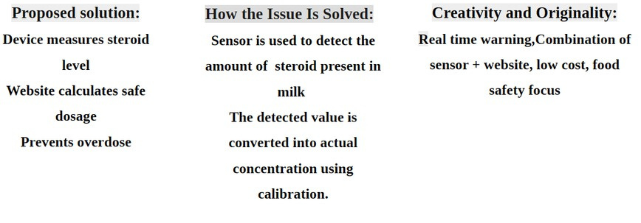
PURE CHECK

Slide 3
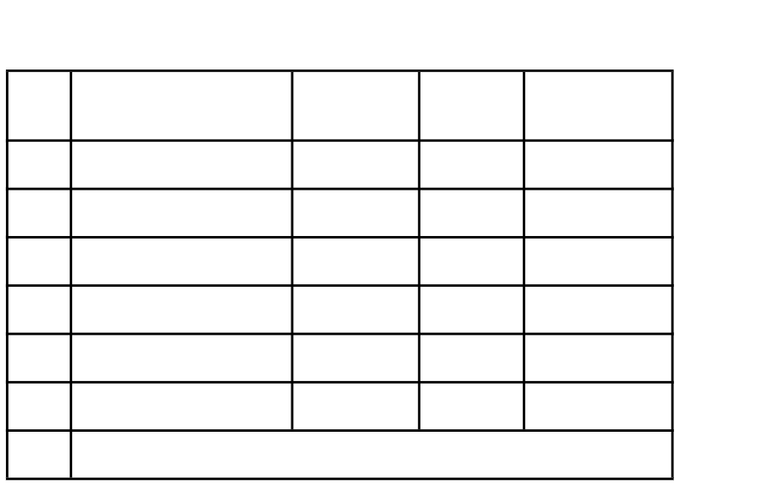
TEAM DETAILS
DEPARTMENT
ROLL
NO
NAME
S.No.
ROLE
1
CSE A
25UCS125
Team lead(hardware)
Charumathi M
2
AIDS B
25UAD208
Hardware and Social media handling
Nesavandana K R
3
AIDS B
25UAD248
Research and publication and
Social media handling
Sudharsna S
4
CSE A
25UCS141
Research and Publication
Hashini S
5
CSE A
25UCS138
Software
Gurushunth A R
6
AIML A
25UAM121
Software
Dev venkat S
Anish karthick V S

Slide 4
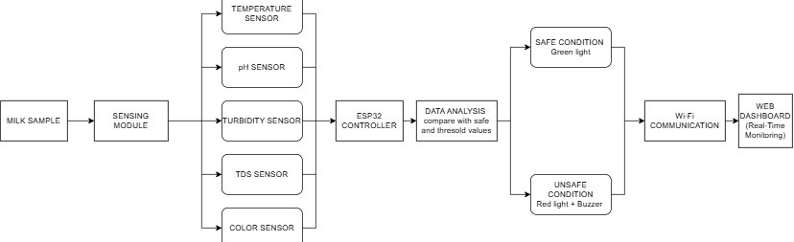
TECHNICAL APPROACH
JSON PYTHON HTML CSS

Slide 5
Your project
Application:
Food Quality Monitoring fssai
Dairy product manufacturing factories
Github:
https://github.com/PyExpo2K26/PY26052.git

