Slide 1




PY-EXPO 2026
Team Name - PYZEN
Problem Statement ID - PY057
Team Members
P. Kavya
M. Madhumitha
P. Kishore
P.R. Gokul
K. Dhinesh
T. Nishanth

Slide 2

PROBLEM STATEMENT
In the current dairy supply system, consumers largely depend on packaged milk provided by large dairy companies. During processing, storage, and distribution, milk may undergo several alterations such as removal of natural fat, addition of preservatives, and other modifications to enhance shelf life and appearance. This raises concerns among consumers regarding the freshness, purity, and quality of the milk they consume.
At the same time, dairy farmers face significant challenges in selling their produce. They often rely on intermediaries or cooperatives, which results in lower profit margins and limited control over pricing. Additionally, due to the perishable nature of milk, any excess production that is not sold quickly can lead to spoilage and wastage, causing financial losses for farmers.
Thus, there exists a gap in the current system where consumers lack access to truly fresh milk, and farmers lack a direct, profitable, and efficient way to reach nearby customers.

Slide 3
PROJECT _NAME
Proposed Solution:
The proposed solution is a "Hyperlocal Direct Milk Supply Platform" that helps farmers connect with consumers directly and provide them with fresh milk supplies. This platform will be useful in solving the problems mentioned above.
How the Issues Solved:
Freshness and Purity: Fresh milk will be supplied from nearby farms.
Farmer Income: There will be no middleman involved, and farmers will be able to earn money through subscription.
Milk Wastage: This will be reduced to zero.
Trust and Transparency: This will be ensured through the details provided.
Creativity & Feasibility:
The proposed system will be implemented through a mobile/web application with separate dashboards for farmers and consumers.
Consumers will be provided with fresh milk supplies, and farmers will be able to earn money.
The proposed system will be implemented in real time, thus reducing milk wastage to zero.

Slide 4
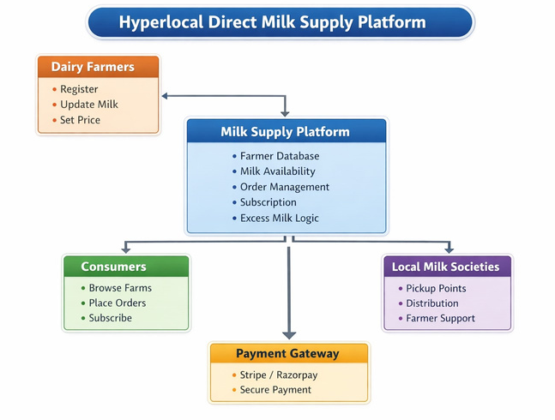
TECHNICAL APPROACH
FRONTEND
HTML, CSS, JavaScript
BACKEND
Python/Framework:Flask
DATABASE
SQL Lite
OTHER TOOLS
Razorpay - Payment Gateway
Google Maps/Leaflet.js - Geolocation Search
Cron jobs - Daily Milk Availability Updates

Slide 5
TECHNICAL APPROACH
METHODOLOGY
Farmer Registration: Farmers provide farm location, milk capacity, price, delivery radius.
Daily Milk Availability: Farmers update morning and evening milk availability.
Consumer Ordering: Consumers browse nearby farms, place orders, choose delivery or pickup.
Subscription Model: Consumers subscribe for daily delivery (morning/evening).
Excess Milk Handling: Platform suggests paneer, ghee, butter, cheese, or supply to local shops.
Milk Society Distribution: Local centers facilitate quick distribution and pickup.

