Slide 1

Research Paper
Team Name:PYHUSTLE Team ID:PY080 Team Lead:P.DHARMA Team Members:RITHIKA R, MISAL MAYUR V,A.MOHAMED
THARIK,M.DHARSHAN SANJAY,R.DEEPAK RAJA

Slide 2


Problem statement
Pipeline inspection is a risky process due to the confined spaces involved in the inspection process. The traditional methods of pipeline inspection are lengthy processes that rely on manual observation. The process is risky as human lives are involved in the process. The proposed project focuses on the development of a low- cost ESP32-CAM-based robotic car that includes real-time video streaming and a machine learning model for automatic crack detection. The proposed system helps in efficient detection of structural defects in the pipeline.

Slide 3

Objectives
To create a budget-friendly robotic system using the ESP32-CAM, we will integrate a machine learning model for real-time pipeline inspection and automatic crack detection. To design a robotic car which can navigate through pipelines to inspect the interiors of such confined spaces. To incorporate the ESP32-CAM module to stream live video from inside the pipelines. To design a wireless control mechanism based on Wi-Fi technology to control the robot from a distance. To design a machine learning model to identify cracks in images captured by the robot’s camera. To incorporate a machine learning model within the system to identify defects in the pipelines. To minimize human intervention in dangerous locations. To provide an efficient solution compared to conventional methods.

Slide 4

Solution
The ESP32-CAM car moves inside the pipeline and sends live video to the mobile application. The machine learning model analyzes the images and automatically detects cracks in the pipe. The detected crack areas are highlighted on the screen to help in easy identification. This system focuses only on crack detection, making it simple and efficient for visual inspection, maintenance, and monitoring of pipelines.

Slide 5
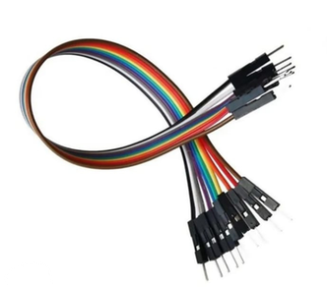
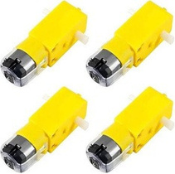
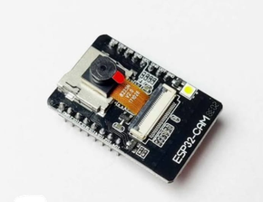
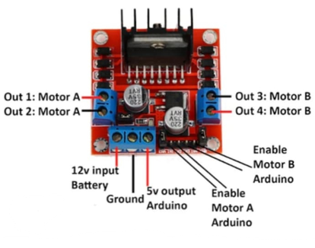
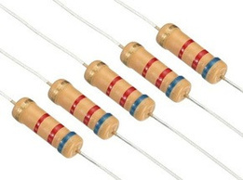
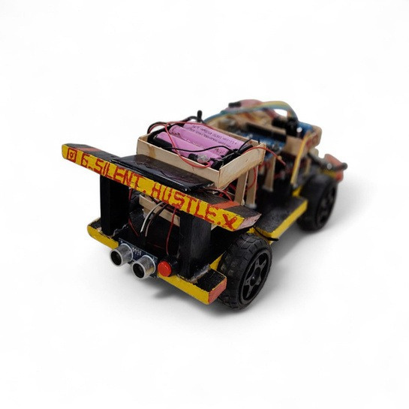
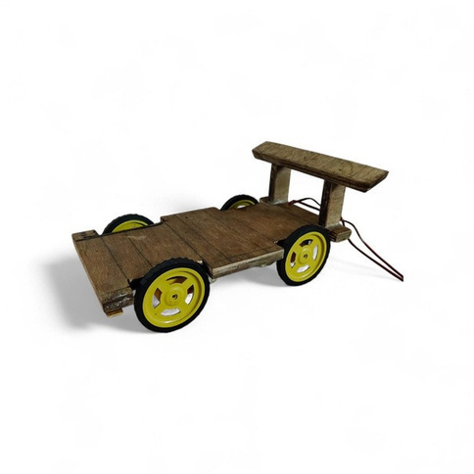
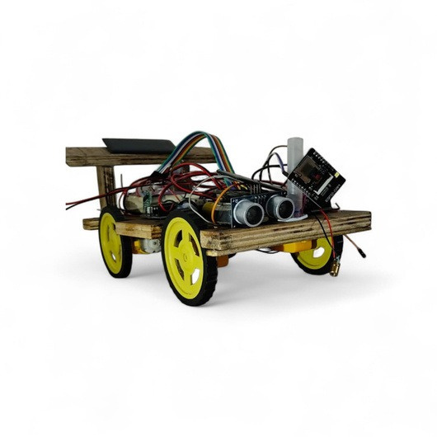
Tech stack
Jumper wire
Resistance
Gear motor
Wifi Module
Motor driver

Slide 6

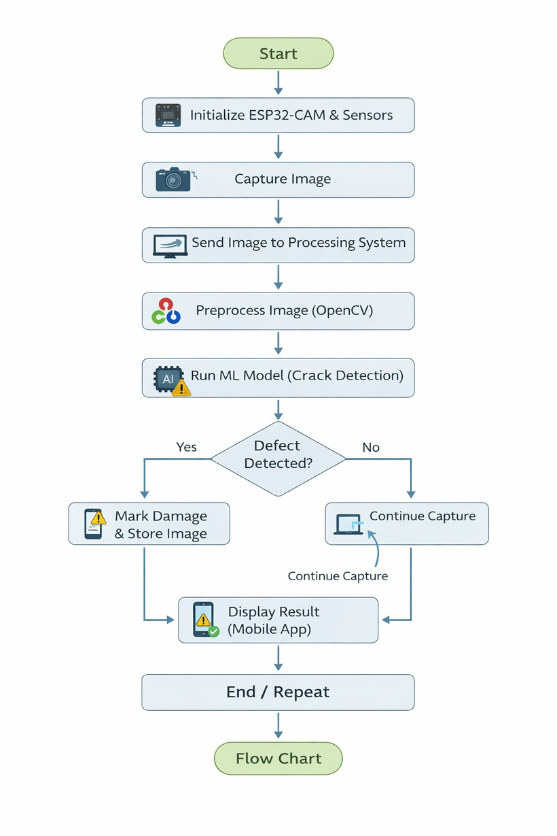
Flowchart

Slide 7

Methodology
The system uses an ESP32-CAM based robotic car with motors and sensors for pipeline inspection. It provides live video streaming via Wi-Fi and can be controlled through a mobile app. A machine learning algorithm detects cracks and blockages in real time. An ultrasonic sensor measures blockage distance inside the pipe. The system runs on a battery-powered setup optimized for efficient operation.

Slide 8

Reference
Github repo link: https://github.com/PyExpo2K26/PY26080.git LaTex link:
Demo Video Link:
PPT link:https://docs.google.com/presentation/d/1vGcdBbrDi79Ux5Ed23tY
Ysx6CWqrJH1_/edit?
usp=sharing&ouid=107511890916983927730&rtpof=true&sd=tru
e

