Slide 1
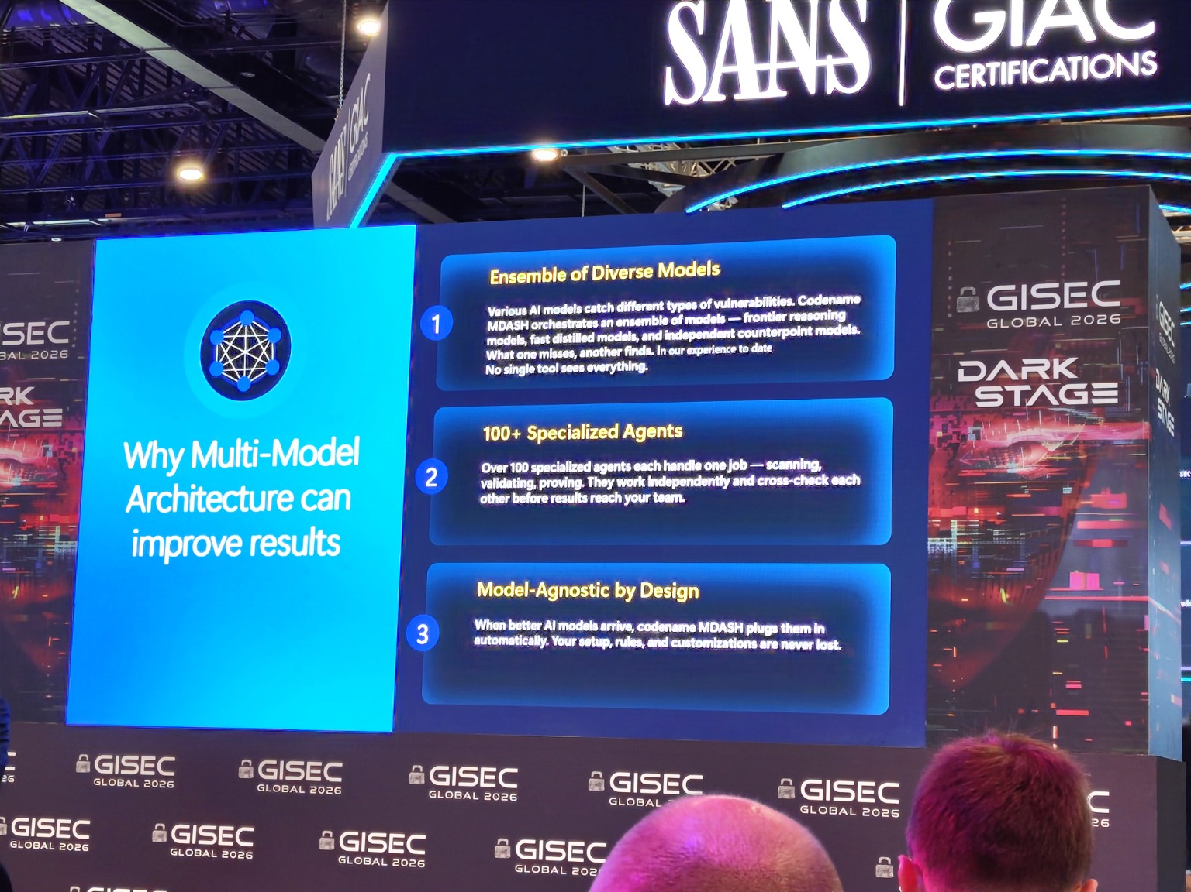
AI & cybersecurity
Knowledge and observations
from GISEC 2026
Opening section before Post-Quantum Cryptography
01
Notes:
Suggested introduction: GISEC highlighted how AI changes application development and security testing. This section focuses on the concepts behind the demonstrations, then transitions into PQC. Approximate speaking time: 8–10 minutes, or 5–6 minutes with brief explanations.
Sources: Presenter-supplied GISEC photos.

Slide 2
AI across the application lifecycle
Build with AI
Test with AI
Secure AI systems
Coding assistants generate
code and dependencies.
Models assist code review,
triage and fix proposals.
LLMs, retrieval and agents
introduce new trust boundaries.
Each use of AI adds a security responsibility.
02
Notes:
Explain the distinction between AI helping developers, AI helping defenders, and AI becoming part of the application. These roles overlap. Generated code still needs review and testing. AI-powered applications still need ordinary authentication, authorization and input handling.
Sources: Supplied lifecycle and Securing AI screenshots. OWASP: https://genai.owasp.org/llm-top-10/

Slide 3
AI complements established AppSec tools
SAST & SCA
LLM analysis
Repeatable code checks
Dependency and license inventory
Traceable findings and policy gates
Reasoning about code context
Explaining suspected vulnerabilities
Assisting triage and remediation
Combined workflow
Scan
AI analysis
Human validation
Fix & retest
03
Notes:
SAST means Static Application Security Testing. SCA means Software Composition Analysis. The talk argued for combining established tools with LLM analysis. Avoid absolute claims that scanners cover every line or that LLMs always produce more false positives. Both methods have coverage limits. AI output is a hypothesis until the team validates it.
Sources: Presenter photo 1000076378.jpg, GISEC talk.

Slide 4
The emerging AI attack surface
Where AI enters
What can go wrong
Employees use AI
Sensitive information leaves approved systems.
Developers use generated code
Insecure code or unverified packages enter a build.
Applications retrieve documents
Malicious content influences model instructions.
Agents invoke tools
Broad permissions turn bad output into actions.
04
Notes:
Prompt injection occurs when attacker-controlled input steers model behavior. Indirect injection can arrive through retrieved documents or tool output. RAG means Retrieval-Augmented Generation. Separate sensitive data access from model reasoning, validate outputs and evaluate dependencies before installation. These examples describe possible risks, not inevitable failures.
Sources: OWASP LLM risks: https://genai.owasp.org/llm-top-10/; presenter Securing AI screenshots.

Slide 5
An agent has an identity and privileges
User request
Agent
Tools & APIs
Retrieved content
Untrusted context
Business systems
Documents, memory
and tool responses
Controls at the action boundary
Least privilege / Explicit authorization / Action logs
05
Notes:
Illustrative architecture. An agent may read content and act through APIs. A malicious document could attempt to make it send data outside the organization. Model instructions alone are insufficient authorization. Enforce permissions in tools and APIs, isolate credentials, and require approval for sensitive actions. MCP is a tool integration protocol, not an authorization mechanism.
Sources: Photo 1000076560.jpg; OWASP excessive agency and prompt injection: https://genai.owasp.org/llm-top-10/

Slide 6
Specialized agents can cross-check findings
Discover
Reproduce
Challenge
Fix & retest
Engineer review
Useful output: a finding with evidence
Affected code, reproduction steps, impact and a verified fix.
06
Notes:
This is an illustrative workflow inspired by the multi-agent demonstrations at GISEC, not a benchmark or guaranteed architecture. Specialized roles can divide work and challenge findings. Different models can still share errors, so agent agreement is not proof. Human review and reproducible evidence remain essential. Red/blue/green labels vary between vendors and are not a universal standard.
Sources: Presenter photos 1000076341.jpg and 1000078044.png.

Slide 7
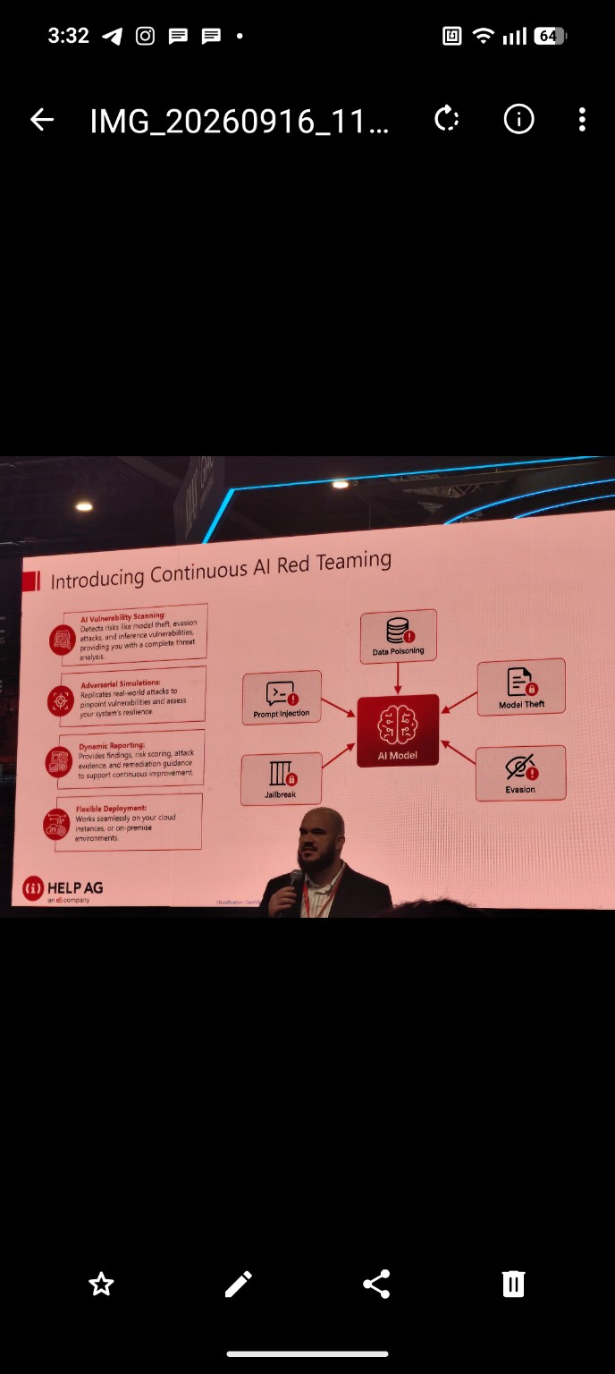
AI testing continues after deployment
Test the full system
Prompt injection and data disclosure
Tool misuse and permission boundaries
Changes to models, prompts or retrieval
Regression tests after remediation
Track whether controls hold
07
Notes:
Continuous testing means repeating a maintained set of adversarial and regression tests when the system changes and monitoring relevant behavior in production. It does not mean launching uncontrolled attacks against live systems. Combine application testing, access control checks and AI-specific abuse cases. Track successful unauthorized actions and data disclosure, not just whether the model refuses a prompt.
Sources: Presenter Continuous AI Red Teaming screenshot; OWASP risk taxonomy: https://genai.owasp.org/llm-top-10/

Slide 8
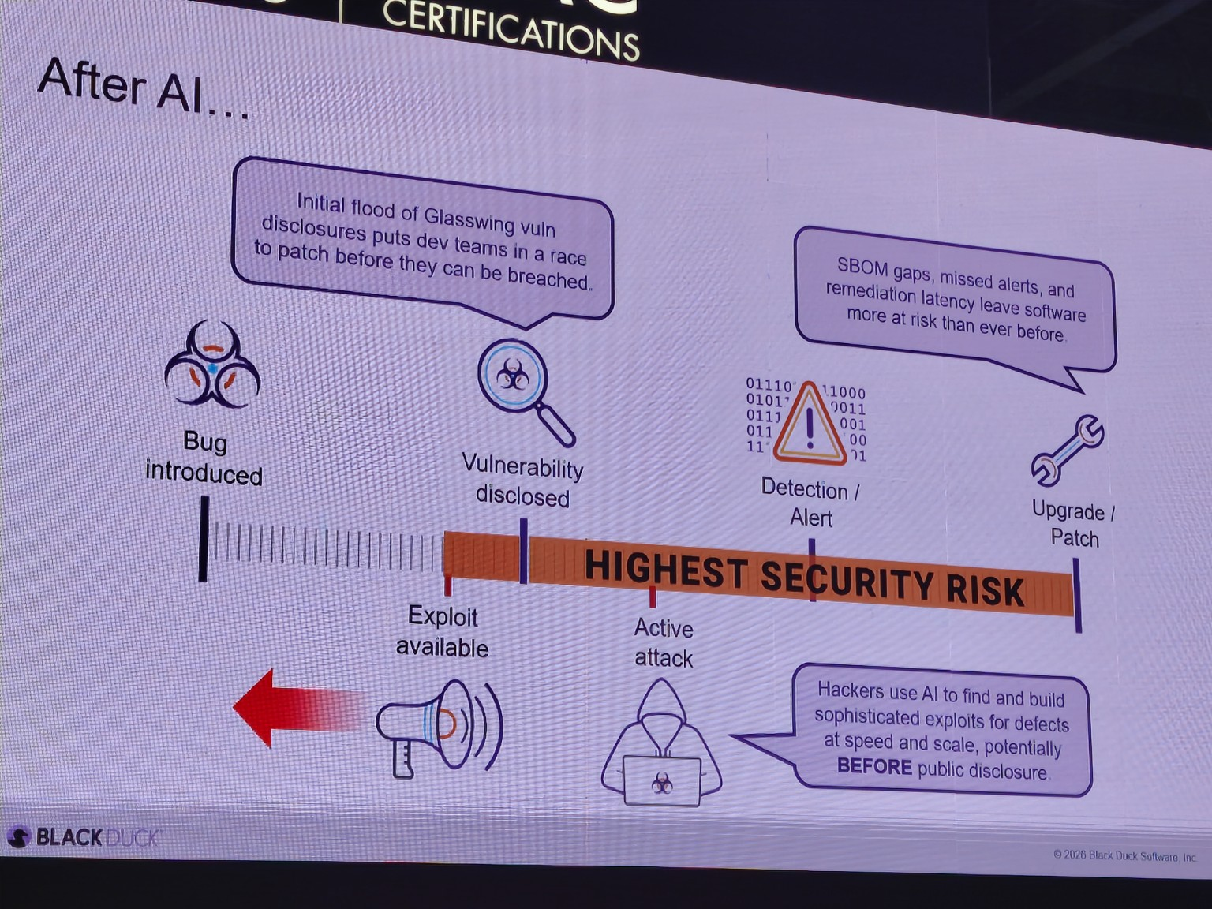
Vulnerability prioritization needs context
Severity
CVSS describes technical severity.
Threat
KEV identifies known exploitation.
EPSS estimates exploitation likelihood.
Business exposure
Reachability, asset importance and controls
determine local urgency.
08
Notes:
GISEC talks raised concerns about disclosure volume and enrichment delays. The deck does not reproduce the photographed CVE counts or forecasts because their methodology was not provided. Use CNA/advisory data and multiple sources. CVSS is severity, KEV is evidence of exploitation in the wild, and EPSS is a probability of observed exploitation over the next 30 days. Neither EPSS nor a CVSS score alone measures organizational risk. AI can assist summarization and triage, while the team owns the prioritization decision.
Sources: CISA KEV: https://www.cisa.gov/known-exploited-vulnerabilities-catalog; FIRST EPSS: https://www.first.org/epss/using-epss; presenter photos.

Slide 9
Post-Quantum
Cryptography
Preparing for the cryptographic transition
Next section
09
Notes:
Transition: AI changes how we build, test and secure applications. Our main topic now shifts to the cryptographic foundations those applications rely on, and how we prepare for post-quantum cryptography. This is a divider for the main PQC presentation, not a full PQC section.
Sources:

