Slide 1




TALLER VIDEOJUEGOS
Reinforcement Learning
Gema Parreño Piqueras
@SoyGema
SoyGema
Notes:
AI as a tool to transform technology with multiple domain possibility that transform world

Slide 2
Supervised Learning
Notes:
Supervised learning LEARNING based on tagged data . We have a knowledge external supervisor
We know how the data works and tag new coming data
CLASSIFY, PREDICT with LINEAR REGRESSION, NAIVE BAYES,RANDOM FOREST or SUPPORT VECTOR MACHINES

Slide 3
LEARNING by known data
Notes:
Supervised learning LEARNING based on tagged data . We have a knowledge external supervisor
We know how the data works and tag new coming data
CLASSIFY, PREDICT with LINEAR REGRESSION, NAIVE BAYES,RANDOM FOREST or SUPPORT VECTOR MACHINES

Slide 4
Unsupervised Learning
Unsupervised Learning
Notes:
In unsupervised learning we LEARN with not tagged data find patterns in data. Finding structures hidden in collections of unlabeled data.
CLASSIFY, DISCOVER.
KMEANS , NEURAL NETWORKS

Slide 5
LEARNING by unknown data
Notes:
In unsupervised learning we LEARN with not tagged data find patterns in data. Finding structures hidden in collections of unlabeled data.
CLASSIFY, DISCOVER.
KMEANS , NEURAL NETWORKS

Slide 6
Reinforce Learning
Notes:
In Learning based on giving a goal –goaloriented learning- . Systems that are capable of LEARNING how to adapt in the real world .

Slide 7
Reinforcement Learning LEARNING WHILE INTERACTING WITH ENVIRONMENT
Notes:
GOAL : creating systems that are capable of LEARNING How to adapt in real world .
Learning from experience and with interaction with the environment
The Goal of RL is to find an optimal policy which achieves the maximum expected return
Goal-oriented learning

Slide 8
Classify Machine Learning by learning method
Notes:
RECAP the differences between the three types of machine learning
In Learning based on giving a goal . Systems that are capable of LEARNING how to adapt in the real world .

Slide 9
States / Actions
Notes:
Perception-action-learning-loop
Defined environment in wich we identify a set of states .
The agent recieves state St from the environment and uses its policy to choose an action a.
Once the action is executed the environment transitions a step, providing st+1 (next step) and feedback in a form of reward.

Slide 10
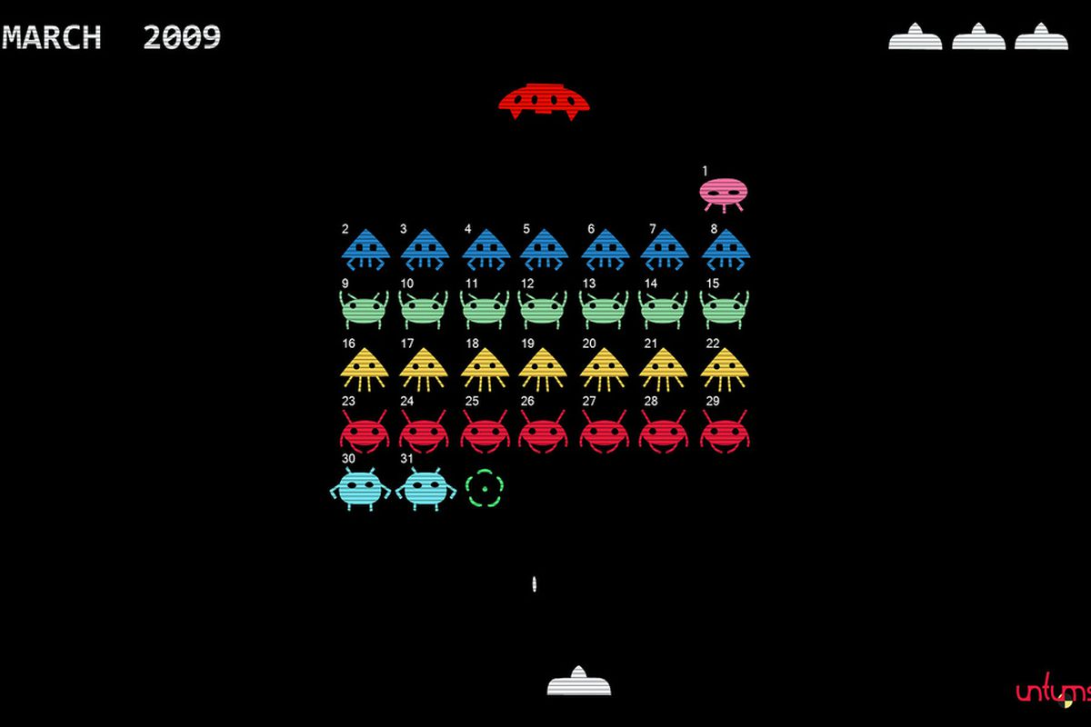
ENVIRONMENT
Notes:
Environment. The context . Must be defined with the actions and the time .
Why videogames are great environments?
General purpose learning . Behind videogames there are systems that are capable of learning how to adapt in the real world .
Maybe how to design an environment

Slide 11
Agent
INCLUDES :
POLICY
VALUE FUNCTION
MODEL
Notes:
Learner . Decision maker.
The goal of the agent is to learn a policy (control strategy) that maximizes the expected return ( cumulative, discounted reward)
The agent uses knowledge of state transitions, of the form (st, at, st+1, rt+1) in order to learn and improve its policy

Slide 12
Agent
Notes:
Learner . Decision maker.
The goal of the agent is to learn a policy (control strategy) that maximizes the expected return ( cumulative, discounted reward)
The agent uses knowledge of state transitions, of the form (st, at, st+1, rt+1) in order to learn and improve its policy

Slide 13
Policy
Notes:
Core of reinforce learning,sufficient to determine behaviour
Policy defines behaviour, the way of behaving at a given time.
The goal of RL is to find an optimal policy which achieves the maximum expected return from all states . maximize the reward.

Slide 14
States / Actions
Notes:
We get into how the feedback works for learning the policy

Slide 15
The ATARI CASE
Notes:
So far described key formalism used in RL.

Slide 16
Environment description
x 2600
Notes:
Notes about the environment
Description of the environments.
Videogame are good RL learning environments that are goal-reward directed environments
From classic control to complex videogames

Slide 17
Policy Architecture
Input
SPATIAL/ NON SPATIAL FEATURES
Notes:
Architecture Input and Architecture Output

Slide 18
Policy Architecture
Output
SPATIAL/ NON SPATIAL ACTION POLICY
Notes:
Architecture Input and Architecture Output

Slide 19

Results
Notes:
Video : click

Slide 20
The goal of RL is to find a policy π such that V π (s) is maximized
Notes:
AI as a tool to transform technology with multiple domain possibility that transform world

Slide 21
Challenges
Notes:
So far described key formalism used in RL.

Slide 22
TRIAL AND
ERROR
Notes:
The optimal policy must be inferred by trial-and-error interaction with the environment.
The only learning signal the agent receives is the reward.

Slide 23
CREDIT ASSIGNMENT PROBLEM
Notes:
Agents must deal with long-range time dependencies
Often the consequences of an action only materialize after many transitions of the environment
It has to learn that there are different rewards in different times with different consecuences

Slide 24
EXPLORATION
VS
EXPLOTATION
Notes:
When should the agent try out (percieved) non-optimal actions in order to explore the environment (and potentially improve the model)
And when should it explot the optimal action in order to make useful progress ?

Slide 25
Agent
INCLUDES :
POLICY
VALUE FUNCTION
MODEL
Notes:
Learner . Decision maker.
The goal of the agent is to learn a policy (control strategy) that maximizes the expected return ( cumulative, discounted reward)
The agent uses knowledge of state transitions, of the form (st, at, st+1, rt+1) in order to learn and improve its policy

Slide 26
Let´s code!
@SoyGema
SoyGema
Notes:
FAQ
Alphago zero. Two Networks: policy and value net

