Slide 1
Inroduction Of Qdev
Meng Yang
meyang@redhat.com
2014.1

Slide 2
Agenda
What's qdev
PC architecture
Examples of device tree
Common device uses
Help

Slide 3
What's Qdev
QDev = QEMU Device Model
Qdev is:
1) The factory interface that QEMU uses to create guest devices and connect them to each other
2) It also provides a uniform way to expose host
devices (character, network and block) to the guest
https://lists.nongnu.org/archive/html/qemu-devel/2011-07/msg00842.html
Why Qdev ?

Slide 4
Before qdev
All devices using different API interfaces:
-drive if=TYPE,index=IDX,bus=BUS,unit=UNIT,HOST-OPTS. . .
-usbdevice disk:format=FMT:FILENAME
-serial CHARDEV
-parallel CHARDEV
-usbdevice serial:vendorid=VID,productid=PRID,CHARDEV
-usbdevice NAME
-virtioconsole CHARDEV
-net nic,vlan=VLAN,macaddr=MACADDR,model=MODEL,name=ID,addr=STR,vectors=V
-usbdevice net:vlan=VLAN,macaddr=MACADDR,name=ID,addr=STR,vectors=V
-vga VGA
-soundhw C1,...
-watchdog NAME
-pcidevice host=ADDR,dma=none,id=ID
-usbdevice host:auto:BUS.ADDR:VID:PRID

Slide 5
After qdev
Device Model Abstraction
Tree of devices connected by buses
Devices have properties
Devices implement a common API
Generic device configuration & control
Turn code into data
qdev is conceptually simple, devil’s in the details

Slide 6
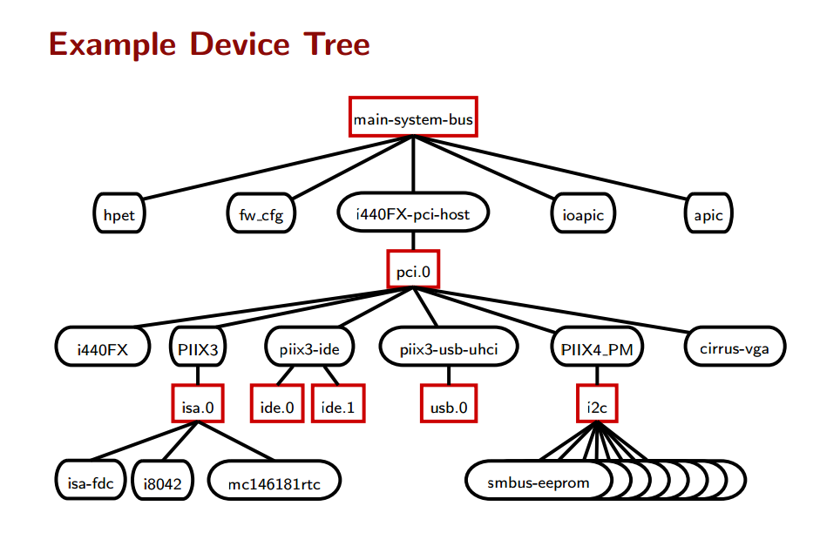
Device Tree

Slide 7
Terminology
main-system-bus: the root of the tree
I440FX-pci-host:host pci bus
I8042:keyboard controller
Hpet:High Precision Event Timer
PIIX3:hardware controller
[root@hp-dl385g7-14 home]# qemu-kvm -machine ?
Supported machines are:
pc RHEL 7.1.0 PC (i440FX + PIIX, 1996) (alias of pc-i440fx-rhel7.1.0)
pc-i440fx-rhel7.1.0 RHEL 7.1.0 PC (i440FX + PIIX, 1996) (default)
pc-i440fx-rhel7.0.0 RHEL 7.0.0 PC (i440FX + PIIX, 1996)
rhel6.5.0 RHEL 6.5.0 PC
rhel6.4.0 RHEL 6.4.0 PC
rhel6.3.0 RHEL 6.3.0 PC
rhel6.2.0 RHEL 6.2.0 PC
rhel6.1.0 RHEL 6.1.0 PC
rhel6.0.0 RHEL 6.0.0 PC
q35 RHEL-7.1.0 PC (Q35 + ICH9, 2009) (alias of pc-q35-rhel7.1.0)
pc-q35-rhel7.1.0 RHEL-7.1.0 PC (Q35 + ICH9, 2009)
pc-q35-rhel7.0.0 RHEL-7.0.0 PC (Q35 + ICH9, 2009)
none empty machine

Slide 8
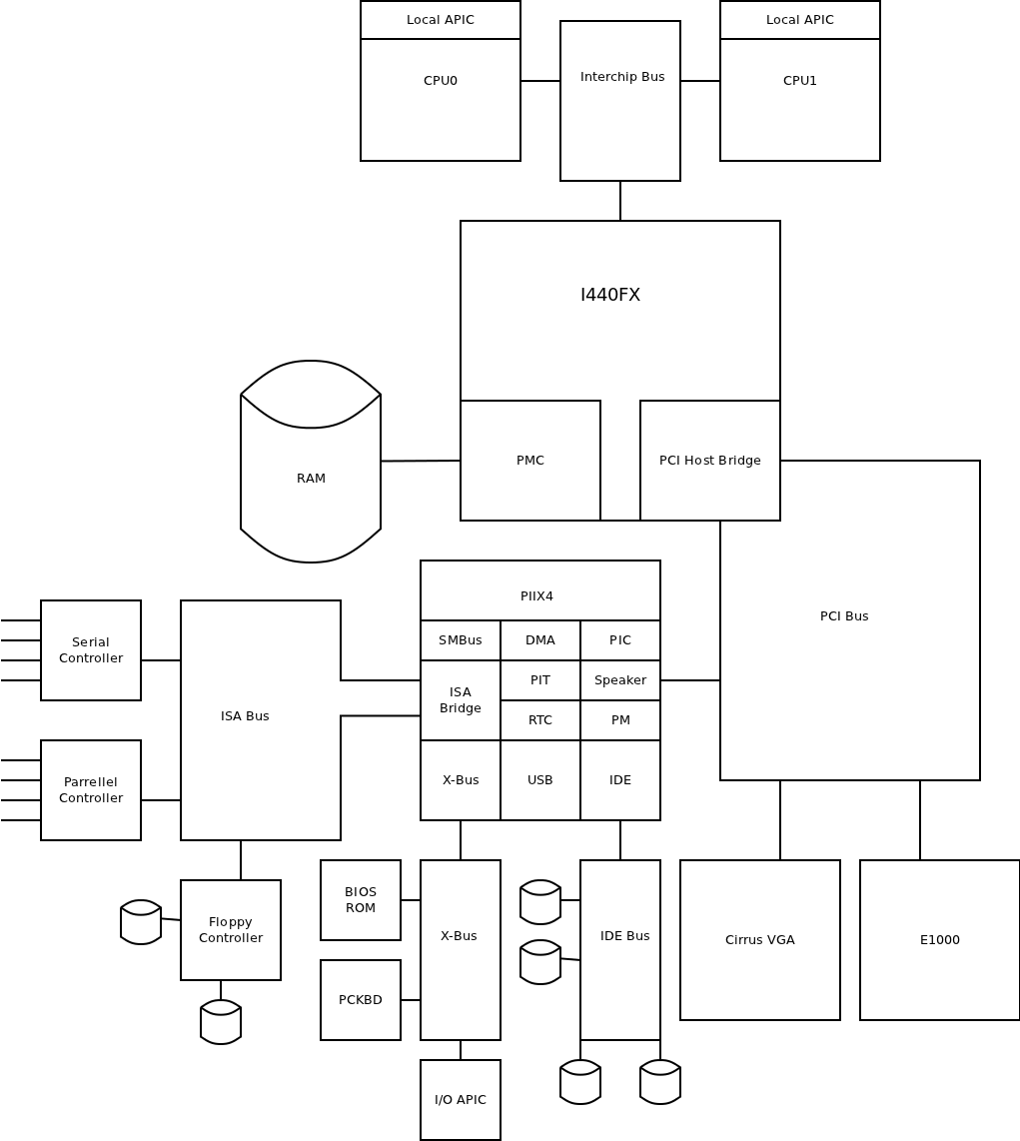

Slide 9
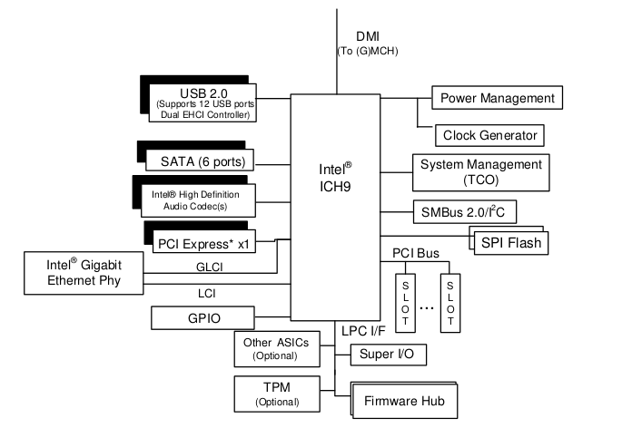

Slide 10
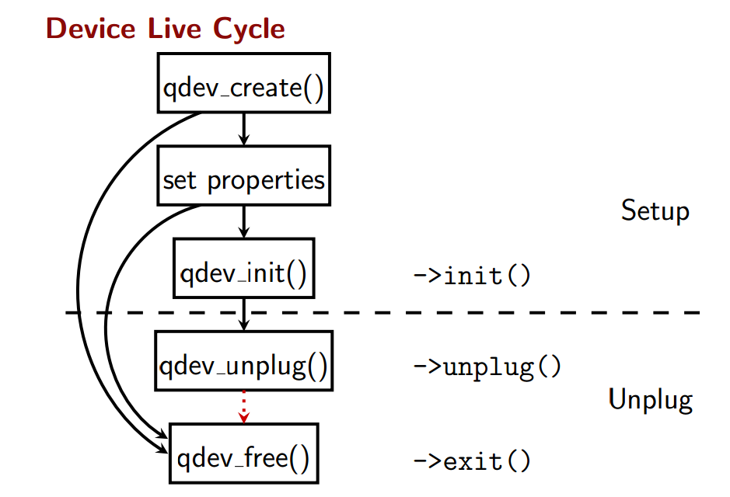
Device Tree

Slide 11
Example Device Tree:
nec-usb-xhci
CMD:
-device nec-usb-xhci,id=usb1,bus=pci.0,addr=03 \
-device usb-tablet,id=usb-tablet1,bus=usb1.0,port=1 \
-device usb-hub,id=usb-hub1,bus=usb1.0,port=2 \
-device usb-kbd,id=usb-kbd1,bus=usb1.0,port=3 \
pci.0
usb controller
PIIX3
nec-usb-xhci
usb bus
usb1.0
usb-kbd
usb-hub
usb-tablet
usb devices

Slide 12
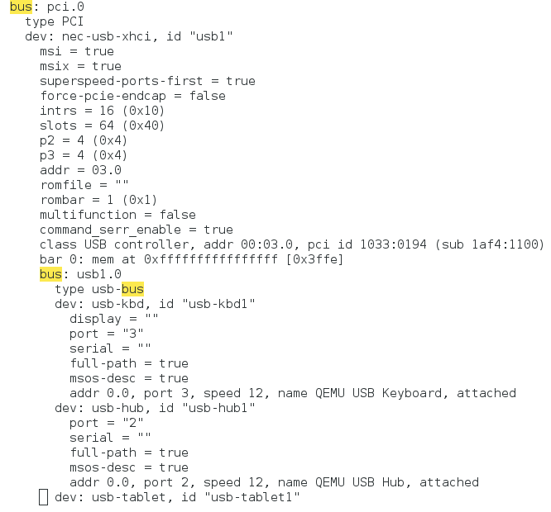
nec-usb-xhci: Properties

Slide 13
Example Device Tree: ISA
CMD: (Why no controller, no bus info in cmd?)
-chardev socket,id=serial,path=/tmp/serial,server,nowait \
-device isa-serial,chardev=serial \
-chardev socket,id=seabios,path=/tmp/seabios,server,nowait \
-device isa-debugcon,chardev=seabios,iobase=0x402 \
pci.0
Isa controller, it's
added to slot 1
default
PIIX3
isa bus
isa.0
Isa-debugcon
Isa-serial
Isa-fdac
isa devices

Slide 14
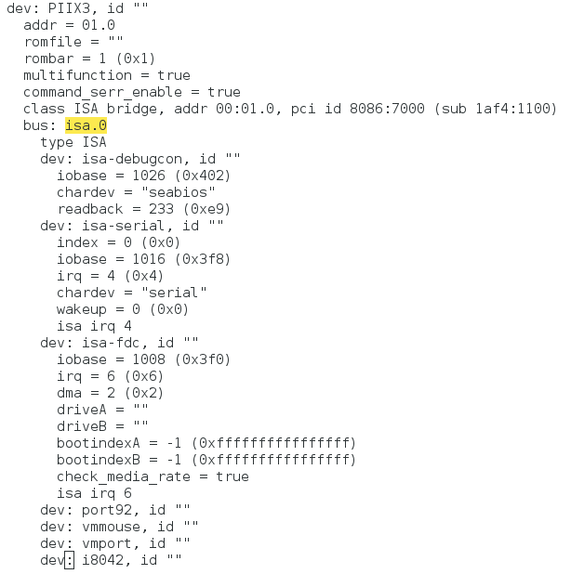
Example Device Tree: ISA

Slide 15
Common Devices
USB Devices
Serial Devices
Block Devices
Network Devices
Others

Slide 16
USB Device Using Qdev
Usb1.0(full speed 12Mbit/s) uhci controller
Usb2.0(high speed 480Mbit/s) ehci controller
Usb3.0(super speed 5Gbit/s) xhci controller
Common Usb device in qdev:
-usb \
-device usb-hub,bus=usb-bus.0,port=2 \
-device usb-storage,bus=usb-bus.0,drive=usbstick5,id='d5',port=2.8 \
-drive if=none,id=usbstick5,file=/home/usb-disk4.qcow2 \
-device usb-kbd,id=kbd,port=2,bus=usb-bus.0 \
-device usb-mouse,id=mouse,port=1,bus=usb-bus.0 \
-device usb-ehci,id=ehci1 \
-drive if=none,id=usbstick,file=/home/usb-disk.qcow2 \
-device usb-storage,bus=ehci1.0,drive=usbstick,port=1 \
-device nec-usb-xhci,id=xhci \
-drive if=none,id=usbstick-1,file=/home/usb-disk4.qcow2 \
-device usb-storage,bus=xhci.0,drive=usbstick-1,port=1 \
Usb-tablet
Usb-storage
Usb-hub
What is Usb pass through?

Slide 17
USB Device Using Qdev
Usb-host stand for “usb pass through”.
● USB Printer
● USB Scanner
● USB Speaker
● USB Stick
● USB Webcam
● USB Keyboard
● USB Mouse
● USB Smartcard Reader
Properties:
hostbus=<nr> -- Specifies the bus number the device must be attached
to.
hostaddr=<nr> -- Specifies the device address the device got
assigned by the guest os.
hostport=<str> -- Specifies the physical port the device is attached
to.
vendorid=<hexnr> -- Specifies the vendor ID of the device.
productid=<hexnr> -- Specifies the product ID of the device.
(1) vendorid+productid -- match for a specific device, pass it to
the guest when it shows up somewhere in the host.
(2) hostbus+hostport -- match for a specific physical port in the
host, any device which is plugged in there gets passed to the
guest.
(3) hostbus+hostaddr -- most useful for ad-hoc pass through as the
hostaddr isn't stable, the next time you plug in the device it
gets a new one ...
-usb \
-device usb-host,vendorid=05ac,productid==12a0 \
-device usb-host,hostbus=3,hostport=4 \
-device usb-host,hostbus=3,hostaddr=2 \
Usb-host
Lsusb -t
[...]
Bus 03.Port 1: Dev 1, Class=root_hub, Driver=xhci_hcd/4p, 480M
|__ Port 4: Dev 2, If 0, Class=Imaging, Driver=, 480M
|__ Port 4: Dev 2, If 1, Class=Vendor Specific Class, Driver=usbfs, 480M
|__ Port 4: Dev 2, If 2, Class=Vendor Specific Class, Driver=ipheth, 480M
[...]
lsusb
[...]
Bus 003 Device 002: ID 05ac:12a0 Apple, Inc. iPhone 4S
[...]

Slide 18
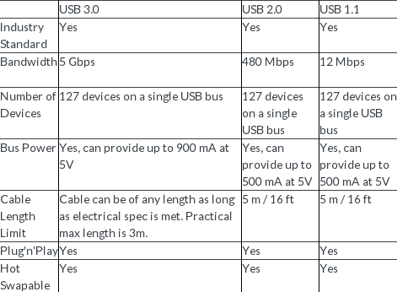

Slide 19
Serial Device
Isa-serial
-device isa-serial,chardev=serial_id_serial0 \
-chardev socket,id=serial_id_serial0,path=/tmp/serial-serial2,server,nowait \
-chardev socket,id=serial_id_serial0,host=10.66.83.172,port=2014,server,nowait \
Properties:
server specifies that the socket shall be a listening socket.
nowait specifies that QEMU should not block waiting for a client to connect to a listening socket.
Virtio-serial
-device virtio-serial,max_ports=31 \
-chardev socket,id=channel0,path=/tmp/serial-socket-1,server,nowait
-device virtserialport,chardev=channel0,name=com.redhat.port.1,bus=virtio-serial0.0,id=port1
This will create a device and expose one serial port to the guest. The guest kernel should load the virtio_console.ko module and expose a /dev/vport0p1 port to guest userspace app developers.
/dev/virtio-ports/com.redhat.port.1 -> /dev/vport0p1

Slide 20
Serial Device
Virtio-serial
-device virtio-serial \
-chardev socket,path=/tmp/foo,server,nowait,id=foo \
-device virtconsole,chardev=foo,name=com.redhat.console.foo \
The console ports will be available in the guest as /dev/hvc0 and /dev/hvc1.
Spawn console ports via:
agetty /dev/hvc0 9600 vt100
-device virtio-serial \
-device virtserialport,chardev=spicechannel0,name=com.redhat.spice.0 \
-chardev spicevmc,id=spicechannel0,name=vdagent \
How to transfer the file between the host and guest.
Host: # cat host-file | nc -U /tmp/serial-socket-1
Guest: #cat /dev/vport0p1 > received-file;
or use socat.

Slide 21
Block Device
virtio-blk
virtio-scsi
Ide
Ahci
Virtio-blk limits the device to 30 on the pci in the guest
Virtio-scsi can have up tp 1000 devices
Virtio-scsi
-drive id=drive-data-disk,if=none,cache=none,snapshot=off,format=qcow2,
file=/home/RHEL-Server-7.1-64-virtio.qcow2 \
-device virtio-scsi-pci,id=scsi1,bus=pci.0 \
-device scsi-hd,id=data-disk,bus=scsi1.0,drive=drive-data-disk \
-drive id=drive-data-disk1,if=none,cache=none,snapshot=off,format=raw,
file=/home/disk2.raw \
-device scsi-hd,id=data-disk1,bus=scsi1.0,drive=drive-data-disk1 \
Virtio-blk
-drive file=/home/system-img.qcow2,if=none,id=drive-virtio0-0-0,media=disk,
werror=stop,rerror=stop,cache=none,format=qcow2
-device virtio-blk-pci,bus=pci.0,addr=0x4,drive=drive-virtio0-0-0,id=virtio0-0-0

Slide 22
Block Device
 | AHCI | IDE
Stand for | Advanced Host Controller Interface | Integrated Drive Electronics
 | Supports NCQ Tech | Do not
Hot plugging | Support | Do not
Transfer | Serial interface | parallel interface
Native Command Queuing
Native Command Queuing (NCQ) is a technology designed to improve performance and reliability as the transactional workload increases on SATA hard disk drives. When multiple read and write commands are sent to the SATA drive, NCQ steps in to optimize the completion of these commands by grouping the commands in order of processing efficiency, thereby reducing the mechanical workload and increase performance from the drive. Without NCQ, the drive would process and complete each command one at a time in the order in which it was received.
ide
-drive id=cdrom_d,if=none,file=/home/cd1.raw,media=cdrom,format=raw,readonly=on,unit=1/0 \
-device ide-drive,id=cdrom1,drive=cdrom_d \
-drive id=cdrom_d1,if=none,file=/home/cd2.raw,media=cdrom,format=raw,readonly=on \
-device ide-drive,id=cdrom2,drive=cdrom_d1 \
ahci
-device ahci,id=ahci0,bus=pci.0,addr=0x5
-drive file=/home/system-img.raw,if=none,id=drive-sata0-0-0,format=raw,werror=stop,rerror=stop
-device ide-drive,bus=ahci0.0,drive=drive-sata0-0-0,id=sata0-0-0

Slide 23
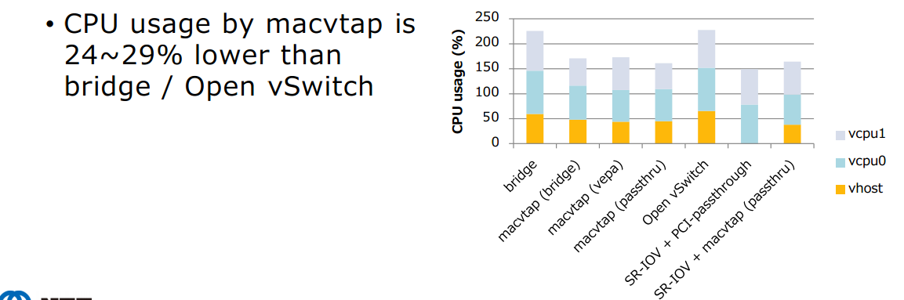
Network Device
Network
For tap backend (bridge-utils based & openvswitch based)：
Rtl8139 e1000 virtio-net
-device virtio-net-pci,mac=fa:f7:f8:5f:fa:5b,id=idn0VnaA,vectors=4,netdev=id8xJhp7,bus=pci.0,addr=06 \
-netdev tap,id=id8xJhp7,vhost=on,script=/etc/ifup_script,downscript=/etc/ifdown_script \
For macvtap:
1)create the interface:
ip link add link enp5s0f1 name macvtap1 type macvtap mode vepa/private/bridge
2)find the index:
[root@hp-dl385g7-14 ~]# ip -d link show
42: macvtap1@enp5s0f1: <BROADCAST,MULTICAST> mtu 1500 qdisc noop state DOWN .....
macvtap mode vepa
-device virtio-net-pci,any_layout=on,netdev=dev1,mac=$mac_macvtap_interface,id=net1 3<>/dev/42 \
-netdev tap,id=dev1,fd=3,vhost=on

Slide 24
Other device
CD-ROM
-device ide-drive,id=cdrom1,drive=cdrom_d \
-drive id=cdrom_d,if=none,file=1.iso,media=cdrom,format=raw,readonly=on \
-device virtio-scsi-pci,bus=pci.0,addr=0x6,id=scsi0 \
-drive file=1.iso,if=none,id=drive-cd-disk,media=cdrom,format=raw,cache=none,werror=stop,rerror=stop \
-device scsi-cd,drive=drive-cd-disk,bus=scsi0.0,id=scsi_cd \
drive file=/home/floppy2.raw,if=none,id=drive-fdc0-1-0,readonly=on,format=raw \
-global isa-fdc.driveA=drive-fdc0-1-0 \
1)Audio device:
-device intel-hda,id=sound0,bus=pci.0,addr=07 \
-device hda-duplex \
2)Qmp :
-chardev socket,id=qmp_id_qmpmonitor1,path=/tmp/monitor-qmp,server,nowait \
-mon chardev=qmp_id_qmpmonitor1,mode=control \
or
-qmp tcp:localhost:4444,server,nowait
-qmp unix:./qmp-sock,server,nowait
3)balloon
-device virtio-balloon-pci,id=balloon0,bus=pci.0,addr=0x9 \
4)vga
-vga qxl \
-spice port=8000,disable-ticketing \
-vnc
4)
-M pc \ #pc architecture
-nodefaults \ #Don't initialize the default devices by qemu
-m 8192 \ #memory
-smp 8 \ # cpu number
-cpu 'Opteron_G3' \ cpu type
-boot order=cdn,once=c,menu=off \ boot order

Slide 25
Tips for the Beginner
How to Get Supported Devices
use “qemu-kvm -device help / ? to get the supported devices list
How to Get Supported Devices Properties
choose a device from the devices list use “qemu-kvm -device [device-name],?”
How to Get the First CMD
use the virsh xml file to bootup a guest and using ps aux | grep qemu to get the qemu commands.
Man & help & info
man qemu-kvm or login to tcms and check tcms cases .

Slide 26
Thanks For the Helps
Shuang , Xu han , Xiaoling gao , cheliu , Qian guo and etc
Reference Link
http://www.techfest.com/hardware/bus/pci.htm
http://wiki.qemu.org/Features/QOM
http://www.linux-kvm.org/wiki/images/f/fe/2010-forum-armbru-qdev.pdf
http://www.linux-kvm.org/wiki/images/b/bc/2011-forum-armbru-qdev.pdf
https://lists.nongnu.org/archive/html/qemu-devel/2011-07/msg00842.html
http://blog.chinaunix.net/uid-9185047-id-445165.html
http://www.cs.fsu.edu/~baker/devices/notes/ch12.html
http://en.wikipedia.org/wiki/Southbridge_(computing)
https://github.com/qemu/qemu/blob/master/docs/qdev-device-use.txt
http://git.qemu.org/?p=qemu.git;a=blob_plain;f=docs/usb2.txt;hb=HEAD
https://github.com/qemu/qemu/blob/master/docs/ich9-ehci-uhci.cfg
https://github.com/openvswitch/ovs/blob/master/WHY-OVS.md
....

Slide 27
Q&A

