Slide 1
method resolution order
David Xu
In Python Multiple Inheritance

Slide 2
David Xu
Hardware engineer
Inquisitive software and data science enthusiasts
Intermediate Python learner
Twitter, @davidwcx
Github, david-wx
Notes:
Keep learning. Python never stops amazing me.

Slide 3
Tough crowd?
Know Python?
Use OOP in Python?
Use OOP in C++?
Define and use multiple inheritance?
Define and use metaclass?
References:
Python’s super() considered super! by Raymond Hettinger
https://en.wikipedia.org/wiki/C3_linearization

Slide 4
Overview
The motivation
Inheritance
The problem
Multiple
The solution
Method resolution order (MRO)

Slide 5
inheritance
From Wikipedia:
“… in MOST class-based object oriented languages is a mechanism in which one object acquires all the properties and behaviors of PARENT object. ”
A tool for code reuse
To call parent is to call super()*
As in Java or C++
https://en.wikipedia.org/wiki/Inheritance_(object-oriented_programming)
Notes:
Code reuse!

Slide 6
Python Super() function
super([type[, object-or-type]])
Return a proxy object that delegates method calls to a parent or sibling class of type. This is useful for accessing inherited methods that have been overridden in a class.
https://docs.python.org/3/library/functions.html#super

Slide 7
Inheritance, single & linear
# In python, Everything Is An Object...
# Definition
class A(object):
pass
def foo(self):
print("Class invoked: A")
class B(A):
pass
def foo(self):
print("Class invoked: B")
class C(B):
pass
def foo(self):
print("Class invoked: C")
# if you do not define foo in C
# return super().foo()
# Instantiation
xa=A()
xb=B()
xc=C()
# Method call
xa.foo()
xb.foo()
xc.foo()
Notes:
# In python, Everything Is An Object...
# Definition
class A(object):
pass
def foo(self):
print("Class invoked: A")
class B(A):
pass
def foo(self):
print("Class invoked: B")
class C(B):
pass
def foo(self):
print("Class invoked: C")
# if you do not define foo in C
# return super().foo()

Slide 8
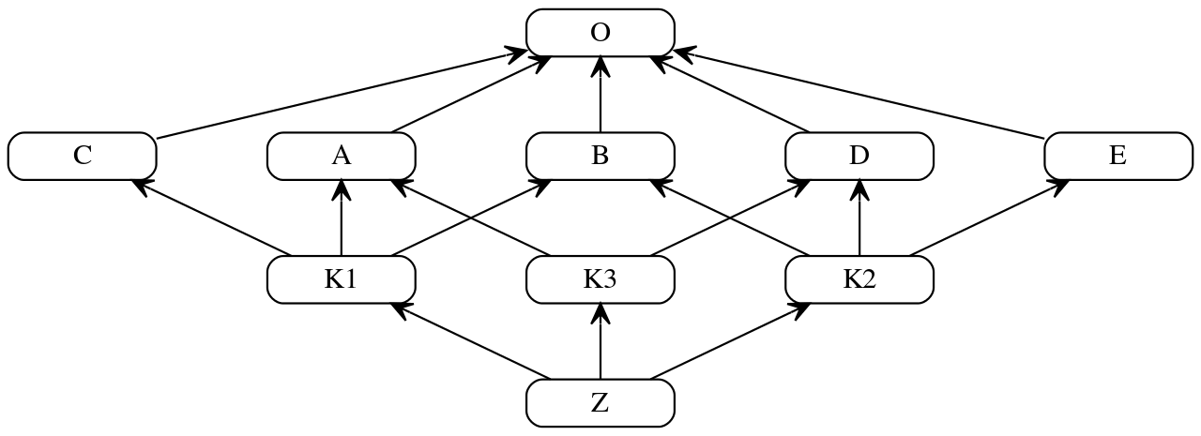
Multiple inheritance
Merge-split-merge diamonds
Same method defined on two opposite sides

Slide 9
Multiple inheritance
class Type(type):
def __repr__(cls):
return cls.__name__
A = Type('A', (object,), {})
B = Type('B', (object,), {})
C = Type('C', (object,), {})
D = Type('D', (object,), {})
E = Type('E', (object,), {})
K1 = Type('K1', (C, A, B), {})
K3 = Type('K3', (A, D), {})
K2 = Type('K2', (B, D, E), {})
Z = Type('Z', (K1, K3, K2), {})
# Ref: https://en.wikipedia.org/wiki/C3_linearization
# K1 = Type('K1', (C, A, B), {})
# The above is equivalent to
class K1(C, A, B, metaclass=Type):
pass
Notes:
1 C,A,B is the base classes of K1. The order is important.
Especially tricky situation: the same method appearing on the two different sides of a Dimond above

Slide 10
Method resolution order
Constraints
Children are called before their parents
Parents get called in the order listed
Notes:
Object (O) is called last

Slide 11
Graph linearizED
The youngest child (bottommost node) in the line determines the order
The ONLY such order matters for Z
Notes:
How?
Python takes care of it and you need not to know.
What’s the algorithm? C3 linearization
The order cannot be known in advance for K1, K3, K2.
The children determine where to go up in the chain.
The bottom class Z is called first.
The top class “object” is called last.
DI feature enabler.

Slide 12
Inheritance (revised)
From Wikipedia:
“… in MOST class-based object oriented languages is a mechanism in which one object acquires all the properties and behaviors of PARENT object. “
Not TURE for Python
https://en.wikipedia.org/wiki/Inheritance_(object-oriented_programming)

Slide 13
want to call parent class?
Use super()
But super() does not always call the parents
To call supper() is to call the next one in line
A parent class cannot call its own parent class
It can only call next in line in the youngest child’s ancestors
Such line is determined by MRO
Works for all inheritance cases

Slide 14
method resolution order
Q & A

