Slide 1

PyNoon
Week 1

Slide 2
Thanks
To the sponsors and host!
You - for making this a success

Slide 3
Administrivia
Fire escapes
Bathrooms
Cleaning up after ourselves
WiFi

Slide 4
Introductions
Instructors
Helpers
Attendees
Raise your hand if…
…you haven't ever programmed before?
…you haven't programmed in the last year?
…you haven't used Python before?
Notes:
The helpers are here to help you

Slide 5
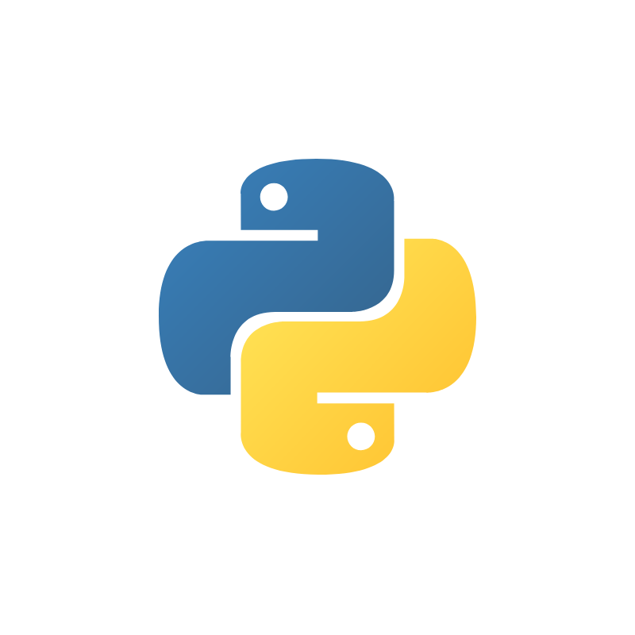
Why Python?

Slide 6
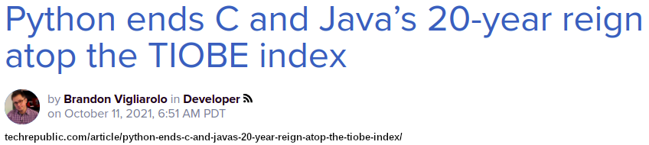
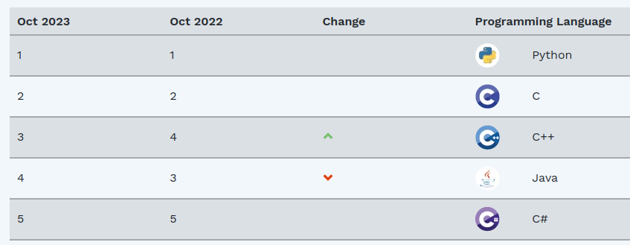
World’s Most Popular Programming Language
“Python, which started as a simple scripting language, as an alternative to Perl, has become mature. Its ease of learning, its huge amount of libraries and its widespread use in all kinds of domains, has made it the most popular programming language of today,” said TIOBE CEO Paul Jansen.
#1

Slide 7
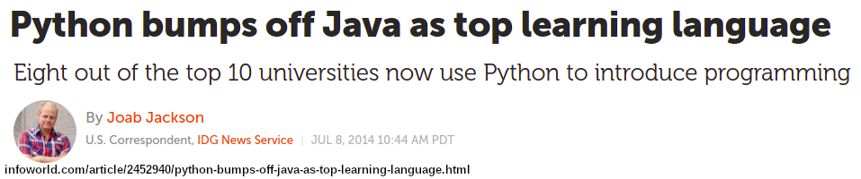
World’s Main Teaching Language
Shallow learning curve - simpler syntax than Java or C++.
Novices can start writing programs almost immediately.
Flow of new graduates altering the workforce (in one direction)

Slide 8
Versatile
Can use same language for:
data science
web development
automation
big data pipelines
No splintering of teams by language
less risk - the team, and new Python hires, can do whatever is needed
more efficient - always something interesting for the team to do
higher quality code - not mediocre at lots of languages but good at one

Slide 9
What to expect
from PyNoon

Slide 10
Course Objectives
PyNoon Starter: Learning the very basics of Python programming
PyNoon Data: Analysing and plotting tabular (spreadsheet) data
PyNoon Plus: Advanced topics, from using AI models to calling web APIs

Slide 11
Course Objectives
Along the way:
Not just about getting the right output - we want to help you write readable and maintainable Python code
By the end:
We want you to be solving your problems with Python

Slide 12
Lesson Structure
Times are a guideline - but core will be 12:00pm - 1:00pm
11:30am - 12:00pm - Independent work and help with homework
12:00am - 12:30pm - Lunch, networking, and whiteboard lesson
12:30pm - 1:00pm - Follow-along live-coding tutorial
1:00pm - 1:30pm - Independent work
Exercises following on from live coding
Lessons from futurecoder.io
Extension exercises from https://fullstackpython.com
We recommend completing outstanding work as homework
Optional, but recommended to become productive in Python within the 10-week course

Slide 13
Tips For Getting the Most Out of PyNoon

Slide 14
Here to Learn
As much as humanly possible don't do emails and work
You’ll barely have enough time as it is to become a productive coder
Even if you’re more advanced do the simple things (albeit faster)
Sometimes there are things you missed the first time or have forgotten

Slide 15
Questions?

Slide 16
Lunchtime!
Say hello to someone you didn't come with
Find out what other people want to use Python for
The tutorial will start at 12:30

