Slide 1
Simplify-early
Reordering the PyPSA-USA DAG so the network shrinks before the heavy rules run
master-benchmark ca73014 vs develop d773abc
Case: usa / config.equivalence-usa.yaml / simpl=300 / clusters=134 / 3h / horizon 2030
Measured on Sherlock, partition serc, 16 cores (USA) / 8 cores (western smoke), 2026-09-15
Notes:
This deck is about one structural change to the workflow: the order of the
simplification/clustering rules relative to the per-bus heavy rules. It is not
about the equivalence bugs; those live in the run cards.
Branches: master-benchmark ca73014f62077b53e02ba027516f91400fe9cf61 is the baseline that actually
builds; develop d773abcb1a16c6c6672f1fce6d9d26e46848b4e5 is the refactored branch.
Case: usa / config.equivalence-usa.yaml / simpl=300 / clusters=134 / 3h / horizon 2030.
All timing and memory numbers come from snakemake `benchmark:` TSVs written on
2026-09-15 on Sherlock's serc partition. No single Slurm job built both branches from a cold cache. The harness reuses finished rules across jobs through snakemake's mtime rerun triggers, so the two 'build OK in Ns' lines in any one job are not a like-for-like total. End-to-end cold total pipeline wall time, master vs develop, is NOT MEASURED. The per-rule benchmark TSVs are per-rule cold measurements and are what the deck compares.

Slide 2
The change in one line
- master reduces LAST.
- build_base_network -> build_bus_regions -> build_renewable_profiles, build_electrical_demand, add_demand, add_electricity ALL at nodal resolution -> simplify_network -> cluster_network.
- develop reduces FIRST.
- simplify_network is split into aggregate_to_substations (topology) and cluster_resources ({simpl} kmeans), and both move to the front. The heavy rules then consume elec_s{simpl}.
- On the USA case the heavy rules go from 82,549 buses to 300, a 275x reduction in the dimension every per-bus array is keyed on.
- Nothing else about the model changes: same config, same data, same final cluster count. The equivalence harness exists to hold that claim to account.
Notes:
The load-bearing sentence is in the repo's own CLAUDE.md, section "Architecture:
the DAG and the resources/ layout": "topology aggregation and {simpl} kmeans
clustering happen before the per-bus heavy rules. The clustered network is the
input to demand/RE/electricity assembly, not the substation-level network."
Note the split is two rules, not one moved rule. master's simplify_network did
both the nodal->substation aggregation and the kmeans; develop separates them so
the topology step (aggregate_to_substations) and the resource step
(cluster_resources) can be reasoned about and cached independently.
A second consequence, visible in the rule signatures: the {simpl} wildcard is now
load-bearing on nearly every rule downstream of cluster_resources. Any new
per-bus rule must carry _s{simpl} on its inputs and outputs.

Slide 3
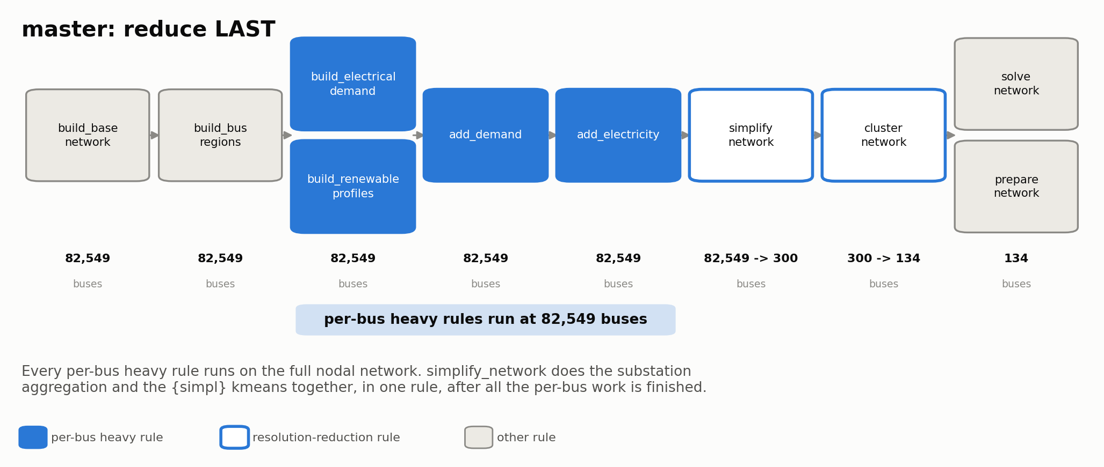
master: the heavy rules run on the full nodal network
Bus counts under each stage. simplify_network does substation aggregation AND {simpl} kmeans, in one rule, after all the per-bus work is finished.
Rule graph read from .worktrees/master-benchmark/workflow/rules/build_electricity.smk; bus counts from the busmap CSVs
Notes:
Read off master's build_electricity.smk:
build_base_network -> elec_base_network.nc
build_bus_regions -> regions_onshore.geojson (one region per nodal bus)
build_renewable_profiles input regions = regions_onshore.geojson (NODAL)
add_demand input elec_base_network.nc -> elec_base_network_dem.nc (NODAL)
add_electricity input elec_base_network_dem.nc -> elec_base_network_l_pp.pkl (NODAL)
simplify_network input elec_base_network_l_pp.pkl + bus2sub + sub -> elec_s{simpl}.nc
cluster_network elec_s{simpl}.nc -> elec_s{simpl}_c{clusters}.nc
So on master every per-bus rule is keyed on 82,549 buses.
Bus counts (source: develop-side busmap CSVs, which both branches' shared
build_base_network feeds):
nodal 82,549 = rows in bus2sub.csv
substations 41,012 = unique sub_id in busmap_b.csv
{simpl} 300 = unique cluster_bus in busmap_s300.csv
final 134 = unique target in busmap_s300_134.csv
Note for the audience: the brief's working estimate of "about 20k substations"
was wrong; the measured figure is 41,012.

Slide 4
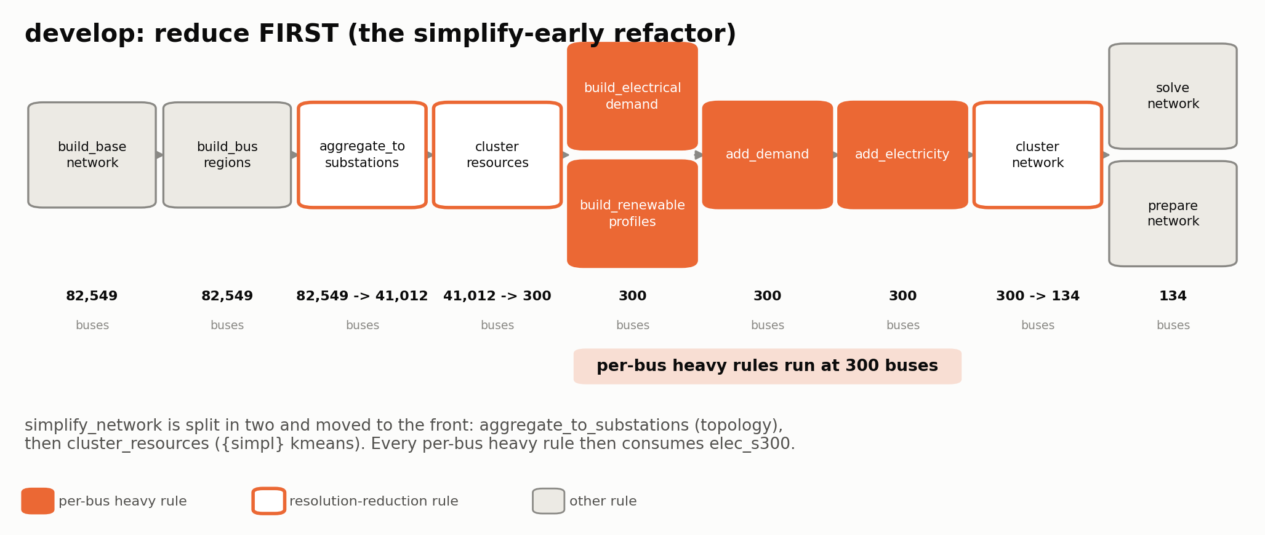
develop: aggregate and cluster first, then do the heavy work
The same rules, reordered. Two reduction steps now sit ahead of the heavy rules, which see 300 buses instead of 82,549.
Rule graph read from workflow/rules/build_electricity.smk on feat/equivalence-usa-benchmark; see also the repo's CLAUDE.md
Notes:
Read off develop's build_electricity.smk (file order is not DAG order - this is
the input/output graph):
aggregate_to_substations elec_base_network.nc + bus2sub + sub -> elec_b.nc, busmap_b.csv
cluster_resources elec_b.nc + regions -> elec_s{simpl}.nc, regions_*_s{simpl}.geojson, busmap_s{simpl}.csv
build_renewable_profiles regions = regions_onshore_s{simpl}.geojson -> profile_{tech}_s{simpl}.nc
add_demand elec_s{simpl}.nc -> elec_s{simpl}_dem.nc
add_electricity elec_s{simpl}_dem.nc -> elec_s{simpl}_l_pp.pkl
cluster_network elec_s{simpl}_l_pp.pkl -> elec_s{simpl}_c{clusters}.nc
One honest nuance: build_renewable_profiles on develop still takes the NODAL
regions as a second input (regions_nodal). Land-availability cells are computed
against the nodal regions and then carried to the cluster through
busmap_s{simpl}. That is why this one rule's wall time does not fall even though
its output shrinks ~60x - see the runtime slide.
EGS gets a parallel aggregate_egs rule that remaps NREL substation-keyed supply
curves through busmap_s{simpl} before add_electricity sees them. HAC clustering
was removed; kmeans and modularity remain.

Slide 5
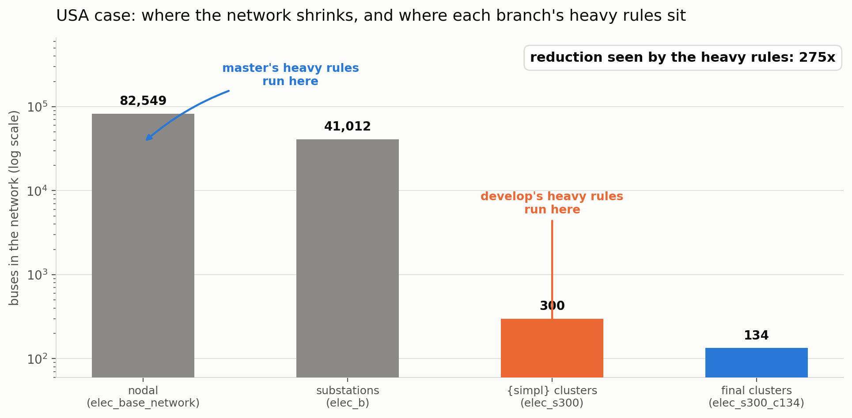
Where the network shrinks, and where each branch does its work
Source: unique-value counts in resources/equivalence/busmaps/usa/*.csv, read 2026-09-17
Notes:
Measured bus counts, USA case, all from busmap CSVs (no model run needed):
nodal 82,549 rows in resources/equivalence/busmaps/usa/bus2sub.csv (develop) - one row per base-network bus
substations 41,012 unique sub_id in resources/equivalence/busmaps/usa/busmap_b.csv
{simpl}=300 300 unique cluster_bus in resources/equivalence/busmaps/usa/busmap_s300.csv
clusters=134 134 unique target in resources/equivalence/busmaps/usa/busmap_s300_134.csv
The two reduction steps develop inserts are 82,549 -> 41,012
(a 2.0x topology aggregation) and 41,012 -> 300
(a 137x kmeans reduction).
Net: master's heavy rules see 82,549 buses,
develop's see 300. That is the
275x factor every later slide traces back to.
The final cluster count (134) is identical on both branches - the refactor does
not change the modelled resolution, only where in the DAG the reduction happens.

Slide 6
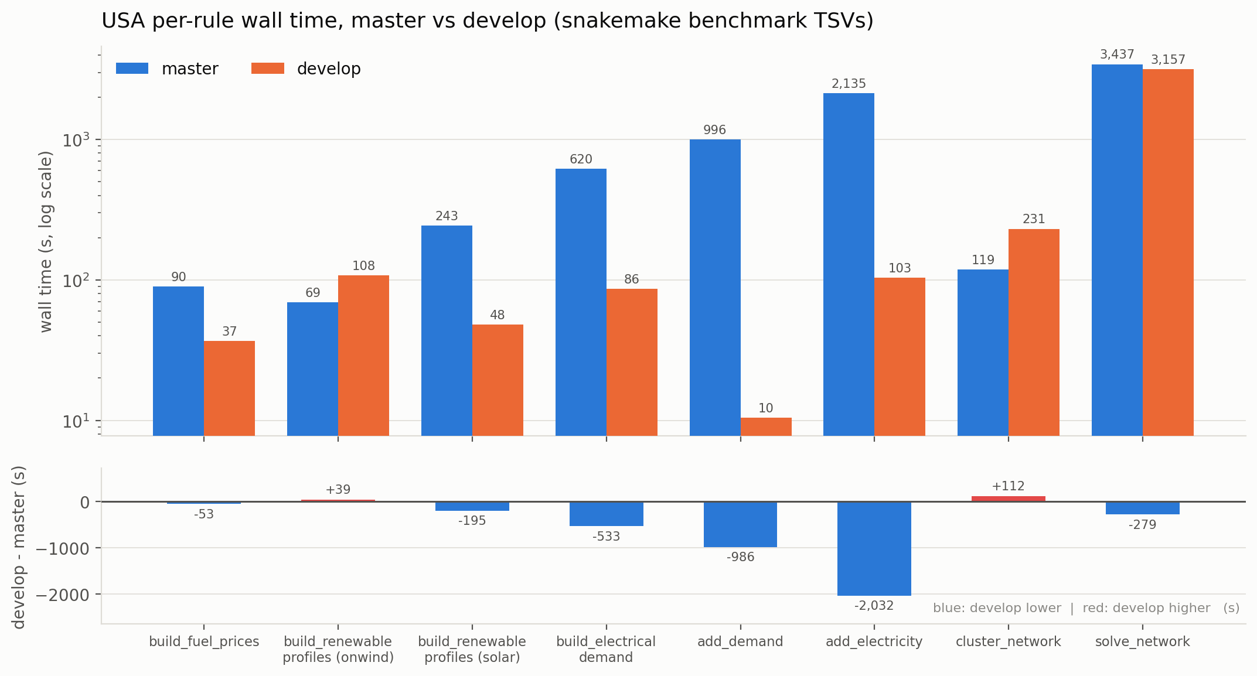
Wall time per rule
Log scale on top; develop minus master on its own panel below, with a zero line.
Source: snakemake benchmark TSVs, USA equivalence case, 2026-09-15 (develop d773abc / master-benchmark ca73014), Sherlock serc
Notes:
All values are the `s` column of the snakemake benchmark TSV for that rule.
build_fuel_prices master 89.6 s develop 36.7 s
build_renewable_profiles onwind master 69.1 s develop 107.7 s
build_renewable_profiles solar master 243.0 s develop 48.1 s
build_electrical_demand master 619.6 s develop 86.4 s
add_demand master 996.3 s develop 10.4 s
add_electricity master 2,135.3 s develop 103.4 s
cluster_network master 118.9 s develop 231.3 s
solve_network master 3,436.5 s develop 3,157.4 s
Headlines: add_demand 96x faster,
add_electricity 21x faster,
build_electrical_demand 7x faster.
Three rules go the other way and we should say so:
- build_renewable_profiles (onwind) is SLOWER on develop (107.7 s vs 69.1 s).
The rule still evaluates land availability against the nodal regions.
- cluster_network is slower on develop (231.3 s vs 118.9 s) because it now
consumes the pickled add_electricity output, i.e. it inherited work that
master had already done before simplify_network.
- solve_network is close (3157 s develop vs 3437 s master) but the two sides do
not yet produce the same solution, so do not read it as a speedup.
Caveat to state if asked: these TSVs were not all written by one Slurm job - the
harness reuses finished rules across jobs. Each row's mtime and job are in
figures/fig4_runtime_usa.csv and in measurements.py. They are per-rule cold
measurements of the same config on the same partition.

Slide 7
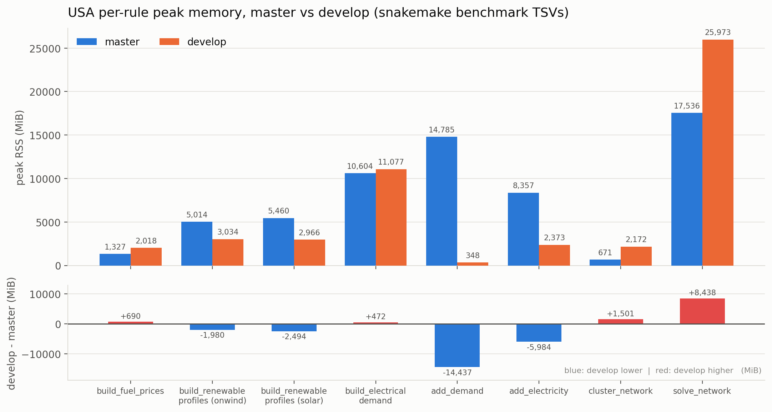
Peak memory per rule
max_rss from the same benchmark TSVs. Linear scale; delta on its own panel.
Source: snakemake benchmark TSVs, USA equivalence case, 2026-09-15 (develop d773abc / master-benchmark ca73014), Sherlock serc
Notes:
max_rss column, MiB.
add_demand master 14,785 develop 348 (42x less)
add_electricity master 8,357 develop 2,373 (3.5x less)
profiles onwind master 5,014 develop 3,034
profiles solar master 5,460 develop 2,966
build_electrical_demand master 10,604 develop 11,077 (essentially flat)
solve_network master 17,536 develop 25,973 (develop HIGHER)
The clean win is add_demand: 14,785 MiB -> 348 MiB.
It no longer materialises a demand array keyed on 82,549 buses.
Two rules do not improve and must not be glossed:
- build_electrical_demand peak RSS is flat (10,604 -> 11,077 MiB). It still
reads the same zonal source data; only its output shrinks.
- solve_network uses MORE memory on develop (17,536 -> 25,973 MiB). That is
downstream of this refactor and is tangled with the still-open equivalence
differences, so it is reported, not claimed as a result of the reordering.
Whole-job peak RSS from sacct, for scale: job 43640844 31.6 GiB, job 43671766
33.4 GiB, western smoke 43671762 1.74 GiB.

Slide 8
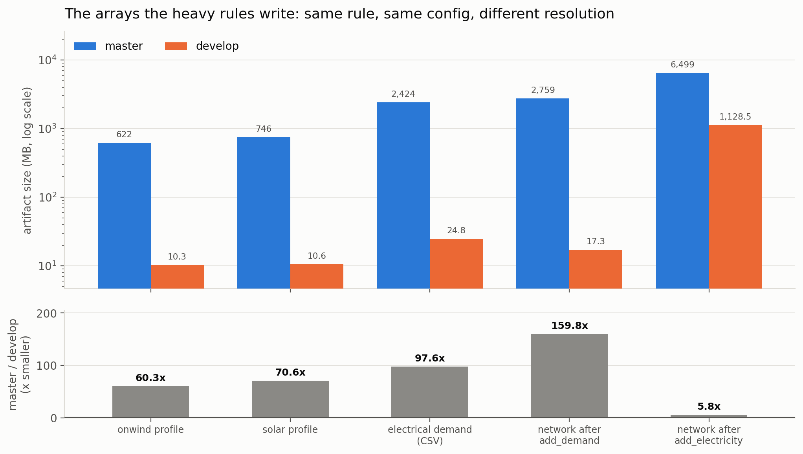
Why it saves work: the arrays get smaller by the reduction factor
Same rule, same config, different keying resolution. Sizes are bytes on disk.
Source: ls -la on the 2026-09-15 run artifacts, both worktrees, read 2026-09-17
Notes:
The mechanism is not subtle: a per-bus rule writes an array whose leading
dimension is the bus count. Divide the bus count by 275 and
the array divides with it.
onwind profile 622,450,598 B -> 10,330,358 B 60.3x
solar profile 746,175,398 B -> 10,575,778 B 70.6x
electrical demand CSV 2,424,183,225 B -> 24,843,782 B 97.6x
network after add_demand 2,758,570,331 B -> 17,262,481 B 159.8x
network after add_electricity 6,498,564,020 B -> 1,128,509,306 B 5.8x
The add_electricity pickle is the smallest ratio (5.8x, not
275x) and that is the honest limit of the argument: it carries one
entry per attached generator, and the generator count does not fall as steeply
as the per-bus time series do. master's is 6.5 GB; develop's is 1.1 GB.
Caveat on the demand CSV bar: develop also writes
power_zonal_components_s300.parquet (186,302,484 B) which master has no
counterpart for. It is excluded from the bar and noted in the CSV twin.
A nice illustration for the room: elec_s300.nc is 137,502,390 B on master but
597,423 B on develop. Same bus count, different pipeline stage - on master it
already carries everything the heavy rules attached; on develop it is topology
only, because the heavy rules have not run yet.

Slide 9
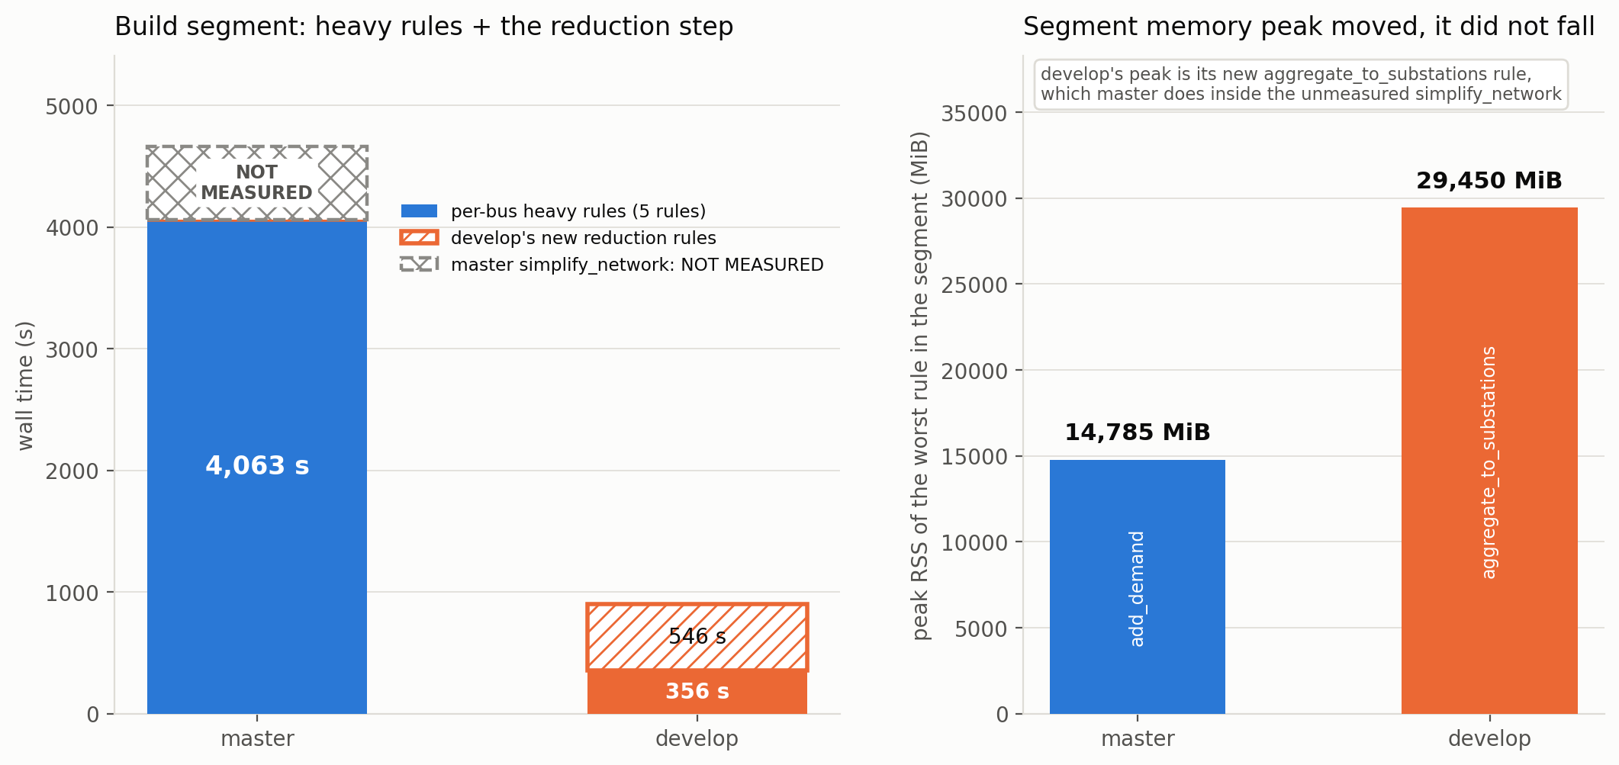
The segment total, and the one number we do not have
master's simplify_network carries no benchmark: directive on master-benchmark, so its cost was never recorded
Notes:
Summing the five per-bus heavy rules measured on BOTH branches:
master 4,063 s
develop 356 s -> 11.4x faster
develop pays for that with two new rules master does not have:
aggregate_to_substations 191 s, peak 29,450 MiB
cluster_resources 355 s, peak 13,962 MiB
total new work 546 s
Segment as measured: master 4,063 s vs develop 902 s
= 4.5x.
THE GAP, say it out loud: master's simplify_network does the same two jobs
develop's new rules do, but it has no `benchmark:` directive on
master-benchmark, so no wall time and no peak RSS exist for it. master's bar is
therefore a LOWER BOUND; the true factor is larger than 4.5x. The
hatched block on master's bar is drawn at an arbitrary height purely to mark the
gap - it is not an estimate and is labelled NOT MEASURED.
Second honest point, the right-hand panel: peak memory in this segment did not
fall, it MOVED. master's worst rule is add_demand at 14,785 MiB;
develop's worst is its new aggregate_to_substations at 29,450 MiB,
which is higher. Whether that is better or worse than master's unmeasured
simplify_network peak is exactly the thing we cannot say. Adding a benchmark:
directive to master's simplify_network is the cheap fix and is worth doing.

Slide 10
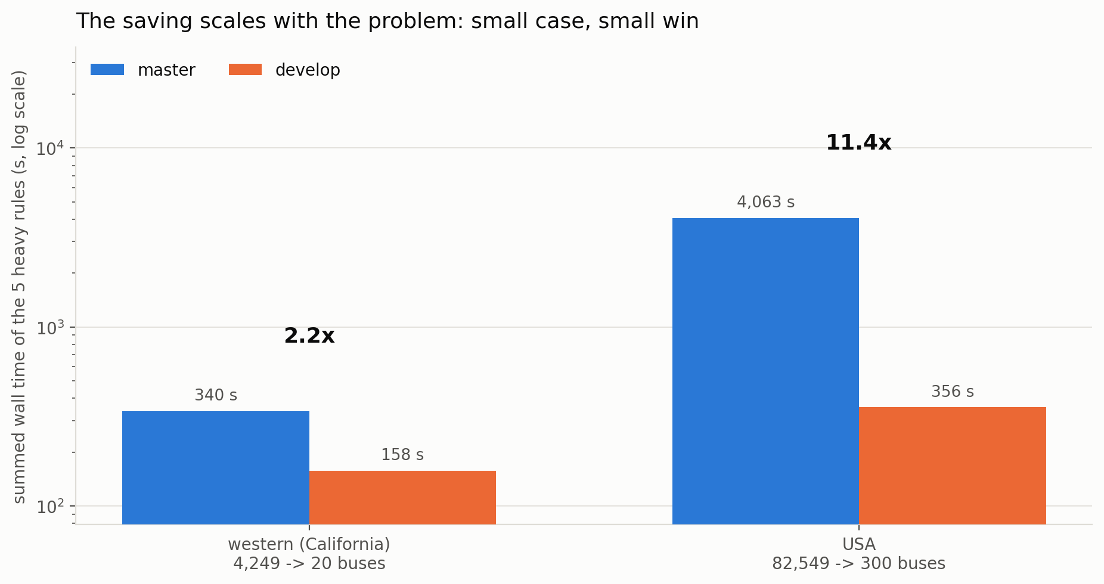
The win scales with the problem
The same five heavy rules on the California smoke case and on the USA case.
Source: benchmarks/equivalence/{western,usa}/ on both branches
Notes:
western (California only, 4,249 nodal -> 20 clusters):
master 340 s, develop 158 s -> 2.2x
usa (82,549 nodal -> 300 clusters):
master 4,063 s, develop 356 s -> 11.4x
This is the expected shape: the saving is a function of how much the reduction
step removes, so the small diagnostic leg shows a modest win and the acceptance
case shows a large one. On western, add_electricity is actually slower on
develop (10.7 s -> 32.7 s) - at 20 clusters there is nothing to save and the
extra indirection costs a little.
Practical read: do not benchmark this refactor on a toy case and expect the USA
numbers. Equally, do not promise USA-scale savings to someone running a
single-state model.
Note the western leg's name is the interconnect wildcard; the modelled footprint
is California only (model_topology.include.reeds_state: [CA], ReEDS zones
p8-p11).

Slide 11
What stays equivalent, and how that is checked
- A reordering is only worth anything if the model it produces is the same model. That is enforced by the Tier C equivalence harness, not by inspection.
- Lives in code/pypsa-usa/tests/equivalence/, documented in code/pypsa-usa/docs/equivalence.md.
- The baseline is a branch, not a patched checkout: master-benchmark is a sha you can check out, carrying only the commits master needs to run the same config.
- Both branches build the same config; the harness then compares:
- capacity factor profiles (p_max_pu)
- resource availability (p_nom_max) by zone and carrier
- existing capacity (p_nom) by zone and carrier
- demand by zone
- solved objective, capacity and dispatch
- Every compared row gets one of three verdicts: equivalent, explained (it maps to a numbered hot-fix in the ledger), or UNEXPLAINED - and UNEXPLAINED is a test failure.
- 13 test modules, plus hotfixes.yaml and waivers.yaml as machine-readable ledgers, so 'we know why that differs' is version-controlled rather than remembered.
The current verdict table for the USA case is a run-card matter, not a slide in this deck
Notes:
Keep this slide short and do not be drawn into the specific open differences -
they are a separate conversation with their own run cards and GitHub issues.
The point to land: the refactor is not asserted to be equivalent, it is tested
for equivalence, on the same config, against a baseline that is a checkout-able
commit rather than a patched working tree. Differences are not tolerated
silently; each one is either equivalent, mapped to a numbered hot-fix with a
written reason, or a failure.
If someone asks "is it currently passing?": on the USA case, no - there are open
UNEXPLAINED rows under active diagnosis, tracked in experiments/runs/. That is
the harness doing its job. The western smoke leg is much closer. Point them at
the run cards rather than debugging live.
Harness modules: build.py provisions and builds both sides; metrics.py defines
the compared quantities; compare.py/tables.py produce the verdict table;
plots.py emits the PNG+CSV figure set.

Slide 12
What is measured here, and what is not
- Measured, from artifacts:
- per-rule wall time and peak RSS - snakemake benchmark TSVs, both branches, USA and western
- bus counts at every stage - unique-value counts in the busmap CSVs
- artifact sizes - bytes on disk for the outputs of the same rule on each branch
- whole-job elapsed and MaxRSS - sacct for jobs 43640844, 43671766, 43671762
- NOT measured - stated as such on the slides:
- master's simplify_network wall time and peak RSS. No benchmark: directive on master-benchmark, so master's reduction cost is absent and its segment bar is a lower bound.
- end-to-end cold pipeline wall time, master vs develop. No single job built both sides from a cold cache: in job 43671766 develop built in 3,910 s while master reused finished rules in 117 s; in job 43640844 master built in 8,297 s while develop was cached at 4 s. Those pairs are not comparable and are not charted.
- master-side build_base_network, build_bus_regions, build_shapes, add_extra_components, prepare_network, add_sectors - instrumented on develop only, so not charted.
- Every figure ships a CSV twin with the exact plotted numbers, the source file and the mtime.
figures/*.csv carry the provenance of every plotted value; measurements.py is the single source
Notes:
This slide exists so nobody has to guess which numbers are real.
No single Slurm job built both branches from a cold cache. The harness reuses finished rules across jobs through snakemake's mtime rerun triggers, so the two 'build OK in Ns' lines in any one job are not a like-for-like total. End-to-end cold total pipeline wall time, master vs develop, is NOT MEASURED. The per-rule benchmark TSVs are per-rule cold measurements and are what the deck compares.
The cheap fixes, if we want the missing numbers:
1. add a `benchmark:` directive to simplify_network on master-benchmark, then
rebuild the master side once. That closes the single biggest gap.
2. run one job with both sides cold (delete both branches' resources for the
case) to get a true end-to-end total. Expensive - master's cold build alone
was 8,297 s - but it is the number people will ask for.
Also worth stating: the eq-usa jobs show State=FAILED in sacct. That is the
equivalence comparison verdict, not a build crash; the networks were built on
both sides. See experiments/runs/eq-usa-80abb3bc125f/CARD.md.

Slide 13
Summary
- The refactor moves the reduction from after the heavy rules to before them, so the per-bus rules run at 300 buses instead of 82,549 - a 275x cut in the dimension that matters.
- The five heavy rules go from 4,063 s to 356 s on the USA case (11.4x); including develop's two new reduction rules the segment is still 4.5x faster, and that is a lower bound.
- The arrays shrink with the bus count: profiles 60-71x, demand 98x, post-add_demand network 160x.
- Memory did not simply fall - it moved. add_demand drops 42x, but develop's new aggregate_to_substations peaks at 29,450 MiB, the highest rule in the segment.
- The win scales with the problem: 2.2x on the California smoke case, 11.4x on the USA case.
- Equivalence is tested, not asserted: the Tier C harness compares both branches on the same config and treats an unexplained difference as a failure.
- Next measurement to take: benchmark master's simplify_network, and run one job with both sides cold for a true end-to-end total.
Source: snakemake benchmark TSVs, USA equivalence case, 2026-09-15 (develop d773abc / master-benchmark ca73014), Sherlock serc
Notes:
One-sentence version: the network now shrinks before the expensive rules run,
which is worth about 11x on the heavy segment of the USA build and roughly
two orders of magnitude on the intermediate files, at the cost of two new rules
and a new memory peak we have not yet compared against master's equivalent.
Open asks for the room:
- is 275x the right {simpl} for USA, or should s300 be revisited now that
the heavy rules are cheap?
- is aggregate_to_substations' 29,450 MiB peak worth attacking, given it
now sets the memory requirement for the whole build segment?

