Slide 1
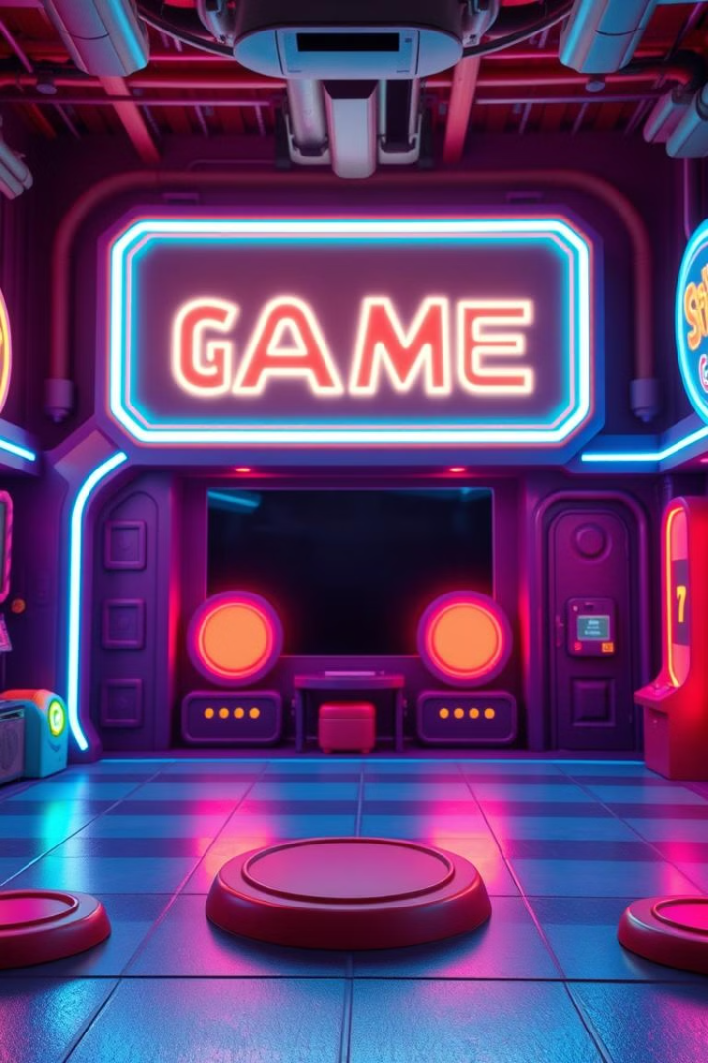
Mind Architect
A Fun Memory Game for Kids!
Presented By: Prajwal Ravi Kote

Slide 2
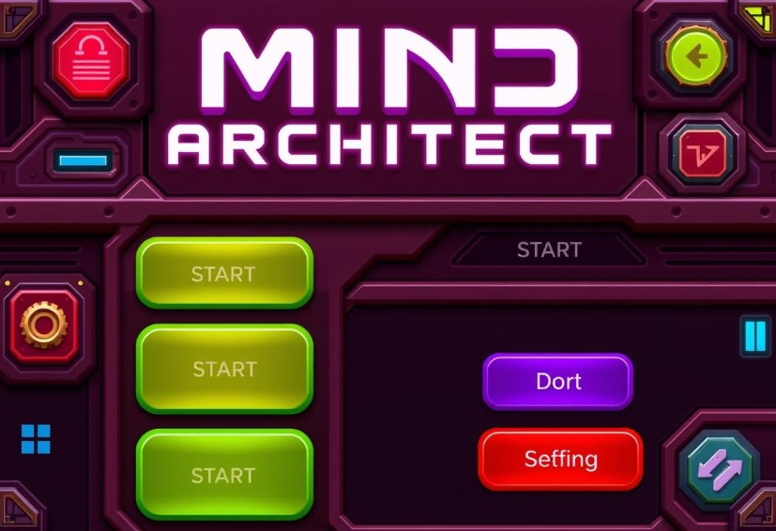
Introduction
Mind Architect boosts memory, attention, and pattern recognition.
Built using Pygame, offering playful learning with visuals.

Slide 3



Objective
Improve Skills
Challenge Learning
Enhance children's cognitive skills via gameplay.
Encourage kids to challenge themselves daily.

Slide 4
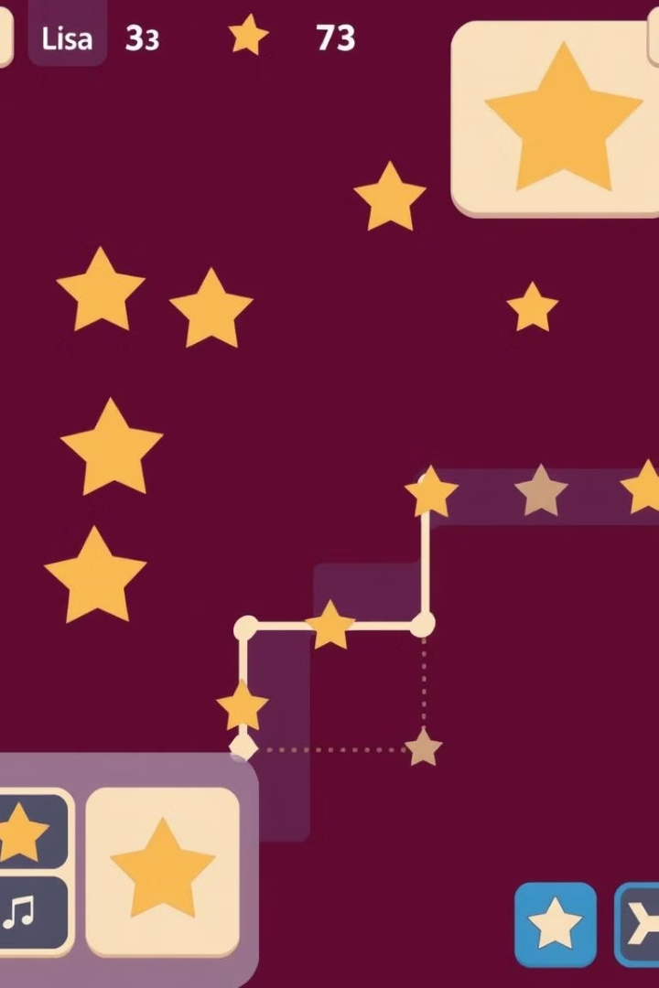




Features
Colorful UI
Levels
Star Collection
Cool backgrounds.
Progressive difficulty with 15 levels.
Rewarding star system.
Motivating Sounds
Encouragement for wins and retries.

Slide 5





How to Play
1. Start Puzzle
Click Start Puzzle to begin.
2. Memorize Sequence
Memorize the displayed sequence.
3. Type Sequence
Type correctly to proceed.
4. Earn Stars
Earn stars for successful attempts!

Slide 6

Benefits for Kids
Memory Skills
Enhances memory skills.
Boosts Focus
Boosts concentration and focus.
Pattern Recognition
Builds pattern recognition abilities.
Fun to Learn
Fun way to improve daily!

Slide 7


Conclusion
Brains Sharper
1
Make children’s brains sharper.
Keep Challenging
2
Great for loving puzzles.
Mind Architect makes children’s brains stronger while having fun.
Future: more levels, improved UI, and more interactive.

