Slide 1
Spread Spectrum Steganography
Matthew Seaworth
Sean Soderman
Dylan Soderman
Group #6

Slide 2
Overview
Taking advantage of naturally noisy properties in images

Slide 3
Embedding
An error correcting code is used on the message bits to increase robustness and reduce errors.
Two noise streams are generated with a seed (key)
A bit from the error-corrected message is compared with 0, if equal a value from the regular stream is assigned to the cover, otherwise a value from the alternative stream is assigned.
Before assignment, the inverse cdf function is applied to both values.

Slide 4
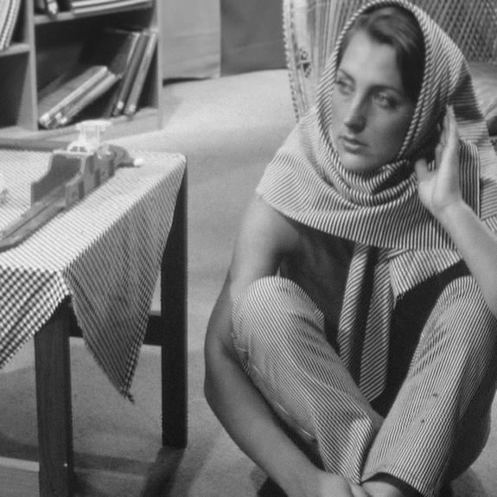

Can you tell the difference between these two images?

Slide 5
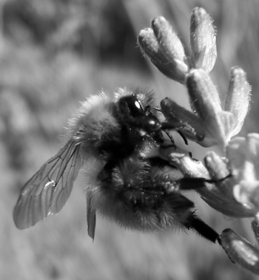

How about these?

Slide 6
Security - Perceptibility
Quite low!
This is because the embedded message is multiplied with additive white gaussian noise - the same type of noise that occurs in natural scenes
So if you haven't seen the original image – you probably wouldn't be able to tell.
This imperceptibility applies to computers too!

Slide 7
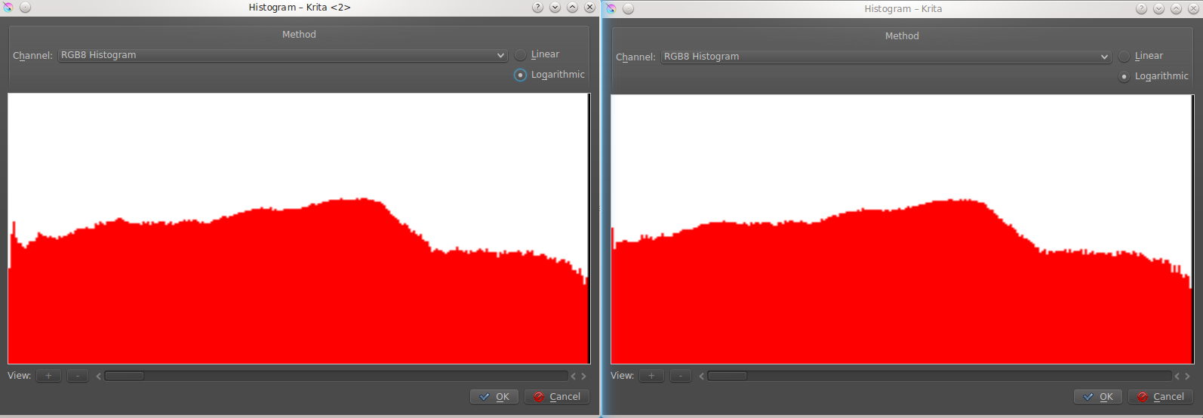
Histograms are not effective

Slide 8
Image Restoration
Image data is read from the grayscale bitmap.
An alpha-mean trimmed filter algorithm is imposed upon its pixels.
Every pixel in the image is assigned the value of the mean of its surrounding pixels, including itself, minus the outlier pixel values (biggest and smallest).
This removes much of the noise from the embedding process, leaving us with a rough estimate of the original cover image.

Slide 9
Extracting
The estimate of the cover image is subtracted from the stegoimage, resulting in the convolutionally encoded message.
This is then decoded with the Viterbi algorithm to produce a good approximation of the original image.

Slide 10
Robustness (t.b.d.)

Slide 11
Capacity
Although imperceptibility and robustness are quite high, capacity is low
1 bit is hidden per byte – higher rates of convolutional encoding decrease capacity further.
For a ½ rate convolutional code, twice the amount of bits are hidden
Hiding 5000kb with a 1/6 rate code would require the image be at least

