Slide 1

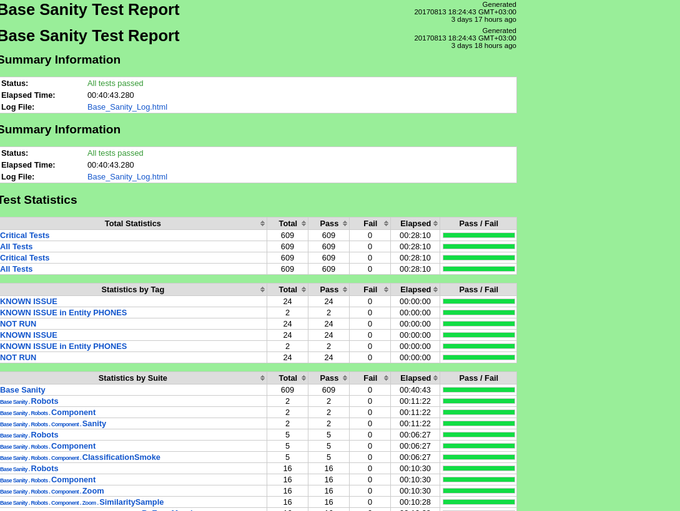

Test Automation with Robot Framework
Mark Geyzer
SW Developer at

Slide 2
Have Framework – Will Automate
Some banal facts
Testing FrameWork required for:
Test Case flow control
Fault management
Results Analysis
Presentation!!!

Slide 3
Where Do I Get One?
Buy it
How much are you willing to spend?
Will it be suitable to my needs?
Develop it in-house
How long can you wait for it?
Use Open Source
Is it reliable?

Slide 4
Why Robot Framewok?
Mature Open Source project
Rich test management options
Results in XML and HTML formats
Business community support
Team support on Slack
Written in Python!

Slide 5
Icing on Pythonistas Cake
Mix Python helpers and Robot Libraries in Robot code

Slide 6
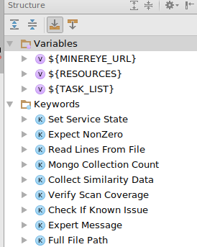
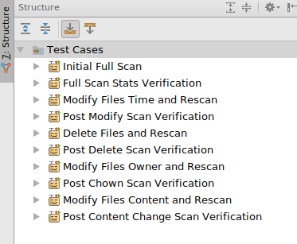
PyCharm Plugin

Slide 7
More Icing on Pythonistas Cake
Use Robot packages in Python code

Slide 8
Are there any challenges?
You have to learn a new DSL
Not that complicated
Not well suited for complicated logic
Delegate to Python helpers
Tcl-ish coding style
That’s a tough one :)

Slide 9
Show me the money
Let the show begin

Slide 10
My Personal Challenges
Test Suite Execution Order
Used wrapper script to run the tests
Needed parameterized TC looping over data
Built TestCases “on the fly” from
Configuration files
Templates

Slide 11
Useful Links
Home page - http://robotframework.org/
User Guide - http://robotframework.org/robotframework/latest/RobotFrameworkUserGuide.html
Python APIs - https://robot-framework.readthedocs.io/en/3.0.2/

