Slide 1



BWC
Offlink
A DECENTRALIZED PEER-TO-PEER

Slide 2

Offlink
Offlink
We provide a decentralized peer-to-peer platform for crypto traders to exchange their stablecoins, especially cUSD, for fiat. The platform uses an escrow smart contract to hold funds until the trade has been completed.

Slide 3
Offlink
Problem
01
03
02
Unfair Pricing
Centralization
Apps like Yellow App use fixed pricing.
Time
Paylink don’t support cUSD
Paylink could take up to 30 minutes

Slide 4

Offline
The Solution
01
Traders determine the price
02
Decentralized
03
5 minutes TX Finalization

Slide 5


Offlink
Target Market
Remitters
p2p merchants

Slide 6
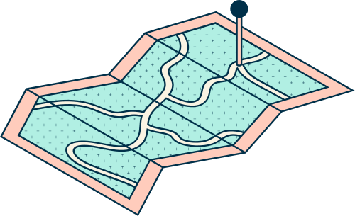
Offlink
Size of the market
100M
MiniPay users
7.5M
Yearly p2p trade on Binance
0
Decentralized p2p platforms for cUSD

Slide 7
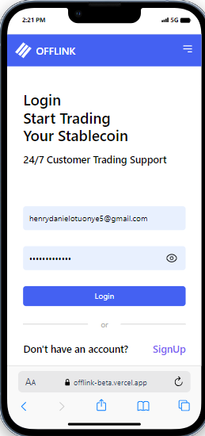
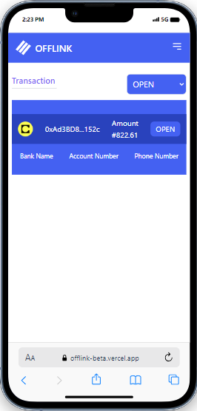
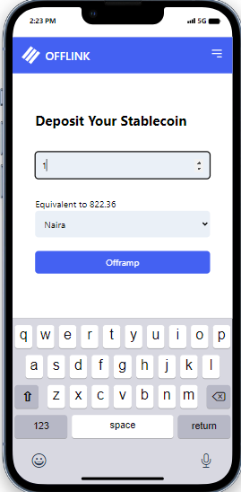
Offlink

Slide 8
Ingoude Company
Meet the Team
Henry Enzewa
Emmauel Eko
Bolarinwa
Lead
Backend Developer
Frontend Developer

Slide 9


Offlink
Contact Us
Email Address
henry.daniel@bih.com.ng

