Slide 1





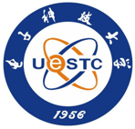

HCMA 2024 is organized in collaboration with NWPT, USTC, A*STAR, RUC, UESTC, Tsinghua University。

