Slide 1
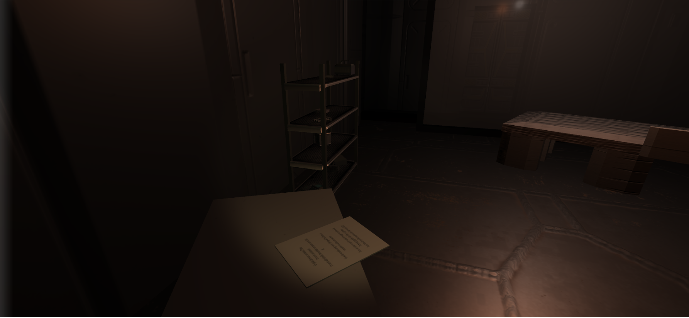
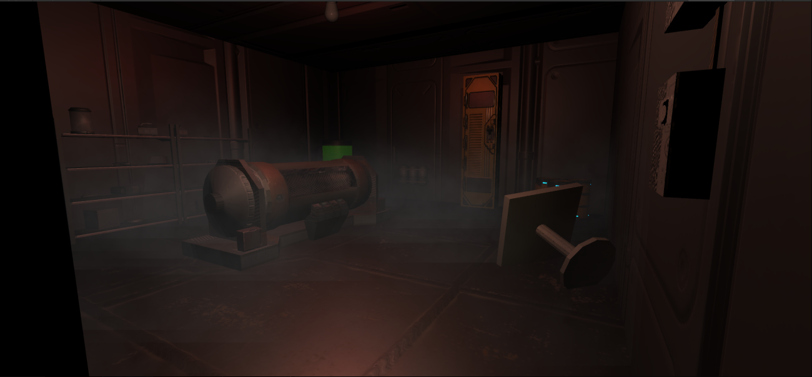
Lunaris
The city on the moon
A first person horror game
Storyworld
Our storyworld is set in a near future, where humanity is split up into three major factions, the United Nations of America, the Union of Communist States and the Europe-Africa Faction. The relations between these countries are tense, in a cold-war like scenario. The climate change has also drastically progressed and problems like desertification and rising water levels have decreased the inhabitable area, further increasing the peoples urge to expand into space. The first important waypoint for this is the moon, as it is an easy resupply and launch platform for exploration missions into deeper space. Of course all three factions tried to claim the moon for their own interest, though all the pressure achieved the exact opposite when the people of the moon declared themselves an independent nation. However the moon is far away from being self sufficent and is still reliant on supplies from earth, which lead to a very weird and tense situation between the nations.
Story
3 main characters:
John Doe: Main character, Ex-Solider, working for maintainance company on the moon
Dr. Andrew: Antagonist, Psychiatrist, was involved in experiments on human test subjects
Fletcher: Johns Friend, Ex-Solider, working for the same company as John, helping him with his missions
What seemed like normal repair works at an abandoned spacestation at first, turns into a traumatic event for John really quick. Whilst fixing the security system, he damaged his suit. He didnt know at that time, that he inhaled a highly dangerous gas, which was developed on that station, which causes strong halluzinations. John imagines various monsters to be there, that in reality are just control lamps, doors or other similar things. In the end he gets knocked out, and his friend comes to save him. When he wakes up on a hospital station, he barely remembers anything that happened. To deal with those events, he seeks advice from a psychiatrist, whose name sounded familiar to him for some reason. While talking to him, John lives through various flashbacks to the adventures on the station and slowly starts to remember. He also realizes, that his psychiatrist, Dr. Andrew has something to do with the experiments he saw on the station.
Gameplay
The main gameplay scenes consist of the flashbacks John has, while talking to Dr. Andrew. This way the player can explore the station from Johns point of view and learn about its hidden story by finding notes, that other people left.
Gamedesign
Doors: To give our player a sense of freedom, there are a lot of paths to walk in the station, though most doors are locked by a certain code, that can only be obtained by following a certain predefined route. This way we can guide our player through the levels, without affecting immersion too much.
Fog: Through ambient fog, we create a rather sinister mood, which may spook out the player at some point of the game
Lighting: A lot of the level is poorly lit, which leaves the player with only his tiny flashlight, which lights around 30% of the screen, where the rest of it is almost completely dark. This leaves a lot room for the players imagination, to create things, that are not actually there.
Sound system: One of the most important aspects of horror games or movies is the Sound design. For this reason, we created a library of more than 30 different ambient noises, which trigger randomly and may spook the player this way.
„Monster“: Since there are no real monsters in our story, but rather things John imagines to be monsters. So you might see random control lights, pop up from time to time, but you will never see an actual monster.
Research notes left behind
Generator room in facility level 1
Technische Universität München
Fakultät für Informatik

