Slide 1
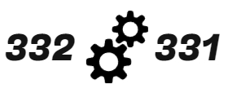
Functional Fan

Slide 2
CONTENTS
1
Introduction
2
Goal & Role
3
Overall Design
4
Module Design
With Timer/Counter
5
Demo Video

Slide 3
Introduction

Slide 4
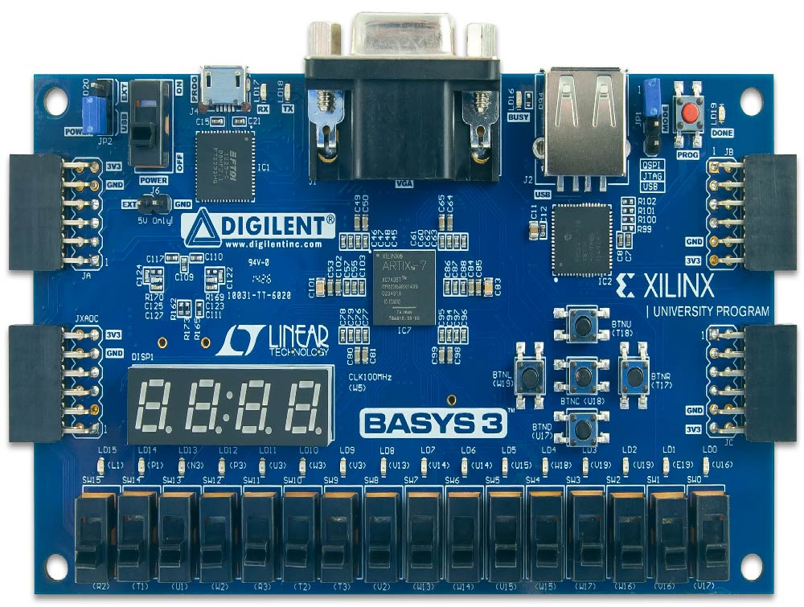
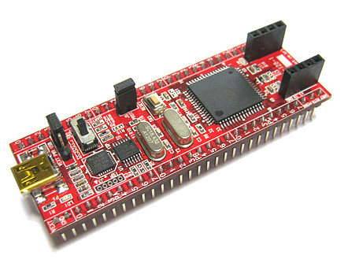
Introduction
Expensive device price
Not Enough I/O Pins
Need a long time for program
Drive at 3.3V
Not to much expensive
Enough I/O Pins including timer 0 ~ 3
Quick debug
Drive at 5V

Slide 5
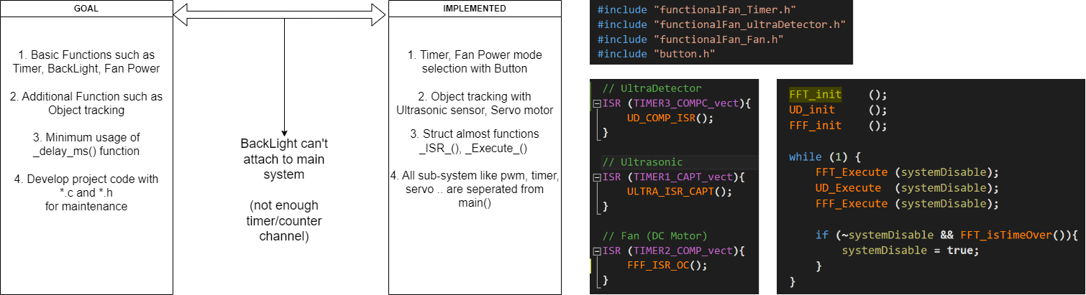
Goal & Role

Slide 6
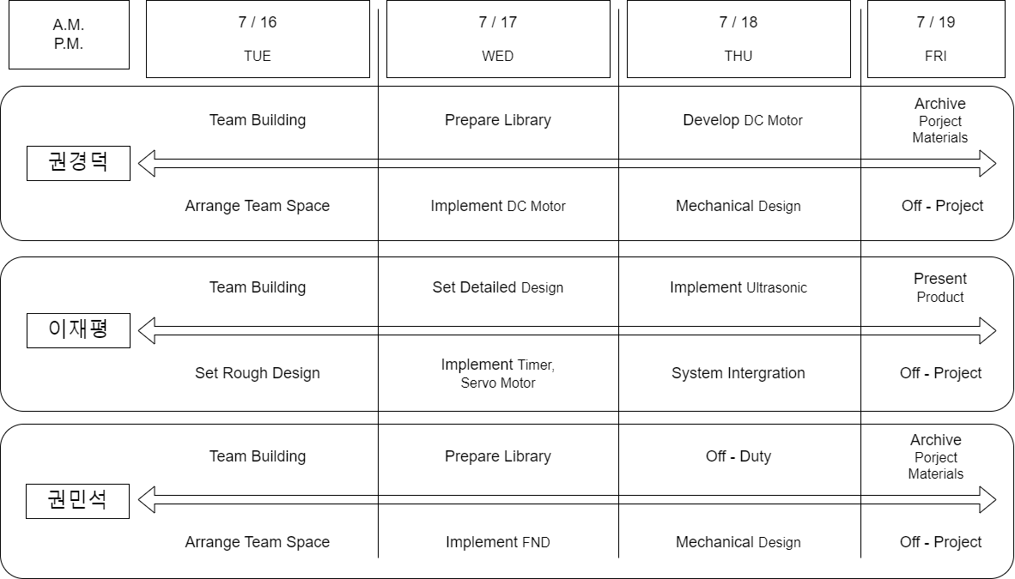
Goal & Role

Slide 7
Overall Design

Slide 8
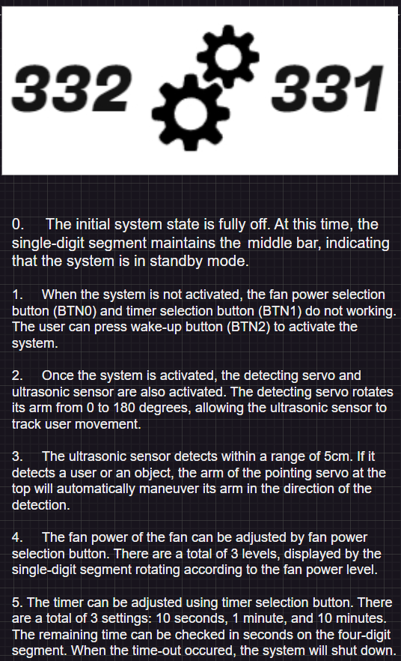
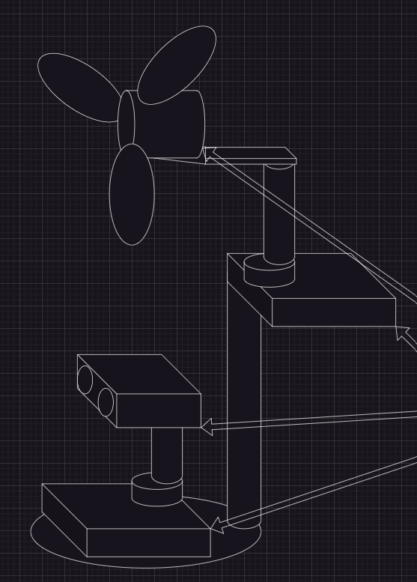
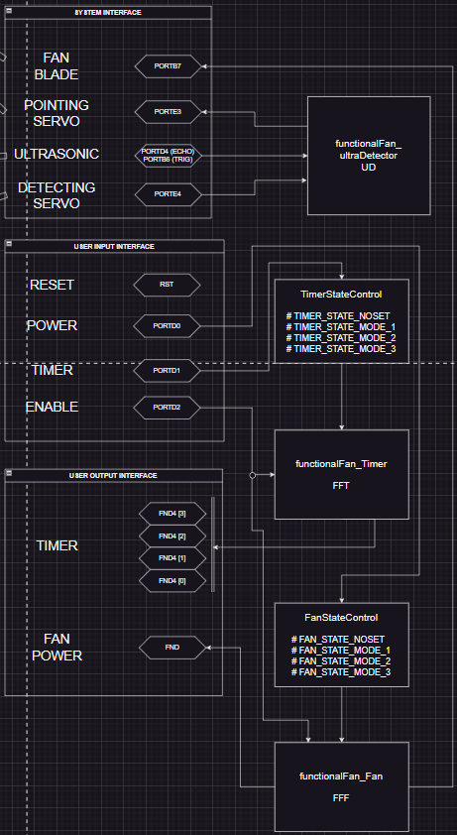
Overall Design

Slide 9
Module Design

Slide 10
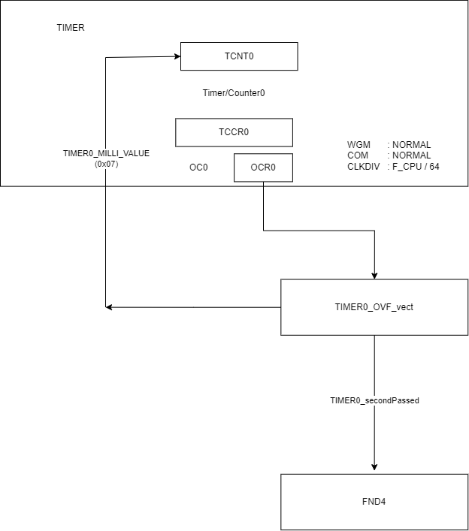
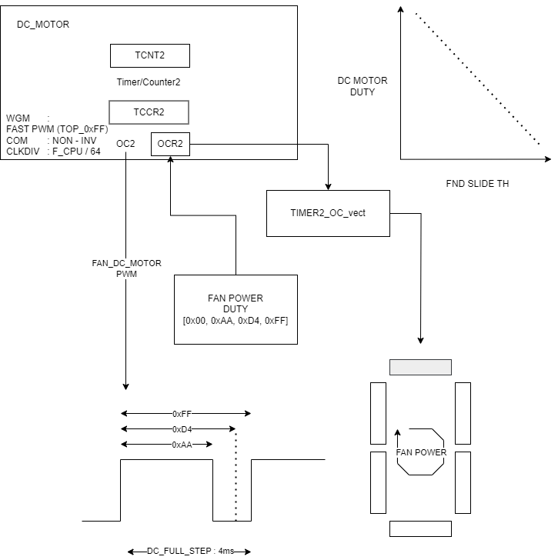
Module Design
Notes:
0번 64분주 2번 64분주, 세그먼트 슬라이드 th조절하여 설정

Slide 11
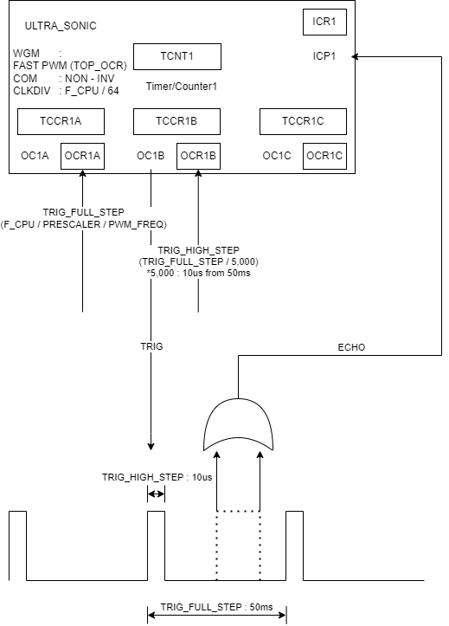
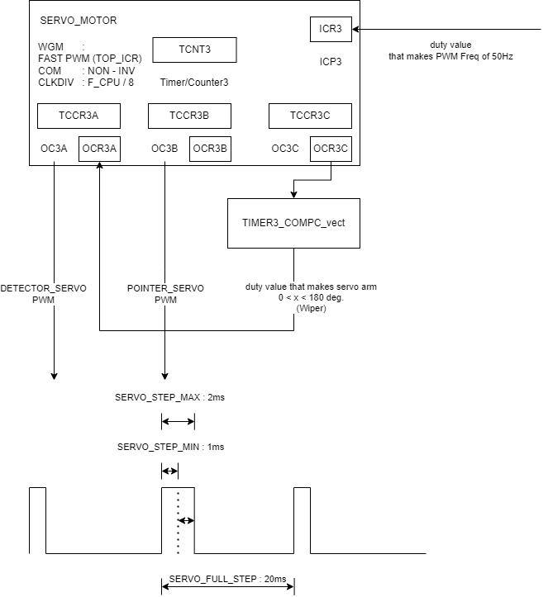
Module Design
Notes:
타이머1 15번, OCR1A로 TOP조절, OCR1B에서 OutputCompare

Slide 12
Demo Video
YouTubeDemoLink

Slide 13
Q&A

