Slide 1
Harman Semicon Academy Verilog HDL
Project #1
2024.07.08
이재평

Slide 2
01
02
03
04
05
06
Introduction
Hardware Usage Report
Block Diagram
Additional Job
Demo. Video
Q & A
Contents

Slide 3
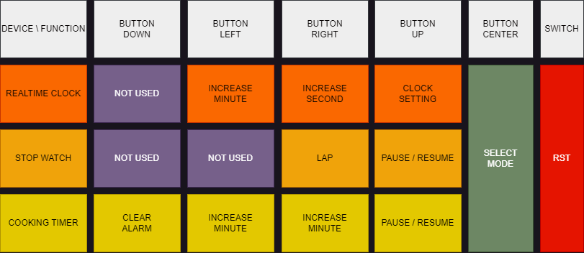
Introduction
FunctionalWatch
Subject
1. Allow the user to select from 3 functions
(Realtime Clock, Stopwatch, Cooking Timer)
2. Each function should run in the background
Main Work
1. Determine the logic that can maintain the signal level with respect to the input edge signal
2. Construct the block with select signals
< Figure 1. Available function and related I/Os >

Slide 4
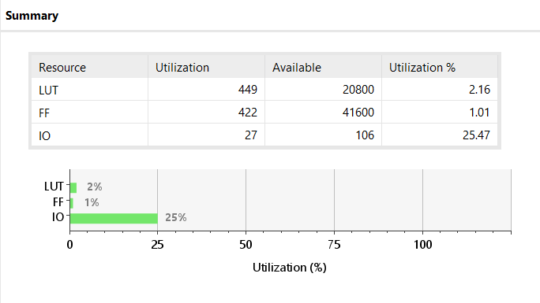
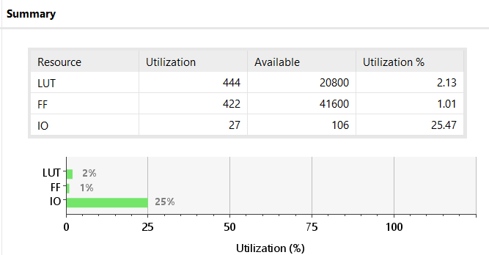
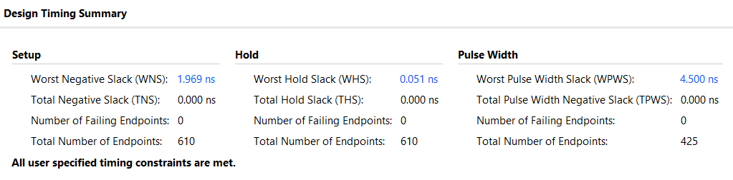
Hardware Usage Report
FunctionalWatch
< Figure 2. Summary of HW Usage in Synthesized Design >
< Figure 3. Summary of HW Usage in Implemented Design >
< Figure 4. Timing Summary in Implemented Design >

Slide 5
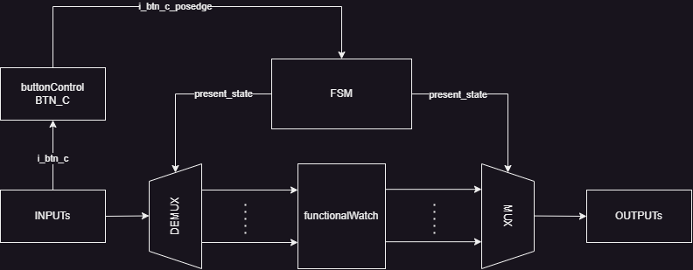
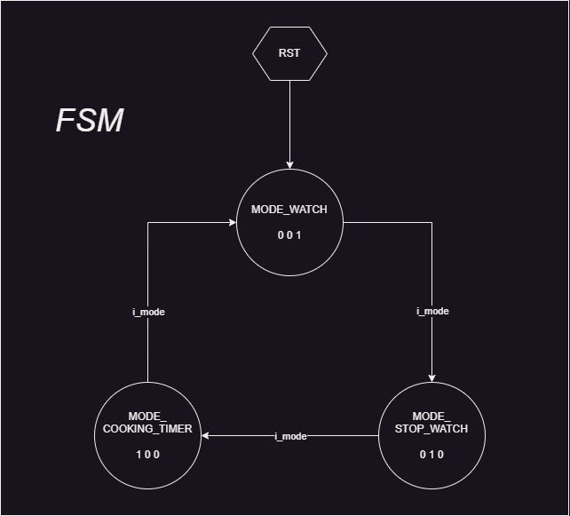
Block Diagram
FunctionalWatch
< Figure 5. Streamlined Block Diagram >
< Figure 6. State Diagram >

Slide 6
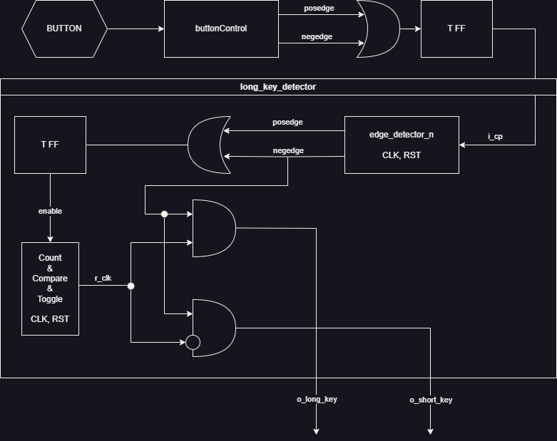
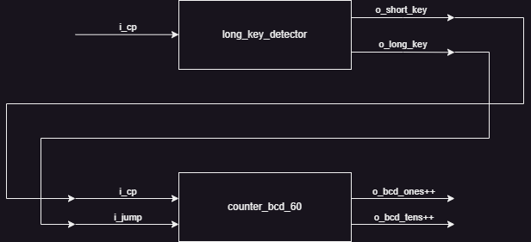
Additional Job
FunctionalWatch
< Figure 7. long_key_detector Block Diagram >
< Figure 8. Modification on counter_bcd_60 >

Slide 7
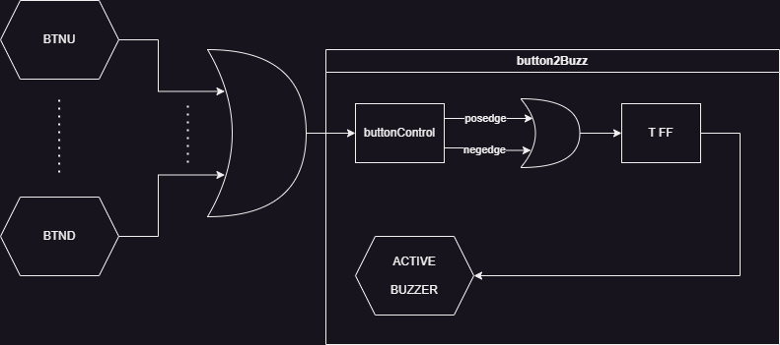
Additional Job
FunctionalWatch
< Figure 9. button2Buzz Block Diagram >

Slide 8
Demo. Video
FunctionalWatch
DemoVideoYoutubeHyperLink

Slide 9
Q & A

