Slide 1
EECS 388: Lab 3
Padding Oracle Attack
Bleichenbacher Attack

Slide 2
Current Assignments
Reminder: Canvas quizzes due the day before the next lecture
Project 1 Part 2 due Thursday, September 19 at 6 p.m.
Padding Oracle Attack
Bleichenbacher Attack (RSA signature forgery)
Notes:
Note: No weekend OH

Slide 3
Padding Oracle Attack

Slide 4
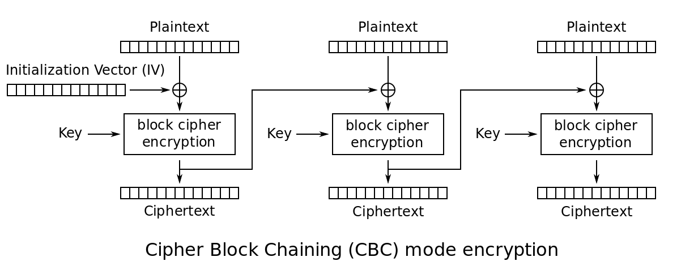
Cipher Block Chaining (CBC) + MAC-then-Encrypt
Last block uses padding to fit the block size
Notoriously hard to implement correctly
Vulnerable to Padding Oracle Attack
https://www.youtube.com/watch?v=O5SeQxErXA4
Notes:
Different interpretation from video

Slide 5
Padding
What if our message is not a multiple of the block size?
Allows us to use CBC without ambiguity in the resulting message
PKCS #7
XX
XX
XX
XX
XX
XX
XX
01
XX
XX
XX
XX
XX
XX
02
02
XX
07
07
07
07
07
07
07
2A
FF
01
78
9A
08
08
08
08
08
08
08
08
Notes:
[FF FF FF 01] [04 04 04 04]

Slide 6
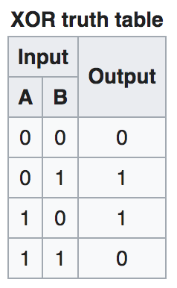
XOR Properties
A ⊕ A = 0
A ⊕ 0 = A
A ⊕ B = B ⊕ A
If A ⊕ B = C, then C ⊕ B = A and C ⊕ A = B

Slide 7
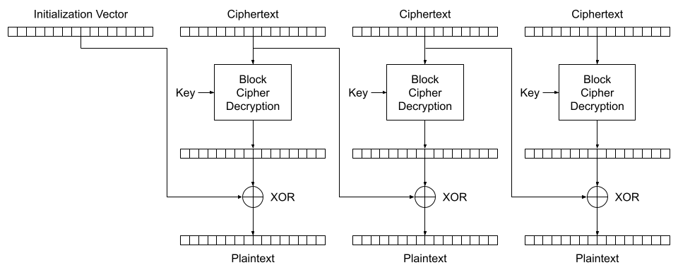
Padding Oracle Attack!
You are Mallory and you’ve just intercepted an encrypted message from Alice to Bob. You know that Alice used CBC.
Bob’s server will tell you whether or not the padding was correct
All Mallory has is ciphertext
Bob decrypts and lets you know if the padding is valid or not
Notes:
AES is an example of CBC

Slide 8
Padding Oracle Attack!
Mallory can modify the ciphertext and get feedback from Bob
Assume Bob is using AES with PKCS #7 padding
Last block is padded with the number of padding bytes (R,E,A,L,S,T,U,F,F,7,7,7,7,7,7,7)
What can Mallory do with this?
All Mallory has is ciphertext
Bob decrypts and lets you know if the padding is valid or not
Notes:
AES is an example of CBC

Slide 9
Premise
Mallory initially only knows the ciphertext
Mallory is able to query Bob to incrementally decrypt the ciphertext
Alice
Ciphertext
Bob
C’
Error (“Invalid padding”)
Mallory

Slide 10
Premise
Starting Here
Mallory initially only knows the ciphertext
Mallory is able to query Bob to incrementally decrypt the ciphertext
Alice
Ciphertext
Bob
C’
Error (“Invalid padding”)
Mallory

Slide 11
Alice’s Encryption
Secret Message
G
o
_
B
l
u
e
_
!
Encode (utf-8) & Add Padding
Secret Plaintext
47
6F
20
42
6C
75
65
20
21
03
03
03
Split into blocks (4 Bytes here)
Secret Plaintext
47
6F
20
42
6C
75
65
20
21
03
03
03

Slide 12
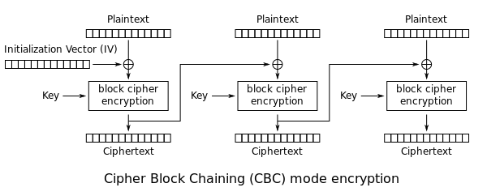
Alice’s Encryption (cont.)
Secret Plaintext
47
6F
20
42
6C
75
65
20
21
03
03
03
Pick random IV
ED
85
6E
F4
Alice and Bob share secret key
ED
85
6E
F4
70
26
C6
AC
7B
2E
6A
00
91
0D
2D
5B
IV
Ciphertext
Notes:
hash([pw] || [command old] || [padding old] || [new command])
hash([pw] || [command old] || XXX || [command new])

Slide 13
Alice’s Encryption (cont.)
ED
85
6E
F4
70
26
C6
AC
7B
2E
6A
00
91
0D
2D
5B
IV
Ciphertext
Full Ciphertext
ED
85
6E
F4
70
26
C6
AC
7B
2E
6A
00
91
0D
2D
5B
Send to Bob!

Slide 14
Premise
Starting Here
Mallory initially only knows the ciphertext
Mallory is able to query Bob to incrementally decrypt the ciphertext
Alice
Ciphertext
Bob
C’
Error (“Invalid padding”)
Mallory

Slide 15
Premise
Here now!
Mallory initially only knows the ciphertext
Mallory is able to query Bob to incrementally decrypt the ciphertext
Alice
Ciphertext
Bob
C’
Error (“Invalid padding”)
Mallory

Slide 16
Bob’s Decryption
Ciphertext
ED
85
6E
F4
70
26
C6
AC
7B
2E
6A
00
91
0D
2D
5B
Initialization Vector
Ciphertext
Ciphertext
Ciphertext
Block Cipher Decryption
Block Cipher Decryption
Block Cipher Decryption
Key
Key
Key
XOR
XOR
XOR
Plaintext
Plaintext
Plaintext

Slide 17
Bob’s Decryption (cont.)
Ciphertext
ED
85
6E
F4
70
26
C6
AC
7B
2E
6A
00
91
0D
2D
5B
Initialization Vector
Ciphertext
Ciphertext
Ciphertext
ED
85
6E
F4
70
26
C6
AC
7B
2E
6A
00
91
0D
2D
5B
Block Cipher Decryption
Block Cipher Decryption
Block Cipher Decryption
Key
Key
Key
XOR
XOR
XOR
Plaintext
Plaintext
Plaintext

Slide 18
Bob’s Decryption (cont.)
Ciphertext
ED
85
6E
F4
70
26
C6
AC
7B
2E
6A
00
91
0D
2D
5B
Initialization Vector
Ciphertext
Ciphertext
Ciphertext
ED
85
6E
F4
70
26
C6
AC
7B
2E
6A
00
91
0D
2D
5B
Block Cipher Decryption
Block Cipher Decryption
Block Cipher Decryption
Key
Key
Key
Alice and Bob share secret key
XOR
XOR
XOR
Plaintext
Plaintext
Plaintext

Slide 19
Bob’s Decryption (cont.)
Ciphertext
ED
85
6E
F4
70
26
C6
AC
7B
2E
6A
00
91
0D
2D
5B
Initialization Vector
Ciphertext
Ciphertext
Ciphertext
ED
85
6E
F4
70
26
C6
AC
7B
2E
6A
00
91
0D
2D
5B
Block Cipher Decryption
Block Cipher Decryption
Block Cipher Decryption
Key
Key
Key
Decrypt first block
AA
EA
4E
B6
XOR
XOR
XOR
Plaintext
Plaintext
Plaintext

Slide 20
Bob’s Decryption (cont.)
Ciphertext
ED
85
6E
F4
70
26
C6
AC
7B
2E
6A
00
91
0D
2D
5B
Initialization Vector
Ciphertext
Ciphertext
Ciphertext
ED
85
6E
F4
70
26
C6
AC
7B
2E
6A
00
91
0D
2D
5B
Block Cipher Decryption
Block Cipher Decryption
Block Cipher Decryption
Key
Key
Key
XOR with previous block
AA
EA
4E
B6
XOR
XOR
XOR
47
6F
20
42
Plaintext
Plaintext
Plaintext

Slide 21
Bob’s Decryption (cont.)
Ciphertext
ED
85
6E
F4
70
26
C6
AC
7B
2E
6A
00
91
0D
2D
5B
Initialization Vector
Ciphertext
Ciphertext
Ciphertext
ED
85
6E
F4
70
26
C6
AC
7B
2E
6A
00
91
0D
2D
5B
Block Cipher Decryption
Block Cipher Decryption
Block Cipher Decryption
Key
Key
Key
Continue for rest of message
AA
EA
4E
B6
1C
53
A3
8C
5A
2D
69
03
XOR
XOR
XOR
47
6F
20
42
6C
75
65
20
21
03
03
03
Plaintext
Plaintext
Plaintext

Slide 22
Bob’s Decryption (cont.)
Ciphertext
ED
85
6E
F4
70
26
C6
AC
7B
2E
6A
00
91
0D
2D
5B
Initialization Vector
Ciphertext
Ciphertext
Ciphertext
ED
85
6E
F4
70
26
C6
AC
7B
2E
6A
00
91
0D
2D
5B
Block Cipher Decryption
Block Cipher Decryption
Block Cipher Decryption
Key
Key
Key
Now have plaintext!
AA
EA
4E
B6
1C
53
A3
8C
5A
2D
69
03
XOR
XOR
XOR
47
6F
20
42
6C
75
65
20
21
03
03
03
Plaintext
Plaintext
Plaintext
Plaintext
47
6F
20
42
6C
75
65
20
21
03
03
03

Slide 23
Bob’s Decryption (cont.)
Ciphertext
ED
85
6E
F4
70
26
C6
AC
7B
2E
6A
00
91
0D
2D
5B
Plaintext
47
6F
20
42
6C
75
65
20
21
03
03
03
Remove Padding
47
6F
20
42
6C
75
65
20
21
Decode (utf-8)
G
o
_
B
l
u
e
_
!

Slide 24
Ciphertext
ED
85
6E
F4
70
26
C6
AC
7B
2E
6A
00
91
0D
2D
5B
Initialization Vector
Ciphertext
Ciphertext
Ciphertext
C1
C2
C3
C4
C5
C6
C7
C8
C9
C10
C11
C12
C13
C14
C15
C16
ED
85
6E
F4
70
26
C6
AC
7B
2E
6A
48
91
0D
2D
5B
Block Cipher Decryption
Block Cipher Decryption
Block Cipher Decryption
Send modified Ciphertext to server…
Server will respond with Padding Error or Padding Valid
Key
Key
Key
D5
D6
D7
D8
D9
D10
D11
D12
D13
D14
D15
D16
??
??
??
??
??
??
??
??
??
??
??
??
XOR
XOR
XOR
P5
P6
P7
P8
P9
P10
P11
P12
P13
P14
P15
P16
??
??
??
??
??
??
??
??
??
??
??
4B
Plaintext
Plaintext
Plaintext
Secret Plaintext
47
6F
20
42
6C
75
65
20
21
03
03
03

Slide 25
Premise
Here now!
Mallory initially only knows the ciphertext
Mallory is able to query Bob to incrementally decrypt the ciphertext
Alice
Ciphertext
Bob
C’
Error (“Invalid padding”)
Mallory

Slide 26
Premise
Mallory initially only knows the ciphertext
Mallory is able to query Bob to incrementally decrypt the ciphertext
Alice
Ciphertext
Bob
C’
Error (“Invalid padding”)
Mallory
Mallory’s Turn!

Slide 27
Mallory’s Attack
Ciphertext
ED
85
6E
F4
70
26
C6
AC
7B
2E
6A
00
91
0D
2D
5B
Initialization Vector
Ciphertext
Ciphertext
Ciphertext
Block Cipher Decryption
Block Cipher Decryption
Block Cipher Decryption
Key
Key
Key
XOR
XOR
XOR
Plaintext
Plaintext
Plaintext

Slide 28
Mallory’s Attack (cont.)
Ciphertext
ED
85
6E
F4
70
26
C6
AC
7B
2E
6A
00
91
0D
2D
5B
Initialization Vector
Ciphertext
Ciphertext
Ciphertext
ED
85
6E
F4
70
26
C6
AC
7B
2E
6A
00
91
0D
2D
5B
Block Cipher Decryption
Block Cipher Decryption
Block Cipher Decryption
Key
Key
Key
XOR
XOR
XOR
Plaintext
Plaintext
Plaintext

Slide 29
Mallory’s Attack (cont.)
Ciphertext
ED
85
6E
F4
70
26
C6
AC
7B
2E
6A
00
91
0D
2D
5B
Initialization Vector
Ciphertext
Ciphertext
Ciphertext
ED
85
6E
F4
70
26
C6
AC
7B
2E
6A
00
91
0D
2D
5B
Block Cipher Decryption
Block Cipher Decryption
Block Cipher Decryption
Key
Key
Key
Mallory does not know the Key!
XOR
XOR
XOR
Plaintext
Plaintext
Plaintext

Slide 30
Mallory’s Attack (cont.)
Ciphertext
ED
85
6E
F4
70
26
C6
AC
7B
2E
6A
00
91
0D
2D
5B
Initialization Vector
Ciphertext
Ciphertext
Ciphertext
ED
85
6E
F4
70
26
C6
AC
7B
2E
6A
00
91
0D
2D
5B
Block Cipher Decryption
Block Cipher Decryption
Block Cipher Decryption
Key
Key
Key
Can’t decrypt any block!
??
??
??
??
??
??
??
??
??
??
??
??
XOR
XOR
XOR
??
??
??
??
??
??
??
??
??
??
??
??
Plaintext
Plaintext
Plaintext

Slide 31
Mallory’s Attack (cont.)
Ciphertext
ED
85
6E
F4
70
26
C6
AC
7B
2E
6A
00
91
0D
2D
5B
Initialization Vector
Ciphertext
Ciphertext
Ciphertext
ED
85
6E
F4
70
26
C6
AC
7B
2E
6A
00
91
0D
2D
5B
Block Cipher Decryption
Block Cipher Decryption
Block Cipher Decryption
Key
Key
Key
Padding Oracle Attack time!
??
??
??
??
??
??
??
??
??
??
??
??
XOR
XOR
XOR
??
??
??
??
??
??
??
??
??
??
??
??
Plaintext
Plaintext
Plaintext

Slide 32
Ciphertext
ED
85
6E
F4
70
26
C6
AC
7B
2E
6A
00
91
0D
2D
5B
Initialization Vector
Ciphertext
Ciphertext
Ciphertext
ED
85
6E
F4
70
26
C6
AC
7B
2E
6A
00
91
0D
2D
5B
Block Cipher Decryption
Block Cipher Decryption
Block Cipher Decryption
Key
Key
Key
??
??
??
??
??
??
??
??
??
??
??
??
XOR
XOR
XOR
??
??
??
??
??
??
??
??
??
??
??
??
Plaintext
Plaintext
Plaintext
Secret Plaintext
47
6F
20
42
6C
75
65
20
21
03
03
03

Slide 33
Ciphertext
ED
85
6E
F4
70
26
C6
AC
7B
2E
6A
00
91
0D
2D
5B
Initialization Vector
Ciphertext
Ciphertext
Ciphertext
C1
C2
C3
C4
C5
C6
C7
C8
C9
C10
C11
C12
C13
C14
C15
C16
ED
85
6E
F4
70
26
C6
AC
7B
2E
6A
00
91
0D
2D
5B
Block Cipher Decryption
Block Cipher Decryption
Block Cipher Decryption
Key
Key
Key
D5
D6
D7
D8
D9
D10
D11
D12
D13
D14
D15
D16
??
??
??
??
??
??
??
??
??
??
??
??
XOR
XOR
XOR
P5
P6
P7
P8
P9
P10
P11
P12
P13
P14
P15
P16
??
??
??
??
??
??
??
??
??
??
??
??
Plaintext
Plaintext
Plaintext
Secret Plaintext
47
6F
20
42
6C
75
65
20
21
03
03
03

Slide 34
Ciphertext
ED
85
6E
F4
70
26
C6
AC
7B
2E
6A
00
91
0D
2D
5B
Initialization Vector
Ciphertext
Ciphertext
Ciphertext
C1
C2
C3
C4
C5
C6
C7
C8
C9
C10
C11
C12
C13
C14
C15
C16
ED
85
6E
F4
70
26
C6
AC
7B
2E
6A
00
91
0D
2D
5B
Block Cipher Decryption
Block Cipher Decryption
Block Cipher Decryption
Key
Key
Key
Want to find value of P16
D5
D6
D7
D8
D9
D10
D11
D12
D13
D14
D15
D16
??
??
??
??
??
??
??
??
??
??
??
??
XOR
XOR
XOR
P5
P6
P7
P8
P9
P10
P11
P12
P13
P14
P15
P16
??
??
??
??
??
??
??
??
??
??
??
??
Plaintext
Plaintext
Plaintext
Secret Plaintext
47
6F
20
42
6C
75
65
20
21
03
03
03

Slide 35
Ciphertext
ED
85
6E
F4
70
26
C6
AC
7B
2E
6A
00
91
0D
2D
5B
Initialization Vector
Ciphertext
Ciphertext
Try all values of c (0–255)
until you get valid padding
Ciphertext
C1
C2
C3
C4
C5
C6
C7
C8
C9
C10
C11
C12
C13
C14
C15
C16
ED
85
6E
F4
70
26
C6
AC
7B
2E
6A
00
91
0D
2D
5B
Block Cipher Decryption
Block Cipher Decryption
Block Cipher Decryption
Key
Key
Key
Can modify C12 to change decrypted value of P16
D5
D6
D7
D8
D9
D10
D11
D12
D13
D14
D15
D16
??
??
??
??
??
??
??
??
??
??
??
??
XOR
XOR
XOR
P5
P6
P7
P8
P9
P10
P11
P12
P13
P14
P15
P16
??
??
??
??
??
??
??
??
??
??
??
??
Plaintext
Plaintext
Plaintext
Secret Plaintext
47
6F
20
42
6C
75
65
20
21
03
03
03

Slide 36
Ciphertext
ED
85
6E
F4
70
26
C6
AC
7B
2E
6A
00
91
0D
2D
5B
Initialization Vector
Ciphertext
Ciphertext
Ciphertext
C1
C2
C3
C4
C5
C6
C7
C8
C9
C10
C11
C12
C13
C14
C15
C16
ED
85
6E
F4
70
26
C6
AC
7B
2E
6A
48
91
0D
2D
5B
Block Cipher Decryption
Block Cipher Decryption
Block Cipher Decryption
Change C12 to first “guess”
Note: Don’t actually know value of P16’ here
Key
Key
Key
D5
D6
D7
D8
D9
D10
D11
D12
D13
D14
D15
D16
??
??
??
??
??
??
??
??
??
??
??
??
XOR
XOR
XOR
P5
P6
P7
P8
P9
P10
P11
P12
P13
P14
P15
P16
??
??
??
??
??
??
??
??
??
??
??
4B
Plaintext
Plaintext
Plaintext
Secret Plaintext
47
6F
20
42
6C
75
65
20
21
03
03
03

Slide 37
Ciphertext
ED
85
6E
F4
70
26
C6
AC
7B
2E
6A
00
91
0D
2D
5B
Initialization Vector
Ciphertext
Ciphertext
Ciphertext
C1
C2
C3
C4
C5
C6
C7
C8
C9
C10
C11
C12
C13
C14
C15
C16
ED
85
6E
F4
70
26
C6
AC
7B
2E
6A
48
91
0D
2D
5B
Block Cipher Decryption
Block Cipher Decryption
Block Cipher Decryption
Key
Key
Key
Padding Error
Keep changing C12…
D5
D6
D7
D8
D9
D10
D11
D12
D13
D14
D15
D16
??
??
??
??
??
??
??
??
??
??
??
??
XOR
XOR
XOR
P5
P6
P7
P8
P9
P10
P11
P12
P13
P14
P15
P16
??
??
??
??
??
??
??
??
??
??
??
4B
Plaintext
Plaintext
Plaintext
Secret Plaintext
47
6F
20
42
6C
75
65
20
21
03
03
03

Slide 38
Ciphertext
ED
85
6E
F4
70
26
C6
AC
7B
2E
6A
00
91
0D
2D
5B
Initialization Vector
Ciphertext
Ciphertext
Ciphertext
C1
C2
C3
C4
C5
C6
C7
C8
C9
C10
C11
C12
C13
C14
C15
C16
ED
85
6E
F4
70
26
C6
AC
7B
2E
6A
7F
91
0D
2D
5B
Block Cipher Decryption
Block Cipher Decryption
Block Cipher Decryption
Key
Key
Key
Padding Error
D5
D6
D7
D8
D9
D10
D11
D12
D13
D14
D15
D16
??
??
??
??
??
??
??
??
??
??
??
??
XOR
XOR
XOR
P5
P6
P7
P8
P9
P10
P11
P12
P13
P14
P15
P16
??
??
??
??
??
??
??
??
??
??
??
7C
Plaintext
Plaintext
Plaintext
Secret Plaintext
47
6F
20
42
6C
75
65
20
21
03
03
03

Slide 39
Ciphertext
ED
85
6E
F4
70
26
C6
AC
7B
2E
6A
00
91
0D
2D
5B
Initialization Vector
Ciphertext
Ciphertext
Ciphertext
C1
C2
C3
C4
C5
C6
C7
C8
C9
C10
C11
C12
C13
C14
C15
C16
ED
85
6E
F4
70
26
C6
AC
7B
2E
6A
6F
91
0D
2D
5B
Block Cipher Decryption
Block Cipher Decryption
Block Cipher Decryption
Key
Key
Key
Padding Error
D5
D6
D7
D8
D9
D10
D11
D12
D13
D14
D15
D16
??
??
??
??
??
??
??
??
??
??
??
??
XOR
XOR
XOR
P5
P6
P7
P8
P9
P10
P11
P12
P13
P14
P15
P16
??
??
??
??
??
??
??
??
??
??
??
6C
Plaintext
Plaintext
Plaintext
Secret Plaintext
47
6F
20
42
6C
75
65
20
21
03
03
03

Slide 40
Ciphertext
ED
85
6E
F4
70
26
C6
AC
7B
2E
6A
00
91
0D
2D
5B
Initialization Vector
Ciphertext
Ciphertext
Ciphertext
C1
C2
C3
C4
C5
C6
C7
C8
C9
C10
C11
C12
C13
C14
C15
C16
ED
85
6E
F4
70
26
C6
AC
7B
2E
6A
02
91
0D
2D
5B
Block Cipher Decryption
Block Cipher Decryption
Block Cipher Decryption
Key
Key
Key
Padding Valid
D5
D6
D7
D8
D9
D10
D11
D12
D13
D14
D15
D16
Padding is correct!
Now we know we’ve set P16’ to 0x01
??
??
??
??
??
??
??
??
??
??
??
??
XOR
XOR
XOR
P5
P6
P7
P8
P9
P10
P11
P12
P13
P14
P15
P16
??
??
??
??
??
??
??
??
??
??
??
01
Plaintext
Plaintext
Plaintext
Secret Plaintext
47
6F
20
42
6C
75
65
20
21
03
03
03

Slide 41
Ciphertext
ED
85
6E
F4
70
26
C6
AC
7B
2E
6A
00
91
0D
2D
5B
Initialization Vector
Ciphertext
Ciphertext
Ciphertext
C1
C2
C3
C4
C5
C6
C7
C8
C9
C10
C11
C12
C13
C14
C15
C16
ED
85
6E
F4
70
26
C6
AC
7B
2E
6A
02
91
0D
2D
5B
Padding Valid
Block Cipher Decryption
Block Cipher Decryption
Block Cipher Decryption
Key
Key
Key
D5
D6
D7
D8
D9
D10
D11
D12
D13
D14
D15
D16
??
??
??
??
??
??
??
??
??
??
??
??
XOR
XOR
XOR
P5
P6
P7
P8
P9
P10
P11
P12
P13
P14
P15
P16
??
??
??
??
??
??
??
??
??
??
??
01
Plaintext
Plaintext
Plaintext
Secret Plaintext
47
6F
20
42
6C
75
65
20
21
03
03
03

Slide 42
Ciphertext
ED
85
6E
F4
70
26
C6
AC
7B
2E
6A
00
91
0D
2D
5B
Initialization Vector
Ciphertext
Ciphertext
Ciphertext
C1
C2
C3
C4
C5
C6
C7
C8
C9
C10
C11
C12
C13
C14
C15
C16
ED
85
6E
F4
70
26
C6
AC
7B
2E
6A
02
91
0D
2D
5B
Padding Valid
Block Cipher Decryption
Block Cipher Decryption
Block Cipher Decryption
Key
Key
Key
C12’ = 0x02
D5
D6
D7
D8
D9
D10
D11
D12
D13
D14
D15
D16
??
??
??
??
??
??
??
??
??
??
??
??
XOR
XOR
XOR
P5
P6
P7
P8
P9
P10
P11
P12
P13
P14
P15
P16
??
??
??
??
??
??
??
??
??
??
??
01
Plaintext
Plaintext
Plaintext
Secret Plaintext
47
6F
20
42
6C
75
65
20
21
03
03
03

Slide 43
Ciphertext
ED
85
6E
F4
70
26
C6
AC
7B
2E
6A
00
91
0D
2D
5B
Initialization Vector
Ciphertext
Ciphertext
Ciphertext
C1
C2
C3
C4
C5
C6
C7
C8
C9
C10
C11
C12
C13
C14
C15
C16
ED
85
6E
F4
70
26
C6
AC
7B
2E
6A
02
91
0D
2D
5B
Padding Valid
Block Cipher Decryption
Block Cipher Decryption
Block Cipher Decryption
Key
Key
Key
C12’ = 0x02
P16’ = 0x01
D5
D6
D7
D8
D9
D10
D11
D12
D13
D14
D15
D16
??
??
??
??
??
??
??
??
??
??
??
??
XOR
XOR
XOR
P5
P6
P7
P8
P9
P10
P11
P12
P13
P14
P15
P16
??
??
??
??
??
??
??
??
??
??
??
01
Plaintext
Plaintext
Plaintext
Secret Plaintext
47
6F
20
42
6C
75
65
20
21
03
03
03

Slide 44
Ciphertext
ED
85
6E
F4
70
26
C6
AC
7B
2E
6A
00
91
0D
2D
5B
Initialization Vector
Ciphertext
Ciphertext
Ciphertext
C1
C2
C3
C4
C5
C6
C7
C8
C9
C10
C11
C12
C13
C14
C15
C16
ED
85
6E
F4
70
26
C6
AC
7B
2E
6A
02
91
0D
2D
5B
Padding Valid
Block Cipher Decryption
Block Cipher Decryption
Block Cipher Decryption
Key
Key
Key
C12’ = 0x02
P16’ = 0x01
P16’ = C12’ ⊕ D16
D5
D6
D7
D8
D9
D10
D11
D12
D13
D14
D15
D16
??
??
??
??
??
??
??
??
??
??
??
??
XOR
XOR
XOR
P5
P6
P7
P8
P9
P10
P11
P12
P13
P14
P15
P16
??
??
??
??
??
??
??
??
??
??
??
01
Plaintext
Plaintext
Plaintext
Secret Plaintext
47
6F
20
42
6C
75
65
20
21
03
03
03

Slide 45
Ciphertext
ED
85
6E
F4
70
26
C6
AC
7B
2E
6A
00
91
0D
2D
5B
Initialization Vector
Ciphertext
Ciphertext
Ciphertext
C1
C2
C3
C4
C5
C6
C7
C8
C9
C10
C11
C12
C13
C14
C15
C16
ED
85
6E
F4
70
26
C6
AC
7B
2E
6A
02
91
0D
2D
5B
Padding Valid
Block Cipher Decryption
Block Cipher Decryption
Block Cipher Decryption
Key
Key
Key
C12’ = 0x02
P16’ = 0x01
P’16 = C12’ ⊕ D16
D5
D6
D7
D8
D9
D10
D11
D12
D13
D14
D15
D16
??
??
??
??
??
??
??
??
??
??
??
??
D16 = C12’ ⊕ P’16
XOR
XOR
XOR
P5
P6
P7
P8
P9
P10
P11
P12
P13
P14
P15
P16
??
??
??
??
??
??
??
??
??
??
??
01
Plaintext
Plaintext
Plaintext
Secret Plaintext
47
6F
20
42
6C
75
65
20
21
03
03
03

Slide 46
Ciphertext
ED
85
6E
F4
70
26
C6
AC
7B
2E
6A
00
91
0D
2D
5B
Initialization Vector
Ciphertext
Ciphertext
Ciphertext
C1
C2
C3
C4
C5
C6
C7
C8
C9
C10
C11
C12
C13
C14
C15
C16
ED
85
6E
F4
70
26
C6
AC
7B
2E
6A
02
91
0D
2D
5B
Padding Valid
Block Cipher Decryption
Block Cipher Decryption
Block Cipher Decryption
Key
Key
Key
C12’ = 0x02
P16’ = 0x01
P’16 = C12’ ⊕ D16
D5
D6
D7
D8
D9
D10
D11
D12
D13
D14
D15
D16
??
??
??
??
??
??
??
??
??
??
??
??
D16 = C12’ ⊕ P’16
D16 = 0x02 ⊕ 0x01
XOR
XOR
XOR
P5
P6
P7
P8
P9
P10
P11
P12
P13
P14
P15
P16
??
??
??
??
??
??
??
??
??
??
??
01
Plaintext
Plaintext
Plaintext
Secret Plaintext
47
6F
20
42
6C
75
65
20
21
03
03
03

Slide 47
Ciphertext
ED
85
6E
F4
70
26
C6
AC
7B
2E
6A
00
91
0D
2D
5B
Initialization Vector
Ciphertext
Ciphertext
Ciphertext
C1
C2
C3
C4
C5
C6
C7
C8
C9
C10
C11
C12
C13
C14
C15
C16
ED
85
6E
F4
70
26
C6
AC
7B
2E
6A
02
91
0D
2D
5B
Padding Valid
Block Cipher Decryption
Block Cipher Decryption
Block Cipher Decryption
Key
Key
Key
C12’ = 0x02
P16’ = 0x01
P’16 = C12’ ⊕ D16
D5
D6
D7
D8
D9
D10
D11
D12
D13
D14
D15
D16
??
??
??
??
??
??
??
??
??
??
??
03
D16 = C12’ ⊕ P’16
D16 = 0x02 ⊕ 0x01
XOR
XOR
XOR
D16 = 0x03
P5
P6
P7
P8
P9
P10
P11
P12
P13
P14
P15
P16
??
??
??
??
??
??
??
??
??
??
??
01
Plaintext
Plaintext
Plaintext
Secret Plaintext
47
6F
20
42
6C
75
65
20
21
03
03
03

Slide 48
Ciphertext
ED
85
6E
F4
70
26
C6
AC
7B
2E
6A
00
91
0D
2D
5B
Initialization Vector
Ciphertext
Ciphertext
Ciphertext
C1
C2
C3
C4
C5
C6
C7
C8
C9
C10
C11
C12
C13
C14
C15
C16
ED
85
6E
F4
70
26
C6
AC
7B
2E
6A
02
91
0D
2D
5B
Padding Valid
Block Cipher Decryption
Block Cipher Decryption
Block Cipher Decryption
Key
Key
Key
C12’ = 0x02
P16’ = 0x01
P’16 = C12’ ⊕ D16
D5
D6
D7
D8
D9
D10
D11
D12
D13
D14
D15
D16
??
??
??
??
??
??
??
??
??
??
??
03
D16 = C12’ ⊕ P’16
D16 = 0x02 ⊕ 0x01
XOR
XOR
XOR
D16 = 0x03
P5
P6
P7
P8
P9
P10
P11
P12
P13
P14
P15
P16
P16 = D16 ⊕ C12
??
??
??
??
??
??
??
??
??
??
??
01
Plaintext
Plaintext
Plaintext
Secret Plaintext
47
6F
20
42
6C
75
65
20
21
03
03
03

Slide 49
Ciphertext
ED
85
6E
F4
70
26
C6
AC
7B
2E
6A
00
91
0D
2D
5B
Initialization Vector
Ciphertext
Ciphertext
Ciphertext
C1
C2
C3
C4
C5
C6
C7
C8
C9
C10
C11
C12
C13
C14
C15
C16
ED
85
6E
F4
70
26
C6
AC
7B
2E
6A
00
91
0D
2D
5B
Padding Valid
Block Cipher Decryption
Block Cipher Decryption
Block Cipher Decryption
Key
Key
Key
C12’ = 0x02
P16’ = 0x01
P’16 = C12’ ⊕ D16
D5
D6
D7
D8
D9
D10
D11
D12
D13
D14
D15
D16
??
??
??
??
??
??
??
??
??
??
??
03
D16 = C12’ ⊕ P’16
D16 = 0x02 ⊕ 0x01
XOR
XOR
XOR
D16 = 0x03
P5
P6
P7
P8
P9
P10
P11
P12
P13
P14
P15
P16
P16 = D16 ⊕ C12
??
??
??
??
??
??
??
??
??
??
??
01
Plaintext
Plaintext
Plaintext
Secret Plaintext
47
6F
20
42
6C
75
65
20
21
03
03
03

Slide 50
Ciphertext
ED
85
6E
F4
70
26
C6
AC
7B
2E
6A
00
91
0D
2D
5B
Initialization Vector
Ciphertext
Ciphertext
Ciphertext
C1
C2
C3
C4
C5
C6
C7
C8
C9
C10
C11
C12
C13
C14
C15
C16
ED
85
6E
F4
70
26
C6
AC
7B
2E
6A
00
91
0D
2D
5B
Padding Valid
Block Cipher Decryption
Block Cipher Decryption
Block Cipher Decryption
Key
Key
Key
C12’ = 0x02
P16’ = 0x01
P’16 = C12’ ⊕ D16
D5
D6
D7
D8
D9
D10
D11
D12
D13
D14
D15
D16
??
??
??
??
??
??
??
??
??
??
??
03
D16 = C12’ ⊕ P’16
D16 = 0x02 ⊕ 0x01
XOR
XOR
XOR
D16 = 0x03
P5
P6
P7
P8
P9
P10
P11
P12
P13
P14
P15
P16
P16 = D16 ⊕ C12
??
??
??
??
??
??
??
??
??
??
??
03
Plaintext
Plaintext
Plaintext
Secret Plaintext
47
6F
20
42
6C
75
65
20
21
03
03
03

Slide 51
Ciphertext
ED
85
6E
F4
70
26
C6
AC
7B
2E
6A
00
91
0D
2D
5B
Initialization Vector
Ciphertext
Ciphertext
Ciphertext
C1
C2
C3
C4
C5
C6
C7
C8
C9
C10
C11
C12
C13
C14
C15
C16
ED
85
6E
F4
70
26
C6
AC
7B
2E
6A
00
91
0D
2D
5B
Block Cipher Decryption
Block Cipher Decryption
Block Cipher Decryption
Key
Key
Key
Want to find value of P15
D5
D6
D7
D8
D9
D10
D11
D12
D13
D14
D15
D16
??
??
??
??
??
??
??
??
??
??
??
03
XOR
XOR
XOR
P5
P6
P7
P8
P9
P10
P11
P12
P13
P14
P15
P16
??
??
??
??
??
??
??
??
??
??
??
03
Plaintext
Plaintext
Plaintext
Secret Plaintext
47
6F
20
42
6C
75
65
20
21
03
03
03

Slide 52
Ciphertext
ED
85
6E
F4
70
26
C6
AC
7B
2E
6A
00
91
0D
2D
5B
Initialization Vector
Ciphertext
Ciphertext
Ciphertext
C1
C2
C3
C4
C5
C6
C7
C8
C9
C10
C11
C12
C13
C14
C15
C16
ED
85
6E
F4
70
26
C6
AC
7B
2E
6A
00
91
0D
2D
5B
Block Cipher Decryption
Block Cipher Decryption
Block Cipher Decryption
Key
Key
Key
Need to force P16 to be 0x02 to get a valid padding with P15
D5
D6
D7
D8
D9
D10
D11
D12
D13
D14
D15
D16
??
??
??
??
??
??
??
??
??
??
??
03
XOR
XOR
XOR
P5
P6
P7
P8
P9
P10
P11
P12
P13
P14
P15
P16
??
??
??
??
??
??
??
??
??
??
??
03
Plaintext
Plaintext
Plaintext
Secret Plaintext
47
6F
20
42
6C
75
65
20
21
03
03
03

Slide 53
Ciphertext
ED
85
6E
F4
70
26
C6
AC
7B
2E
6A
00
91
0D
2D
5B
Initialization Vector
Ciphertext
Ciphertext
Ciphertext
C1
C2
C3
C4
C5
C6
C7
C8
C9
C10
C11
C12
C13
C14
C15
C16
ED
85
6E
F4
70
26
C6
AC
7B
2E
6A
00
91
0D
2D
5B
P16’ = D16 ⊕ C12’’
Block Cipher Decryption
Block Cipher Decryption
Block Cipher Decryption
Key
Key
Key
We know P16’ and D16!
D5
D6
D7
D8
D9
D10
D11
D12
D13
D14
D15
D16
??
??
??
??
??
??
??
??
??
??
??
03
C12’’= D16 ⊕ P16’
XOR
XOR
XOR
C12’’= 0x03 ⊕ 0x02
P5
P6
P7
P8
P9
P10
P11
P12
P13
P14
P15
P16
??
??
??
??
??
??
??
??
??
??
??
03
Plaintext
Plaintext
Plaintext
Secret Plaintext
47
6F
20
42
6C
75
65
20
21
03
03
03

Slide 54
Ciphertext
ED
85
6E
F4
70
26
C6
AC
7B
2E
6A
00
91
0D
2D
5B
Initialization Vector
Ciphertext
Ciphertext
Ciphertext
C1
C2
C3
C4
C5
C6
C7
C8
C9
C10
C11
C12
C13
C14
C15
C16
ED
85
6E
F4
70
26
C6
AC
7B
2E
6A
01
91
0D
2D
5B
P16’ = D16 ⊕ C12’’
Block Cipher Decryption
Block Cipher Decryption
Block Cipher Decryption
Key
Key
Key
We know P16’ and D16!
D5
D6
D7
D8
D9
D10
D11
D12
D13
D14
D15
D16
??
??
??
??
??
??
??
??
??
??
??
03
C12’’= D16 ⊕ P16’
XOR
XOR
XOR
C12’’= 0x03 ⊕ 0x02
P5
P6
P7
P8
P9
P10
P11
P12
P13
P14
P15
P16
??
??
??
??
??
??
??
??
??
??
??
02
Plaintext
Plaintext
Plaintext
Secret Plaintext
47
6F
20
42
6C
75
65
20
21
03
03
03

Slide 55
Ciphertext
ED
85
6E
F4
70
26
C6
AC
7B
2E
6A
00
91
0D
2D
5B
Initialization Vector
Ciphertext
Ciphertext
Ciphertext
C1
C2
C3
C4
C5
C6
C7
C8
C9
C10
C11
C12
C13
C14
C15
C16
ED
85
6E
F4
70
26
C6
AC
7B
2E
87
01
91
0D
2D
5B
Block Cipher Decryption
Block Cipher Decryption
Block Cipher Decryption
Key
Key
Key
Padding Error
D5
D6
D7
D8
D9
D10
D11
D12
D13
D14
D15
D16
??
??
??
??
??
??
??
??
??
??
??
03
XOR
XOR
XOR
P5
P6
P7
P8
P9
P10
P11
P12
P13
P14
P15
P16
??
??
??
??
??
??
??
??
??
??
EE
02
Plaintext
Plaintext
Plaintext
Secret Plaintext
47
6F
20
42
6C
75
65
20
21
03
03
03

Slide 56
Ciphertext
ED
85
6E
F4
70
26
C6
AC
7B
2E
6A
00
91
0D
2D
5B
Initialization Vector
Ciphertext
Ciphertext
Ciphertext
C1
C2
C3
C4
C5
C6
C7
C8
C9
C10
C11
C12
C13
C14
C15
C16
ED
85
6E
F4
70
26
C6
AC
7B
2E
26
01
91
0D
2D
5B
Block Cipher Decryption
Block Cipher Decryption
Block Cipher Decryption
Key
Key
Key
Padding Error
D5
D6
D7
D8
D9
D10
D11
D12
D13
D14
D15
D16
??
??
??
??
??
??
??
??
??
??
??
03
XOR
XOR
XOR
P5
P6
P7
P8
P9
P10
P11
P12
P13
P14
P15
P16
??
??
??
??
??
??
??
??
??
??
4F
02
Plaintext
Plaintext
Plaintext
Secret Plaintext
47
6F
20
42
6C
75
65
20
21
03
03
03

Slide 57
Ciphertext
ED
85
6E
F4
70
26
C6
AC
7B
2E
6A
00
91
0D
2D
5B
Initialization Vector
Ciphertext
Ciphertext
Ciphertext
C1
C2
C3
C4
C5
C6
C7
C8
C9
C10
C11
C12
C13
C14
C15
C16
ED
85
6E
F4
70
26
C6
AC
7B
2E
6B
01
91
0D
2D
5B
Block Cipher Decryption
Block Cipher Decryption
Block Cipher Decryption
Key
Key
Key
Padding Valid
D5
D6
D7
D8
D9
D10
D11
D12
D13
D14
D15
D16
??
??
??
??
??
??
??
??
??
??
??
03
XOR
XOR
XOR
P5
P6
P7
P8
P9
P10
P11
P12
P13
P14
P15
P16
??
??
??
??
??
??
??
??
??
??
02
02
Plaintext
Plaintext
Plaintext
Secret Plaintext
47
6F
20
42
6C
75
65
20
21
03
03
03

Slide 58
Ciphertext
ED
85
6E
F4
70
26
C6
AC
7B
2E
6A
00
91
0D
2D
5B
Initialization Vector
Ciphertext
Ciphertext
Ciphertext
C1
C2
C3
C4
C5
C6
C7
C8
C9
C10
C11
C12
C13
C14
C15
C16
ED
85
6E
F4
70
26
C6
AC
7B
2E
6B
01
91
0D
2D
5B
Block Cipher Decryption
Block Cipher Decryption
Block Cipher Decryption
Key
Key
Key
Padding Valid
D5
D6
D7
D8
D9
D10
D11
D12
D13
D14
D15
D16
Find D15 and P15
??
??
??
??
??
??
??
??
??
??
69
03
XOR
XOR
XOR
P5
P6
P7
P8
P9
P10
P11
P12
P13
P14
P15
P16
??
??
??
??
??
??
??
??
??
??
03
03
Plaintext
Plaintext
Plaintext
Secret Plaintext
47
6F
20
42
6C
75
65
20
21
03
03
03

Slide 59
Ciphertext
ED
85
6E
F4
70
26
C6
AC
7B
2E
6A
00
91
0D
2D
5B
Initialization Vector
Ciphertext
Ciphertext
Ciphertext
C1
C2
C3
C4
C5
C6
C7
C8
C9
C10
C11
C12
C13
C14
C15
C16
ED
85
6E
F4
70
26
C6
AC
7B
2E
6A
00
91
0D
2D
5B
Block Cipher Decryption
Block Cipher Decryption
Block Cipher Decryption
Key
Key
Key
Keep Going!
D5
D6
D7
D8
D9
D10
D11
D12
D13
D14
D15
D16
??
??
??
??
??
??
??
??
??
??
69
03
XOR
XOR
XOR
P5
P6
P7
P8
P9
P10
P11
P12
P13
P14
P15
P16
??
??
??
??
??
??
??
??
??
??
03
03
Plaintext
Plaintext
Plaintext
Secret Plaintext
47
6F
20
42
6C
75
65
20
21
03
03
03

Slide 60
Ciphertext
ED
85
6E
F4
70
26
C6
AC
7B
2E
6A
00
91
0D
2D
5B
Initialization Vector
Ciphertext
Ciphertext
Ciphertext
C1
C2
C3
C4
C5
C6
C7
C8
C9
C10
C11
C12
C13
C14
C15
C16
ED
85
6E
F4
70
26
C6
AC
7B
13
6A
00
91
0D
2D
5B
Block Cipher Decryption
Block Cipher Decryption
Block Cipher Decryption
Key
Key
Key
Padding Error
D5
D6
D7
D8
D9
D10
D11
D12
D13
D14
D15
D16
??
??
??
??
??
??
??
??
??
??
69
03
XOR
XOR
XOR
P5
P6
P7
P8
P9
P10
P11
P12
P13
P14
P15
P16
??
??
??
??
??
??
??
??
??
3E
03
03
Plaintext
Plaintext
Plaintext
Secret Plaintext
47
6F
20
42
6C
75
65
20
21
03
03
03

Slide 61
Ciphertext
ED
85
6E
F4
70
26
C6
AC
7B
2E
6A
00
91
0D
2D
5B
Initialization Vector
Ciphertext
Ciphertext
Ciphertext
C1
C2
C3
C4
C5
C6
C7
C8
C9
C10
C11
C12
C13
C14
C15
C16
ED
85
6E
F4
70
26
C6
AC
7B
2E
6A
00
91
0D
2D
5B
Block Cipher Decryption
Block Cipher Decryption
Block Cipher Decryption
Key
Key
Key
Padding Valid
D5
D6
D7
D8
D9
D10
D11
D12
D13
D14
D15
D16
??
??
??
??
??
??
??
??
??
??
69
03
XOR
XOR
XOR
P5
P6
P7
P8
P9
P10
P11
P12
P13
P14
P15
P16
??
??
??
??
??
??
??
??
??
03
03
03
Plaintext
Plaintext
Plaintext
Secret Plaintext
47
6F
20
42
6C
75
65
20
21
03
03
03

Slide 62
Ciphertext
ED
85
6E
F4
70
26
C6
AC
7B
2E
6A
00
91
0D
2D
5B
Initialization Vector
Ciphertext
Ciphertext
Ciphertext
C1
C2
C3
C4
C5
C6
C7
C8
C9
C10
C11
C12
C13
C14
C15
C16
ED
85
6E
F4
70
26
C6
AC
7B
2E
6A
00
91
0D
2D
5B
Block Cipher Decryption
Block Cipher Decryption
Block Cipher Decryption
Key
Key
Key
Finish the block
D5
D6
D7
D8
D9
D10
D11
D12
D13
D14
D15
D16
??
??
??
??
??
??
??
??
5A
2D
69
03
XOR
XOR
XOR
P5
P6
P7
P8
P9
P10
P11
P12
P13
P14
P15
P16
??
??
??
??
??
??
??
??
21
03
03
03
Plaintext
Plaintext
Plaintext
Secret Plaintext
47
6F
20
42
6C
75
65
20
21
03
03
03

Slide 63
Ciphertext
ED
85
6E
F4
70
26
C6
AC
7B
2E
6A
00
91
0D
2D
5B
Initialization Vector
Ciphertext
Ciphertext
Ciphertext
C1
C2
C3
C4
C5
C6
C7
C8
C9
C10
C11
C12
C13
C14
C15
C16
ED
85
6E
F4
70
26
C6
AC
7B
2E
6A
00
91
0D
2D
5B
Block Cipher Decryption
Block Cipher Decryption
Block Cipher Decryption
Key
Key
Key
After a block is done, we can “chop it off”, and move on to the previous one
D5
D6
D7
D8
D9
D10
D11
D12
D13
D14
D15
D16
??
??
??
??
??
??
??
??
5A
2D
69
03
XOR
XOR
XOR
P5
P6
P7
P8
P9
P10
P11
P12
P13
P14
P15
P16
??
??
??
??
??
??
??
??
21
03
03
03
Plaintext
Plaintext
Plaintext
Secret Plaintext
47
6F
20
42
6C
75
65
20
21
03
03
03

Slide 64
Ciphertext
ED
85
6E
F4
70
26
C6
AC
7B
2E
6A
00
91
0D
2D
5B
Initialization Vector
Ciphertext
Ciphertext
Ciphertext
C1
C2
C3
C4
C5
C6
C7
C8
C9
C10
C11
C12
C13
C14
C15
C16
ED
85
6E
F4
70
26
C6
AC
7B
2E
6A
00
91
0D
2D
5B
Block Cipher Decryption
Block Cipher Decryption
Block Cipher Decryption
Key
Key
Key
Change C8 until P12 becomes 0x01
(Only send C1–C12 to the server, so P12 is the final byte)
D5
D6
D7
D8
D9
D10
D11
D12
D13
D14
D15
D16
??
??
??
??
??
??
??
??
5A
2D
69
03
XOR
XOR
XOR
P5
P6
P7
P8
P9
P10
P11
P12
P13
P14
P15
P16
??
??
??
??
??
??
??
??
21
03
03
03
Plaintext
Plaintext
Plaintext
Secret Plaintext
47
6F
20
42
6C
75
65
20
21
03
03
03

Slide 65
Ciphertext
ED
85
6E
F4
70
26
C6
AC
7B
2E
6A
00
91
0D
2D
5B
Initialization Vector
Ciphertext
Ciphertext
Ciphertext
C1
C2
C3
C4
C5
C6
C7
C8
C9
C10
C11
C12
C13
C14
C15
C16
ED
85
6E
F4
70
26
C6
8D
7B
2E
6A
00
91
0D
2D
5B
Block Cipher Decryption
Block Cipher Decryption
Block Cipher Decryption
Key
Key
Key
Padding Valid
Calculate D12 and P12
D5
D6
D7
D8
D9
D10
D11
D12
D13
D14
D15
D16
??
??
??
??
??
??
??
??
5A
2D
69
03
XOR
XOR
XOR
P5
P6
P7
P8
P9
P10
P11
P12
P13
P14
P15
P16
??
??
??
??
??
??
??
01
21
03
03
03
Plaintext
Plaintext
Plaintext
Secret Plaintext
47
6F
20
42
6C
75
65
20
21
03
03
03

Slide 66
Ciphertext
ED
85
6E
F4
70
26
C6
AC
7B
2E
6A
00
91
0D
2D
5B
Initialization Vector
Ciphertext
Ciphertext
Ciphertext
C1
C2
C3
C4
C5
C6
C7
C8
C9
C10
C11
C12
C13
C14
C15
C16
ED
85
6E
F4
70
26
C6
AC
7B
2E
6A
00
91
0D
2D
5B
Block Cipher Decryption
Block Cipher Decryption
Block Cipher Decryption
Key
Key
Key
Padding Valid
Calculate D12 and P12
D5
D6
D7
D8
D9
D10
D11
D12
D13
D14
D15
D16
??
??
??
??
??
??
??
8C
5A
2D
69
03
XOR
XOR
XOR
P5
P6
P7
P8
P9
P10
P11
P12
P13
P14
P15
P16
??
??
??
??
??
??
??
20
21
03
03
03
Plaintext
Plaintext
Plaintext
Secret Plaintext
47
6F
20
42
6C
75
65
20
21
03
03
03

Slide 67
Ciphertext
ED
85
6E
F4
70
26
C6
AC
7B
2E
6A
00
91
0D
2D
5B
Initialization Vector
Ciphertext
Ciphertext
Ciphertext
C1
C2
C3
C4
C5
C6
C7
C8
C9
C10
C11
C12
C13
C14
C15
C16
ED
85
6E
F4
70
26
C6
AC
7B
2E
6A
00
91
0D
2D
5B
Block Cipher Decryption
Block Cipher Decryption
Block Cipher Decryption
Key
Key
Key
Repeat for each block…
D5
D6
D7
D8
D9
D10
D11
D12
D13
D14
D15
D16
AA
EA
4E
B6
1C
53
A3
8C
5A
2D
69
03
XOR
XOR
XOR
P5
P6
P7
P8
P9
P10
P11
P12
P13
P14
P15
P16
47
6F
20
42
6C
75
65
20
21
03
03
03
Plaintext
Plaintext
Plaintext
Secret Plaintext
47
6F
20
42
6C
75
65
20
21
03
03
03

Slide 68
Ciphertext
ED
85
6E
F4
70
26
C6
AC
7B
2E
6A
00
91
0D
2D
5B
Initialization Vector
Ciphertext
Ciphertext
Ciphertext
C1
C2
C3
C4
C5
C6
C7
C8
C9
C10
C11
C12
C13
C14
C15
C16
ED
85
6E
F4
70
26
C6
AC
7B
2E
6A
00
91
0D
2D
5B
Block Cipher Decryption
Block Cipher Decryption
Block Cipher Decryption
Key
Key
Key
D5
D6
D7
D8
D9
D10
D11
D12
D13
D14
D15
D16
AA
EA
4E
B6
1C
53
A3
8C
5A
2D
69
03
XOR
XOR
XOR
We now know the Secret Plaintext!
P5
P6
P7
P8
P9
P10
P11
P12
P13
P14
P15
P16
47
6F
20
42
6C
75
65
20
21
03
03
03
Plaintext
Plaintext
Plaintext
Secret Plaintext
47
6F
20
42
6C
75
65
20
21
03
03
03

Slide 69
Tricky Edge Cases
What if one of the blocks of Plaintext is ?
When the last byte is 0x01 OR 0x02, the block can have valid padding!
Other edge cases as well, imagine:
ED
85
02
FF
ED
85
02
01
ED
85
02
02
ED
03
03
01
ED
03
03
03

Slide 70
Ciphertext
ED
85
6E
F4
70
26
C6
AC
7B
2E
6A
00
91
0D
2D
5B
Initialization Vector
Ciphertext
Ciphertext
Ciphertext
C1
C2
C3
C4
C5
C6
C7
C8
C9
C10
C11
C12
C13
C14
C15
C16
ED
85
6E
F4
70
26
C6
AC
7B
2E
6A
00
91
0D
2D
5B
Block Cipher Decryption
Block Cipher Decryption
Block Cipher Decryption
Key
Key
Key
Already found P13–P16
Want to find P12…
Start changing C8
D5
D6
D7
D8
D9
D10
D11
D12
D13
D14
D15
D16
??
??
??
??
??
??
??
??
5A
2D
69
03
XOR
XOR
XOR
P5
P6
P7
P8
P9
P10
P11
P12
P13
P14
P15
P16
??
??
??
??
??
??
??
??
21
03
03
03
Plaintext
Plaintext
Plaintext
Secret Plaintext
47
6F
20
42
ED
85
02
FF
21
03
03
03

Slide 71
Ciphertext
ED
85
6E
F4
70
26
C6
AC
7B
2E
6A
00
91
0D
2D
5B
Initialization Vector
Ciphertext
Ciphertext
Ciphertext
C1
C2
C3
C4
C5
C6
C7
C8
C9
C10
C11
C12
C13
C14
C15
C16
ED
85
6E
F4
70
26
C6
61
7B
2E
6A
00
91
0D
2D
5B
Block Cipher Decryption
Block Cipher Decryption
Block Cipher Decryption
Key
Key
Key
Padding Valid
D5
D6
D7
D8
D9
D10
D11
D12
D13
D14
D15
D16
??
??
??
??
??
??
??
??
5A
2D
69
03
XOR
XOR
XOR
P5
P6
P7
P8
P9
P10
P11
P12
P13
P14
P15
P16
??
??
??
??
ED
85
02
01
21
03
03
03
Plaintext
Plaintext
Plaintext
Secret Plaintext
47
6F
20
42
ED
85
02
FF
21
03
03
03

Slide 72
Ciphertext
ED
85
6E
F4
70
26
C6
AC
7B
2E
6A
00
91
0D
2D
5B
Initialization Vector
Ciphertext
Ciphertext
Ciphertext
C1
C2
C3
C4
C5
C6
C7
C8
C9
C10
C11
C12
C13
C14
C15
C16
ED
85
6E
F4
70
26
C6
62
7B
2E
6A
00
91
0D
2D
5B
Block Cipher Decryption
Block Cipher Decryption
Block Cipher Decryption
Key
Key
Key
Padding Valid
(still!)
How can we prevent this?
D5
D6
D7
D8
D9
D10
D11
D12
D13
D14
D15
D16
??
??
??
??
??
??
??
??
5A
2D
69
03
XOR
XOR
XOR
P5
P6
P7
P8
P9
P10
P11
P12
P13
P14
P15
P16
??
??
??
??
ED
85
02
02
21
03
03
03
Plaintext
Plaintext
Plaintext
Secret Plaintext
47
6F
20
42
ED
85
02
FF
21
03
03
03

Slide 73
Ciphertext
ED
85
6E
F4
70
26
C6
AC
7B
2E
6A
00
91
0D
2D
5B
Initialization Vector
Ciphertext
Ciphertext
Ciphertext
C1
C2
C3
C4
C5
C6
C7
C8
C9
C10
C11
C12
C13
C14
C15
C16
ED
85
6E
F4
70
26
C7
62
7B
2E
6A
00
91
0D
2D
5B
Block Cipher Decryption
Block Cipher Decryption
Block Cipher Decryption
Key
Key
Key
Increment C7 to change P11
0x02 in P12 is now
Padding Error
D5
D6
D7
D8
D9
D10
D11
D12
D13
D14
D15
D16
??
??
??
??
??
??
??
??
5A
2D
69
03
XOR
XOR
XOR
P5
P6
P7
P8
P9
P10
P11
P12
P13
P14
P15
P16
??
??
??
??
ED
85
E2
02
21
03
03
03
Plaintext
Plaintext
Plaintext
Secret Plaintext
47
6F
20
42
ED
85
02
FF
21
03
03
03

Slide 74
Ciphertext
ED
85
6E
F4
70
26
C6
AC
7B
2E
6A
00
91
0D
2D
5B
Initialization Vector
Ciphertext
Ciphertext
Ciphertext
C1
C2
C3
C4
C5
C6
C7
C8
C9
C10
C11
C12
C13
C14
C15
C16
ED
85
6E
F4
70
26
C7
61
7B
2E
6A
00
91
0D
2D
5B
Block Cipher Decryption
Block Cipher Decryption
Block Cipher Decryption
Key
Key
Key
Only one case of
Padding Valid
(P12 is the expected 0x01)
D5
D6
D7
D8
D9
D10
D11
D12
D13
D14
D15
D16
??
??
??
??
??
??
??
??
5A
2D
69
03
XOR
XOR
XOR
P5
P6
P7
P8
P9
P10
P11
P12
P13
P14
P15
P16
??
??
??
??
ED
85
E2
01
21
03
03
03
Plaintext
Plaintext
Plaintext
Secret Plaintext
47
6F
20
42
ED
85
02
FF
21
03
03
03

Slide 75
Project Differences
16 byte blocks (4 byte blocks in this example)
MAC appended to plaintext before padding and block encryption
New error message from server: Invalid Mac
Padding is correct, but the MAC is not valid for the message

Slide 76
Another Edge Case
|
Plaintext looks like this ➡️
How will the server respond to the bottom case?
47
6F
20
42
6C
75
65
20
21
03
03
03
47
6F
20
42
6C
75
65
20
21
03
03
01
47
6F
20
42
6C
75
65
20
21
03
02
02
?
47
6F
20
42
6C
75
65
20
21
03
03
03

Slide 77
Bleichenbacher Attack (RSA Signature Forgery)

Slide 78
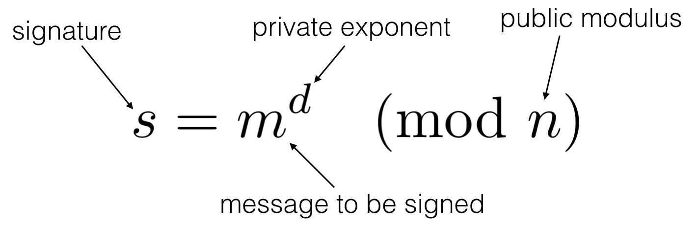
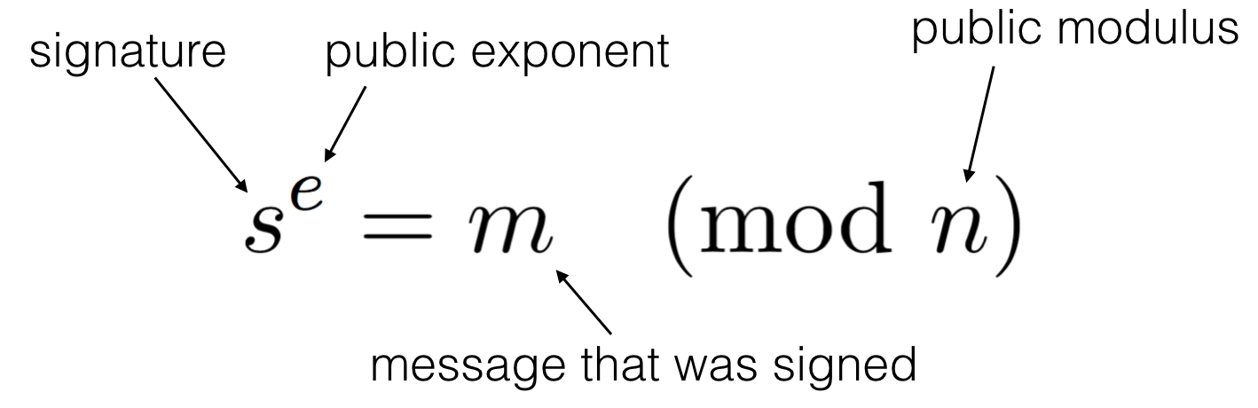
Textbook RSA Signatures
Signing Verifying
See the guts of your own key:
$ openssl genrsa -out private.key 4096
$ openssl rsa -in private.key -pubout -out public.key
$ openssl rsa -in private.key -text -noout
$ openssl rsa -in public.key -pubin -text -noout
generate private
…and public key
print private
…and public key info
Notes:
N = p*q, where p and q are two large primes

Slide 79


Textbook RSA Signatures
Our good friends Alice and Bob want to communicate with sender authenticity using RSA
(m, s)
She sends both the message and the signature
Public: (e, N)
Private: d
Message: m
Signature: s = m^{d} mod N
Verify: s^{e} mod N == m
Notes:
Provides both integrity and authenticity.
Prevents masquerading or man-in-the-middling: only Alice can make that signature,
And if Mallory modifies the message, the signatures won’t match.

Slide 80
A Problem With Textbook RSA
It’s really easy for Mallory to generate a valid (m, s) pair
Instead of starting with m and generating s, they start with s and generate m:
m = s^{e} mod N
Fix: Instead of signing m, we sign PKCS-PAD(m)
The output of PKCS-PAD follows a very specific format
It’s infeasible for Mallory to find a value of s such that s^{e} mod N will follow this format
The PKCS-PAD digest will be the same length for any message
Notes:
The error that Bleichenbacher exploits is if the implementation does not check that the hash+ASN.1 data is right-justified within the PKCS-1padding. Some implementations apparently remove the PKCS-1 padding by looking for the high bytes of 0 and 1, then the 0xFF bytes, then the zero byte; and then they start parsing the ASN.1 data and hash. The ASN.1 data encodes the length of the hash within it, so this tells them how big the hash value is. These broken implementations go ahead and use the hash, without verifying that there is no more data after it. Failing to add this extra check makes implementations vulnerable to a signature forgery, as follows.

Slide 81
Bleichenbacher Attack: Vulnerability 1
So what’s Bleichenbacher got to do with it?
If e is small enough, we can forge a signature that Bob will verify is correct without needing to know Alice’s private key. How?
(m, s)
She sends both the message and the signature
Public: (e, N)
Private: d
Message: m
Signature: s = (PKCS-PAD(m))^{d} mod N
Verify: s^{e} mod N == PKCS-PAD(m)
What if e is really small, like, 3?
Notes:
Ability to take roots without overflowing modulus

Slide 82


Bleichenbacher Attack: Vulnerability 2
How should a secure bank’s operations work?
m = “gimme some $$$”
s = (PKCS-PAD(m))^{d} mod N
Admin sends the bank’s server the (m, s) pair
Bank recreates the PKCS-PAD(m) using what Admin sent: x = PKCS-PAD(m)
Bank raises s to Admin’s public exponent e: y = s^{e} mod N
If x == y, Admin is authenticated

Slide 83
Bleichenbacher Attack: Vulnerability 2
How do the bank’s operations actually work?
m = “gimme some $$$”
s = (PKCS-PAD(m))^{d} mod N
Admin sends the bank’s server the (m, s) pair
Bank raises s to Admin’s public exponent e: y = s^{e} mod N
Bank parses the SHA-256 digest, h, from y
If h == SHA-256(m), Admin is authenticated

Slide 84
Bleichenbacher Attack
What the result of the signature verification should look like (s^{e} mod N)
Format of PKCS-PAD(m) above.
Lazy implementation
Does not count FF bytes; also does not verify hash is in rightmost bytes
How can we forge something such that (s^{e} mod N) gives us the 2nd message seen above?
What if e just so happens to be very small?
Accepted due to poor implementation
Notes:
Top (correct) padding is completely deterministic
Bottom (incorrect) padding has immense freedom from (unspecified, arbitrary) bytes on the right.

Slide 85
When it doesn’t wrap around...
Let’s forge a signature for message m with e = 3
How do we make it so that verifying the message gives us m (mod n)?
How does the “lazy implementation” of checking signatures help with this?
Signing Verifying

Slide 86
Exam Practice

Slide 87
Exam Practice
W23 Midterm Question 2 a-g

Slide 88
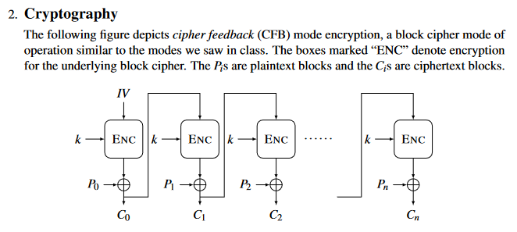

Slide 92
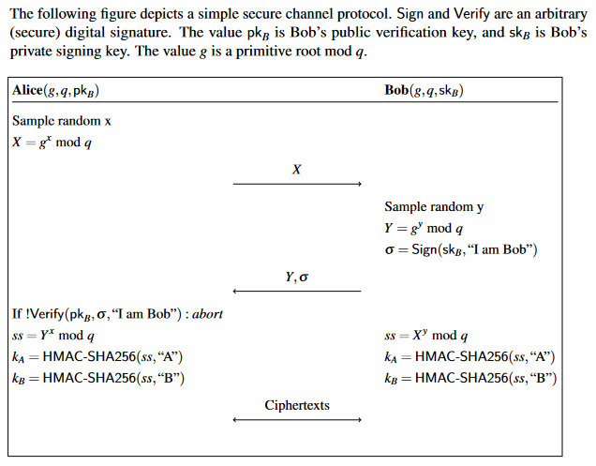
(d) Why doesn’t the protocol prevent an active attacker from impersonating Bob to
Alice?
(e) Explain how to fix the problem you identified in part (d)

Slide 93
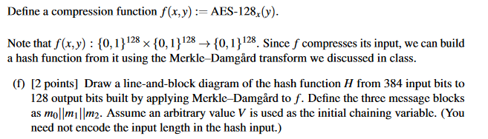

Slide 95
Answer Key

Slide 96
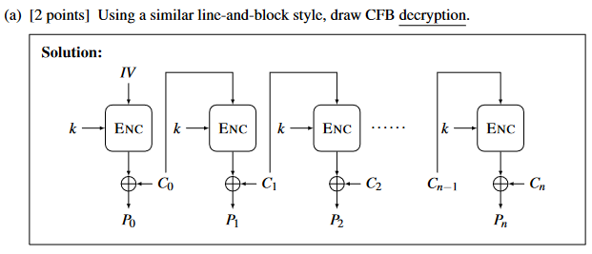

Slide 97
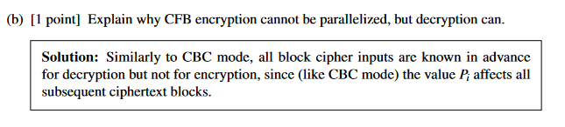

Slide 98
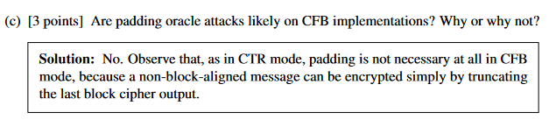

Slide 99
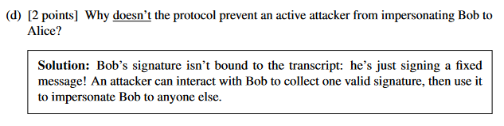
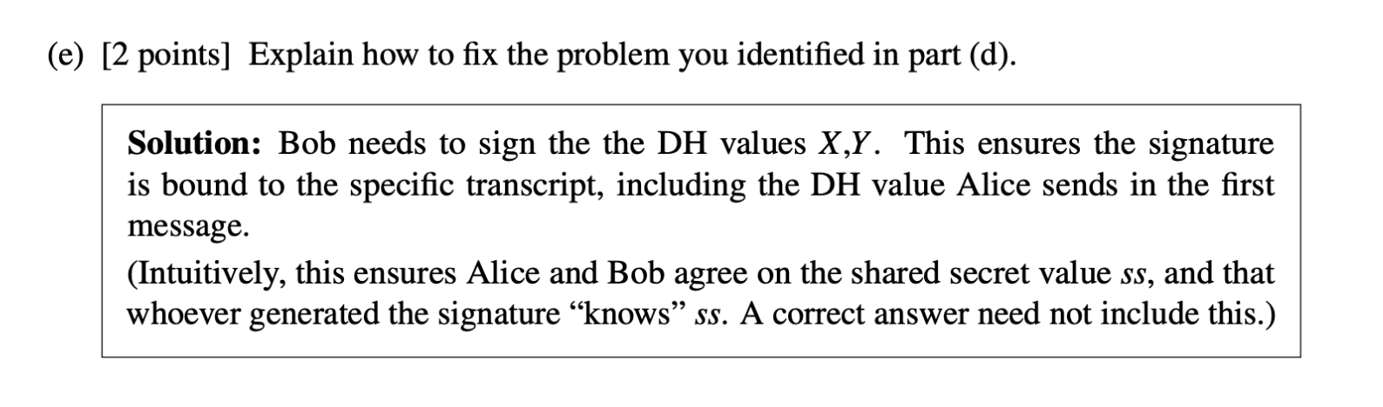

Slide 100
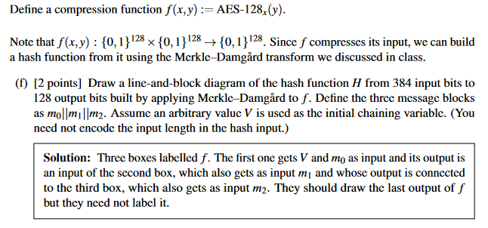

Slide 101
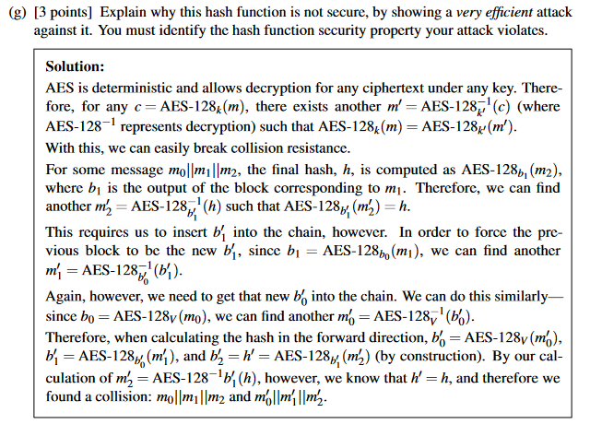
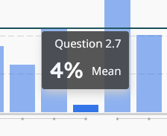

Slide 102
See you next week!

