Slide 1
💀 DARKDECODER
Dual-Framework Cyber Threat Intelligence Platform
MITRE ATT&CK
MITRE ATLAS
RED TEAM INTEL
Praising Harris | Solo Submission
Beyond Tomorrow Summit Hackathon 2026
github.com/Pyhroff/darkdecoder
💀 DARKDECODER | Beyond Tomorrow Summit 2026
1 / 10

Slide 2
// PROBLEM STATEMENT
The Security Crisis Nobody Is Solving
🔍
🤖
🎯
MALWARE BLINDNESS
AI ATTACKS IGNORED
NO ATTACKER LENS
Analysts spend hours on a single malicious file. Tools say "dangerous" but never explain WHY, HOW, or WHAT TO DO. Speed is survival in security.
Every company ships LLM products in 2026. Prompt injection, data poisoning, jailbreaks — no mainstream tool detects these. The attack surface is invisible.
Defenders think defensively. Red team perspective — understanding the full kill chain — costs $50K+/year in consultants. It should cost $0.
60% of breaches involve malware · AI-targeted attacks up 400% YoY · Average breach cost: $4.88M
💀 DARKDECODER | Beyond Tomorrow Summit 2026
2 / 10

Slide 3
// PROPOSED SOLUTION
DarkDecoder — One Platform, Three Weapons
⚠️
🤖
🔴
MALWARE SCANNER
AI THREAT ANALYZER
RED TEAM INTEL
MITRE ATT&CK
MITRE ATLAS
ATT&CK Kill Chain
Deobfuscates base64, hex, eval chains
Classifies: Ransomware, RAT, Keylogger...
Extracts IOCs — IPs, domains, registry keys
Danger score 1–10 with full justification
Remediation steps + PDF/JSON report
Detects prompt injection attempts
Identifies jailbreak & bypass techniques
Catches training data poisoning samples
Flags model extraction query patterns
Maps to official AML.TXXXX codes
10-phase kill chain grid visualization
Weaponization + stealth scoring (1–10)
Privilege escalation level assessment
Named APT group similarity matching
CVSS vector + full attack narrative
20 seconds from paste → full threat intelligence report with PDF export
💀 DARKDECODER | Beyond Tomorrow Summit 2026
3 / 10

Slide 4
// INNOVATION & NOVELTY
What Makes DarkDecoder Unique
❌ EXISTING TOOLS
✅ DARKDECODER
Signature-based scanners — yes/no only
No explanation of WHY code is dangerous
Zero AI/ML threat detection capability
No MITRE ATLAS framework support
Red team analysis costs $50K+/year
No kill chain visualization
No structured report export
AI reasoning — explains WHY, HOW, WHAT
MITRE ATT&CK + ATLAS dual framework
First tool to detect AI-specific attacks
Full kill chain in 10-phase visual grid
CVSS vector + APT group similarity
Attack timeline + narrative generation
PDF + JSON + TXT reports in one click
→
Only platform combining MITRE ATT&CK + MITRE ATLAS + Red Team Intel in a single open-source tool
💀 DARKDECODER | Beyond Tomorrow Summit 2026
4 / 10

Slide 5
// TECHNOLOGY STACK
Built On Real Infrastructure
🦙
Groq API
🛡️
MITRE ATT&CK
🤖
MITRE ATLAS
Llama 3.3 70B
Traditional Threats
AI/ML Threats
70B parameter LLM for deep code reasoning and security analysis. Sub-2s inference.
Global standard for mapping adversary behavior. 200+ techniques, 14 tactics.
Official AI threat framework. AML.TXXXX codes for adversarial machine learning attacks.
🐍
Python + Streamlit
📄
fpdf2
🔐
Groq Free Tier
Full Stack
Report Generation
Zero Cost
Entire application in pure Python. Streamlit renders the terminal-style UI with zero frontend code.
Professional branded PDF export with threat scores, MITRE tables, IOC lists, and timelines.
14,400 requests/day free. No credit card. Entire platform runs at $0 infrastructure cost.
Deployable for $0 · Open source · Built in 12 hours · Zero external dependencies
💀 DARKDECODER | Beyond Tomorrow Summit 2026
5 / 10

Slide 6
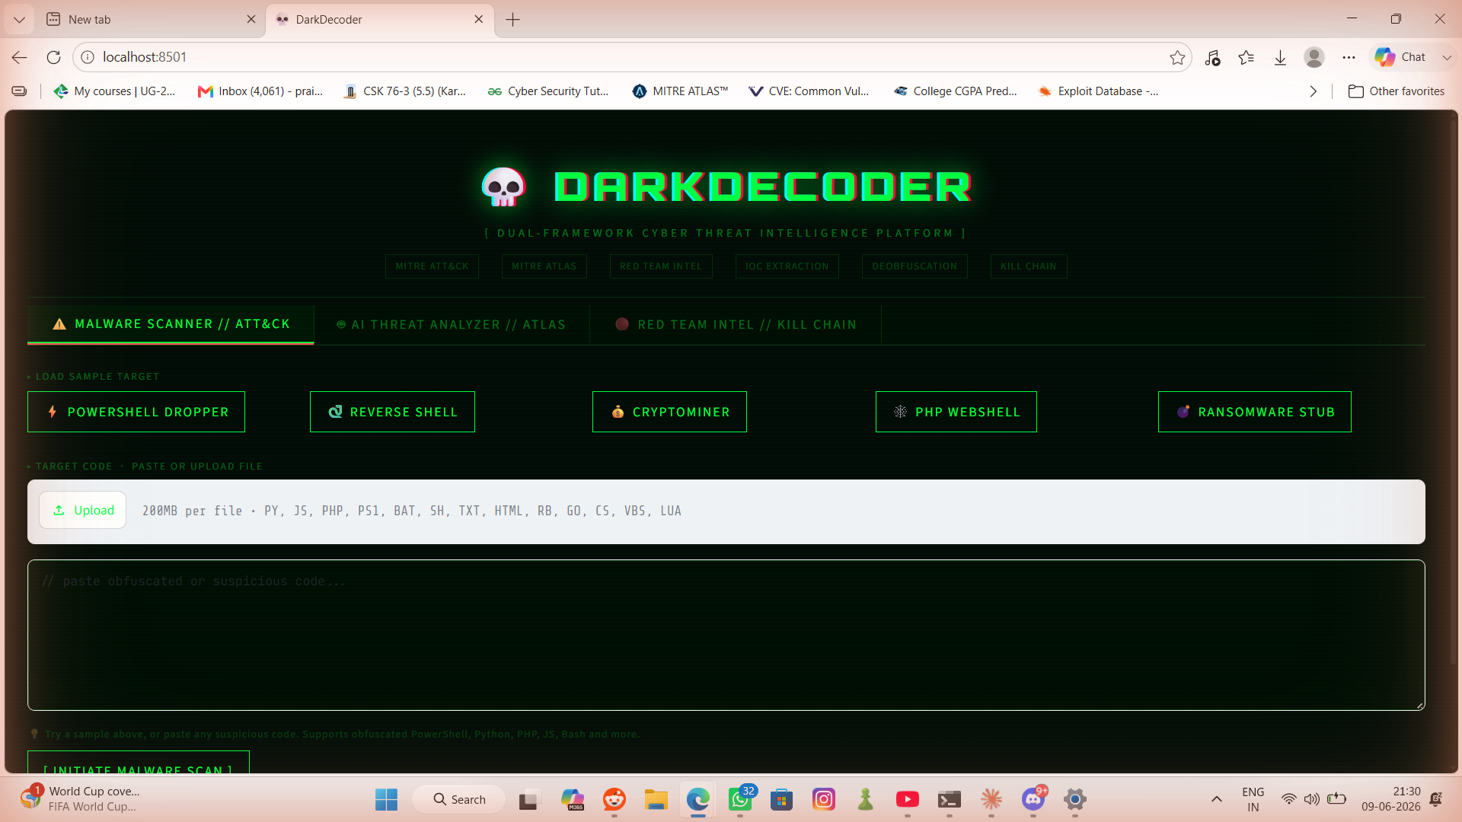
[ PLATFORM IN ACTION ]
Live system — real scan results — zero manual setup
Module 1: Malware Scanner | Module 2: AI Threat Analyzer (ATLAS) | Module 3: Red Team Intel

Slide 7
// IMPACT & FEASIBILITY
Real Impact. Zero Barriers.
20s
3
$0
200+
ANALYSIS TIME
ANALYST MODULES
DEPLOYMENT COST
MITRE TECHNIQUES
Who Benefits
🏢 SOC Teams
🛡️ AI Builders
🎯 Bug Bounty
Reduce analysis time from hours to 20 seconds. PDF reports slot directly into incident tickets and compliance workflows.
Every LLM product needs prompt injection and jailbreak protection. DarkDecoder is the only ATLAS-mapped detection tool available free.
Understand full kill chain impact of discovered vulnerabilities. Generate CVSS vectors. Write professional HackerOne reports faster.
Open source · Free to deploy · No login required · Works on any device · Runs in <20 seconds
💀 DARKDECODER | Beyond Tomorrow Summit 2026
7 / 10

Slide 8
// KEY FEATURES
Platform Walkthrough
FEATURE SET
SCAN FLOW
🔓
Deobfuscation Engine
01
Paste or Upload Code
Decodes base64, hex, eval, string concat
Supports 12+ file types
🗺️
MITRE ATT&CK Mapping
T-codes with confidence + description
02
Select Module
🤖
MITRE ATLAS Mapping
Malware / AI Threats / Red Team
AML.TXXXX for AI adversarial threats
📍
IOC Extraction
03
Groq LLM Analysis
IPs, domains, registry, mutex, paths
⚔️
Kill Chain Grid
Llama 3.3 70B reasoning over code
10-phase ATT&CK visualization
📄
PDF Report Export
04
Framework Mapping
Branded, professional, one-click
ATT&CK / ATLAS techniques applied
📁
File Upload
.py .js .php .ps1 .sh .bat support
05
Export Report
⏱️
Attack Timeline
PDF · JSON · TXT in one click
Numbered progression with technique IDs
💀 DARKDECODER | Beyond Tomorrow Summit 2026
8 / 10

Slide 9
// FUTURE SCOPE
The Roadmap Ahead
NOW
Core DarkDecoder v2.0
3 modules · MITRE ATT&CK + ATLAS · Kill chain grid · PDF export · File upload · Attack timeline · Session history
Q3 2026
VirusTotal Integration
Cross-check extracted IOCs against 70+ AV engines in real time. Transform IOC extraction into live threat intelligence.
Q4 2026
VS Code Extension
Real-time code analysis as developers write. Security shift-left — catch threats before they hit production.
Q1 2027
GitHub Repository Scanner
Point DarkDecoder at any public repo. Auto-scan all files. Generate org-wide threat reports in minutes.
2027
SaaS Platform
Team dashboards · API access · Enterprise tier · White-label PDF reports · Slack & Teams integrations.
💀 DARKDECODER | Beyond Tomorrow Summit 2026
9 / 10

Slide 10
💀
DarkDecoder is not a hackathon toy.
It is the tool every security team needs —
and no one has built, until today.
2
3
<20s
Security Frameworks
Analysis Modules
Time to Threat Intel
github.com/Pyhroff/darkdecoder · Praising Harris · Beyond Tomorrow Summit 2026
Thank you
💀 DARKDECODER | Beyond Tomorrow Summit 2026
10 / 10

