Slide 1

Django
Joel Eche

Slide 2
Why django?
Provides a set of tools and functionalities:
Security features
Database access
Sessions
Template processing
URL routing
Internationalization
Enables us to develop secure and reliable Web applications very quickly in a standardized way.
Community.

Slide 3
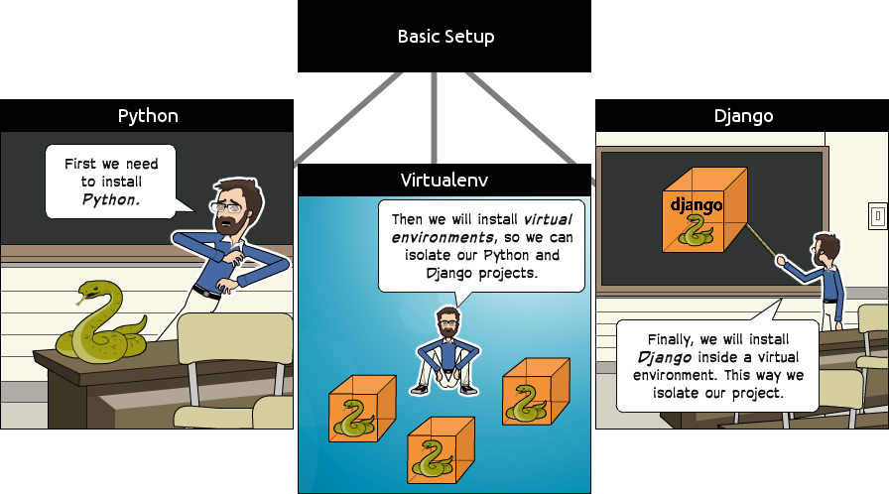
First steps

Slide 4
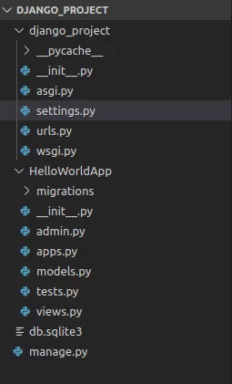
Structure of an application

Slide 5
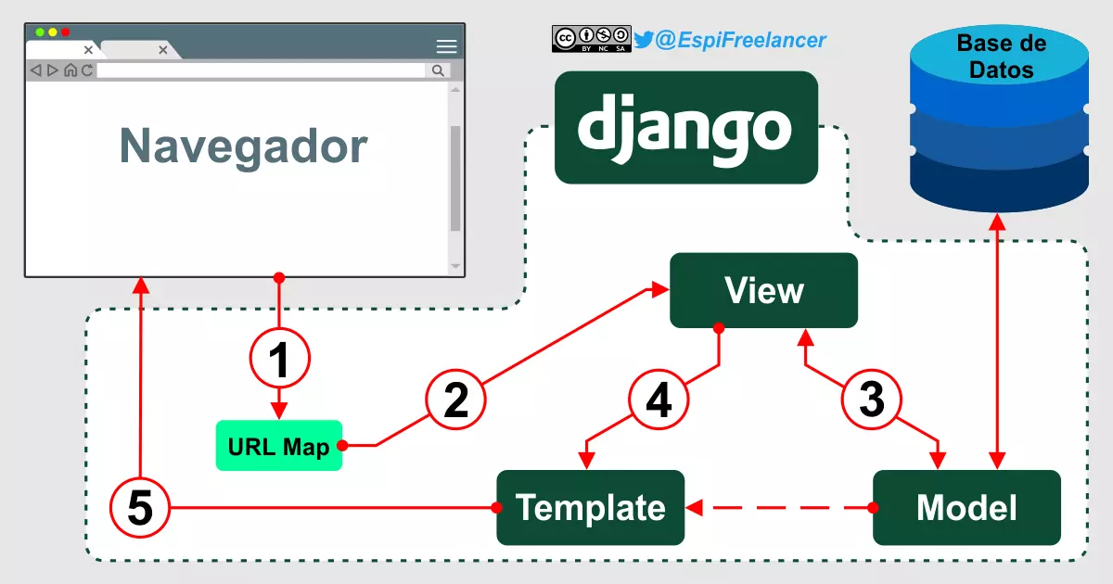
MVT Django

Slide 6
Links
https://simpleisbetterthancomplex.com/series/2017/09/04/a-complete-beginners-guide-to-django-part-1.html
https://www.askpython.com/django/django-app-structure-project-structure
https://espifreelancer.com/mtv-django.html

