Slide 1


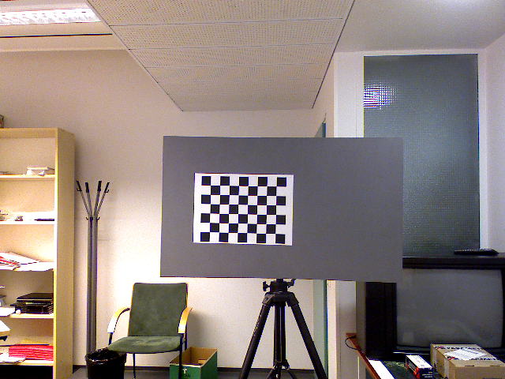
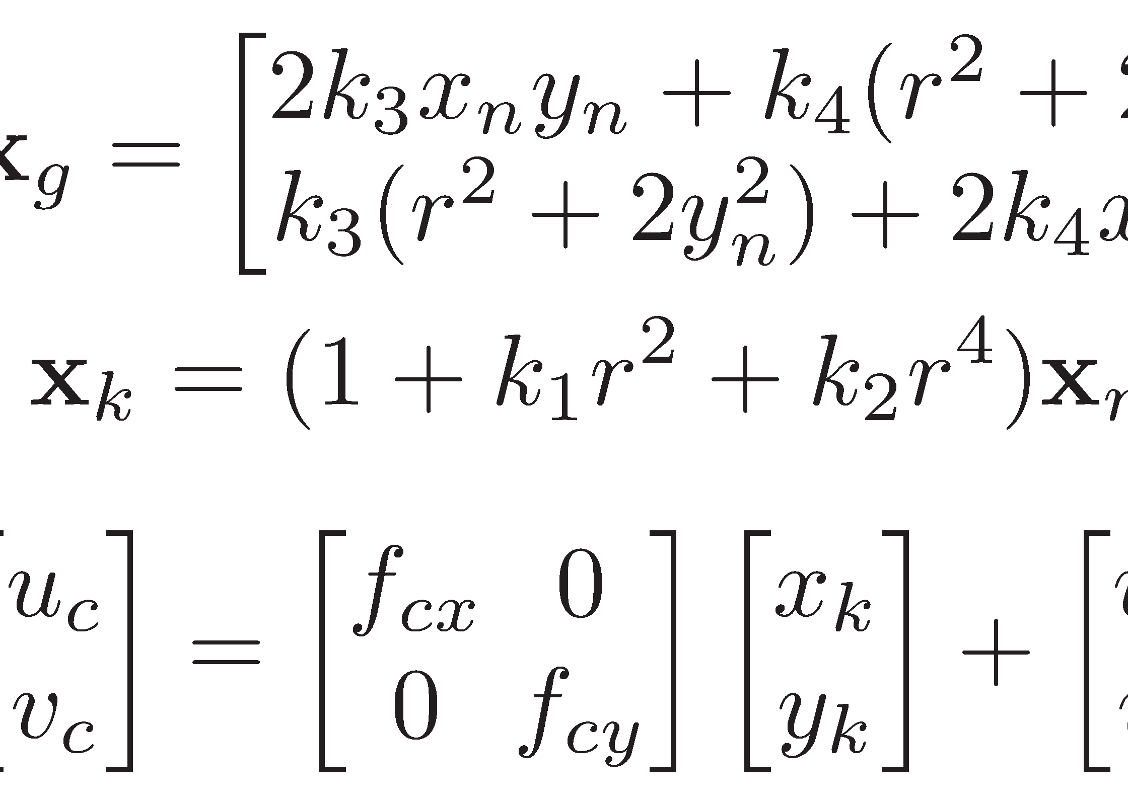
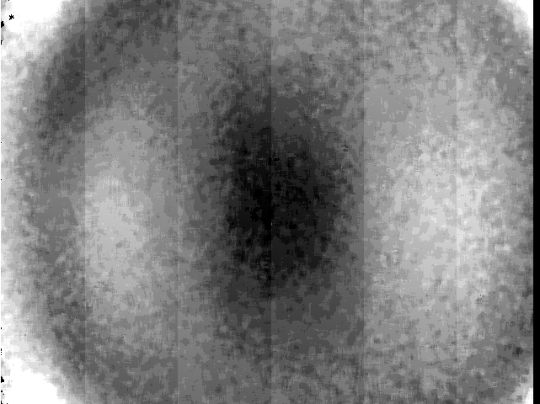
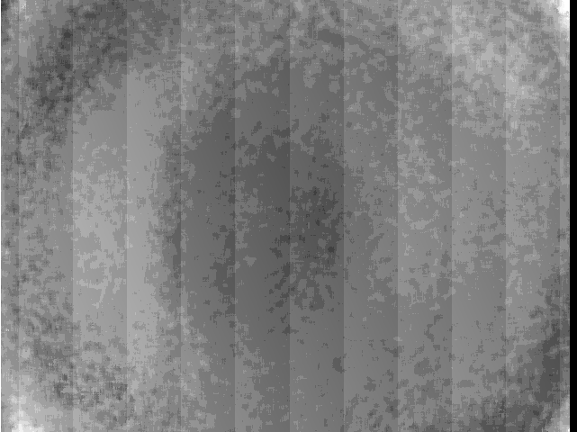
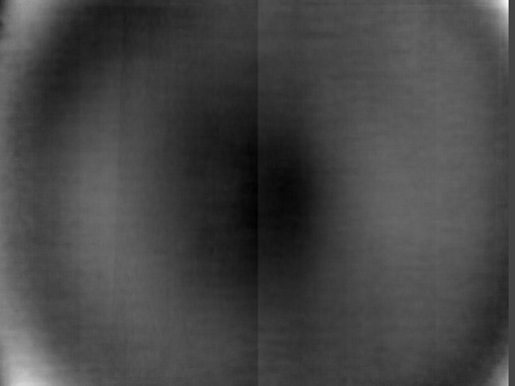
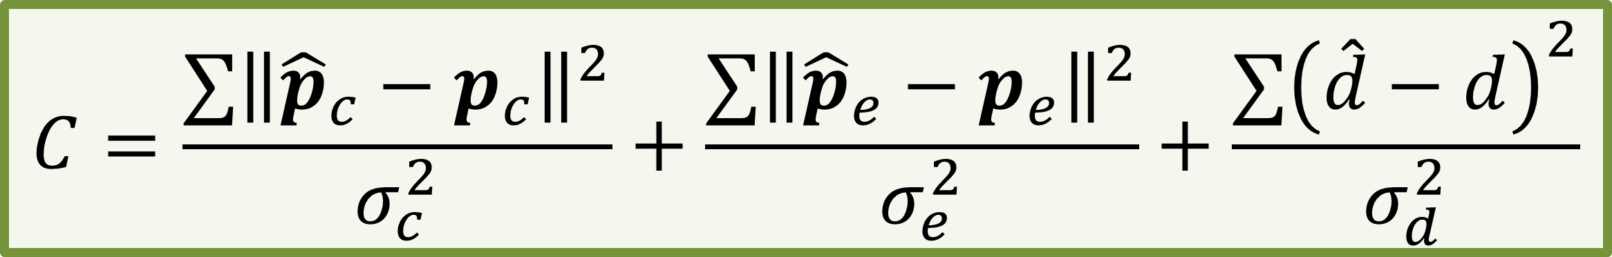


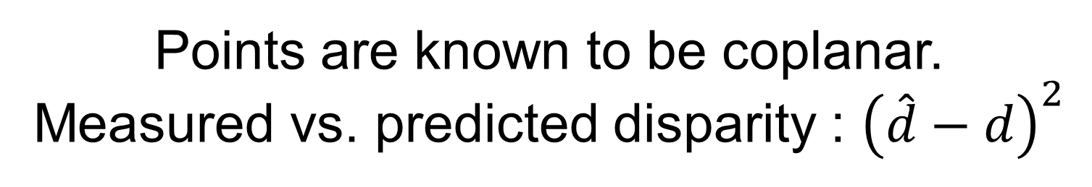

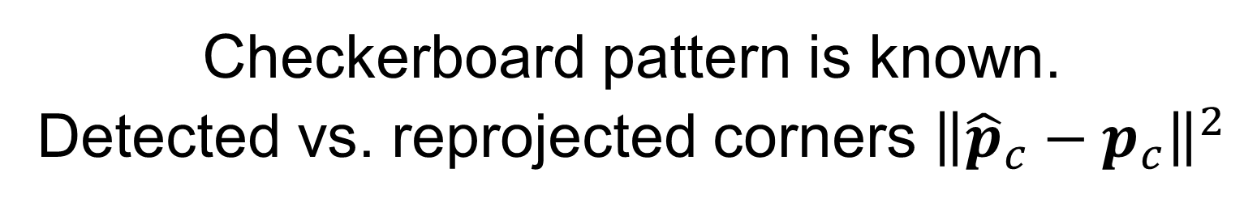
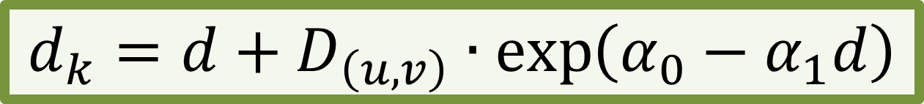
oint Depth and Color Camera alibration
with istortion Correction
Daniel Herrera C., Juho Kannala, Janne Heikkilä
Center for Machine Vision Research, University of Oulu, Finland
Abstract
Problem
We present an algorithm that simultaneously calibrates two color cameras, a depth camera, and the relative pose between them.
Characteristics:
Accurate, practical, and applicable to a wide range of sensors.
Does not use depth discontinuities.
Applied to a Kinect device.
Requirements:
Planar surface imaged from several poses.
Rigidly attached depth and color cameras.
Depth discontinuities are noisy for depth calibration.
How to calibrate a color and a depth camera jointly?
Kinect’s color camera has low resolution.
How to learn a distortion model for the Kinect?
Constraints
Color camera
External camera
Depth camera
Checkerboard pattern is known.
Detected vs. reprojected corners ${\left\|{\hat{p}}_{c}−p_{c}\right\|}^{2}$
Points are known to be coplanar.
Measured vs. predicted disparity : ${\left(\hat{d}−d\right)}^{2}$
Rigidly attached
$$C=\frac{∑{\left\|{\hat{p}}_{c}−p_{c}\right\|}^{2}}{σ_{c}^{2}}+\frac{∑{\left\|{\hat{p}}_{e}−p_{e}\right\|}^{2}}{σ_{e}^{2}}+\frac{∑{\left(\hat{d}−d\right)}^{2}}{σ_{d}^{2}}$$
Non-linear minimization (LM)
Constraints of one camera affect the others!
Kinect distortion correction
Results
All cameras have geometric distortion:
Accurate, practical, and flexible algorithm.
Adaptable to different depth sensors.
Better Kinect accuracy than manufacturer (half the error at 1m).
Kinect also has a fixed error pattern that vanishes at long distance.
0.5m 1.2m
Decouple fixed pattern from the distance dependent component:
$$Error\left(u,v,d\right)=f\left(u,v\right)∙g\left(d\right)$$
$f\left(u,v\right)$ is constant
$g\left(d\right)$ is exponential
Open source toolbox:
http://http://www.ee.oulu.fi/~dherrera/kinect/
Reference
Herrera C., D., Kannala, J., Heikkilä, J., “Joint depth and color camera calibration with distortion correction”, TPAMI, in press 2012.
$$d_{k}=d+D_{\left(u,v\right)}∙\exp\left(α_{0}−α_{1}d\right)$$

