Slide 1

Automated Generation of Security-Centric Descriptions
for Smart Contract Bytecode
Yu Pan (University of Utah)
Zhichao Xu(University of Utah)
Levi Taiji Li (University of Utah)
Yunhe Yang (University of Utah)
Mu Zhang (University of Utah)
Notes:
Thank you all for joining my presentation today! I am Yu Pan, a second year Ph.D. student from the UU. I’d like to introduce our work: $title$. All authors are from the University of Utah.

Slide 2

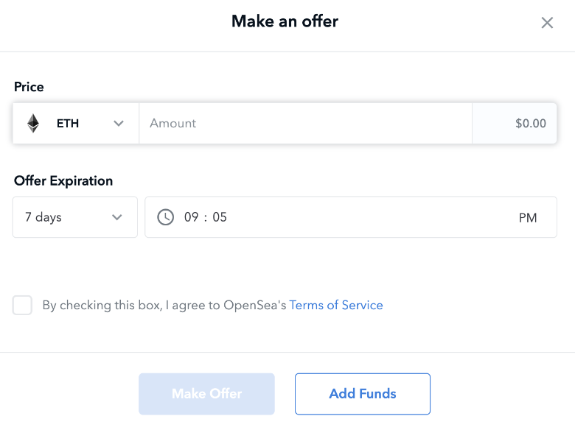
DApp UI is hard to understand
Can users understand the UI?
Opensea auction example
Transfer ether, but to whom?
Set the deadline, but whether check it,
in what context?
Notes:
is hard to understand;
add opensea
check it in what context?
rm line -> can users.. in one line
**highlight text in UI**
Explain the auction, make an offer amount
Given information is not enough
introduction first, then raise a question, finally analyze it
Developers often create a front-end interface to make smart contracts more accessible and user-friendly for end users. DApp UI text is not clear, making it hard for end users to understand its logic and risks. First, the user is prompted to enter an "amount" in the text field, indicating the desired transfer amount. However, it is unclear to the user whom the funds will be transferred to.
Additionally, the interface allows the user to set an "offer expiration" for the transaction, seemingly implying that the user can define a deadline. However, it is uncertain whether the smart contract will actually validate or enforce this expiration date.
Put to first page, title: DApp UI is not clear
DApp backend is smart contract, UI is added, but UI is not good?
What do you think the DApp can do?
Transfer amount to whom? Check timestamp?
Unclear texts in UI, and there are some problems in understanding DApp.
e.g. problems in amount, set a deadline
can user understand the UI
// Our motivation comes from opensea, one of the most famous NFT market DApp. The UI text simply indicates that the end user can make an offer for the bidding, they can enter a price amd set a deadline.
// Howeve, it does not show reveal its internal business logic, including calculating fees, transfer interests and so on. Besides, smart contracts are compiled to bytecode, and then deployed to blockchain. Thus can be // // hard for end user to understand.

Slide 3
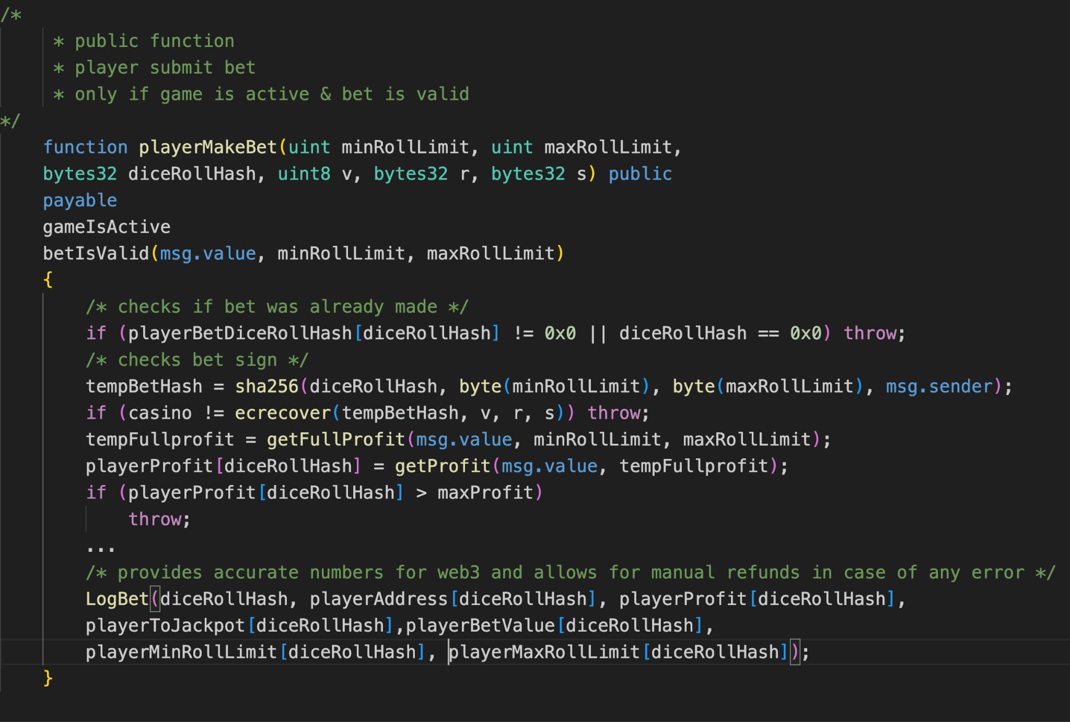
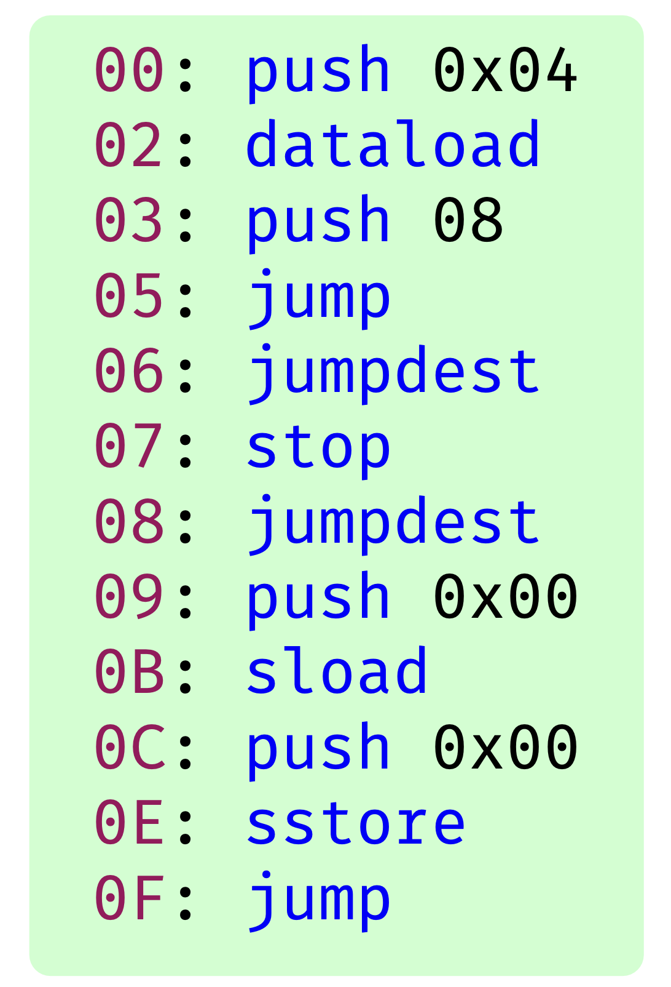
Existing Work
Source to description
Bytecode to report
from comments
MMTrans’(ICPC 21)
Description: public function player submit bet only of game is active bet is valid can be called
from variable name,
function name
ChatGPT
The playerMakeBet function facilitates player bet submissions and updates relevant data structures accordingly.
securify (CCS 18)
There is a reentrancy problem in the contract
There is an Uninitialised struct problem in line #15
Based on source code
Not security-centric
No context
Focus on specific problems
Too professional for end-user to understand
Notes:
chatgpt relies on varname, funcname, describe logic and functionality
securify uses certain rules to identify specific security problems, for example, reentrancy, if a problem is identified, it will generate a natural language security report
There is no guarantee that source code
explain “context”, how, under which condition
**Change the code snippet**
source to description -> ICPC ->
change the description of bytecode
change the picture of ICPC source code and securify bytecode
Add animation
source code based
Existing work can be put into two categories
Source to description (MMTrans’ ICPC 21)
MMTrans, ChatGPT, two descriptions
Source code may not be available, other problems, obfuscation; Add bullet;
Add bytecode picture;
Modify securify report -> nlg + line number
Add pictures, code and comment from ICPC; securify bytecode (works on bytecode and security, no context, specific problems, e.g. low-level problems), readability
Add two bullets,
There are existing work… ICPC MMTrans focus on comment, the descriptions are too general and not security-centric enough to help users understand the smart contract.
HoneyBadger can detect malicious smart contracts, however, it cannot be applied for ambiguous contracts. Meanwhile, it works on source code.
Oyneate, security, zeus, focus on low-level problems.

Slide 4
Challenges & Requirements
Not security-centric
Security-Centric
!
1
!
Source code only
Bytecode
2
No context
Context
!
3
Difficult to understand
Readability
!
4
Notes:
Add limitations on left, challenges on the right side
4 requirements: security-centric, bytecode, context, readability
We expect our textextual descriptions to help end users understand security risks in smart contracts. The descriptions should cover security risks and easy to understand. In such a case, we raise $1, 2, 3$
Bytecode: always available, no symbol (func name, var name)
context: why happens, under which condition it happens

Slide 5
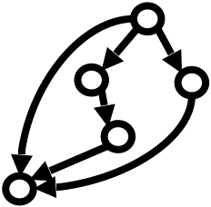
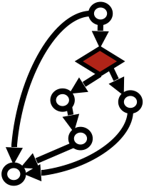
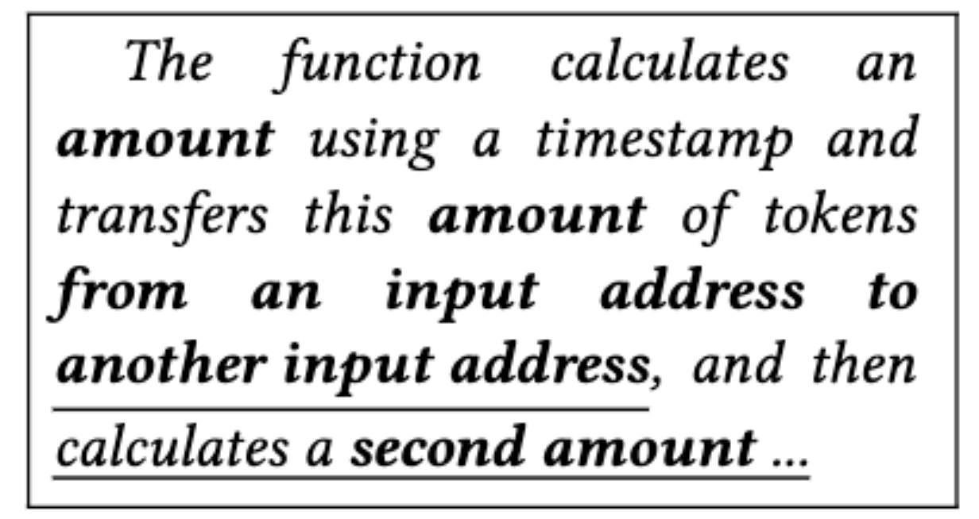

Approach Overview Tx2TXT
static analysis
machine learning
security
semantics
Smart Contract Function
Funds Transfer
Graph Construction
Select insertion of
Conditions
Description
Generation
Bytecode
Security-Centric
Security-Centric
Security-Centric
Context
Readability
Readability
Notes:
perform static analysis to convert each bytecode function to the graph
Title Tx2TXT
stress new graph representation, capture security context
some of the conditions
// Our journey starts with the exploration of transfer-related functions within smart contracts. From there, we construct a comprehensive funds transfer graph that captures the intricate flow of transactions. However, we // encountered a challenge along the way. The graph became complex with numerous conditions, significantly hampering its readability. To overcome this obstacle, we employed a machine-learning mode GCNl // that autonomously incorporates vital conditions into the FTGs. Finally, we convert the graph to natural language using a template
Add an example, change icon of smart contract function and description generation
target at smart contract bytecode,
define a new funds transfer graph representation funds transfer context
Add some conditions, to enrich context, all conditions added making the graph complex, training a model to select conditions. Best efforts, even if without it, FTG is good enough to capture all critical conditions. Better to add.
Extract security-related semantics, define a language to convert FTG to nlg.

Slide 6
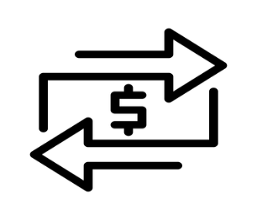
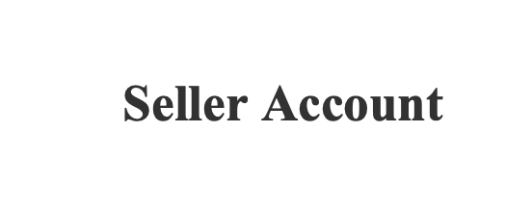
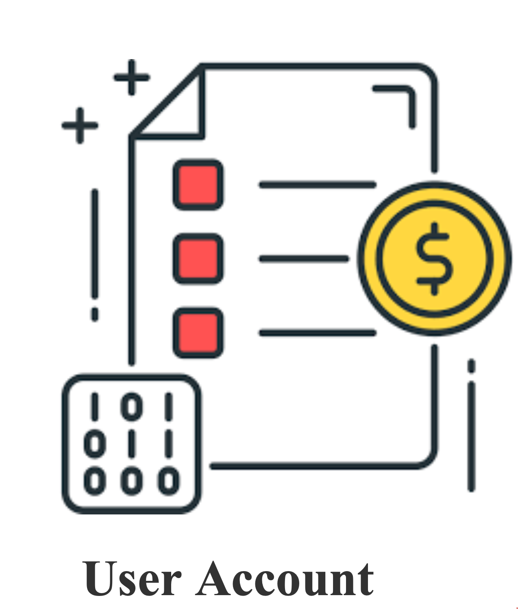
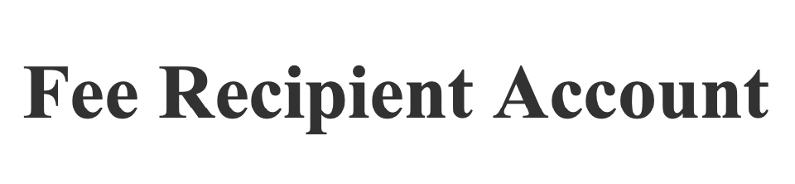

Funds Transfer Graph
Security-Centric
Context
securify(CCS 18), Oyente(CCS 16)
%243 = DUP6(%4D)
/*first amount*/
Pay to buy(5 eth)
Pay to buy
Pay fee
Pay fee(5 *
0.2%= 0.01eth)
%275 = CALL(%274, %23F, %26A, %265, %268, %265, %263) /*transferFrom#1*/
Malicious transfer(10eth)
%398 = CALL(%397, %35B, %38D, %388, %38B, %388, %386) /*transferFrom#2*/
%3B0 = SLOAD(%3A3)
Malicious
Transfer
%3CF = CALL(%3CE, %39A, %3C4, %3BF, %3C2, %3BF, %3BD) /*transferFrom#3*/
Notes:
This is the malicious smart contract that will use user account to make three transactions.
Just considering the transfer calls is not enough, the context matters. Because benign and malicious transfers have different context.
Our description is designed to complement existing security report, providing context. Tx2TXT is not a standalone tool.
to build this ftg, we first identify transfer calls, in this case, we can find three transfers.
list papers understand security-centric
The reason why we list transfer-calls,
major of security problems are related to …
The data source of the first transfer is the selling price, which is calculated from the timestamp
For the second transfer, because the fee is calculate based on the selling price, therefore, they share the same data source.
For the third transfer, the transferred amount is a constant which is independent from the selling price.
built our tool upon octopus (~LOC)
just this ftg is not enough
data source matters
change animation step by step
after three transfers, security-centric
control-flow first, then dataflow
ICON put to end
Pay to buy (5eth) user->seller
Pay fee (5* 0.00 xxx= 0.01 eth) user -> fee recipient
malicious (10 eth) user -> attacker
first amount
in graph highlight the ether
To begin with, explain why we list transfers, transfer matters. -> security centric
First 2 transfers share public source -> context
amount transfer, fee transfer
new graph representation. Funds transfer, pay the fee ()
draw a picture for code, e.g. calculation and transfer…
animation, list one as an example(data-source), dataflow first, reveal all sources, and then finally control-flow
The graph can reveal normal transfer and malicious transfer, e.g. constant address, amount; should have data-dependency with previous amount.
This is an example of funds transfer graph directly from the bytecode. There are three funds transfers, involving calculating the fee, transfer funds and interest, and a transfer of malicious hidden fee.

Slide 7
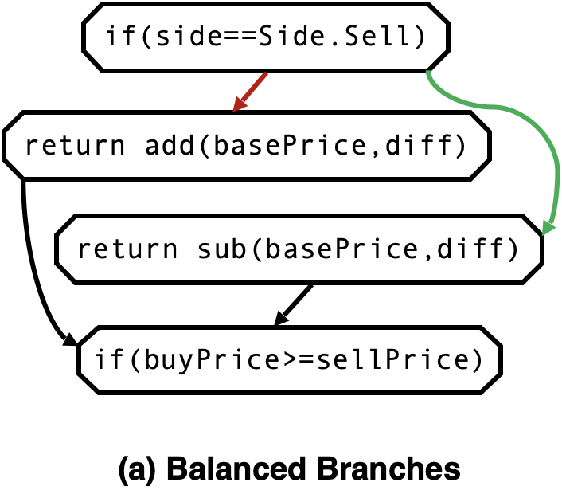
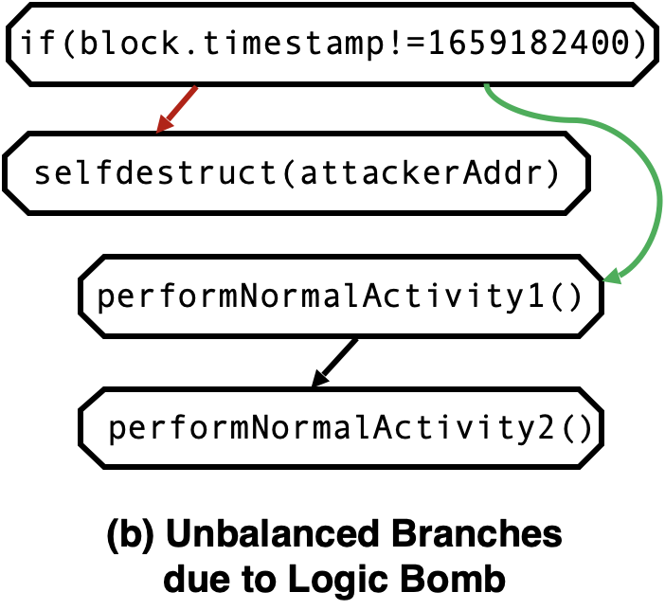
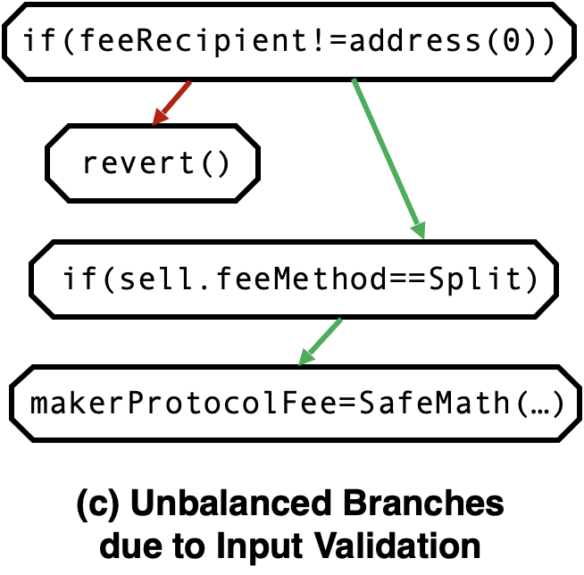


Add security sensitive conditions
GCN
Security-Centric
Readability
Notes:
The key challenge is how to identify security conditions, to understand that, let’s see some examples.
How we identify ss conditions is a node classification problem, to solve it, we feed these features into our custom GCN model to…
example (a), benign contracts calculating selling price based on the condition. In one branch, it uses addition, in another uses subtraction.
because both branches achieve the same goal, they are balanced.
On the other hands, in a logic bomb case, the condition is to check whether whether if reaches a certain time. If the condition is met….
Because of that, the two branches are unbalanced.
Therefore, we believe that whether two branches are balanced is an important feature to identify ss conditions.
However, just looking at whether two branches is not enough. Because normal condition check may also have unbalanced branches.
input validation, if the condition is met, it reverts.
Otherwise, it can performal normal action.
Therefore, their two branches are unbalanced.
The only difference between 2nd and 3rd case is the action that performed on the short path. -> highlight revert()
Then we model this problem as a node classfication problem, and feed this features into a GCN model, which can therefore automatically identify ss conditions.
Both of the branches are used to perform same behavior, just details are different. In this case, one behavior performs add, another one performs sub.
This is the time bomb, checks the timestamp, if it meets, the smart contract performs self-destruct, otherwise, it performs normal behavior.
Therefore, its two branches are not balanced.
It is a node classfication problem, and we use GCN
Based on the comparisons, whether the two branches are balanced is an important judgement for the ss condition.
x √ after (a) (b)
add bullet “GCN, library used”
highlight conditions
to make it readable, add context, security-centric conditions.
GCN, 3 conditions: (1) balanced (2) context (3)
Add √ ×
time bomb
change title to “Adding security sensitive conditions”, how to define security sensitive conditions. change (a) (b) © to animation; Insights/ get the features
These are three example cases for condition analysis. Normally, most of the branches in benign dapp can be balanced. And it is a general condition.
They both calculate the price.
While for malicious ones, one of the branches can be comparatively short, and it contains malicious behavior. And it is a specific condition. We distinguish it between case 3, which checks user input, it is unbalanced but does not contain malicious behavior.

Slide 8
Natural Language Generation
%243 = DUP6(%4D)
%40 = TIMESTAMP
%275 = CALL(%274, %23F, %26A, %265, %268, %265, %263) /*transferFrom#1*/
%398 = CALL(%397, %35B, %38D, %388, %38B, %388, %386) /*transferFrom#2*/
%3B0 = SLOAD(%3A3)
%3CF = CALL(%3CE, %39A, %3C4, %3BF, %3C2, %3BF, %3BD) /*transferFrom#3*/
Notes:
link timestamp to 243, add one more slide, just one description
we still use this example to show.. The key challenge is how to convert low-level information to NL
to extract the semantics, we look at the type of the data sources. For example, the source of first amount is from timestamp and other GVs
Similarly, transfer can be converted to such set of words, based on parameter types
In addition to types, we also consider their data dependencies, for example, in the second transfer, the specified amount is calculated from the first amount.
Because we consider data dependency, the description we generated from the third transfer will be different, because the data source of the third transfer is independent
Add animation, picture first
Add two sources: timestamp, global variable
underline the first amount, share the same source, and then transfers
define semantics: return value and parameter semantics, application-specific semantics
add result description
replace ftg to nlg (animation)
inputa

Slide 9
Natural Language Generation
Timestamp & “global variable”
%275 = CALL(%274, %23F, %26A, %265, %268, %265, %263) /*transferFrom#1*/
%398 = CALL(%397, %35B, %38D, %388, %38B, %388, %386) /*transferFrom#2*/
%3B0 = SLOAD(%3A3)
%3CF = CALL(%3CE, %39A, %3C4, %3BF, %3C2, %3BF, %3BD) /*transferFrom#3*/
Notes:
define semantics: return value and parameter semantics, application-specific semantics
add result description
replace ftg to nlg (animation)
inputa

Slide 10
Natural Language Generation
Timestamp & “global variable”
<“function”, “transfer”, “1st amount”, “from 1st input address to 2nd input address”>
%398 = CALL(%397, %35B, %38D, %388, %38B, %388, %386) /*transferFrom#2*/
%3B0 = SLOAD(%3A3)
%3CF = CALL(%3CE, %39A, %3C4, %3BF, %3C2, %3BF, %3BD) /*transferFrom#3*/
Notes:
Similarly, transfer can be converted to such set of words, based on parameter types
In addition to types, we also consider their data dependencies, for example, in the second transfer, the specified amount is calculated from the first amount.
Because we consider data dependency, the description we generated from the third transfer will be different, because the data source of the third transfer is independent
define semantics: return value and parameter semantics, application-specific semantics
add result description
replace ftg to nlg (animation)
inputa

Slide 11
Natural Language Generation
Timestamp & “global variable”
<“function”, “transfer”, “1st amount”, “from 1st input address to 2nd input address”>
<“function”, “transfer”, “2nd amount calculated from 1st amount”, “from 1st input address to a third-party address”>
%3B0 = SLOAD(%3A3)
%3CF = CALL(%3CE, %39A, %3C4, %3BF, %3C2, %3BF, %3BD) /*transferFrom#3*/
Notes:
define semantics: return value and parameter semantics, application-specific semantics
add result description
replace ftg to nlg (animation)
inputa

Slide 12
Natural Language Generation
Timestamp & “global variable”
<“function”, “transfer”, “1st amount”, “from 1st input address to 2nd input address”>
<“function”, “transfer”, “2nd amount calculated from 1st amount”, “from 1st input address to a third-party address”>
“global variable”
%3CF = CALL(%3CE, %39A, %3C4, %3BF, %3C2, %3BF, %3BD) /*transferFrom#3*/
Notes:
define semantics: return value and parameter semantics, application-specific semantics
add result description
replace ftg to nlg (animation)
inputa

Slide 13
Natural Language Generation
Timestamp & “global variable”
Security-Centric
Readability
<“function”, “transfer”, “1st amount”, “from 1st input address to 2nd input address”>
<“function”, “transfer”, “2nd amount calculated from 1st amount”, “from 1st input address to a third-party address”>
“global variable”
<“function”, “transfer”, “3rd amount from global variable”, “from 1st input address to another third-party address”>
Notes:
define semantics: return value and parameter semantics, application-specific semantics
add result description
replace ftg to nlg (animation)
inputa

Slide 14
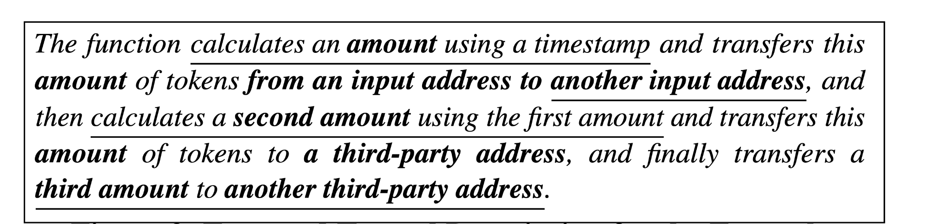
Natural Language Generation
Security-Centric
Readability
Notes:
define semantics: return value and parameter semantics, application-specific semantics
add result description
replace ftg to nlg (animation)
inputa

Slide 15
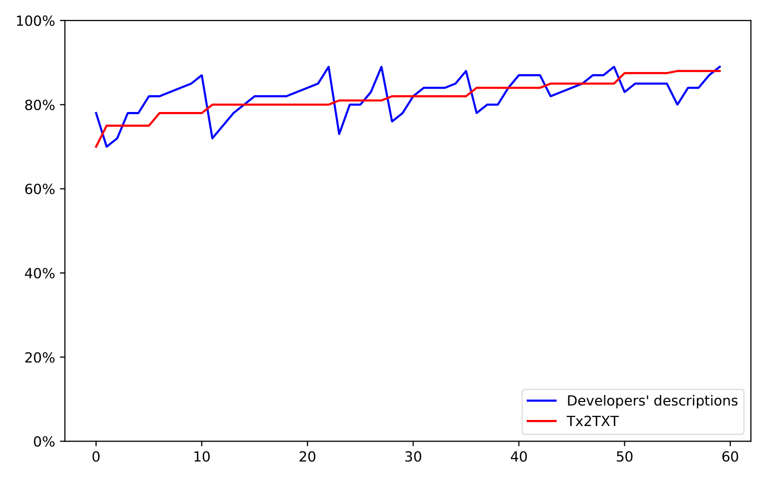
EVALUATION: Readability
Q1: Can average users read the machine generated descriptions?
Readability Score
Notes:
research question
In addition to evaluation of analysis accuracy, we perform a user study to evaluate the readability of effectiveness of generated descriptions.
add title “accuracy…”
We send the both the developers’ and ours to MTurks to ask them to answer questions to show whether they understand the questions.
We generate the readability score based on the percentage of correct answers. So here is the result.
Add animation
within subject, task based;
Add an example;

Slide 16
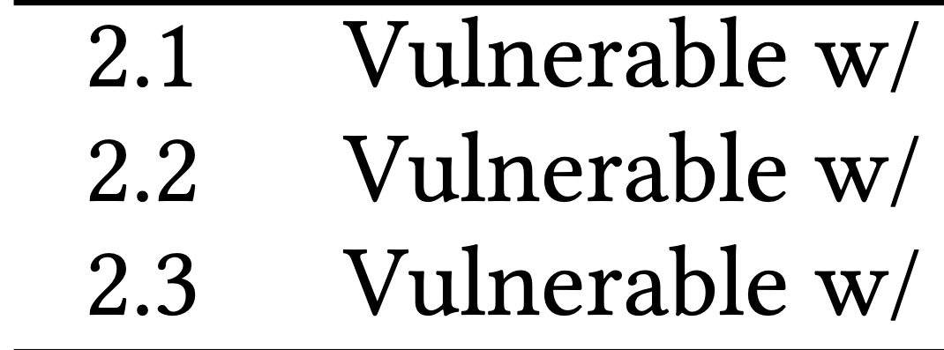
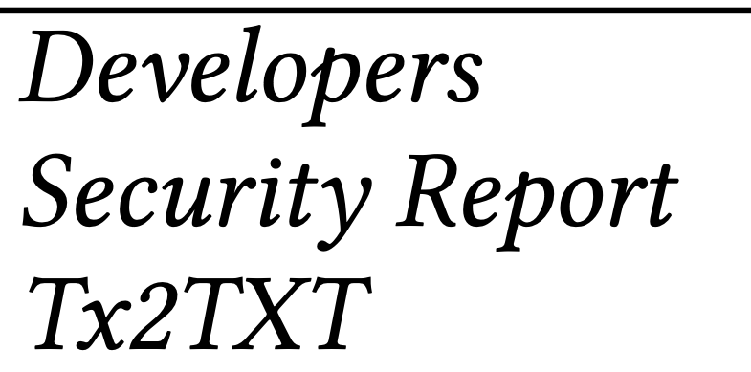
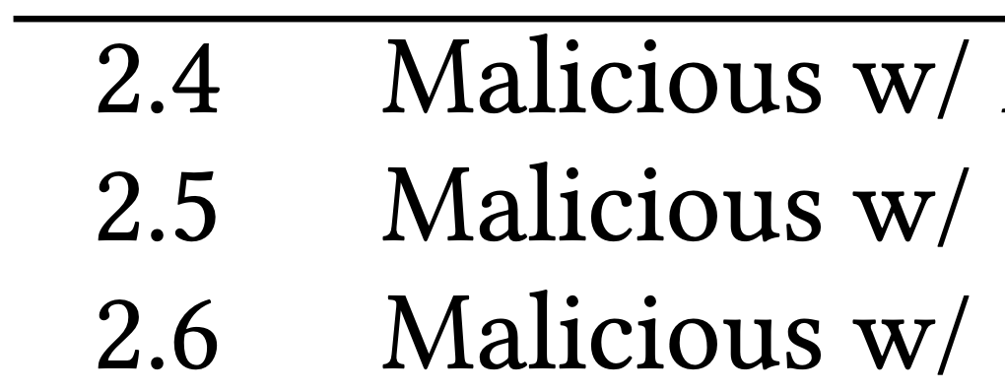
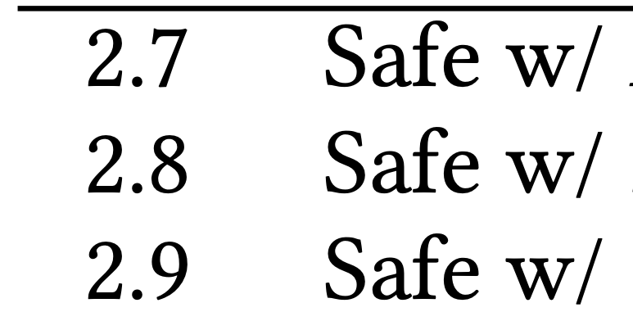
EVALUATION: Security-Awareness
Q2: Developer’s descriptions cannot faithfully reflect the security problems of smart contracts. Can we do better?
Contract Adoption Rate
79.5%
39.4%
30.2%
86.3%
30.2%
20.4%
85.0%
83.4%
80.2%
Notes:
Original developers’ descriptions are not security-centric, cannot help end-users avoid risks. 80 per cent of users will still use the contract.
Sp performs much better, because it focus on security problems.
we show that our descriptions outperforms security report. We can reduce this number by 10 per cent.
Because we give a rich context.
Same is true for malicious contracts.
On the other hand, for safe contracts, our number is similar to the others.
This shows that ….
sp focus on security problems, and it performs better.
ani: vulnerable + malicious + safe
3 kinds of descriptions (2.1 De, 2.2 Sp, 2.3 Tx2TXT)
all result for 2.4~2.9
almost 80 users will still download sc, in contrast, if they look the sp, it will significantly drop. But if they look at our descriptions, because our descriptions capture both the security risks and context, this number will further drop by 10 per cent. The same is true for malicious contracts. + whole result. On the other hand, (safe result whole) this number does not change significantly for the safe contracts. This indicates that our description can precisely focus on security problems, and can effectively help end-users avoid security risks.
split the result table
research question
vulnerable + malicious
significant drop, only 20 …\
On the other hand, drop is not significant, showing that our descriptions can precisely indicate the risky behaviors of smart contracts
usage -> security problems
Add animation
vulnerable, and then malicious, and then safe.
Table 2;
step by step
rm description
descriptions generated by our tool are distributed to participants in the user study. rm security awareness. Add one malicious example

Slide 17
Conclusion
We propose a novel technique that automatically create security-centric textual
descriptions from smart contract bytecode
We implement Tx2TXT which combines program analysis, machine learning and natural language generation to create security-centric, concise and human-readable descriptions.

Slide 18

Thank You!
Notes:
rm listening

