Slide 1
Understanding Smart Contracts: Hype or Hope?
Yu Pan
ZiXiao Chen

Slide 2
Overview
Classify smart contracts by code comments to understand their behavior
NLP techniques to get the embedding {code/comments/code+comments}
Encode token to dense vector representations
Lasso regression and other methods to select feature

Slide 3
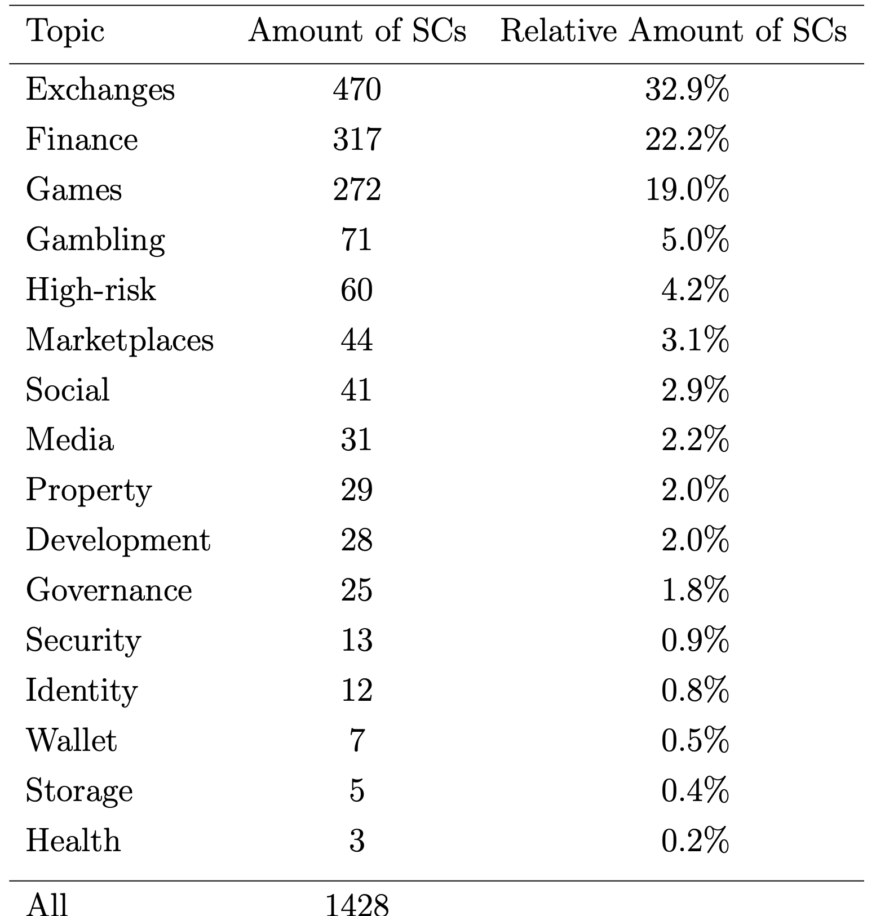
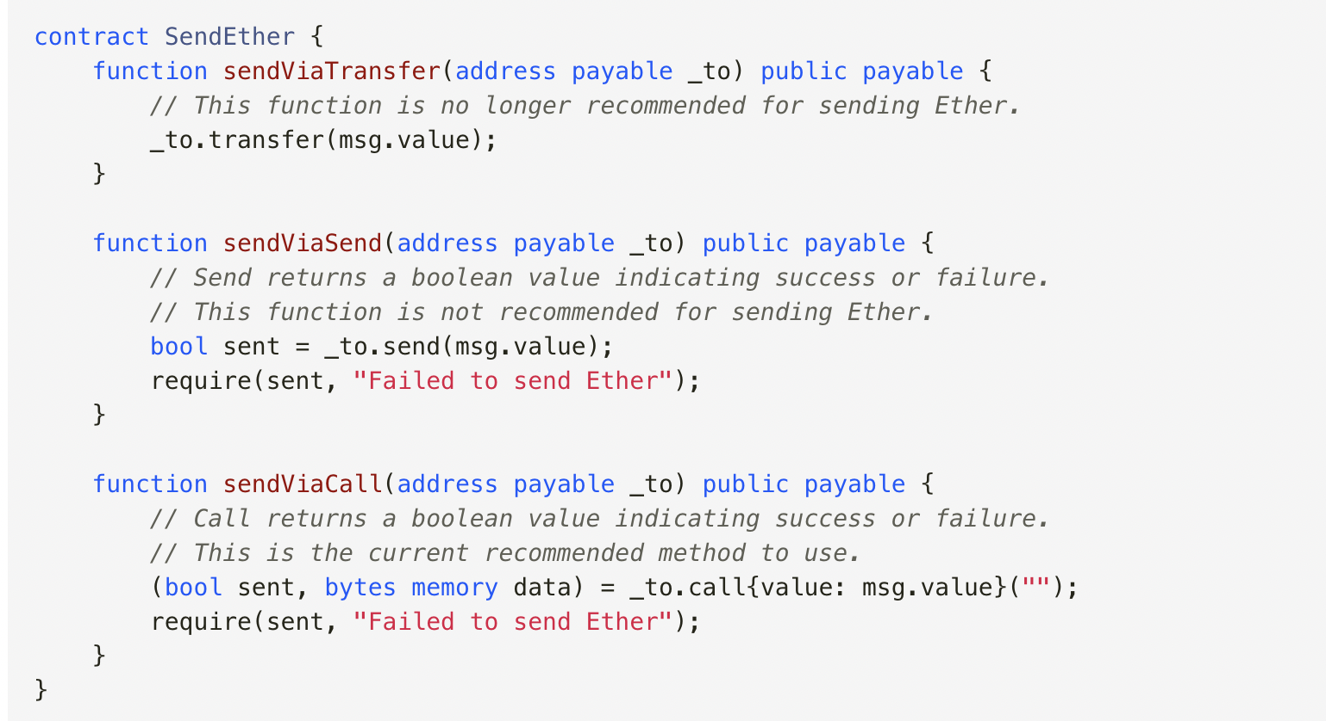
Background
Smart contracts
are autonomous computer programs running atop blockchains
have the unique ability to enable trustworthy and decentralized transactions

Slide 4
Approach
NLP techniques BERT to transform code to token representation
TF-IDF to encode into high-dimensional vectors
Lasso regression and other methods to select feature and classify

Slide 5
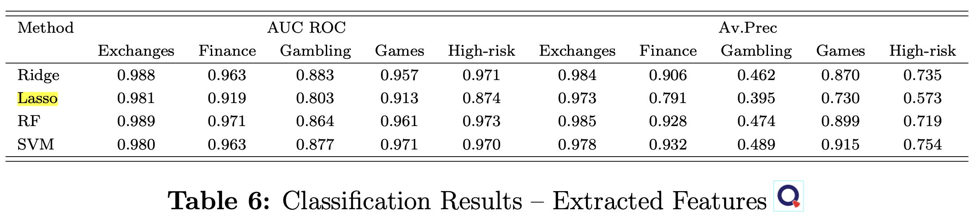
Evaluation

Slide 6
Discussion
Using code as text ignores essential characteristic of a program (AST, cfg, pdg)
Comments by developers are not reliable
Results could be too general to understand smart contract behavior

