Slide 1

Welcome to the
#GLOBALAZURE
KHARKIV, UKRAINE

Slide 2
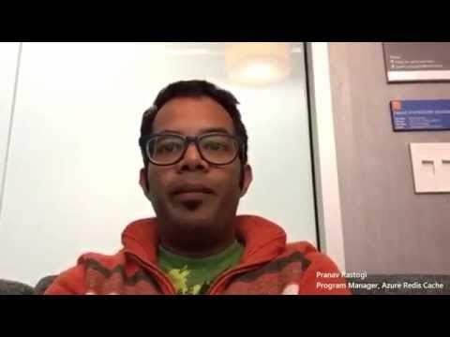

We welcome you, with support from some celebs

Slide 3















2015 Global Sponsors
Make sure to ask the organizers for the “Stuff We All Get” information!

Slide 4



Local Sponsors

Slide 5
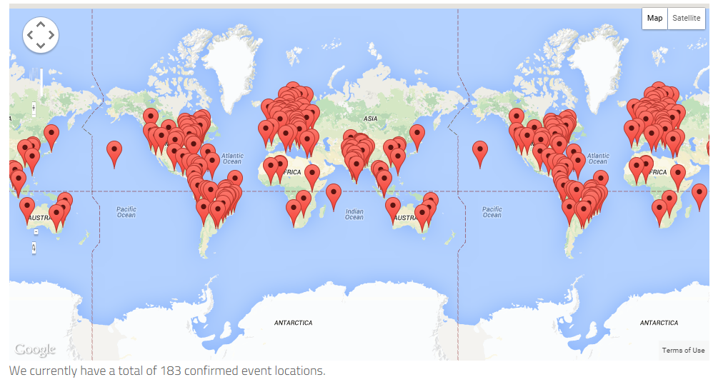
183 Locations

Slide 6
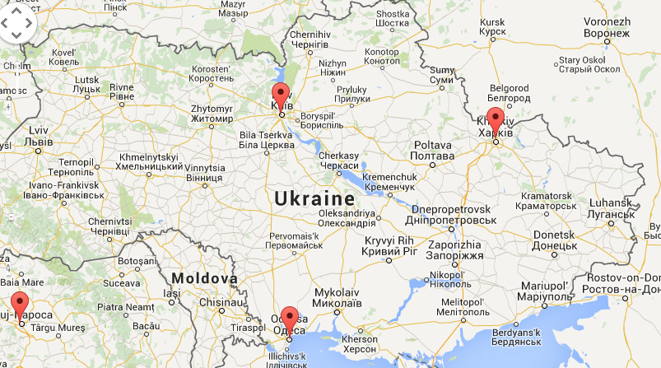
Three Locations in Ukraine

Slide 7
Wi-Fi
Please connect to the Wi-Fi network
Wi-Fi SID: Lab365_1, Lab365_2
Password: 12345678

Slide 8
Рассписание
10:00 | Приветствие
10:30 | Краткий обзор сервисов Microsoft Azure. Новинки и тренды, что и как используется в продакшене. Hands-on Lab – работа с порталом управления Windows Azure и подготовка среды разработки. | Павел Ревенков
12:00 | Миграция сервера приложений в Azure: Websites, Compute Services, VMs Hands-on Lab – миграция веб приложения | Дмитрий Михайлов
13:30 | Кофе-брейк, Обед
14.30 | Развертывание веб-приложения с использованием виртуальных серверов, настройка балансировки Hand-on Lab – миграция веб-приложения на Windows VM | Александр Фещенко
15:00 | Миграция базы данных в Azure: SQL Database, SQL VM Hand-on Lab – Работа с Azure Database, масштабирование | Сергей Криштоп
16.00 | Запуск Charity Lab & Racing Lab
16.30 | Розыграш подарков от спонсоров

Slide 9



The Charity Lab
This year the Global Azure Boot Camp event will help this effort by work by hosting a globally distributed lab in which attendees of the event will deploy virtual machines in Microsoft Azure to help analyze data needed for Breast Cancer research. We are applying PNNL’s latest distributed mass spectrometry analysis tools (GlyQ-IQ, Published May 2014) to discover how our body’s serum protein glycosylation responds to cancer subtypes. We want to know how the human disease response is altered based on the molecules presented on the cancer cell surfaces. The results from this work can hopefully lead to new therapeutics that can directly target different forms of cancer with minimal side effects.
“The power of the cloud is not just in scalable elastic servers that work together as one, but also the power of people working towards a singular goal. The Global Azure Bootcamp is thousands of folks working and learning together to be better developers, makers, and creators. This year they are also throwing their considerable weight behind the cause of breast cancer and I applaud them for it!”
Scott Hanselman
Principal Program Manager – Azure and Web Tools

Slide 10

If you have questions on the labs or issues
Use the HASHTAG
#GLOBALAZURELAB
And the organization will jump on it!

Slide 11
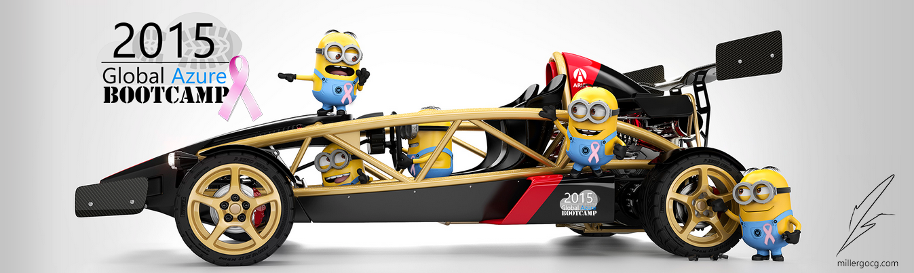
The Racing Lab
Be a good minion and drive a few laps ☺.
Logon with <ENTER COUNTRY CODE HERE> on
http://gabracing.azurewebsites.net

Slide 12
Please share our “little” event on the WWW by any means
Use the HASHTAG
#GLOBALAZURE
extensively

Slide 13
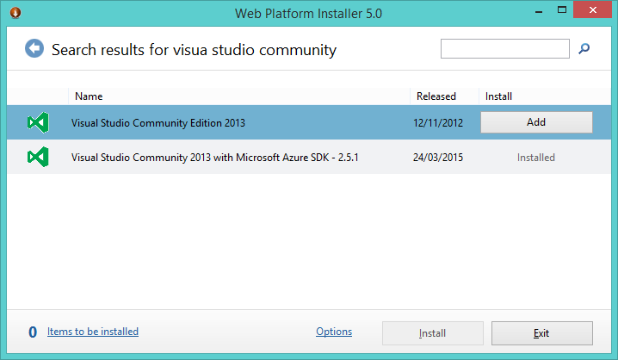
Don’t have the requirements?
Microsoft Azure Subscription: See email for azure pass, or request 90 day Trial, use MSDN benefits
To get all at once use the Web Platform Installer :
http://www.microsoft.com/web/downloads/platform.aspx
Visual Studio: 2013 or 2015 Community edition
Microsoft Azure SDK
Charity Lab: http://global.azurebootcamp.net/charity-lab

Slide 14
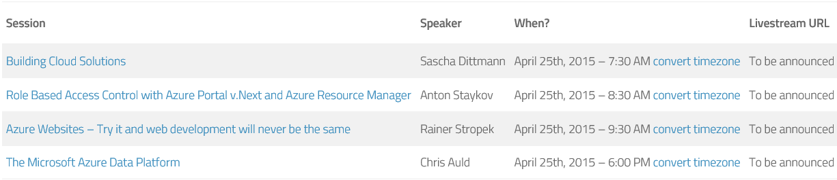

Hollywood’s listening
Don’t feel like there’s enough content already ? Hungry for more or in multi-tasking? Well there as full live stream available too from around the globe:

Slide 15
Find all the online locations here
http://bit.ly/gabflickr
http://bit.ly/gabtwitter http://bit.ly/gabfacebook

Slide 16
And most important we thank you all for sacrificing another Saturday!
Yours truly
the GLOBAL AZURE ORGANNIZERS AND LOCAL ORGANIZERS

Slide 17
Main Topic for Today
Migration to Cloud
Very often Enterprise has the systems which makes them money.
But they are looking for cost effective and flexible solutions.

Slide 18
Cloud Computing Essentials Characteristics
Self-service
Broad network access
Resource pooling
Rapid elasticity
Measured service
Definition by NIST
Notes:
http://csrc.nist.gov/publications/nistpubs/800-145/SP800-145.pdf

Slide 19
Phases of Cloud Migration
Data Migration
Application Migration
Proof of Concept
Cloud Assessment
Optimization
Leveraging the Cloud

Slide 20
Cloud Assessment Phase
Estimating Cost
Assess Security
Identify the tools for Migration

Slide 21
Proof of Concept Phase
Run products on cloud
Assess different PaaS and IaaS services

Slide 22
Data Migration Phase
Migrate database
Migrate content
Configure Backups
Run Hybrid Cloud solution

Slide 23
Moving your Apps Phase
Forklift migration strategy
Hybrid migration strategy
Build “cloud-aware” layers of code as needed
Apply Cloud Design Patterns

Slide 24
Leveraging the Cloud & Optimize Phases
Learn from experience
Optimize service usage on demand
Re-engineer the application

Slide 25
Required Skills
Cloud Platform Expertise
Instrumentation (PowerShell, Azure CLI)
Cloud Application Design Patterns

Slide 26
First two we start covering today
Cloud Platform Expertise
Instrumentation (DevOps practices)
Cloud Application Design Patterns

Slide 27
Cloud Application Design Patterns Links
Cloud Design Patterns: Prescriptive Architecture Guidance for Cloud Applications
https://msdn.microsoft.com/en-us/library/dn568099.aspx
Failsafe: Guidance for Resilient Cloud Architect
https://msdn.microsoft.com/en-us/library/azure/jj853352.aspx
and more…

Slide 28
Let’s Start!

