Slide 1

Welcome to the
KHARKIV, UKRAINE

Slide 2
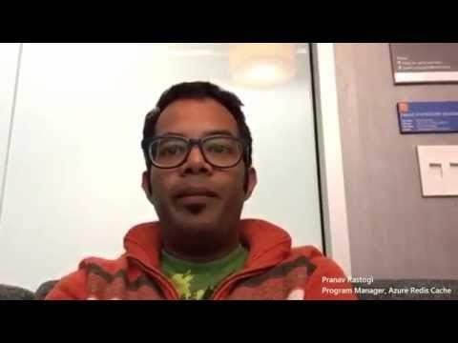

We welcome you, with support from some celebs

Slide 3















2015 Global Sponsors
Make sure to ask the organizers for the “Stuff We All Get” information!

Slide 4



Local Sponsors

Slide 5
Wi-Fi
Please connect to the Wi-Fi network
Wi-Fi SID: <Enter Name>
User Name: <Enter name>
Password: <Enter password>
You may need to open a browser to connect.

Slide 6
Today's Schedule – FREE TO CHANGE
Time | Activity / Session Title | Hands on
8:30 – 9:00 | Guest arrival, Registration
9:00 – 9:15 | Introduction to Global Azure Bootcamp
9:15 – 10:15 | <<ENTER SESSIONS HERE>> | Feel free to work on an azure lab, your azure project or ask tough questions to the azure experts!
10:15 – 10:50 | Research Lab
11:00 – 11:50 | <<ENTER SESSIONS HERE>>
12:00 – 13:00 | Lunch
13:00 – 13:50 | <<ENTER SESSIONS HERE>>
14:00 – 14:50 | <<ENTER SESSIONS HERE>> | Feel free to work on an azure lab, your azure project or ask tough questions to the azure experts!
15:00 – 15:50 | <<ENTER SESSIONS HERE>>
16:00 – 16:50 | <<ENTER SESSIONS HERE>>
16:50 – 17:00 | Closing Remarks, Questions, Raffle & Guest Departure

Slide 7

The Lab(s) – Enter Mad Scientist Mode
There’s a couple of surprises here ……
NOT ONE BUT 2 LABS THIS YEAR!
We pulled a Dr. Evil on you!

Slide 8



The Charity Lab
This year the Global Azure Boot Camp event will help this effort by work by hosting a globally distributed lab in which attendees of the event will deploy virtual machines in Microsoft Azure to help analyze data needed for Breast Cancer research. We are applying PNNL’s latest distributed mass spectrometry analysis tools (GlyQ-IQ, Published May 2014) to discover how our body’s serum protein glycosylation responds to cancer subtypes. We want to know how the human disease response is altered based on the molecules presented on the cancer cell surfaces. The results from this work can hopefully lead to new therapeutics that can directly target different forms of cancer with minimal side effects.
“The power of the cloud is not just in scalable elastic servers that work together as one, but also the power of people working towards a singular goal. The Global Azure Bootcamp is thousands of folks working and learning together to be better developers, makers, and creators. This year they are also throwing their considerable weight behind the cause of breast cancer and I applaud them for it!”
Scott Hanselman
Principal Program Manager – Azure and Web Tools

Slide 9

If you have questions on the labs or issues
Use the HASHTAG
#GLOBALAZURELAB
And the organization will jump on it!

Slide 10
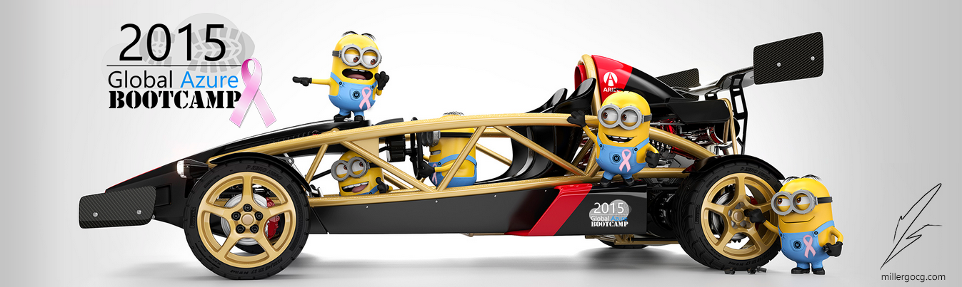
The Racing Lab
Be a good minion and drive a few laps ☺.
Logon with <ENTER COUNTRY CODE HERE> on
http://gabracing.azurewebsites.net

Slide 11
Please share our “little” event on the WWW by any means
Use the HASHTAG
#GLOBALAZURE
extensively

Slide 12
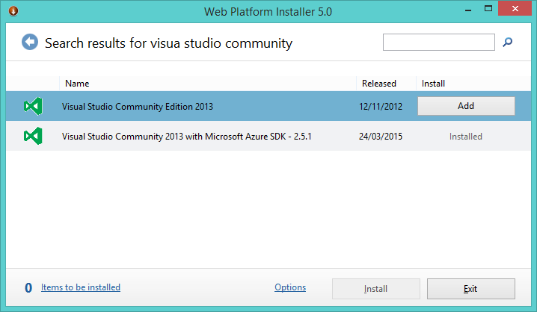
Don’t have the requirements?
Microsoft Azure Subscription: See email for azure pass, or request 90 day Trial, use MSDN benefits
To get all at once use the Web Platform Installer :
http://www.microsoft.com/web/downloads/platform.aspx
Visual Studio: 2013 or 2015 Community edition
Microsoft Azure SDK
Charity Lab: http://global.azurebootcamp.net/charity-lab

Slide 13
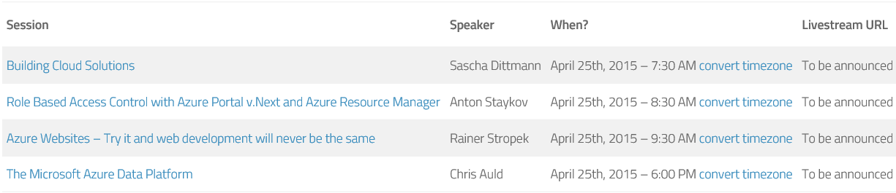

Hollywood’s listening
Don’t feel like there’s enough content already ? Hungry for more or in multi-tasking? Well there as full live stream available too from around the globe:

Slide 14
Find all the online locations here
http://bit.ly/gabflickr
http://bit.ly/gabtwitter http://bit.ly/gabfacebook

Slide 15
And most important we thank you all for sacrificing another Saturday!
Yours truly
the GLOBAL AZURE ORGANNIZERS AND LOCAL ORGANIZERS

