Slide 1
Appendix B: An Example of Back-propagation algorithm
November 2011
http://www.cse.hcmut.edu.vn/~dtanh/teaching.htm

Slide 2
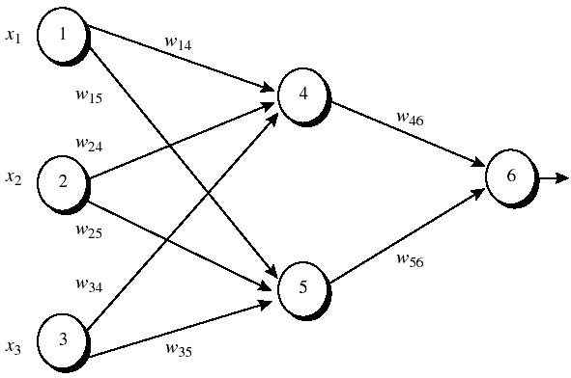
Figure 1: An example of a multilayer feed-forward neural network. Assume that the learning rate η is 0.9 and the first training example, X = (1,0,1) whose class label is 1.
Note: The sigmoid function is applied to hidden layer and output layer.

Slide 3
Table 1: Initial input and weight values
x₁ x₂ x₃ w₁₄ w₁₅ w₂₄ w₂₅ w₃₄ w₃₅ w₄₆ w₅₆ w₀₄ w₀₅ w₀₆
-----------------------------------------------------------------------------------
1 0 1 0.2 -0.3 0.4 0.1 -0.5 0.2 -0.3 -0.2 -0.4 0.2 0.1
Table 2: The net input and output calculation
Unit j Net input I_{j} Output O_{j}
-----------------------------------------------------------------------------------
4 0.2 + 0 -0.5 -0.4 = -0.7 1/(1+e^{0.7})=0.332
5 -0.3 +0+0.2 +0.2 =0.1 1/(1+e^{0.1})=0.525
6 (-0.3)(0.332)-(0.2)(0.525)+0.1 = -0.105 1/(1+e^{0.105})=0.474
Table 3: Calculation of the error at each node
Unit j δ_{j}
-----------------------------------------------------------------------------
6 (0.474)(1-0.474)(1-0.474)=0.1311
5 (0.525)(1-0.525)(0.1311)(-0.2)=-0.0065
4 (0.332)(1-0.332)(0.1311)(-0.3)=-0.0087

Slide 4
Table 4: Calculation for weight updating
Weight New value
------------------------------------------------------------------------------
w₄₆ -03+(0.9)(0.1311)(0.332)= -0.261
w₅₆ -0.2+(0.9)(0.1311)(0.525)= -0.138
w₁₄ 0.2 +(0.9)(-0.0087)(1) = 0.192
w₁₅ -0.3 +(0.9)(-0.0065)(1) = -0.306
w₂₄ 0.4+ (0.9)(-0.0087)(0) = 0.4
w₂₅ 0.1+ (0.9)(-0.0065)(0) = 0.1
w₃₄ -0.5+ (0.9)(-0.0087)(1) = -0.508
w₃₅ 0.2 + (0.9)(-0.0065)(1) = 0.194
w₀₆ 0.1 + (0.9)(0.1311) = 0.218
w₀₅ 0.2 + (0.9)(-0.0065)=0.194
w₀₄ -0.4 +(0.9)(-0.0087) = -0.408

