Slide 1





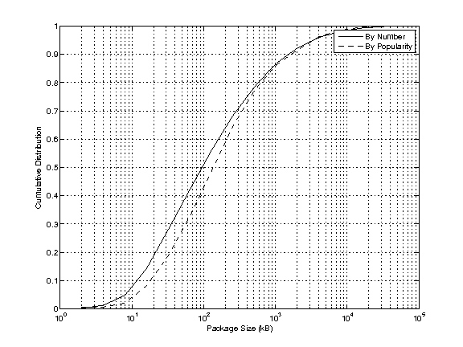


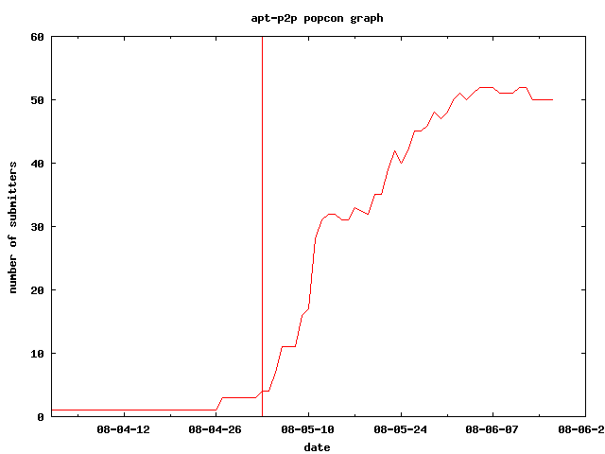
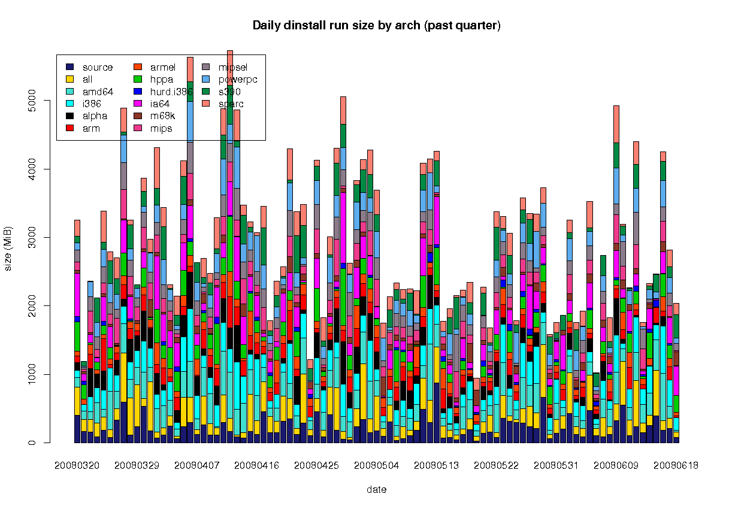


Leveraging Altruistic Peers to Reduce the Bandwidth Costs of Free Content Downloads
Cameron Dale (camerond@cs.sfu.ca) and Jiangchuan Liu, Simon Fraser University
Opportunity and Motivation
Requirements
Customized DHT
files are available to everyone for free
cryptographic hash of the file is available before downloading
all content is divided into packages
altruistic users exist who are willing to contribute upload bandwidth
simple to implement, as unique implementations are required for different systems
work with the existing mirrors unmodified
no undue burden is placed on any peers
fast lookup times to support interactive downloading
fast download times using techniques borrowed from other P2P programs (BitTorrent)
modified version of Kademlia using many ideas from the BitTorrent tracker-less DHT
everything is stored as bencoded dictionaries (like BitTorrent), making enhancements easy
peers store their location (IP/port) value at the key that is the cryptographic hash of the package
modified to support multiple values (peers) per key (package)
improved lookup times (still needs work)
large packages are broken up into 512 kB pieces, and the piece hashes are stored in the DHT
A few of the groups that could benefit
Cygwin
Proposed Model
Piece Storage Strategy
operates as a proxy (1, 7) between the package downloader and the server/peers
peers for individual packages are found in the DHT (2, 3)
packages are downloaded from peers (5a, 6a)
packages that can not be found in peers fall back to downloading from the server (5b, 6b)
a single piece
  no piece hashes are needed
  peers store only their location
a few pieces
  hash the pieces of the package
  store the piece hashes with the peer location at the package's hash key
10's of pieces
  too many pieces to store with the peer location
  hash the list of piece hashes to get a piece hash key
  store the list of piece hashes at the piece hash key
  store the piece hash key with the peer location at the package hash key
100's or 1000's of pieces
  too many pieces to store in the DHT
  hash the list of piece hashes to get a piece hash key
  save the list of piece hashes so others can request it using the piece hash key
  store the piece hash key with the peer location at the package hash key
Problems to be Solved
users are only interested in a small percentage of the total packages available
Local Node
Server
Package
Downloader
1
DHT
4
Proxy
Downloader
5b
2
3
5a
6a
6b
Remote Peers
DHT
Peer
Server
Debian users are typically only interested in less than 5% of the 23,000 packages available to them.
packages are mostly small in size, but some can be very large
Example Implementation: apt-p2p
The Current Situation
caching HTTP proxy for Debian's APT package download program
DHT is based on Khashmir
all peers are HTTP/1.1 servers, which support pipelining multiple requests and Range requests for pieces of a package
servers are also HTTP-based, and so are used almost identically as peers
implementation is available for any Debian user to install in the apt-p2p package
Mirror Network
Server
Server
Server
Server
Client
Client
Client
Client
Client
Client
Client
Client
Client
Client
Client
Client
CDF of Debian's package size, both by the number of packages, and taking into account the popularity of each package. 80% of packages are less than 1 MB, but a few packages are hundreds of MB.
Client
Client
Client
Client
Client
Client
Client
Client
Client
Incremental Deployment as Users Slowly Adopt P2P System
Client
a small percentage of packages are updated regularly (daily)
Early P2P System
Mirror Network
Server
Server
Server
Server
Client
Client
Client
Client
Client
Client
The popularity of the apt-p2p example implementation program in Debian. The line indicates the first upload to the archive on May 2. Not all users report popcon statistics so the numbers are a lower bound, and in reality are probably larger by a factor of 2 or 3.
Client
Peer
Client
Peer
Peer
Client
Client
Peer
Client
Client
Peer
Peer
Client
Client
The size of Debian's daily archive updates, broken up by architecture. Approximately 1% (by size) of the 119,000 MB archive is updated every day.
Peer
Eventually Word Spreads and P2P System Gains Popularity
Peer
Final Deployment
Mirror Network
Server
Server
Server
Server
Client
Peer
Client
Peer
Peer
Client
Peer
Peer
Peer
Peer
Peer
Peer
Peer
Peer
Peer
Peer
Peer
Peer
Peer
Peer
Peer
Peer

