Slide 1
International study centre
An Introduction to object-orientation and the java programming language:
Control Structures
Name : John Alamina
Email : john.alamina@hud.ac.uk

Slide 2
Outline
Types of Control Structure
Sequential Control
Expression types
Selection Control
Unconditional-if
Conditional-if
Bi-conditional if
Cascaded-if
Nested-if
Switch-statements
Iteration Control
Classes of loops
While
do-while
for-loop
Nested-Loops
Arrays
Exercises

Slide 3
Types of control Structures
Sequential
Selection (branch)
Iteration (loop)

Slide 4
Sequential Statements
Commands
Declaration e.g: int x;
Assignment e.g. int x=45;
Expressions e.g. z= x+y;
Method calls e.g. Math.sin(x);

Slide 5
Any Questions?

Slide 6
Selection (Branch) control
Control structures that are not sequential in nature by default will contain a condition statement.
That is, execution will follow two or more different paths.
Any condition that all paths never lead to previously executed statements is a selection.
However, if any path returns back to a previously executed statement those set of statements are in a loop control.

Slide 7
Selection types
Unconditional if
Conditional-if
Bi-conditional if
Cascaded-if
Nested-if
Switch statement

Slide 8
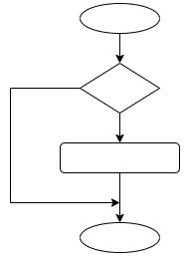
Unconditional-if
Has
1 Condition
1 Branch
0 cascades

Slide 9
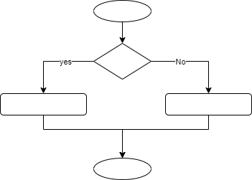
Conditional-if
Has
1 Condition
2 Branches
0 cascades

Slide 10
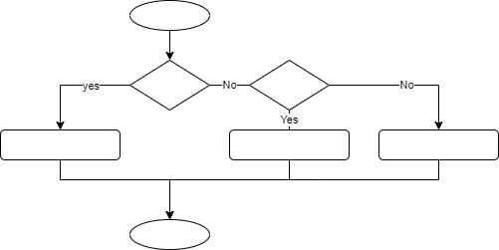
Bi-Conditional-if
Has
2 Conditions
3 Branches
1 cascade

Slide 11
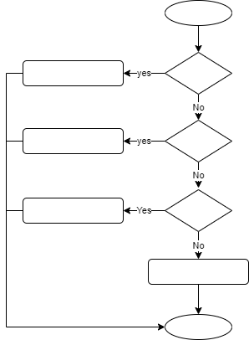
Cascaded-if
Has
3+ Conditions
4+ Branches
2+ cascade

Slide 12
Branch Example
public class Selection{
public static void main (String[] a){
int A=5; // A is going to be temperature in degrees C
if(A==0){
System.out.println( " Freezing! " ); //
}else if(A<0){
System.out.println( " Sub Zero " ); //
}else{
System.out.println( " Above zero " );
}
}
}

Slide 13
Any Questions?

Slide 14
Switch-statements
public class Cascade{ public static void main(String []ar){ int a=10, b=20; char op='+'; int c=0; switch(op) { case '+': c = a + b; break; case '-': c = a - b; break; default: break; } System.out.println(c); } }

Slide 15
Conditional Expression
This is a single expression that is equivalent to a conditional-if statement
String a = age>20?”adult”:”under-age”;
ternary operator (expression) takes:
condition
true value
false value
The equivalent algorithm looks like this
The equivalent conditional-if statement is this
String a;
if (age>20){a=“adult”;}else{a=“under-age”;}
age>20
a=adult
a=under-age

Slide 16
Any Questions?

Slide 17
Nested-if
The difference between nested and cascaded-if is that for a nested--if Post-condition is predicated on precondition being true while for the cascaded if, post condition is predicated on the precondition being false

Slide 18
Nested-if example
public class NestedIf{
public static void main(String []ar){
String pin=“1000”; int bal=20;
if(pin.equals(“1000”) {
if (bal>20)
System.out.println(“can withdraw”);
else
System.out.println(“insufficient balance”);
}else
System.out.println(“invalid pin”);
}
}

Slide 19
Any Questions?

Slide 20
Iteration (Loop) control
Control structures that are not sequential in nature by default will contain a condition statement.
That is, execution will follow two or more different paths.
Any condition that all paths never lead to previously executed statements is a selection.
However, if any path does return back to a previously executed statement those set of statements are in a loop control.

Slide 21
Loop Structure can have any of the following
Count Initializer
Loop body
count update statement
Stop condition
counter=5
str.charAt(counter)
counter--
NO
counter==0?
YES

Slide 22
Loop Classes
Deterministic
Non-deterministic
Pre-condition (for, and while loops)
Post-condition (do-while loop)
Infinite
finite
Nested

Slide 23
Loop class characteristics
Loop Class | Initialiser | Update | Can also be | Stop condition
Deterministic | ☑ | ☑ | Pre-post-finite | ☑
Non-deterministic | ☒ | ☒ | Pre-post-finite | ☑
Pre-condition | ☒☑ | ☒☑ | Deterministic-non-deterministic- finite | ☒☑
Post-condition | ☒☑ | ☒☑ | Deterministic-non-deterministic- finite | ☒☑
Infinite | ☒ | ☒ | Non-deterministic | ☒
finite | ☒☑ | ☒☑ | Pre-post-deterministic-non-deterministic | ☑

Slide 24
Loop Example
public class Control{ public static void main(String []a){ int length; int width; for(int i=0;i<length;i++){ for(int j=0;j<width;j++){ System.out.print("*"); } system.out.println("\n"); } } }

Slide 25
Arrays
Storage for a collection of similar types (primitive or advanced) defined with a single variable known as an array.
Arrays are indexed collections where each element within the array is accessed using an ordered sequence of positive whole numbers starting from zero.
Can be iterated (accessed sequentially in order) using a deterministic loop.
Arrays in themselves are objects. They need to be instantiated using the “new” keyword.
n-dimensional arrays can be iterated using nested loops.
Values of arrays for primitive types are defaulted to 0

Slide 26
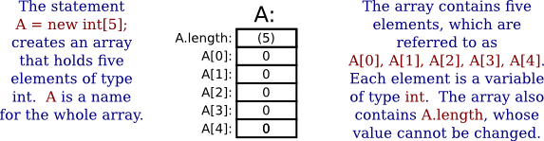
Using arrays
//Store 3 Numbers using an integer variable;
int i=5;
i=6;
i=7;
System.out.println(“”+i); //only stores the most recent value
int i1=5,i2=6,i3=7;
System.out.println(“”+i1+” “+i2+” “+i3); //works but will be difficult for storing large number of values
int [] arr=new int[3]; //declare array
arr[0]=5; arr[1]=6; arr[2]=7;//array assignment starting from zero.
for(int i=0;i<arr.length;i++)System.out.print(arr[i]);//iterating an array
math.hws.edu/javanotes/c3/s8.html

Slide 27
Any Questions?

Slide 28
Exercises
A) Write a program to determine whether the value of an integer variable initialised with the name temp is sub-zero, above zero degrees, exactly zero degrees. If above zero it should display “Above Zero”. If exactly zero it should display “Freezing” and if under zero should display “Sub zero”.
B) What type of branch control structure is this program?
Write a Java program that will output the grade of an integer score entered into the program. 70-100 is a A, 60-69 is a B, 50-59 is a C, 45-49 is a D, 40-44 is an E, and 0-39 is a R. The program should only exit when a value outside these ranges is entered.
B) What type of loop control structure is this program?
For each of the above two programs, draw the equivalent flowchart and paste the draw.io image and url to the padlet board

Slide 29
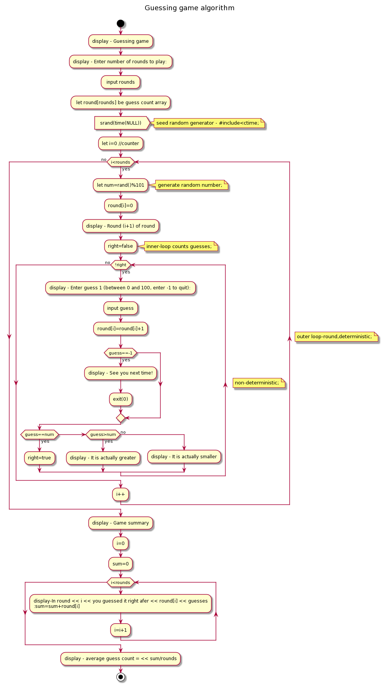
Take-home exercise
Write a Java class to implement the guessing game given by the following algorithm (ctrl-click image to enlarge)

Slide 30
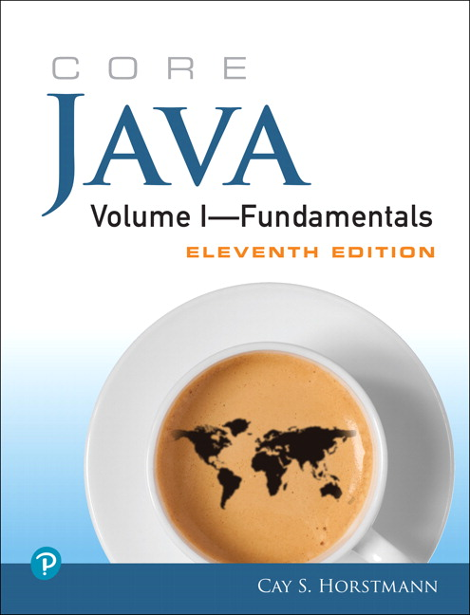
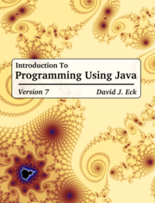
Supplementary material
The Java Tutorial
Java API documentation
Link to today’s Session screencast
Link to John’s Group Padlet
Link to Kelly’s Group Padlet

