Slide 1
International study centre
An Introduction to object-orientation and the java programming language
Name : John Alamina
Email : john.alamina@hud.ac.uk

Slide 2
Outline
Object Oriented programming
Abstraction, Encapsulation, Inheritance and polymorphism
OOP keywords
Class diagrams
Class example
Class members
Object Instantiation
Constructors
this pointer
String class

Slide 3
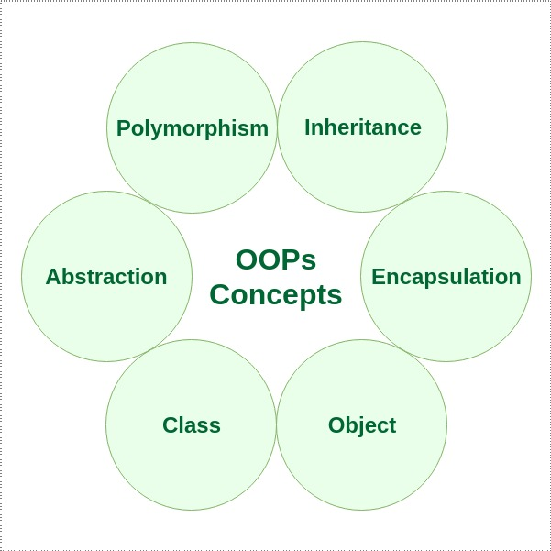
Object-Orientation.
Object-orientation is a software design concept which is used to build systems from a collection of reusable components called objects.
Objects contain data in the form of fields and functionality in the form of procedures. These are grouped together to represent an entity.
Object-oriented design involves defining the objects and their interactions to solve a problem.

Slide 4
Features of Object-oriented Designs.
Abstraction – The identification/description of the essential characteristics of an item.
Encapsulation – The grouping of related concepts into one item, such as a class or component
Inheritance – Inheritance enables new classes to receive the properties and methods of an existing class.
Polymorphism – The ability of different object to respond to the same message in different ways.

Slide 5
Any Questions?

Slide 6
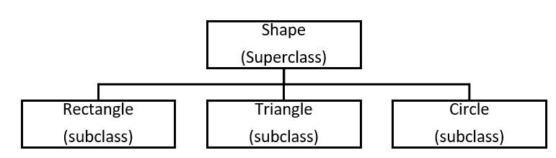
Terms Used in Object-oriented Design.
Object – An instance of a person, place, thing, event, concept, screen or report.
Class – A template from which objects are created, it is a software abstraction of a group of objects with common properties (Attributes), behaviour (operations).
Subclass – If class “B” inherits from class “A”, class “B” is a subclass of “A” and “A” is a superclass of “B”.
Abstract class – A class that does not have objects created from it.
Association – Relationship between objects.

Slide 7
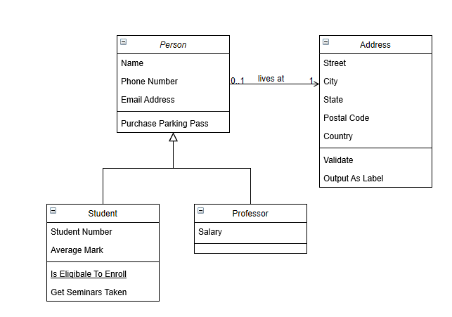
Working with class diagrams
Go to www.draw.io >> choose “save diagrams to device” >> click “create new diagram” >> select “Class Diagram”.
The following example should be shown on your screen:

Slide 8
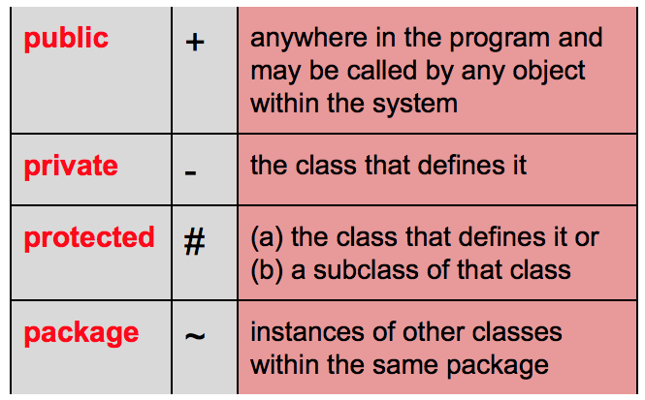
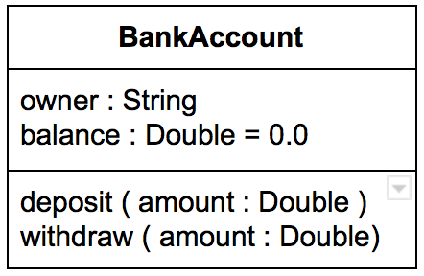
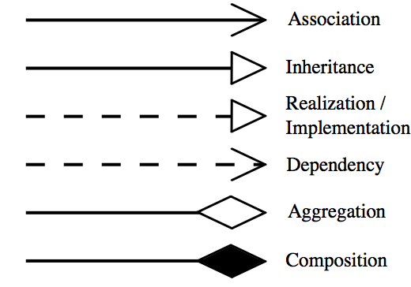
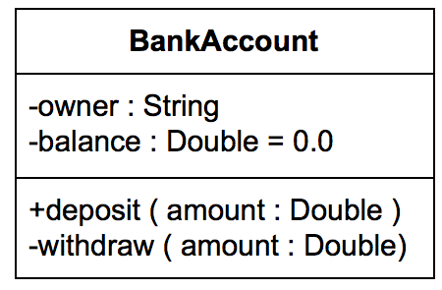
Representations in UML.
Visibility of class members
Class Representation
Class name
Class attributes
Class methods
Relationships

Slide 9
Any Questions?

Slide 10
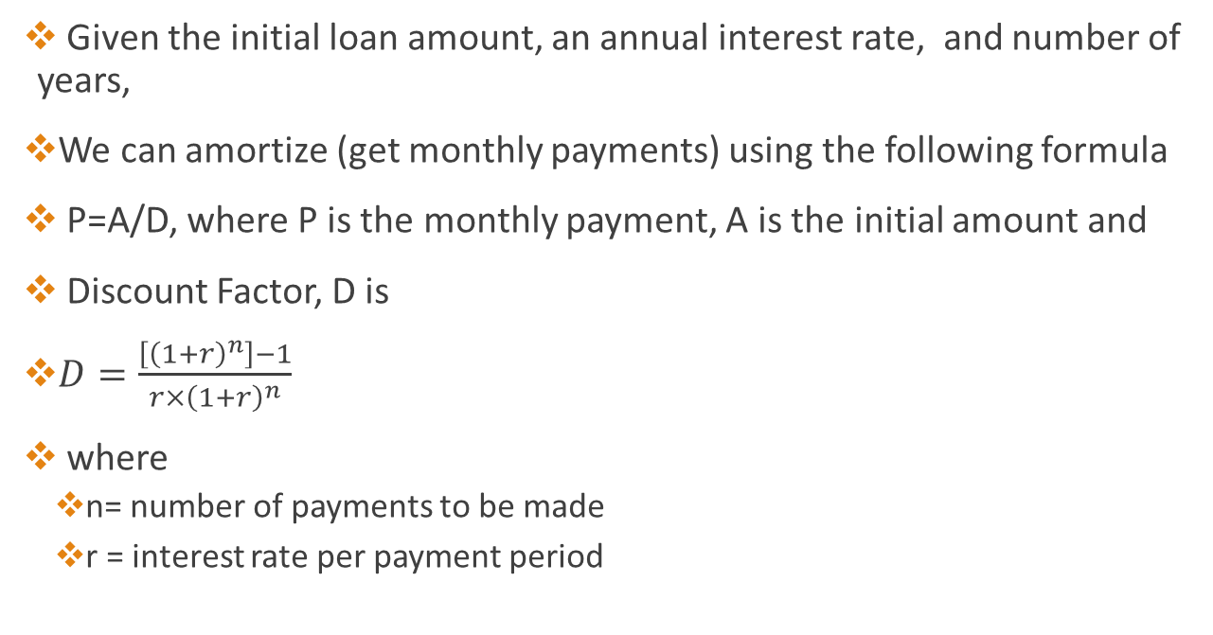
Loan Calculator Example
Given the initial loan amount, an annual interest rate, and number of years,
We can amortize (get monthly payments) using the following formula
P=A/D, where P is the monthly payment, A is the initial amount and
Discount Factor, D is
$D=\frac{\left[{\left(1+r\right)}^{n}\right]−1}{r×{\left(1+r\right)}^{n}}$
where
n= number of payments to be made
r = interest rate per payment period

Slide 11
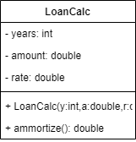
Loan Calculator Class diagram
public class LoanCalc{ private int yrs; private double rate; private double amount; public LoanCalc(int y,double r, double a){ this.rate=r; this.amount=a; this.yrs=y; } public double ammortize() { double r=rate/(100*12); double n=yrs*12; double a=amount; double d = (Math.pow((1 + r),n)- 1)/ (r*Math.pow((1 + r),n)); return a/d ; } public static void main(String ar[]){ int y=7;int r=3;double a=10000; LoanCalc carloan=new LoanCalc(y,r,a); double p=carloan.ammortize(); System.out.println(String.format("monthly payments on %3.2f for %dyrs at %d%% is %3.2f",a,y,r,p)); } }

Slide 12
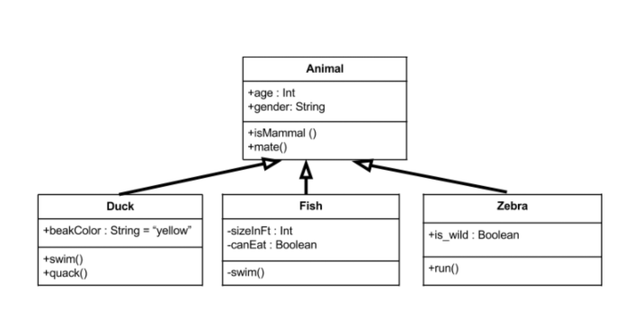
Inheritance Example
Animal is the super class. Duck, Fish, and Zebra are subclasses and they inherit all the members from the superclass. The subclasses also have their own attributes and methods.

Slide 13
The String Class
Although string literals are the same in C++ and Java,
There are two types of string variables in C++, the character array and the string object in the standard namespace.
In Java the string variable is represented as a String object in the Java.lang package.
Declaring and assigning a value to a string object.
String s;
s = “hello world!”;
Declaring a string object using the constructor
String s = new String(“Hello world”);

Slide 14
String methods (operations)
s1.equals(s2)
s1.equalsIgnoreCase(s2)
s1.length()
s1.charAt(N)
s1.substring(N,M)
s1.indexOf(s2)
s1.compareTo(s2)
s1.toUpperCase()
s1.toLowerCase().
s1.trim()
s1.format()
Notes:
s1.equals(s2) is a function that returns a boolean value. It returns true if s1 consists of exactly the same sequence of characters as s2, and returns false otherwise.
s1.equalsIgnoreCase(s2) is another boolean-valued function that checks whether s1 is the same string as s2, but this function considers upper and lower case letters to be equivalent. Thus, if s1 is "cat", then s1.equals("Cat") is false, while s1.equalsIgnoreCase("Cat") is true.
s1.length(), as mentioned above, is an integer-valued function that gives the number of characters in s1.
s1.charAt(N), where N is an integer, returns a value of type char. It returns the Nth character in the string. Positions are numbered starting with 0, so s1.charAt(0) is actually the first character, s1.charAt(1) is the second, and so on. The final position is s1.length() - 1. For example, the value of "cat".charAt(1) is 'a'. An error occurs if the value of the parameter is less than zero or is greater than or equal to s1.length().
s1.substring(N,M), where N and M are integers, returns a value of type String. The returned value consists of the characters of s1 in positions N, N+1,..., M-1. Note that the character in position M is not included. The returned value is called a substring of s1. The subroutine s1.substring(N) returns the substring of s1 consisting of characters starting at position N up until the end of the string.
s1.indexOf(s2) returns an integer. If s2 occurs as a substring of s1, then the returned value is the starting position of that substring. Otherwise, the returned value is -1. You can also use s1.indexOf(ch) to search for a char, ch, in s1. To find the first occurrence of x at or after position N, you can use s1.indexOf(x,N). To find the last occurrence of x in s1, use s1.lastIndexOf(x).
s1.compareTo(s2) is an integer-valued function that compares the two strings. If the strings are equal, the value returned is zero. If s1 is less than s2, the value returned is a number less than zero, and if s1 is greater than s2, the value returned is some number greater than zero. There is also a function s1.compareToIgnoreCase(s2). (If both of the strings consist entirely of lower case letters, or if they consist entirely of upper case letters, then "less than" and "greater than" refer to alphabetical order. Otherwise, the ordering is more complicated.)
s1.toUpperCase() is a String-valued function that returns a new string that is equal to s1, except that any lower case letters in s1 have been converted to upper case. For example, "Cat".toUpperCase() is the string "CAT". There is also a function s1.toLowerCase().
s1.trim() is a String-valued function that returns a new string that is equal to s1 except that any non-printing characters such as spaces and tabs have been trimmed from the beginning and from the end of the string. Thus, if s1 has the value "fred ", then s1.trim() is the string "fred", with the spaces at the end removed.

Slide 15
Any Questions?

Slide 16
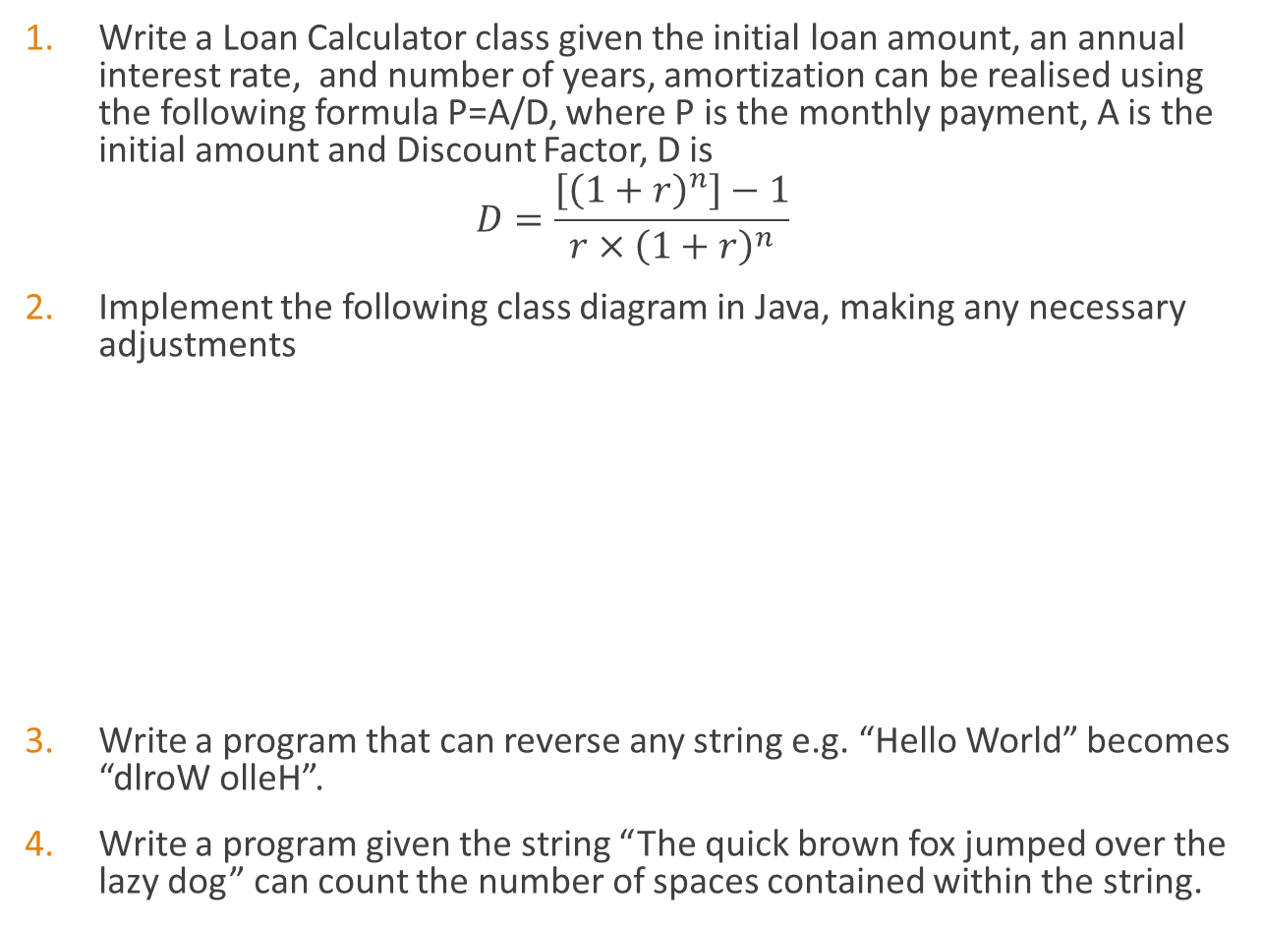
Exercises
Write a Loan Calculator class given the initial loan amount, an annual interest rate, and number of years, amortization can be realised using the following formula P=A/D, where P is the monthly payment, A is the initial amount and Discount Factor, D is
$$D=\frac{\left[{\left(1+r\right)}^{n}\right]−1}{r×{\left(1+r\right)}^{n}}$$
Implement the following class diagram in Java, making any necessary adjustments
Write a program that can reverse any string e.g. “Hello World” becomes “dlroW olleH”.
Write a program given the string “The quick brown fox jumped over the lazy dog” can count the number of spaces contained within the string.

Slide 17
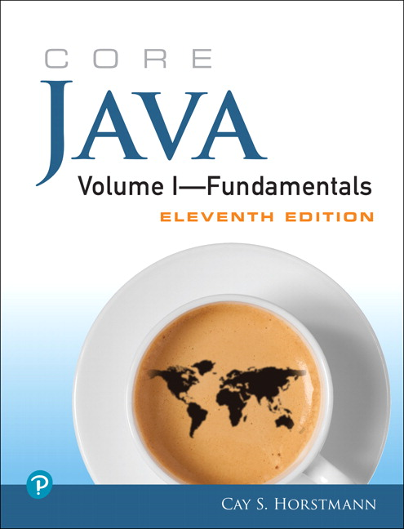
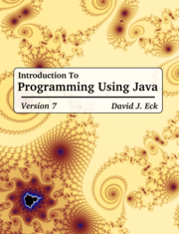
Supplementary material
The Java Tutorial
Java API documentation
Link to today’s Session screencast
Link to John’s Group Padlet
Link to Kelly’s Group Padlet

