Slide 1
Registry Researcher Environment, Research and Enterprise
Thesis Submission Briefing Session
October 2019
Mrs Heather Lee Dr Lianne Stennett
Assistant Registrar, PGR Researcher Development Officer
registryresearch@hud.ac.uk pgrskills@hud.ac.uk

Slide 2
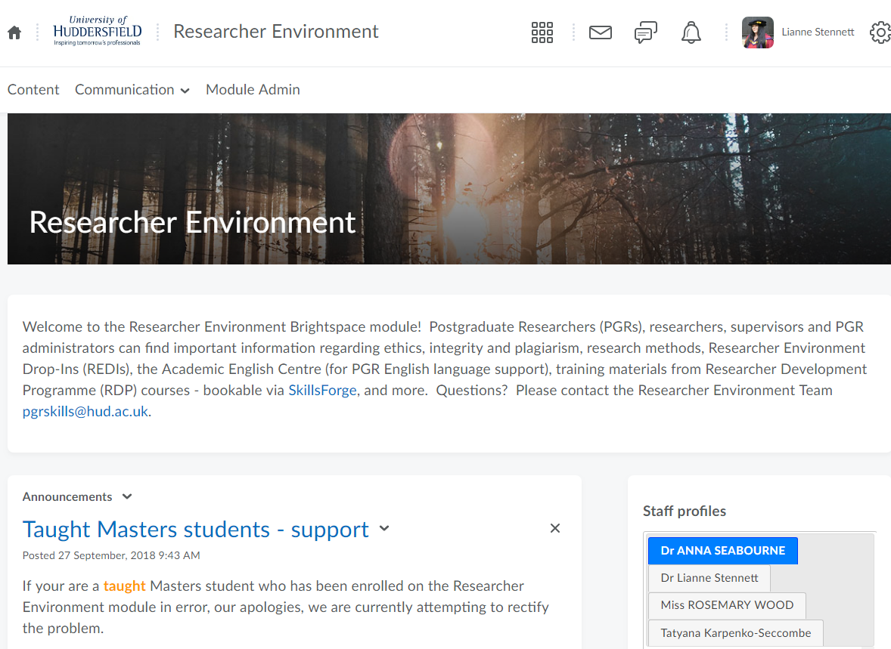

Slide 3
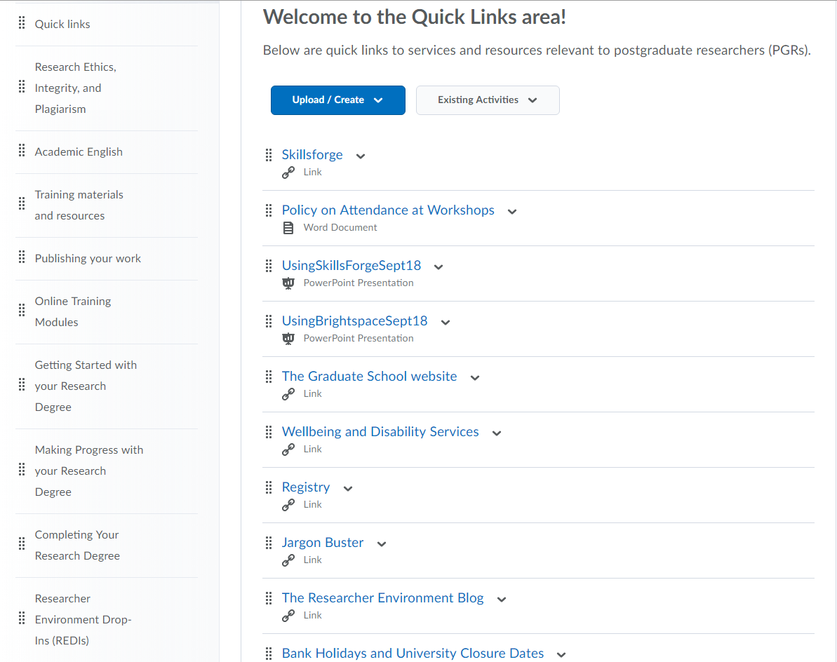

Slide 4

Purpose of the session
Navigating the thesis submission process can be a stressful time for PGRs.
This session is designed to take you through the processes, deadlines and paperwork so you know what you need to do and when to do it.

Slide 5
Agenda
Initial questions?
Purpose and introduction
Pre-submission deadlines: Jobs for PGRs and jobs for main supervisor
The final draft
Plagiarism and referencing
Presentation regulations: Presentation, word count, copyright, thesis binding
Submission: Electronic and paper submission, paperwork and checklists
What happens next?
The viva: Outcomes
Getting your result
Graduation
Things to watch out for: mental health, wellbeing and common issues/mistakes
Q&A
Your views

Slide 6
Pre-submission deadlines
If you are planning to submit on or before your submission date, you do not need to fill in any forms.
If you need more time, complete the:
Application for additional time form.
This form should be completed by the PGR and submitted to your School PGR admin office a minimum of 3 months before you are due to submit your thesis.
Where do I find this form? Please see the Registry webpages.

Slide 7
Pre-submission deadlines
What is the difference between ‘Additional Research Time’ and ‘Additional Writing-up time’? Does it matter which one I apply for?
Answer: YES! Read the guidance located here.
Additional Research Time is for PGRs who are still actively collecting and analysing data and who still need regular supervisory input.
Max 12 months doctoral; Max 4 months master’s. Both FT and PT
Additional Writing-up time is for PGRs who have completed data collection and analysis, need reduced supervisory input and are concentrating on writing.
Max 12 months doctoral; Max 4 month’s master’s. Both FT and PT

Slide 8
Pre-submission deadlines
Important notes!
You cannot apply for ‘Additional Research Time’ once you have entered ‘Additional Writing-up Time’.
If you apply for both maximums, but then decide you do not need that much time, speak to Registry as you will be allowed to submit early.
If you apply for both maximums and think you will need more time, speak to Registry as more time may not be possible under these circumstances.

Slide 9
Pre-submission deadlines
At this time there are also jobs for main supervisors to complete:
Identifying examiners
Appropriate forms must be completed by your main supervisor and submitted to your School’s PGR admin office a minimum of 3 months before you submit your thesis.
The forms are: Application for Exam Arrangements form AND External Examiner Profile and Declaration form.
Although it is your main supervisor’s role to complete and submit these forms, there is no harm in mentioning the deadline to your main supervisor to ensure they are aware.

Slide 10
The final draft
In the final stages of your research degree, you should liaise with your supervisory team as early as possible to discuss finalising and completing your thesis. Some of the things you will need to consider are:
When will you have a final draft to give to your supervisor?
How long will they need to read it and make comments?
Does this give you sufficient time to address and make any recommended changes ahead of your submission date?
Do you intend to have your work proof-read before submission? If so, please ensure you have read the University’s Proof Reading Policy: https://www.hud.ac.uk/media/policydocuments/Proof-Reading-Policy.pdf
Is there anything else you need to take into account (for example, does your supervisor have annual leave planned, how much time is needed for printing the requisite number of copies for submission)?

Slide 11
Activity: Plagiarism and referencing
Can you think of any examples of plagiarism?
Or poor practice that would result in plagiarism?

Slide 12
Plagiarism and referencing
Plagiarism can take many forms, such as (not an exhaustive list):
Representing someone else’s work as yours, either purposely or accidentally through incorrect citation procedures.
Poor paraphrasing: keeping the key ideas, choices and order of examples, and basic structure of the original source, even if it has been reworded. A paraphrase must also be cited correctly to indicate the content is not yours.
Self-plagiarism: includes use of your own work that has been published or submitted as part of a previous or current academic qualification without citing it correctly or without indicating it has been used or partially used previously.
Ghosting: Allowing someone to create an entire piece of work or parts of a piece of work in your name.

Slide 13
Plagiarism and referencing
The standard referencing system for the University of Huddersfield is APA 6th, however different disciplines have different requirements and your supervisor may have requested that you use a different referencing system.
Please ensure that your references are consistent. Reference management software, such as Endnote, Mendeley, RefWorks etc. can be useful in this regard.
Ask for support with paraphrasing and referencing if you are unsure.

Slide 14
Presentation regulations
There are a few guidelines to note about how the University would like you to present your thesis:
Presentation
Type should be double or 1.5 line spaced, except the abstract, which must be single spaced. The abstract must be one side of A4 and be approximately 300 words. A font type that ensures readability must be used for the main text (for example 10 point in a font such as Arial or Verdana, or 12 point in Times New Roman); single spacing may be used for quotations, footnotes and references. Pages can be printed double or single sided.
Notes:
Although pages can be printed single sided or double sided for submission, I would recommend in the first instance that they be printed single sided – this is to allow space for the examiners to write their notes when they are examining your thesis. They will bring their copies to the viva with them and can use the extra space for further notes in the viva. You can also print your own copy to take into the viva and if you print it single sided, you will have extra space to add your own notes both before and during the viva.

Slide 15
Presentation regulations
Title page
The title page should have the following information:
The full title of the thesis
Your full name as author (which must be the same as the name under which you are enrolled)
The award for which the degree is submitted in partial fulfilment of its requirements
That the degree is awarded by the University of Huddersfield
The name of a Collaborating Establishment (this is only applicable where the research project is part of a formal agreement with the University).

Slide 16
Presentation regulations
Example THE ORIGINS OF THE FARMERS’ CO-OPERATIVE IN WESSEX JOHN SMITH A thesis submitted to the University of Huddersfield in partial fulfilment of the requirements for the Degree of Doctor of Philosophy The University of Huddersfield in collaboration with the Borchester Farmers’ Club April 2018
Have a look at this sample title page →
You can also see an example on the Registry website in the Postgraduate Research Degrees: Guidance for the Preparation and Submission of Work for Examination document.

Slide 17
Presentation regulations
List of contents
Your thesis must have a list of contents, giving all relevant subdivisions of the thesis and a page number for each item.
In a multi-volume thesis the contents page(s) in the first volume must show the complete contents of the thesis, volume by volume, and each subsequent volume must have a contents page giving the contents of that volume.
If your thesis contains tables, there should be a separate list of each item, as appropriate, immediately after the contents page(s).

Slide 18
Presentation regulations
Page numbering
Page numbering should consist of one single sequence of standard Arabic numerals (i.e. 1, 2, 3 …) throughout the thesis, starting with the title page as page number 1.
Page numbers must be displayed on all pages, including the appendices except the title page, and should extend to cover all volumes in a multi-volume thesis.

Slide 19
Presentation regulations
Referencing
The standard referencing system for the University of Huddersfield is APA 6th, however different disciplines have different requirements and your supervisor may have requested that you use a different referencing system.
Please ensure that your references are consistent. Reference management software, such as Endnote, Mendeley, RefWorks etc. can be useful in this regard.
Ask for support with paraphrasing and referencing if you are unsure.
Notes:
A repeat of an earlier slide to emphasise the importance of proper referencing and paraphrasing.

Slide 20
Presentation regulations
Optional pages
You may include dedications, acknowledgements, list of abbreviations etc. as appropriate.
Multiple volumes
Where a thesis consists of more than one volume, each volume must contain a title page in the form set out above, but also include the appropriate number and total number of volumes (i.e. Volume 1 of 3).
Resubmission following referral
Where a candidate is referred to complete amendments or further work, the work resubmitted for examination must bear the month and year of the resubmission on the title page and not the original month and year of submission.

Slide 21
Presentation regulations
Word Count
The word counts below list the maximum allowable length for theses, not necessarily the preferred length. In many instances, supervisors may wish to recommend a shorter length. Supervisors should be able to advise on the usual length of theses in their subject area or topic.
Intended Award | Maximum Word Count
Master of Enterprise (MEnt) | 25,000
MA/MSc by Research | 25,000
Master of Philosophy (MPhil) | 40,000
Professional Doctorate (i.e. DBA, DPA) Master’s by Research exit route | 50,000 15,000
Doctor of Philosophy (PhD) | 80,000
PhD by Publication | Publications plus commentary of 15,000 (NB: this is a minimum length)

Slide 22
Presentation regulations
What is and is not included in the word count?
Included in word count | Not included in word count
Abstract | Title page
Main body of text | Copyright statement
Chapter titles, headings and subheadings | Dedications and acknowledgements
Words contained within tables, graphs, charts etc. | List of contents
Captions of tables, graphs, charts and images etc. | Lists of tables, graphs, charts, images etc.
In-text citations, footnotes and endnotes | List of abbreviations/glossary
Quotes | References/bibliography
Equations | Appendices

Slide 23
Presentation regulations
Copyright statement
The following notes on copyright and the ownership of intellectual property rights must be included as written below:
The author of this thesis (including any appendices and/or schedules to this thesis) owns any copyright in it (the “Copyright”) and s/he has given The University of Huddersfield the right to use such Copyright for any administrative, promotional, educational and/or teaching purposes.
Copies of this thesis, either in full or in extracts, may be made only in accordance with the regulations of the University Library. Details of these regulations may be obtained from the Librarian. This page must form part of any such copies made.
The ownership of any patents, designs, trademarks and any and all other intellectual property rights except for the Copyright (the “Intellectual Property Rights”) and any reproductions of copyright works, for example graphs and tables (“Reproductions”), which may be described in this thesis, may not be owned by the author and may be owned by third parties. Such Intellectual Property Rights and Reproductions cannot and must not be made available for use without permission of the owner(s) of the relevant Intellectual Property Rights and/or Reproductions.

Slide 24
Presentation regulations
Thesis binding
First submission
There are no specific guidelines for thesis binding for the first submission. Many PGRs choose to submit spiral-bound or soft-bound copies in the first instance as these are cheaper than hard-bound. The University Library has a do-it-yourself binding area on floor 3 and binding supplies are available to purchase from the Library help desk on floor 4. Alternatively, if you would like the binding done for you, contact Printing Services printing@hud.ac.uk. Once your thesis has been examined, if you have been given a referral and must resubmit your thesis for examination, the same processes listed above can be used.
Final submission
Once your thesis has been examined and you have made all the necessary corrections to your thesis, you will need to submit a final copy of your thesis to the University. This is done electronically only. No paper copies are required for final submission. If you would like one or more bound paper copies for yourself, contact Printing Services printing@hud.ac.uk for further options.

Slide 25
Submission
Take some time to familiarise yourself with the process you need to follow when you are ready to submit your thesis. If you don’t submit in the correct way, and with the appropriate documents, it may be classed as a non-submission.
If you are in any doubt, please speak to your School PGR admin office.
See the Graduate School website for each School’s PGR admin office email address:
https://students.hud.ac.uk/grad/graduate-school/contacts/

Slide 26
Electronic submission via Turnitin
The electronic submission point using Turnitin is located within Brightspace.
To submit, read the following guidelines, which provide a link to the module and follow the instructions located within the module. Your thesis should be submitted as a single .pdf file.
You should only upload your electronic version to Turnitin at the point you are ready to make your submission in full. You are responsible for ensuring that there is no difference between the paper and electronic versions being put forward for examination. This will be checked, and if any difference is found it will stop the examination process.
Electronic and paper submission should take place on the same day where possible.

Slide 27
Submission of paper copies and relevant paperwork
The paper copies of your thesis, with accompanying paperwork, should be submitted to your School PGR admin office. PGRs must submit one paper copy of their thesis for each member of their examination team. The PGR admin office will then complete the Research Degree Submission Checklist, and, if all is in order, your theses and accompanying paperwork will be sent to Registry.
At the point Registry receives these, they will send you an email to confirm. Until you have received this email, any queries about your submission should be made to your School PGR admin office.
See the Graduate School website for each School’s PGR admin office email address: https://students.hud.ac.uk/grad/graduate-school/contacts/
In addition, your main supervisor must complete the Research Degree Supervisor’s Declaration.

Slide 28
PGR candidate checklists A and B
At least 3 months before you are due to submit your thesis, ensure you have followed the steps in Table A below:
Table A | At least 3 months before a PGR is due to submit:
☐ | If you plan to submit your thesis on or before your submission date, you do not need to complete any forms. Move to the next tick-box down in this table. If you need additional time, complete the Application for additional time form. (If the PGR completes the Application for additional time form and the thesis due date is extended, return to this checklist in time to meet the deadlines for your new submission date).
☐ | Main supervisor to complete: the Application for Exam Arrangements form
☐ | Main supervisor to complete: the External Examiner Profile and Declaration form

Slide 29
PGR candidate checklists A and B
Table B | When you are ready to submit your thesis for examination, ensure you have:
☐ | The required number of paper copies of your thesis in the correct format. There must be one copy for each member of the examination team.
☐ | The required number of copies of anything that accompanies the written work (for example a CD or a music score) that needs to be examined alongside the thesis.
☐ | The completed Research Degree Coversheet and Candidate Declaration form. This must have your written signature on it, not a typed name.
☐ | The completed University Repository form (Part A or Part B as applicable). This must have your written signature on it, not a typed name.
☐ | The complete Joint Authorship Declaration form (only if you are submitting for the award of PhD by Publication).
☐ | Uploaded a .pdf copy of the complete thesis to Turnitin. This version must match exactly the paper theses you are submitting for examination.
☐ | A receipt for the Turnitin submission
☐ | Ensure that your main supervisor has completed the Research Degree Supervisor Declaration form and given you a copy of the form.
☐ | Take the required number of paper thesis copies and other material to be examined, plus all of the above paperwork, to your School PGR admin office for submission.
When you are ready to submit your thesis, ensure you follow the steps in Table B:

Slide 30
Where do I get the forms?
Visit Registry’s webpages regarding preparing and submitting your thesis.
Forms and guidance can be found here:
https://www.hud.ac.uk/registry/current-students/pgr/pgr-supv-assess/thesis/

Slide 31
What happens next…
Once your School has received the relevant documents and paperwork, your thesis will be sent to Registry. Registry will organise the examination of your thesis and keep in touch with you during the process.
The first stage of the examination process for all awards is a review of the Turnitin originality report.
Registry will not send your work to the examination team until the internal examiner has confirmed there is no cause to suspect research misconduct.
You can view Turnitin guidance on Registry’s website.

Slide 32
Important note!
Under no circumstances should you contact the examination team direct before the examination.
In the period between the first examination and any resubmission, if you need clarification of required amendments, you should speak either to your main supervisor or Registry, who can contact the examiners on your behalf.

Slide 33
Viva
MA and MSc by Research candidates may be required to undergo a viva but more commonly, MA and MSc by Research theses are examined in written form only. Results should be available 10 weeks after submission.
All doctoral candidates are required to undergo a viva examination.
The core of the examination team are the internal and external examiners, but there may be other staff members present, such as an independent chair or (in the case of staff PGRs) a second external examiner.
You will be emailed the details regarding the names of the examination team members as well as the date, time and venue of the viva by Registry. Viva dates will ideally be scheduled 3 months after submission and doctoral candidates will find out the result on the same day.
You can, if you wish, invite your main supervisor to attend the viva, but they must not participate.
Notes:
Note: No one that you have worked with closely or published with will be able to conduct your viva

Slide 34
Want to know more about the viva?
The University offers two different viva training courses:
Preparing for the viva
Viva survivor
You can book one or both by logging into SkillsForge.
If you can’t attend, you can view the PowerPoint and handouts within the Brightspace Researcher Environment module, under Training Materials and Resources. Scroll down to “P” and “V”.

Slide 35
After the viva: outcomes
Under 2017 regulations the following outcomes are allowed for final doctoral vivas:
Award (no corrections needed)
Award subject to editorial/minor presentational corrections
(2 weeks)
Award subject to minor amendments (3 months)
Referral to complete major amendments (6 months)
Referral to re-write (12 months)
Award MPhil (without amendments) – for doctoral degrees
Referral to amend for MPhil – for doctoral degrees
Fail

Slide 36
Viva: What are examiners looking for?
Your ability to show that your research makes an original contribution to the development of your discipline and where your research fits into your wider discipline
To confirm you have an in-depth understanding of your research, including strengths, weaknesses and can defend your choices
That you used appropriate methodologies and have knowledge of others
To confirm that it was you who wrote the thesis
That you are aware of the impact of your research: see handouts
Handouts will be available within the Researcher Environment
Brightspace module, within the Training Materials and Resources section and the Completing Your Research Degree section

Slide 37
Getting your result
All candidates undergoing a viva will find out the result of the viva on that day. Normal practice is for the candidate (and the supervisor if they are present) to leave the room while the examiners confer. The candidate will then be asked to come back after a short time to hear the result.
Your result and a list of required amendments will be emailed to you by Registry. Please do not contact the examination team directly. If you require further clarification regarding your result or required amendments, please speak to your supervisor or to Registry, who will contact the examination team on your behalf.
If you receive a referral to resubmit, please follow the steps in this document again when you are approaching your resubmission date. You may or may not be required to undergo another viva as part of the resubmission process.

Slide 38
Graduation!
You will be contacted about graduation when your final result has been confirmed.
You can find out more information about graduation here:
https://students.hud.ac.uk/grad/graduation/

Slide 39
Things to watch out for…
Mental health and wellbeing
Ensure you have enough time to complete formatting and relevant paperwork
Make time for other things
Don’t isolate yourself
Take advantage of wellbeing support and other support offered by the University
Computing and Library Services, the Researcher Environment Team, the Students’ Union and the International Office can help with PGR queries. Click here for more information: https://students.hud.ac.uk/grad/graduate-school/support/
Registry’s webpages have more details about preparing and submitting your thesis. Follow this link: https://www.hud.ac.uk/registry/current-students/pgr/pgr-supv-assess/thesis/.
Notes:
For more information on disability support, click here: https://students.hud.ac.uk/help/disability/.
If you would like to know more about the faith centre and the support available, click here: https://students.hud.ac.uk/help/faith/.
Computing and Library Services, the Researcher Environment Team, the Students’ Union and the International Office can help with PGR queries. For more contact details, follow this link: https://students.hud.ac.uk/grad/graduate-school/support/

Slide 40
Common issues and mistakes…
Not completing the paperwork in time
Not handing in all the necessary paperwork to your School PGR admin office when submitting your thesis
Not allowing enough time to format, print and bind your thesis before the due date
Not examining your work closely enough to spot plagiarism and referencing concerns before submission
Not applying for additional time soon enough
Not having examiner arrangements in place in time

Slide 41

Ask us! Q & A session
Any questions?

Slide 42

Your views…
Go to www.menti.com
and enter code 99 23 16

Slide 43
Contact details
Thesis Submission Briefing Session
Mrs Heather Lee Dr Lianne Stennett
Assistant Registrar, PGR Researcher Development Officer
registryresearch@hud.ac.uk pgrskills@hud.ac.uk

