Slide 1
International study centre
An Introduction to object-orientation and the java programming language
Java gui development
Name : John Alamina
Email : john.alamina@hud.ac.uk

Slide 2
Outline
Introduction to GUI development
Setting up an application window
Component Hierarchy
JButton
Labels and TextFields
Basic Layouts in Java
Event Handling
Exception handling
Exercises

Slide 3
Introduction to GUI Development
GUI is the acronym for Graphical User Interface
The Graphical User Interface employs a WYSIWIG approach.
WYSIWIG-what you see is what you get
User interact with the computer using mini graphical screens called application windows occupying regions of the computer screen
Interactions include pointing, clicking buttons, scrolling, typing into text fields/areas etc.
There are different GUI toolkits in Java including SWT, JavaFX and Swing.

Slide 4
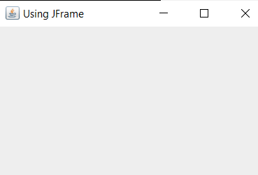
Setting up an application window
The java swing library is the basic java GUI library.
Swing has a number of packages.
We will use the following packages.
javax.swing;
java.awt;
java.awt.event;
import javax.swing.JFrame;
public class CreateWindow{
public CreateWindow(){
JFrame frame = new JFrame("Using JFrame");
frame.setSize(400,300);
frame.setResizable(true);
frame.setVisible(true);
}
public static void main(String ar[]){
new CreateWindow();
}
}

Slide 5
Any Questions?

Slide 6
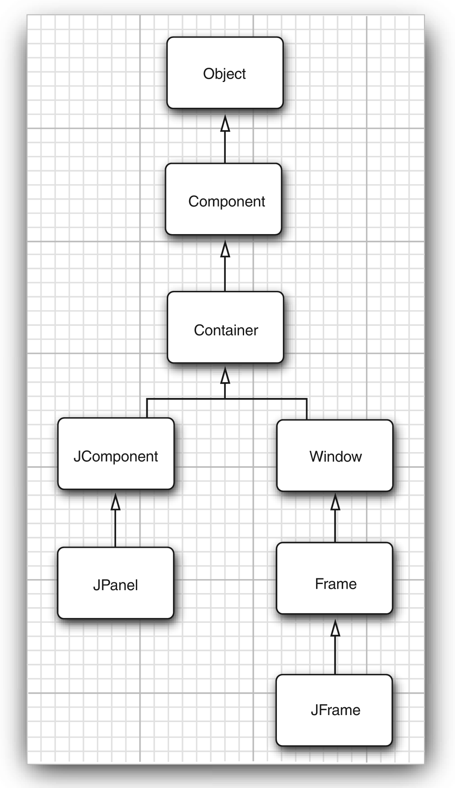
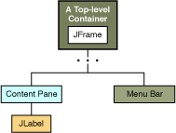
Component Hierarchy
Laying out components
Component inheritance
Horstmann, C. S., & Cornell, G. (2013). Core Java: Essential Features (Vol. 1). Pearson Education.

Slide 7
Button
public class BasicButton{
public BasicButton(){
JFrame frame = new JFrame("Using JFrame2");
frame.setSize(400,300);
frame.setResizable(true);
frame.setDefaultCloseOperation(JFrame.EXIT_ON_CLOSE);
//creating a button
JButton b=new JButton("Just a button");
//add button to frame
frame.getContentPane().add(b);
frame.setVisible(true);
}
public static void main(String ar[]){
new BasicButton();
}
}

Slide 8
Any Questions?

Slide 9
Label and TextField
A label and textfield can be created using the same process of creating a button
TextField is an editable text component for entering text
A label contains a non-editable text component.
You can see how to work with different components in the java swing library here: https://docs.oracle.com/javase/tutorial/uiswing/components/componentlist.html

Slide 10
Behaviours inherited from the javax.swing.Component
comp.getWidth() and comp.getHeight() are functions that give the current size of the component, in pixels
comp.setEnabled(true) and comp.setEnabled(false) can be used to enable and disable the component.
There is a boolean-valued function, comp.isEnabled() that you can call to discover whether the component is enabled.
comp.setVisible(true) and comp.setVisible(false) can be called to hide or show the component.
comp.setFont(font) sets the font that is used for text displayed on the component.
comp.setBackground(color) and comp.setForeground(color) set the background and foreground colors for the component.
comp.setOpaque(true) tells the component that the area occupied by the component should be filled with the component's background color before the content of the component is painted.
comp.setToolTipText(string) sets the specified string as a "tool tip" for the component
comp.setPreferredSize(size) sets the size at which the component should be displayed, if possible.
http://math.hws.edu/eck/cs124/javanotes7/c6/s5.html

Slide 11
Any Questions?

Slide 12
Basic Layouts
There are various ways to layout components within a top-level window.
The simplest way is by absolute positioning. The alternative is using a layout manager
These include
Flow Layout
Border Layout
Grid layout
The basic layouts can be combined together to form complex layouts.
We can use a wireframe diagram to determine how to layout our components and what layouts can be used to achieve a specific design.

Slide 13
Flow and Grid Layout
This is the default layout manager for the JPanel class
The JPanel class is used to group components together
The Flow layout lays out components from left to right and then top to bottom.
The grid layout lays out components in predefined rows and columns of a grid

Slide 14
Border Layout
Border Layout is the Default layout for the JFrame class
Border layout has 5 positions
Top (header) NORTH position
Bottom (footer) SOUTH position
flush right EAST position
flush left WEST position
CENTER
The default position for the border layout is CENTER

Slide 15
Any Questions?

Slide 16
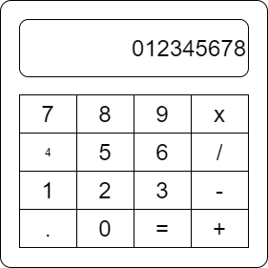
Simple Calculator wireframe
JLabel
JFrame
BorderLayout.NORTH
BorderLayout.CENTER
Button
JPanel group for buttons
Using GridLayout

Slide 17
Simple calculator layout
import javax.swing.JFrame;
import javax.swing.JPanel;
import javax.swing.JButton;
import javax.swing.JTextField;
import java.awt.BorderLayout;
public class SimpleCalc extends JFrame{
public SimpleCalc(){
//initialise frame
this.initFrame();
//create button grid
JPanel buttons=this.createButtonGrid();
//creating a button
JTextField display=new JTextField("0",10);
//add contents and show frame
getContentPane().add(buttons,BorderLayout.CENTER);
getContentPane().add(display,BorderLayout.NORTH);
pack();
setVisible(true);
}
}
private JPanel createButtonGrid(){
JPanel buttons=new JPanel();
buttons.setLayout(new GridLayout(5,4));
buttons.add(new JButton("A/C"));
buttons.add(new JButton("C"));
buttons.add(new JButton("M+"));
buttons.add(new JButton("+/-"));
buttons.add(new JButton("7"));
buttons.add(new JButton("8"));
buttons.add(new JButton("9"));
buttons.add(new JButton("x"));
buttons.add(new JButton("4"));
buttons.add(new JButton("5"));
buttons.add(new JButton("6"));
buttons.add(new JButton("/"));
buttons.add(new JButton("1"));
buttons.add(new JButton("2"));
buttons.add(new JButton("3"));
buttons.add(new JButton("-"));
buttons.add(new JButton("."));
buttons.add(new JButton("0"));
buttons.add(new JButton("="));
buttons.add(new JButton("+"));
return buttons;
}

Slide 18
Any Questions?

Slide 19
Exception Handling
A mechanism of recovering or gracefully exiting from anticipated runtime errors.
We can anticipate that in a division may include a denominator of 0, resulting in a Divide-By-Zero Exception.
We can also anticipate that a file requested by our program to read from may not exist in the operating system file path given, resulting in a File-Not-Found exception.
There are many of such predefined Exception defined by the Java library and we can also define our own exceptions, or use the default Exception class.
Two ways of handling exceptions including either the throws keyword on an encapsulating method or using the try-catch-finally block.
We can also generate predefined or user-defined exceptions using by throwing an exception using the “throw” keyword.

Slide 20
Divide-by-zero Exception handling example
private void div(double x){
try{
setVal(getVal()/x);
} catch(Exception e){
System.out.println(e.getMessage());
};
}

Slide 21
Any Questions?

Slide 22
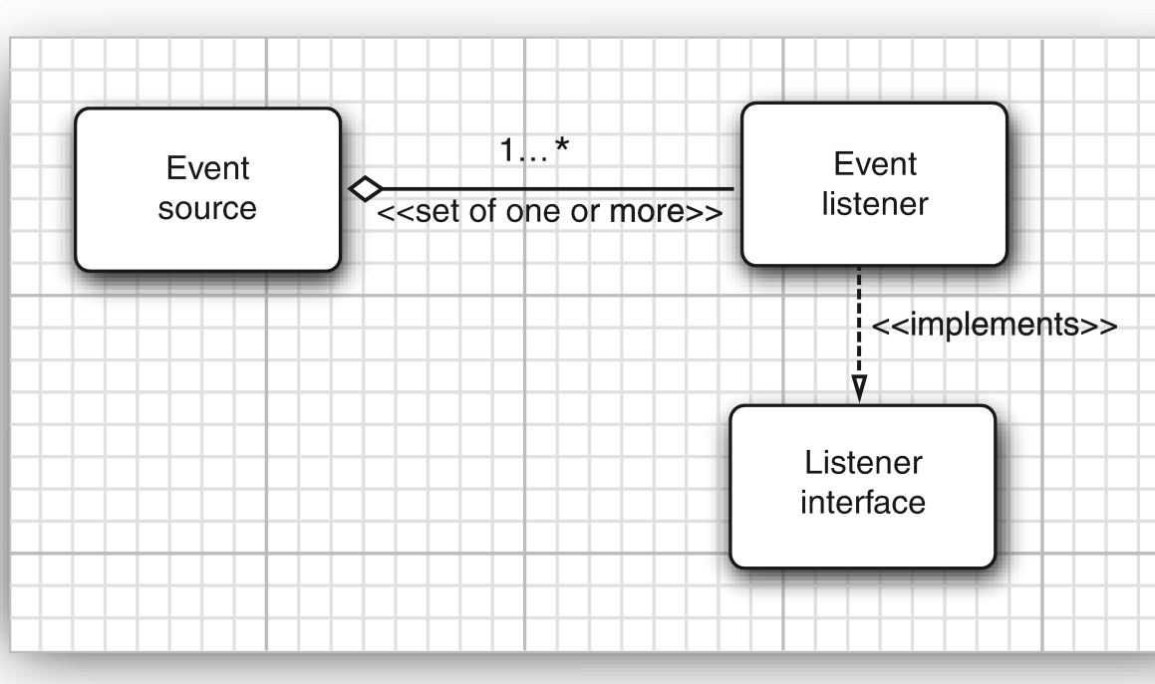
Event handling
An GUI event is a user activity that the program responds to.
These events are activated by interactions from the user on our components such as clicking a button
An event source is a GUI component capable of generating events.
An event listener is attached to an event source and is able to perform action based on events
In Java swing, the Listener interface is implemented by the listener to respond to and acquire information about subscribed events
Horstmann, C. S., & Cornell, G. (2013). Core Java: Essential Features (Vol. 1). Pearson Education.

Slide 23
Simple Calculator events
void actionPerformed(ActionEvent evt){
String op=evt.getActionCommand();
display.setText(calc.calculate(op));
}

Slide 24
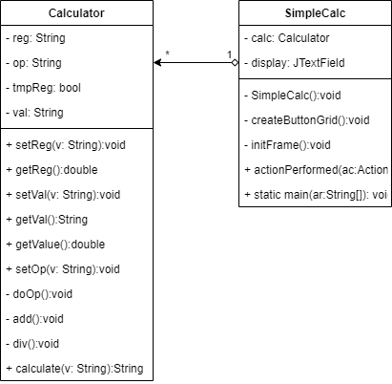
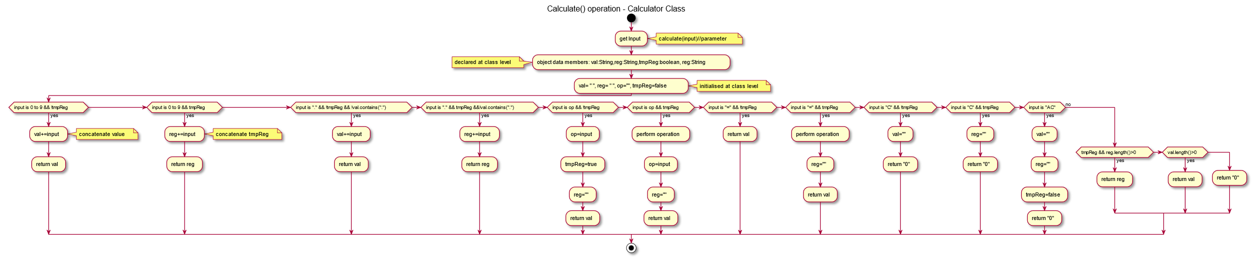
Simple Calculator Design

Slide 25
Any Questions?

Slide 26
Exercises
Create an exception handler for the appropriate portion of the Loan Calculator program developed in Lesson 3.
Create a simple Calculator application using javax.swing GUI library.
Create a wireframe diagram for the address book program.
Create a GUI for the address book program.
(advanced) Complete your address book program by adding the appropriate event handler methods.

Slide 27
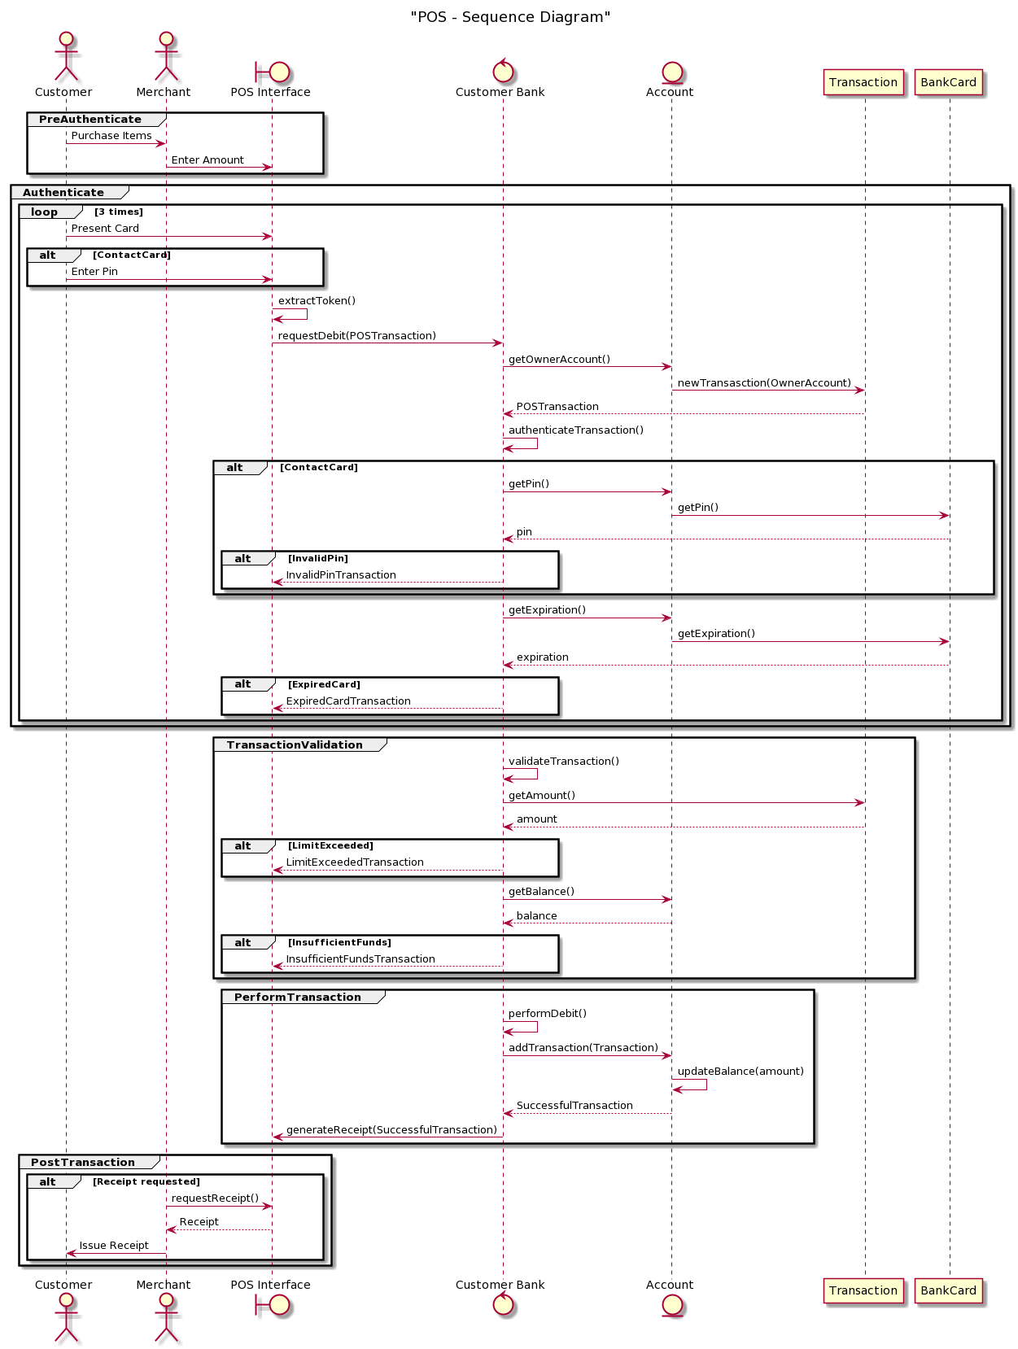
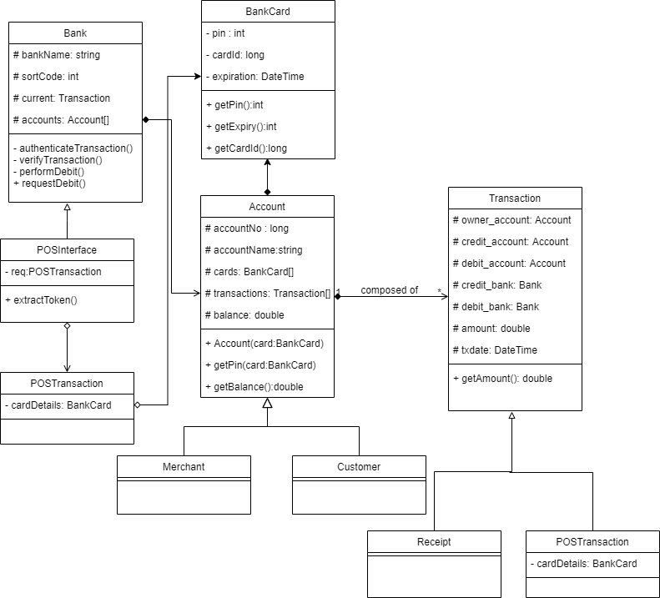
Java Bootcamp challenge
Create a GUI application for the POS system given by the following class and sequence diagram (click on image to open in browser)

Slide 28

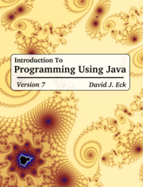
Supplementary material
The Java Tutorial
Java API documentation
Link to today’s Session screencast
Link to John’s Group Padlet
Link to Kelly’s Group Padlet

