Slide 1
International study centre
An Introduction to object-orientation and the java programming language
Name : John Alamina
Email : john.alamina@hud.ac.uk

Slide 2
Java Bootcamp Outline
Lesson 1 – Java Vs C++
Lesson 2 – Structured Programming in Java
Lesson 3 – Introduction to Object-oriented programming in Java
Lesson 4 – More OOP and Core Java language topics
Lesson 5 – Java Generics and Java Collections
Lesson 6 – GUI development and Exception Handling

Slide 3
Ground rules
Attend all the lessons.
Do any pre-class exercise in preparation for the class
5 minute rule and synchronous learning etiquettes
Ensure your camera is on at all times
Use a laptop for all sessions
Participate in all the polls within 2 minutes
Stay till the end of the class to do your exercises
Contact your tutors (john.alamina@hud.ac.uk,
onyedikachi.ulelu@hud.ac.uk )

Slide 4
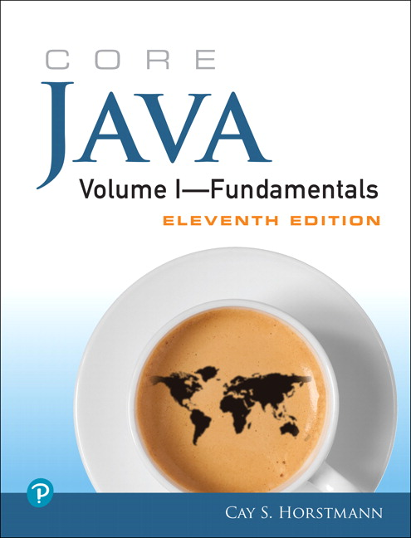
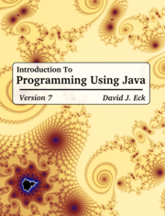
Supplementary material
https://docs.oracle.com/javase/tutorial/
https://docs.oracle.com/javase/8/docs/api/
Link to today’s Session screencast
Link to Group Padlet (submit your exercises here)

Slide 5
Lesson 1 - Outline
Classes and objects in a nutshell
The hello Java class.
Java Variables and Datatypes.
Comparing Java to C++
Operations in Java
Functions in Java (they are now called methods)

Slide 6
Classes and objects in a nutshell
Can you run the bicycle class on your computer?
class Bicycle {
int cadence = 0;
int speed = 0;
int gear = 1;
void changeCadence(int newValue) {
cadence = newValue;
}
void changeGear(int newValue) {
gear = newValue;
}
void speedUp(int increment) {
speed = speed + increment;
}
void applyBrakes(int decrement) {
speed = speed - decrement;
}
void printStates() {
System.out.println("cadence:" +
cadence + " speed:" +
speed + " gear:" + gear);
}
}
class BicycleDemo {
public static void main(String[] args) {
// Create two different
// Bicycle objects
Bicycle bike1 = new Bicycle();
Bicycle bike2 = new Bicycle();
// Invoke methods on
// those objects
bike1.changeCadence(50);
bike1.speedUp(10);
bike1.changeGear(2);
bike1.printStates();
bike2.changeCadence(50);
bike2.speedUp(10);
bike2.changeGear(2);
bike2.changeCadence(40);
bike2.speedUp(10);
bike2.changeGear(3);
bike2.printStates();
}
}
A Class
2 objects
Another class
https://docs.oracle.com/javase/tutorial/java/concepts/class.html

Slide 7
Sample Bicycle Class
A Bicycle has (attributes)
Cadence
Speed
Gear
A Bicycle can (behaviour)
Change Cadence
Change speed
Change gear
Classes are factories for creating objects
class BicycleDemo {
public static void main(String[] args) {
// Create two different
// Bicycle objects
Bicycle bike1 = new Bicycle();
Bicycle bike2 = new Bicycle();
// Invoke methods on
// those objects
bike1.changeCadence(50);
bike1.speedUp(10);
bike1.changeGear(2);
bike1.printStates();
bike2.changeCadence(50);
bike2.speedUp(10);
bike2.changeGear(2);
bike2.changeCadence(40);
bike2.speedUp(10);
bike2.changeGear(3);
bike2.printStates();
}
}

Slide 8
Hello Java
class Main {
public static void main(String[] args) {
System.out.println("Hello world!");
}
}
Hello C++
#include <iostream>
using namespace std;
int main()
{
cout << “Hello World";
return 0;
}

Slide 9
Any Questions?

Slide 10
What is a variable?
A name given by the programmer within a program that is not reserved and can store values. Identify the variables in the following program:
package com.studygroup;
public class Main {
public static void main(String[] args) {
float xx = 5; //int = integer type (whole numbers)
float y = 7;// = is assignment
System.out.println((xx + y) + " " + (xx / y));
}
}

Slide 11
Data Types in Object Oriented Programming
Data Types
Primitive
Integer
Character
Boolean
Floating point
Double floating point
Void
Wide Character
Derived
Array
Pointer
Reference
User Defined
Class
Object
Structure
Union
Enum
Typedef
Function

Slide 12
Java primitive data types
byte - 8-bit signed two's complement integer (-128 to +127)
short - 16-bit signed two's complement integer. (-32768 to +32767)
int - 32-bit signed two's complement integer (~-2m to ~+2m)
long – 64 -bit signed two's complement integer
float - 32-bit IEEE 754 floating point. 7 decimal places accuracy
double – 64 -bit IEEE 754 floating point. 15 decimal places accuracy
char - 16-bit Unicode character.
boolean - This data type represents one bit of information (i.e. true or false)

Slide 13
Any Questions?

Slide 14
Java vs C++
package com.studygroup;
public class Main {
public static void main(String[] args) {
float x = 5; //int = integer type (whole numbers)
float y = 7;// = is assignment
System.out.println((x + y) + " " + (x / y));
}
}
#include <iostream>
using namespace std;
int main()
{
float x = 5; //int = integer type (whole numbers)
float y = 7;// = is assignment
cout << "\n";
cout << x + y << " " << x / y;
cout << "\n";
return 0;
}

Slide 15
Java vs C++
SIMILARITIES | DIFFERENCES
1. Use of curly braces | 1. Code organization
2. Basic syntax | 1a. Package vs namespace
2a. Command/sequential syntax | 2. Entry Class/method
2b. Control structures | 3. Explicit Type modifiers
3. Case sensitivity | 4. User-defined operator-overloading
4. Some keywords | 5. Some keywords
5. Method syntax | 6. Classes and filenames
6. Operators | 7. Include vs import
7. Literal values e.g. string quotes | 8. Method headers
8. Member of operator (.) | 9. Console Input/output
9. Constructor creation | 10. Constructor call
10. Object oriented/language concepts | 11. Object oriented/language syntax
11. Primitive data types/literals | 12. Advanced data types
12. String literals | 13. String variables
13. Concept of References | 14. Implementation of pointers/references

Slide 16
Any Questions?

Slide 17
Operators in Java are similar to that of C++
Arithmetic Operators (+, -, /, *, %)
Relational operators (==, !=, >,<,>=,<=)
Assignment Operations (=, +=,-=, /=, *=, %=, ++, --)
Logical operators (&&,||, !)
Conditional (Ternary) Operator (?:).
Bitwise operators (&, |, ^, ~, >>, <<)

Slide 18
Any Questions?

Slide 19
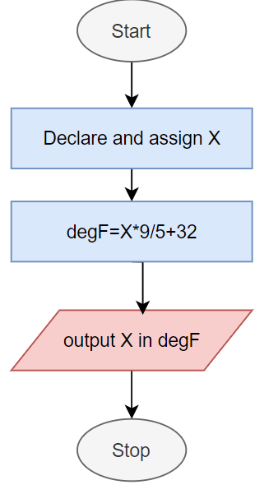
Every program follows an algorithm
Write a program given any real variable declared as X, can convert that X from the Celsius for Fahrenheit.
public class Main {
public static void main(String[] args) {
float x = 5;
float degF = 9/5*x+32;
System.out.println((x ) + " degC = " + (degF) + " degF");
}
}

Slide 20
Static methods in Java
Functions are Advanced operators (they take input and return an output mapping)
In Java, Functions are called methods
Methods are the basic Algorithmic Units of a program
Method Concepts
Creating methods (composition)
Signature
Name
Return type
Type modifiers
Input parameters
Method body
Algorithmic contents
Using methods
Method declaration
Method definition
Method call
What is a static method
Static methods can be called without an object instance variable
Private methods are called within the class and Public methods can be called outside the class

Slide 21
Static method example
public class Main {
public static void main(String[] args) {
float x = 5;
float degF = degF(x);
System.out.println((x ) + " degC = " + (degF) + " degF");
}
public static float degF(float x) {
float degF = 9/5*x+32;
return degF;
}
}

Slide 22
Any Questions?

Slide 23
Exercises
Write a simple Java program that prints “Hello from Java”
Write a program that gives the sum, product, subtraction and division of two numbers
Write a program that takes a real number variable X and converts the value from degrees Celsius to degrees Fahrenheit.
Advanced Questions
Write a program that takes a real number variable X and converts the value from degrees Fahrenheit to degrees Celsius.
Write seven static methods in a single Main class, and then, call them all from the main method displaying their results. The static methods should comprise all the above seven programs. One static method for each question. The static method for question 1 should be called “sayHello()” the arithmetic operator methods should be called “add()”, “sub()”, “mult()” and “div()” and the temperature methods should be called toCelsius() and toFahrenheit().

