Slide 1
International study centre
An Introduction to object-orientation and the java programming language
ADVANCED OOP in java
Name : John Alamina
Email : john.alamina@hud.ac.uk

Slide 2
Outline
Getters and setters
Inheritance
Polymorphism
Composition vs Inheritance
Interface vs Inheritance
Abstract class vs interface vs inheritance
Inner classes
Java packages
Java library and standard classes

Slide 3
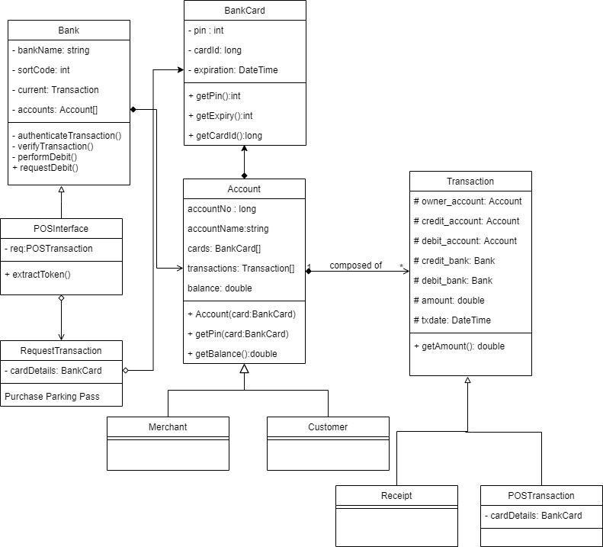
POS Class diagram Example

Slide 4
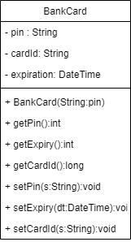
Getters and setters
Getters and setters are a means of externally accessing private/protected members externally
public class BankCard { String pin=""; String cardid=""; Date expiry; public void setPin(String p){ this.pin=p; } public String getPin() { return pin; } public Date getExpiry() { return expiry; } public void setExpiry(Date expiry) { this.expiry = expiry; } public String getCardid() { return cardid; } public void setCardid(String cardid) { this.cardid = cardid; } }

Slide 5
Any Questions?

Slide 6

POS Class diagram - Inheritance

Slide 7
Any Questions?

Slide 8
Polymorphism
Polymorphism is related to how functions or methods are implemented.
There are two types of Polymorphism
Function polymorphism also known as function overloading or method overloading
Method polymorphism also known as method overriding.
Note that method overloading occurs within a single class but overriding is between two or more classes having an inheritance relationship (object polymorphism)

Slide 9
Any Questions?

Slide 10
Method overloading - Example
Note that for method overloading to work, the input parameter types or argument types must be different in other words, the method signature or prototype must be different for each overloaded method.
Voltage can be obtained from various parameters. It can be obtained by multiplying the current, I by the resistance, R. Also voltage can be obtained by dividing charge, Q by capacitance, C. When Q can also be derived from current, I, multiplied by the time, t. Thus
V=IR=It/C
We can therefore write two overloaded methods of getVoltage(). The first overloaded method having two double parameters and the other having three double parameters
getVoltage(double I, double R);
getVoltage(double I, double t, double C);

Slide 11
Any Questions?

Slide 12
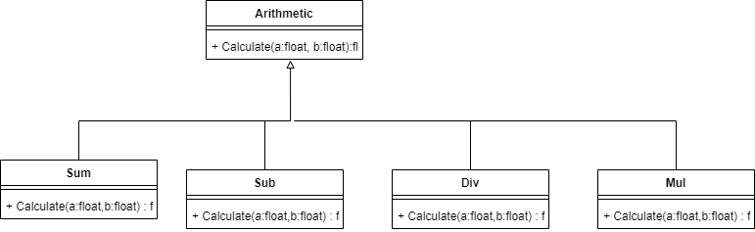
Method overriding - Example

Slide 13
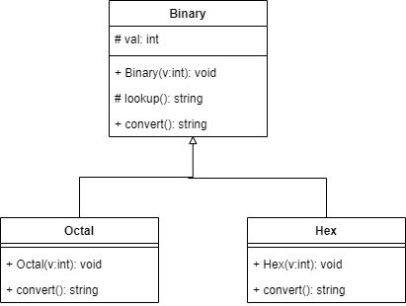
Method overriding - Example

Slide 14
Any Questions?

Slide 15
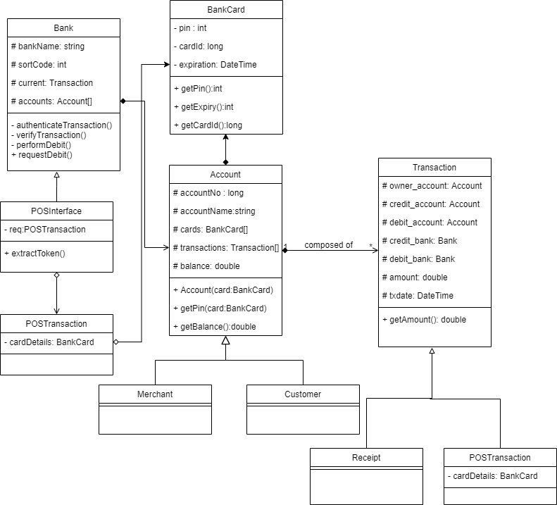
POS Class diagram – Containment vs Inheritance

Slide 16
POS Class diagram – Containment vs Inheritance

Slide 17
Any Questions?

Slide 18
Interface vs Inheritance – Why so many faces
Ubiquitous
Behaviour
Graphical User Interface
Interface
Simplification
Abstraction
Front face
Façade

Slide 19
Interface vs Inheritance
An interface is a special type of inheritance
An interface is a contract that every inherited class must keep by ensuring every method declared in the parent interface is overridden (object polymorphism)
An interface cannot implement any of its methods and doesn’t have any data members.
In Java interfaces are usually used to achieve a concept known as multiple inheritance in C++, where a class can inherit from more than one superclass.
Interfaces can be used to achieve loose coupling while maintaining high cohesion

Slide 20
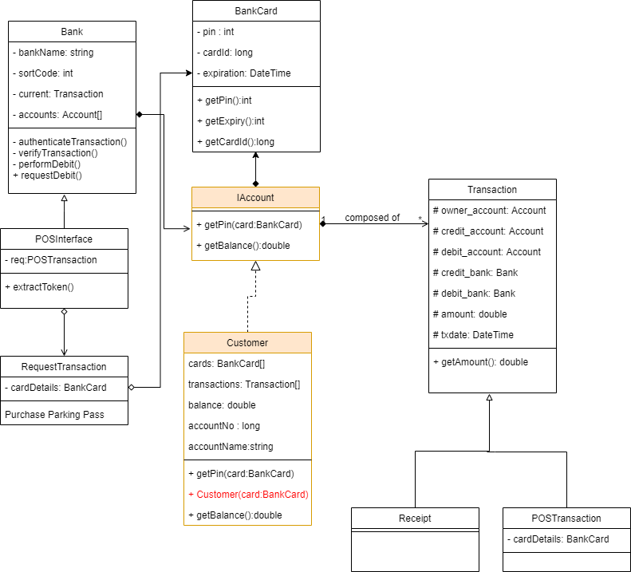
Interface vs Inheritance

Slide 21
Any Questions?

Slide 22
Abstract class vs Interface vs Inheritance
There are limitations associated with an interface which include:
An interface does not have data members only methods.
All the methods declared within an interface must be implemented.
An abstract class is a go between a super class and an interface because it allows
certain methods that must be overridden and others that are optionally overridden.
data members which can be private, public, protected etc.
Methods within an abstract class that must be overridden are called abstract methods.
Notes:
Methods in an interface are implicitly abstract and do not have any implementation whatsoever. However, an abstract class may have a default implementation like a regular super class.
Attributes in a Java interface is final while abstract class variables can be overridden in the sub-class.
Members of a Java interface are public by default.
Java interface should be implemented using keyword “implements”; A Java abstract class should be extended using keyword “extends”.
An interface in java, can extend only one other interface. An abstract class however, while extending only one super class can, at the same time, implement multiple interfaces.
A Java class may implement multiple interfaces but it can, however, only extend one class, whether abstract or concrete.
Interface is completely abstract. It cannot be instantiated or invoked. A Java abstract class on the other hand, while it cannot be instantiated, it can, however, be invoked if a main() exists.
In terms of runtime performance, java abstract classes are faster than slower interfaces as the require extra indirection

Slide 23
Interface vs Abstract class
Methods in an interface are implicitly abstract and do not have any implementation whatsoever. However, an abstract class may have a default implementation like a regular super class.
Attributes in a Java interface is final while abstract class variables can be overridden in the sub-class.
Members of a Java interface are public by default.
Java interface should be implemented using keyword “implements”; A Java abstract class should be extended using keyword “extends”.
An interface in java, can extend only one other interface. An abstract class however, while extending only one super class can, at the same time, implement multiple interfaces.
A Java class may implement multiple interfaces but it can, however, only extend one class, whether abstract or concrete.
Interface is completely abstract. It cannot be instantiated or invoked. A Java abstract class on the other hand, while it cannot be instantiated, it can, however, be invoked if a main() exists.
In terms of runtime performance, java abstract classes are faster than slower interfaces as the require extra indirection
https://javapapers.com/core-java/abstract-and-interface-core-java-2/difference-between-a-java-interface-and-a-java-abstract-class/#:~:text=Main%20difference%20is%20methods%20of,that%20implements%20a%20default%20behavior.&text=An%20abstract%20class%20may%20contain,interface%20are%20public%20by%20default.
Notes:
Main difference is methods of a Java interface are implicitly abstract and cannot have implementations. A Java abstract class can have instance methods that implements a default behavior.
Variables declared in a Java interface is by default final. An abstract class may contain non-final variables.
Members of a Java interface are public by default. A Java abstract class can have the usual flavors of class members like private, protected, etc..
Java interface should be implemented using keyword “implements”; A Java abstract class should be extended using keyword “extends”.
An interface can extend another Java interface only, an abstract class can extend another Java class and implement multiple Java interfaces.
A Java class can implement multiple interfaces but it can extend only one abstract class.
Interface is absolutely abstract and cannot be instantiated; A Java abstract class also cannot be instantiated, but can be invoked if a main() exists.
In comparison with java abstract classes, java interfaces are slow as it requires extra indirection

Slide 24
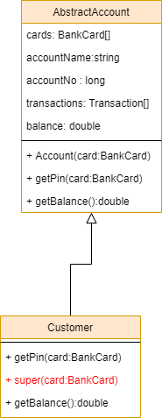
Abstract class diagram

Slide 25
Any Questions?

Slide 26
Inner Classes
Inner classes are used where there is close relationship between two classes and the inner class is only accessed by the containing class.
An example of an inner class is the System.out class we have been using all this while.
System is the outer class and out is the inner class.
System.out class has several methods most notably print() and println() which print strings out to the console.
System also has a System.in inner class used for input we will see in this in action later in this boot camp.
Read more about inner classes here.

Slide 27

Inner-class representation

Slide 28
Any Questions?

Slide 29
Java Packages
OOP helps to organise your code into reusable logical structures known as classes.
A large number of classes have been written by the creator of the java language and arranged into logical hierarchies known as packages.
In practice as every java class represents a compilation unit or file, every package represents an actual sub-folder within your operating system file system.
thus org.studygroup.LoanCalc class has the following hierarchy
org
studygroup
LoanCalc.java

Slide 30
Java Packages
Packages are imported using the import keyword and declared using the package keyword.
e.g.
package addbook; //references AddressBook class inside addbook folder
import java.util.ArrayList; //imports ArrayList class from java.util package
class AddressBook{
private ArrayList addressBook =new ArrayList(); //using the imported class
}

Slide 31
Any Questions?

Slide 32
The Java Standard Edition Library
In C++ there are a lot of functions and objects a programmer can import from the C++ standard library
Java has a rich library which consists of packages and classes.
You can study this in-depth by using the link provided at the end of the slides.
Two common packages referred to in this bootcamp is the java.lang package and the java.util package.
The java.lang package is automatically imported by the java compiler and contains classes like the System class we use for console output and the Math class.
The java.util classes have special utility classes including the Collection package we consider in a later lesson

Slide 33
Common Java Language (java.lang) Package Classes
String
Math
Array
Integer
Double
Float
Character
Byte
StringBuffer
System
Number
Object
StringBuilder
Class
Process
Boolean
Short
Long

Slide 34
Further Reading
String builder vs String buffer

Slide 35
Any Questions?

Slide 36
Exercise 1
Voltage can be obtained from various parameters.
V=IR=It/C=IpL/A
Where
I = Current (amperes)
R = Voltage (volts)
t = time (seconds)
C = Capacitance (farads)
p = Resistivity (Ohm-meter) of copper=1.678x10⁻⁸Ωm
L = Length
A = cross sectional area
Write a program to calculate voltages for the following program.
A Current of 12A across a Capacitor of 0.5F for 5seconds.
Copper length of 1m and cross-sectional area of 0.001m and a current of 10A.

Slide 37
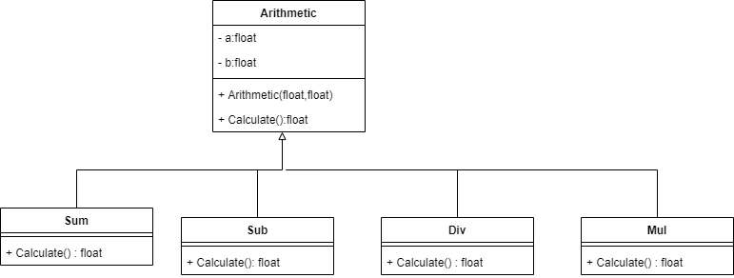
Exercise 2
Implement the class diagram below using object polymorphism
Note that this is the second implementation done earlier

Slide 38
Exercise 3 (advanced)
Implement the class diagram below using object polymorphism.
Starter C++ code can be found here

Slide 39
Exercise 4
Write a program using static cosine function in java.lang.Math and method overloading to find the parameters of a triangle ( 3 sides and 3 angles) given either 2 sides and one angle or two angles and one side. Assume the angles are always whole numbers and while sides are real numbers.

Slide 40


Supplementary material
The Java Tutorial
Java API documentation
Link to today’s Session
Link to John’s Group Padlet
Link to Kelly’s Group Padlet

