Slide 1
International study centre
An Introduction to object-orientation and the java programming language
Java collections and generics introduction
Name : John Alamina
Email : john.alamina@hud.ac.uk

Slide 2
Outline
Introduction to Collections
Lists, Sets and Maps
The collection Interface
Java Generics
The Address book Interface
Address book Array method
Address book List Method
The Map interface
Address book Map method
Exercises

Slide 3
Introduction to collections
The Java collections framework add additional features to basic arrays
There are many classes in the collections framework but they are all derived from either the Collection interface or Map interface.
We will focus on the ArrayList and HashMap
Let’s look at the Collection interface contract
Remember an interface is a contract that promises all sub-classes will implement all the methods declared in the interface.

Slide 4
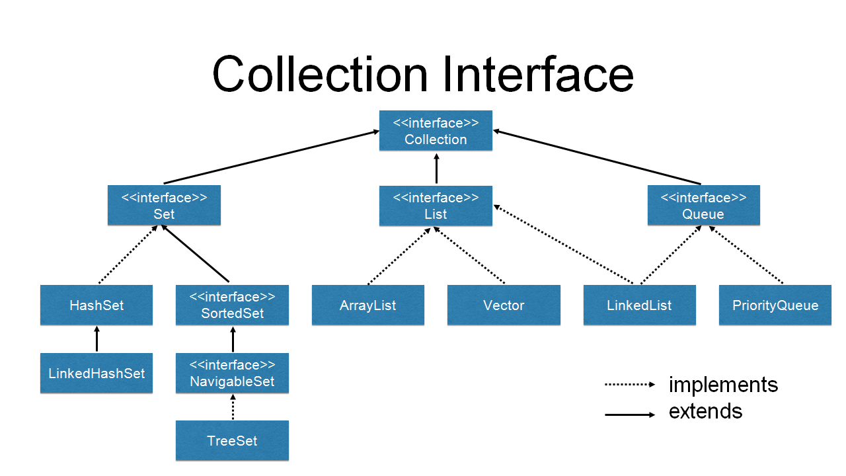
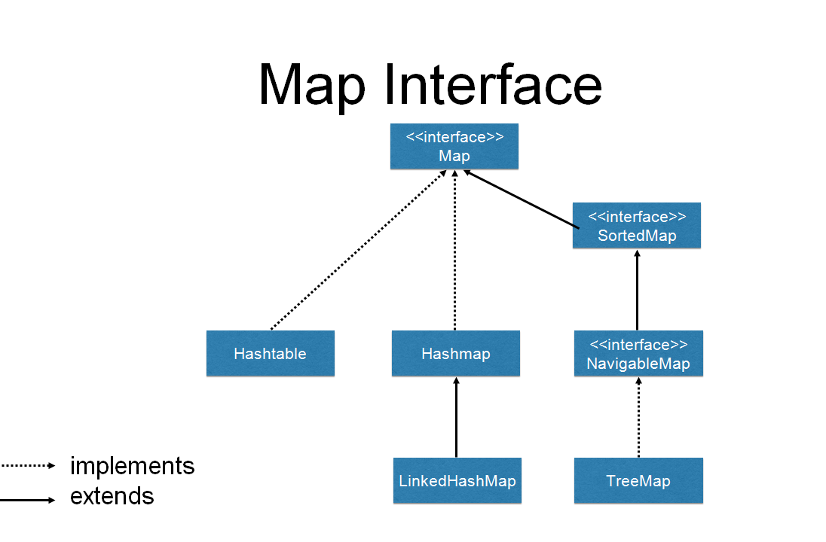
Introduction to collections
https://dzone.com/articles/an-introduction-to-the-java-collections-framework

Slide 5
Lists Set’s and Maps
The Java collections framework add additional features to basic arrays
There are many classes in the collections framework but they are all derived from either the Collection interface or Map interface.
We will focus on the ArrayList and HashMap
Collections come with loop objects called iterators that give access to each item in the collection.
Let’s look at the Collection interface contract
Remember an interface is a contract that promises all sub-classes will implement all the methods declared in the interface.

Slide 6
The Collection interface
coll.size() — returns an int that gives the number of objects in the collection.
coll.isEmpty() — returns a boolean value which is true if the size of the collection is 0.
coll.clear() — removes all objects from the collection.
coll.add(tobject) — adds tobject to the collection.
coll.contains(object) — returns a boolean value that is true if object is in the collection.
coll.remove(object) — removes object from the collection.
coll.containsAll(coll2) — returns a boolean value that is true if every object in coll2 is also in coll
coll.addAll(coll2) — adds all the objects in coll2 to coll. The parameter, coll2, can be any collection of type Collection<T>
coll.removeAll(coll2) — removes every object from coll that also occurs in the collection coll2. coll2 can be any collection.
coll.retainAll(coll2) — removes every object from coll that does not occur in the collection coll2.
coll.toArray() — returns an array of type Object[] that contains all the items in the collection.
Notes:
coll.size() — returns an int that gives the number of objects in the collection.
coll.isEmpty() — returns a boolean value which is true if the size of the collection is 0.
coll.clear() — removes all objects from the collection.
coll.add(tobject) — adds tobject to the collection. The parameter must be of type T; if not, a syntax error occurs at compile time. (Remember that if T is a class, this includes objects belonging to a subclass of T, and if T is an interface, it includes any object that implements T.) The add() method returns a boolean value which tells you whether the operation actually modified the collection. For example, adding an object to a Set has no effect if that object was already in the set.
coll.contains(object) — returns a boolean value that is true if object is in the collection. Note that object is not required to be of type T, since it makes sense to check whether object is in the collection, no matter what type object has. (For testing equality, null is considered to be equal to itself. The criterion for testing non-null objects for equality can differ from one kind of collection to another; see Subsection 10.1.6, below.)
coll.remove(object) — removes object from the collection, if it occurs in the collection, and returns a boolean value that tells you whether the object was found. Again, object is not required to be of type T. The test for equality is the same test that is used by contains().
coll.containsAll(coll2) — returns a boolean value that is true if every object in coll2 is also in coll. The parameter can be any collection.
coll.addAll(coll2) — adds all the objects in coll2 to coll. The parameter, coll2, can be any collection of type Collection<T>. However, it can also be more general. For example, if T is a class and S is a sub-class of T, then coll2 can be of type Collection<S>. This makes sense because any object of type S is automatically of type T and so can legally be added to coll.
coll.removeAll(coll2) — removes every object from coll that also occurs in the collection coll2. coll2 can be any collection.
coll.retainAll(coll2) — removes every object from coll that does not occur in the collection coll2. It "retains" only the objects that do occur in coll2. coll2 can be any collection.
coll.toArray() — returns an array of type Object[] that contains all the items in the collection. Note that the return type is Object[], not T[]! However, there is another version of this method that takes an array of type T[] as a parameter: the method coll.toArray(tarray) returns an array of type T[] containing all the items in the collection. If the array parameter tarray is large enough to hold the entire collection, then the items are stored in tarray and tarray is also the return value of the collection. If tarray is not large enough, then a new array is created to hold the items; in that case tarray serves only to specify the type of the array. For example, coll.toArray(new String[0]) can be used if coll is a collection of Strings and will return a new array of type String[].

Slide 7
Generics introduction
The Java collections framework add additional features to basic arrays such as the ability to use collections without direct reference to it’s index. For example adding elements to a collection.
Generics allows a uniform way to manipulate collections of varying data types. Consider the snippet below
List list = new ArrayList();
list.add("hello");
String s = (String) list.get(0); // without generic code
When re-written to use generics, the code does not require casting:
List<String> list = new ArrayList<String>();
list.add("hello");
String s = list.get(0); // no cast

Slide 8
Iterators
Iterator objects are accessed from the listIterator() method of collection classes
The code below shows how to use iterators. However, these are hardly used as the simpler “for”-each-item-in-syntax also shown below is used as the alternative
//using the iterator syntax
ListIterator<String> iter = stringList.listIterator();
while (iter.hasNext()) {
String item = iter.next();
if (newItem.compareTo(item) <= 0) {
iter.previous();
break;
}
}
iter.add(newItem);
//alternative syntax
for (String item:stringList) {
System.out.println(item);//list all items to console
}

Slide 9
Any Questions?

Slide 10
The Address book Interface
For an address book we would like to maintain a list of addresses that will have the following attributes and behaviours.
Attributes (properties)
Entry (type=class {Entry})
Methods (behaviours)
Add Entry – add an address book entry
Remove entry – remove and address book entry
List Entries – shows all entries
Find entry – find and entry by name
Entry Class properties
Name (type=string, public)
Phone Number (type=

Slide 11
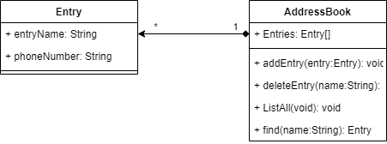
Address book – class diagram

Slide 12
Address book – Array method
public class AddressBookArray {
private Entry[] addressBook= new Entry[3];
private StringBuilder sb=new StringBuilder();
public void ListAll(){
for(int i=0;i<addressBook.length;i++){
if(addressBook[i]!=null){
System.out.print(" Name: "+addressBook[i].entryName);
System.out.println(" Phone: "+addressBook[i].phoneNumber);
}
}
}
private void addEntry(Entry entry){
for(int i=0;i<addressBook.length;i++){
if(addressBook[i]==null){
addressBook[i]=new Entry();
addressBook[i].entryName=entry.entryName;
addressBook[i].phoneNumber=entry.phoneNumber;
System.out.println(" Entry successful!");
return;
}
}
System.out.println(" No room found for entry!");
}
private Entry findEntry(String name){
for(int i=0;i<addressBook.length;i++){
if(addressBook[i]!=null && addressBook[i].entryName.equals(name)){
System.out.println(" Found! ");
System.out.print(" Name: "+addressBook[i].entryName);
System.out.println(" Phone: "+addressBook[i].phoneNumber);
return addressBook[i];
}
}
System.out.println(" Not found! ";
return null;
}
private void deleteEntry(String name){
for(int i=0;i<addressBook.length;i++){
if(addressBook[i]!=null && addressBook[i].entryName.equals(name)){
System.out.println(" Found and deleted! ");
addressBook[i]=null;
return;
}
}
System.out.println(" Not found! ";
return ;
} }

Slide 13
Address book – List method
public class AddressBookList {
private List addressBook= new ArrayList();
public void ListAll(){
for(Entry entry:addressBook){
System.out.print(" Name: "+ entry.entryName);
System.out.println(" Phone: "+entry.phoneNumber);
}
}
}
private void addEntry(Entry entry){
addressBook.add(entry);
System.out.println(" Entry successful!");
}
private Entry findEntry(String name){
for(Entry entry:addressBook){
if(entry.entryName.equals(name)){
System.out.println(" Found! ");
System.out.print(" Name: "+entry.entryName);
System.out.println(" Phone: "+entry.phoneNumber);
return entry;
};
}
System.out.println(" Not found! ";
return null;
private void deleteEntry(String name){
Entry entry=findEntry(name);
if(entry!=null)addressBook.remove(entry);
System.out.println(" Deleted! ");
return null;
}
}

Slide 14
Any Questions?

Slide 15
The map interface
map.get(key) -- returns the object of type V that is associated by the map to the key
map.put(key,value) -- Associates the specified value with the specified key, where key must be of type K and value must be of type V.
map.putAll(map2) -- if map2 is another map of type Map<K,V>, this copies all the associations from map2 into map.
map.remove(key) -- if map associates a value to the specified key, that association is removed from the map.
map.containsKey(key) -- returns a boolean value that is true if the map associates some value to the specified key.
map.containsValue(value) -- returns a boolean value that is true if the map associates the specified value to some key.
map.size() -- returns an int that gives the number of key/value associations in the map.
map.isEmpty() -- returns a boolean value that is true if the map is empty, that is if it contains no associations.
map.clear() -- removes all associations from the map, leaving it empty.
http://math.hws.edu/eck/cs124/javanotes7.0.3-web-site/c10/s3.html
Notes:
map.get(key) -- returns the object of type V that is associated by the map to the key. If the map does not associate any value with key, then the return value is null. Note that it's also possible for the return value to be null when the map explicitly associates the value null with the key. Referring to "map.get(key)" is similar to referring to "A[key]" for an array A. (But note that there is nothing like an IndexOutOfBoundsException for maps.)
map.put(key,value) -- Associates the specified value with the specified key, where key must be of type K and value must be of type V. If the map already associated some other value with the key, then the new value replaces the old one. This is similar to the command "A[key] = value" for an array.
map.putAll(map2) -- if map2 is another map of type Map<K,V>, this copies all the associations from map2 into map.
map.remove(key) -- if map associates a value to the specified key, that association is removed from the map.
map.containsKey(key) -- returns a boolean value that is true if the map associates some value to the specified key.
map.containsValue(value) -- returns a boolean value that is true if the map associates the specified value to some key.
map.size() -- returns an int that gives the number of key/value associations in the map.
map.isEmpty() -- returns a boolean value that is true if the map is empty, that is if it contains no associations.
map.clear() -- removes all associations from the map, leaving it empty.

Slide 16
Address book – Map method
public class AddressBookMap {
private HashMap<String,String> addressBook= new HashMap<String,String>();
public void ListAll(){
Set<String> keys = map.keySet(); // The set of keys in the map.
Iterator<String> keyIter = keys.iterator();
while (keyIter.hasNext()) {
String key = keyIter.next(); // Get the next key.
String value = map.get(key); // Get the value for that key.
System.out.println( " Name:\t" + key + "PhoneNumber" + value + "" );
}
}
private void addEntry(Entry entry){
addressBook.put(entry.entryName,entry.phoneNumber);
System.out.println(" Entry successful!");
}
private Entry findEntry(String name){
Entry entry=addressBook.get(name);
if(entry.entryName!=null){
System.out.println(" Found! ");
System.out.print(" Name:\t"+entry.entryName);
System.out.println("Phone: "+entry.phoneNumber);
return entry;
}
System.out.println(" Not found! ";
return null;
}
private void deleteEntry(String name){
addressBook.remove(entry);
System.out.println(" Deleted! ");
return;
}
}

Slide 17
Summary of collections
In a list we are dealing with one type i.e. List<T>. In a map however, we are dealing with two types Map<K,V>, a key and a value.
HashMap does not allow duplicate values the way a list would allow while adding items to the list.
The collections we have seen allow dynamic addition of items which is superior to static allocation done in arrays.
Arrays have fixed length while collections have dynamic lengths.
Collections provide methods that allow dealing with lists and maps a lot more quicker and convenient than ordinary arrays

Slide 18
Any Questions?

Slide 19
Exception Handling
A mechanism of recovering or gracefully exiting from anticipated runtime errors.
We can anticipate that in a division may include a denominator of 0, resulting in a Divide-By-Zero Exception.
We can also anticipate that a file requested by our program to read from may not exist in the operating system file path given, resulting in a File-Not-Found exception.
There are many of such predefined Exception defined by the Java library and we can also define our own exceptions, or use the default Exception class.
Two ways of handling exceptions including either the throws keyword on an encapsulating method or using the try-catch-finally block.
We can also generate predefined or user-defined exceptions using by throwing an exception using the “throw” keyword

Slide 20
Divide-by-zero Exception handling example
private void div(double x){
try{
setVal(getVal()/x);
} catch(Exception e){
System.out.println(e.getMessage());
};
}

Slide 21
Exercises
Implement the Address book using arrays
Implement an address book using Lists
Implement address book using Map
(advanced) Implement a private sort method called by the List entries method of the address book that will display entries in alphabetical order
Create an exception handler for the appropriate portion of the Loan Calculator program developed in Lesson 3.

Slide 22
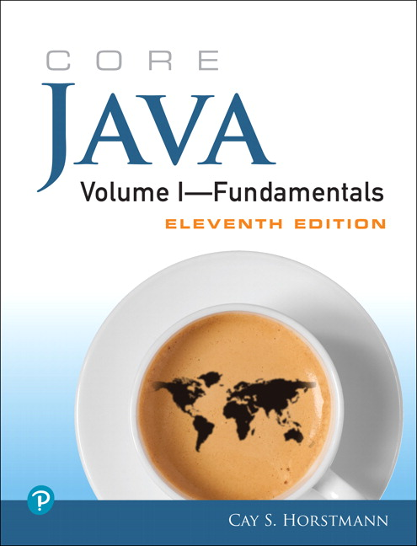
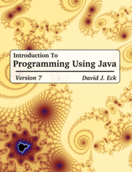
Supplementary material
The Java Tutorial
Java API documentation
Link to today’s Session
Link to John’s Group Padlet
Link to Kelly’s Group Padlet

