Slide 1
Requirements & User Interface
Rocket Fool (A 2D Rocket Game)
Project Group: 5H
Ömer Ekmekcioğlu, Alperen Erkek, Levent Berk Güngen, Hakan Yaman Sözer, Hakan Türkmenoğlu
Assistant: Dorukhan Arslan

Slide 2

1. Initial Problem Discussion
Space travel is expected to be an integral part of mankind’s future. Therefore, learning about it would be beneficial for everyone.

Slide 3
1. Initial Problem Discussion
In order to attract people to space travel and prevent misconceptions about it, it needs the be taught well.

Slide 4


1. Initial Problem Discussion
A fine way to do this would be to show a simulation, which can be done by exhibiting a space game.

Slide 5
2. What is Rocket Fool?
Platform: PC, a desktop application
Genre: Simulation, Educational, Puzzle
Generally, it is about piloting a rocket from one plane to another.
Target Audience: General but especially for high school and university students.

Slide 6
3. Similar Products Review
Basically, Rocket Fool is inspired by:
Kerbal Space Program
Into Space 2
Angry Birds Space

Slide 7
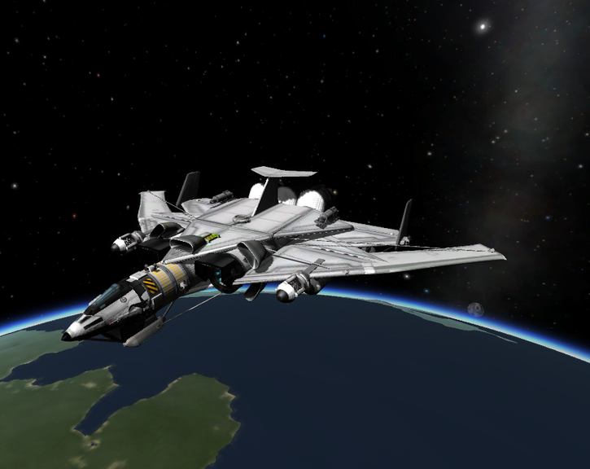
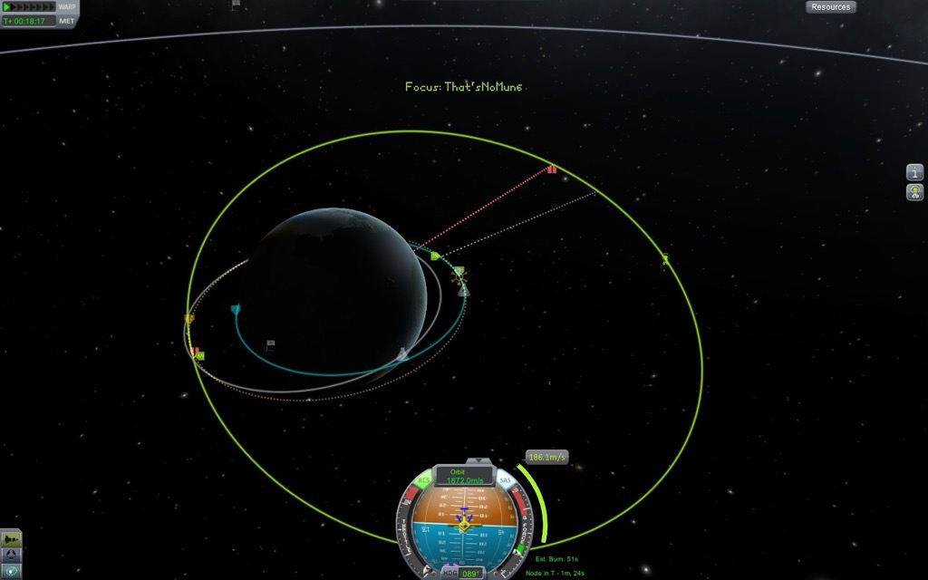
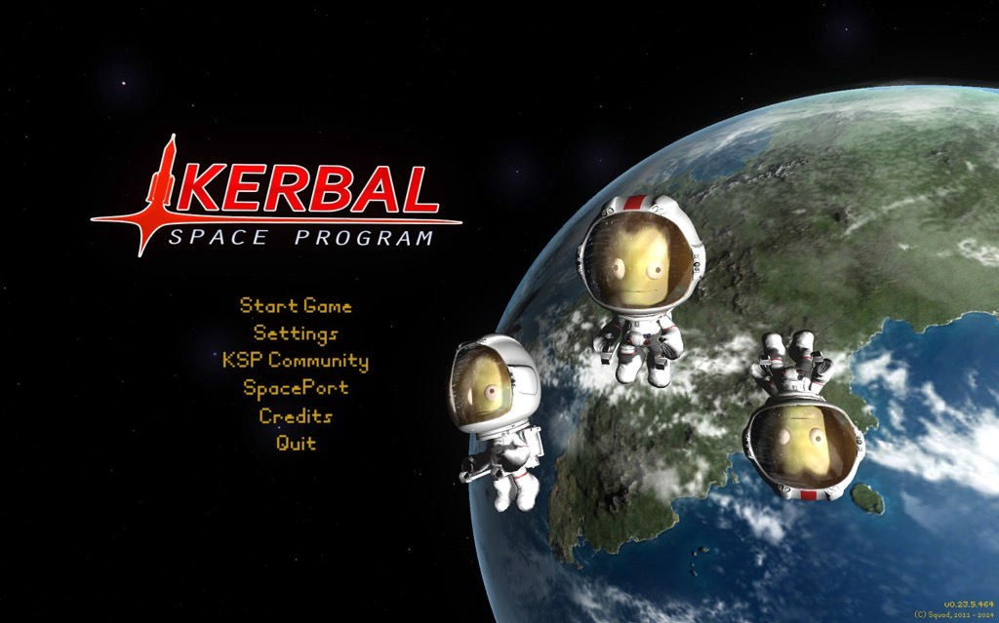
3.1. Kerbal Space Program

Slide 8
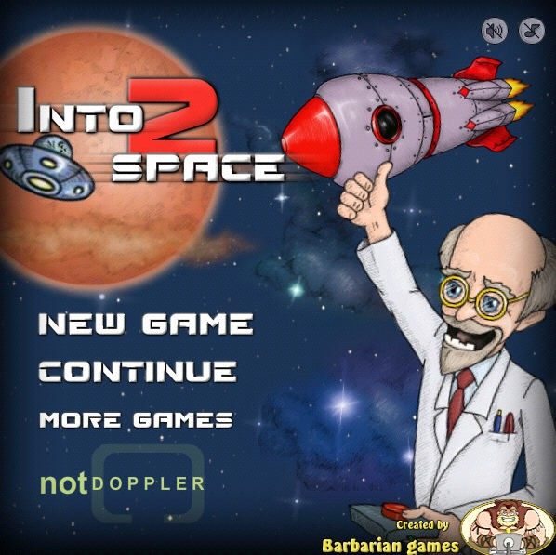
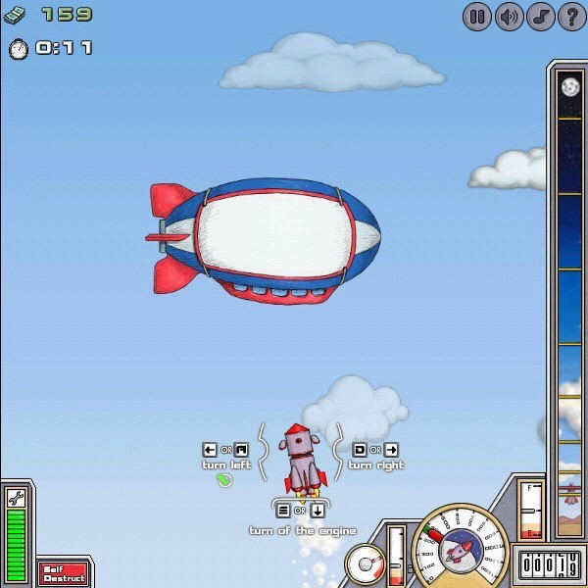
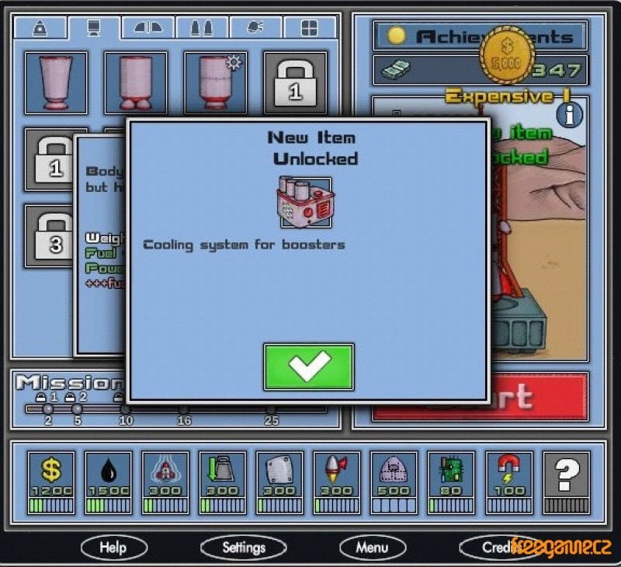
3.2. Into Space 2

Slide 9
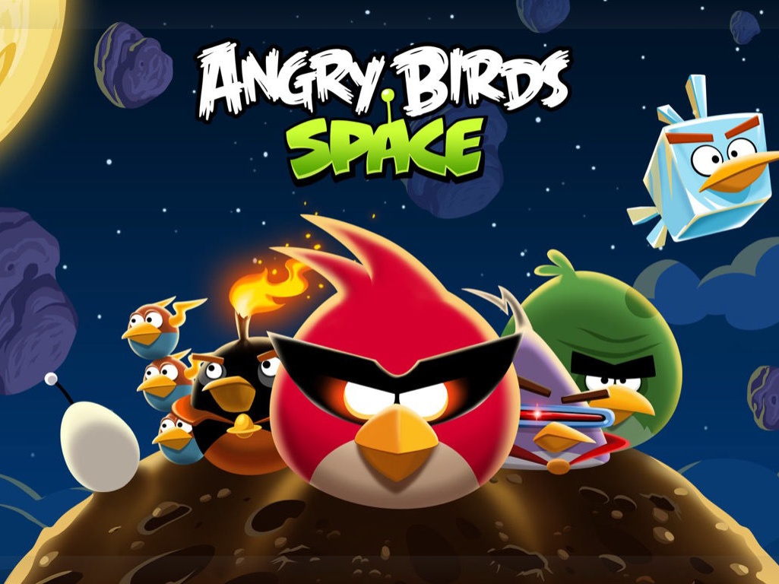
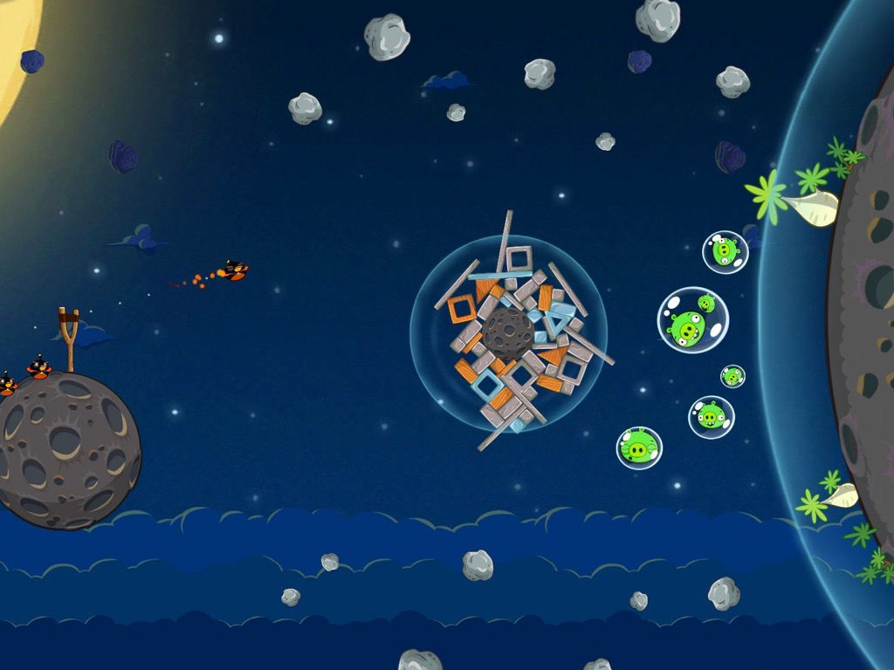
3.3. Angry Birds Space

Slide 10


4. Product Features
Approximately 10 Levels:
- Levels will be connected by a story
- No procedural generation
The controls:
- The rocket will be controlled by arrow keys

Slide 11


4. Product Features
Information windows in order to teach the mathematics and physics needed to play.
Limited rocket fuel management

Slide 12
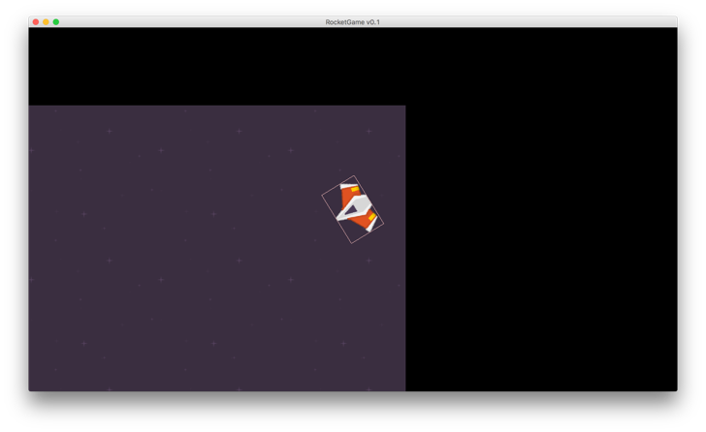
4. Product Features
Camera will be centered on the rocket.

Slide 13
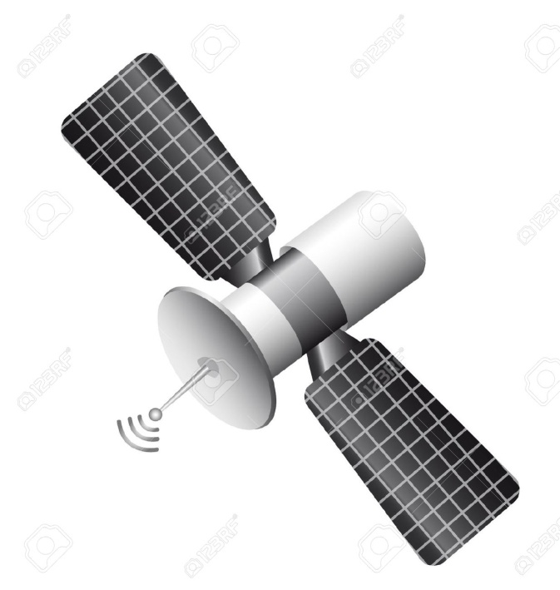

4. Product Features
Objectives in the Game:
Space Exploration
Cargo Delivery
Satellite Positioning
Racing
Rescue Missions

Slide 14

4. Product Features
The Physics Engine:
Realistic Gravitation
Varying Rocket Mass
Collisions

Slide 15
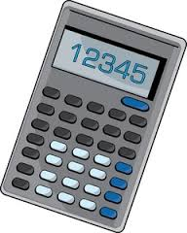
4. Further Product Features
Pop-up boxed with the “Did you know?” facts.
Decision-based action by user in order to learn space travel (Optimal values of speed, mass, endurance…etc.)
Time-warping

Slide 16
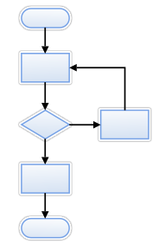
5. User Interface
Starting Screen
Main Menu
Options Menu Screen
Credits Screen
Level Selection Secreen
In-Game Screen
Cut Scenes
Pre-Launch Window (if implemented)

Slide 17
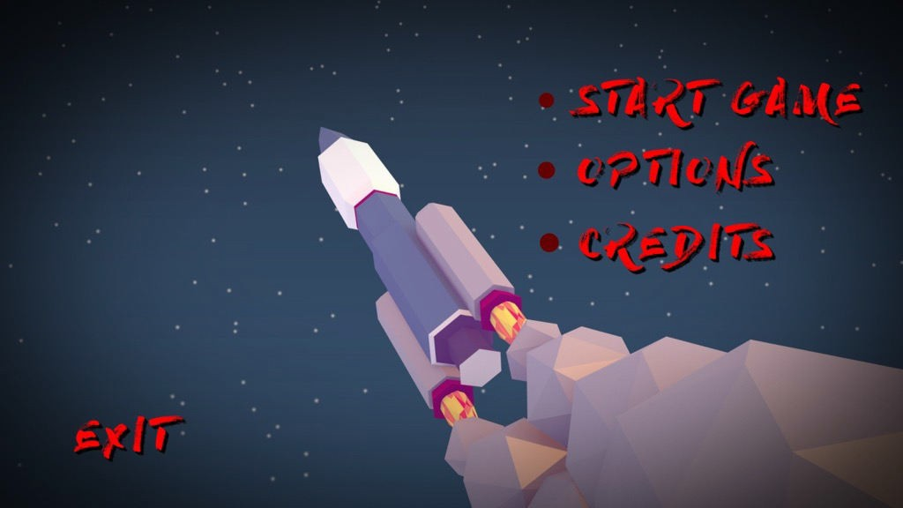
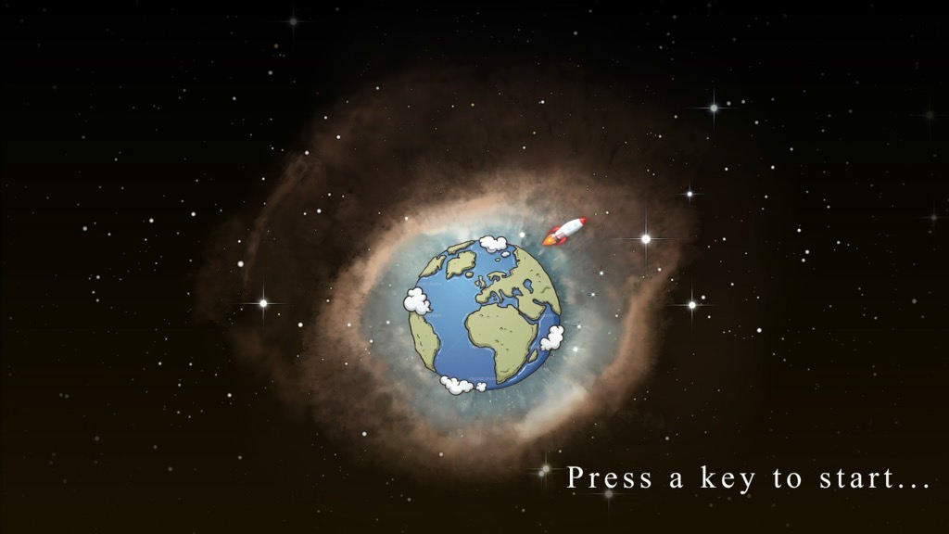

Slide 18
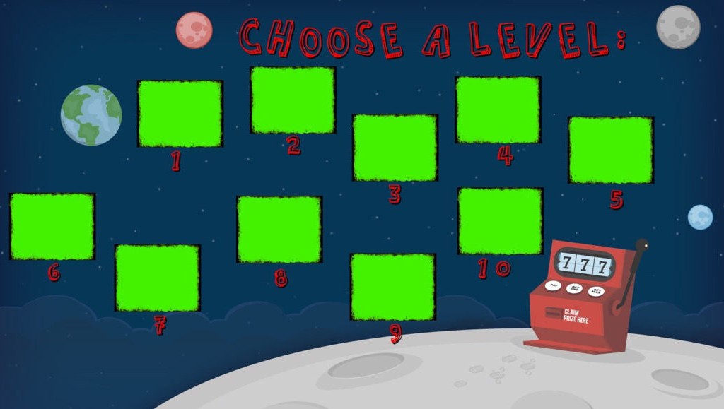

Slide 19
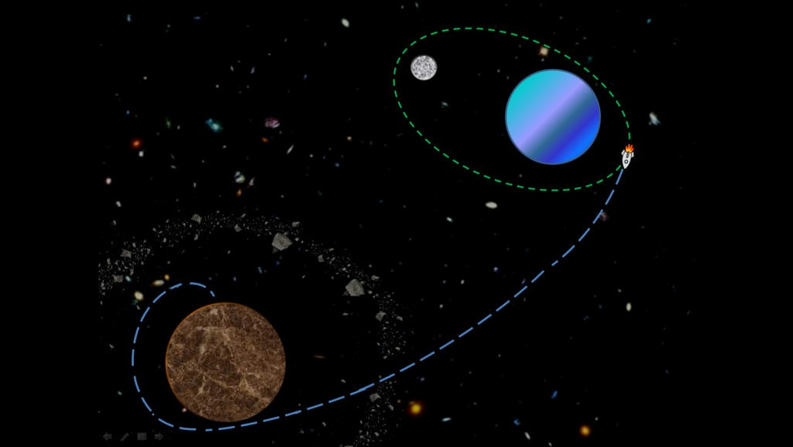

Slide 20
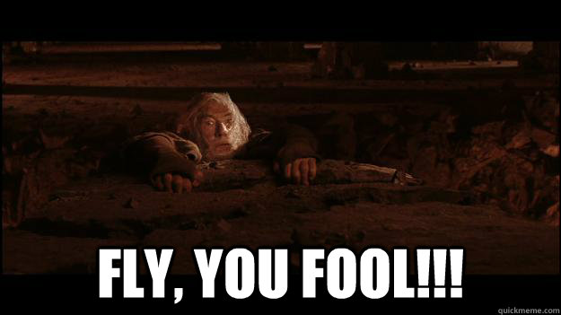
Thank you for your attention!
(possible game slogan)

