Slide 1
Requirements&UserInterface
Rocket Fool (A 2D Rocket Game)
Project Group: 5H
Ömer Ekmekcioğlu, Alperen Erkek, Levent Berk Güngen, Hakan Yaman Sözer, Hakan Türkmenoğlu
Assistant: Dorukhan Arslan

Slide 2
1. Initial Problem Discussion
Space travel is expected to be an integral part of mankind’s future. Therefore, learning about it would be beneficial for everyone.
In order to attract people to space travel and prevent misconceptions about it, it needs the be taught well.
A fine way to do this would be to show a simulation, which can be done by exhibiting a space game.

Slide 3
2. What is Rocket Fool?
Platform: Desktop PC, a desktop application
Genre: Simulation, Educational, Puzzle
Generally, it is about piloting a rocket from one plane to another.
Target Audience: General but especially for high school and university students.

Slide 4
3. Similar Products Review
Basicly, Rocket Fool is inspired by:
Kerbal Space Program
Into Space 2
Angry Birds Space

Slide 5
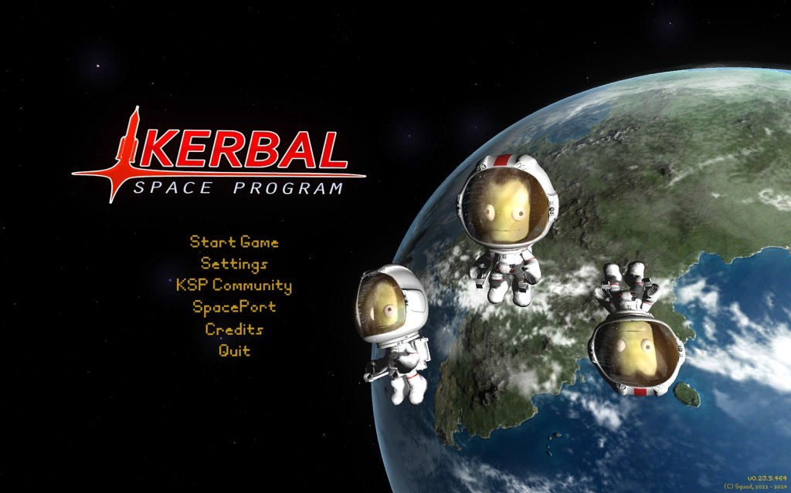
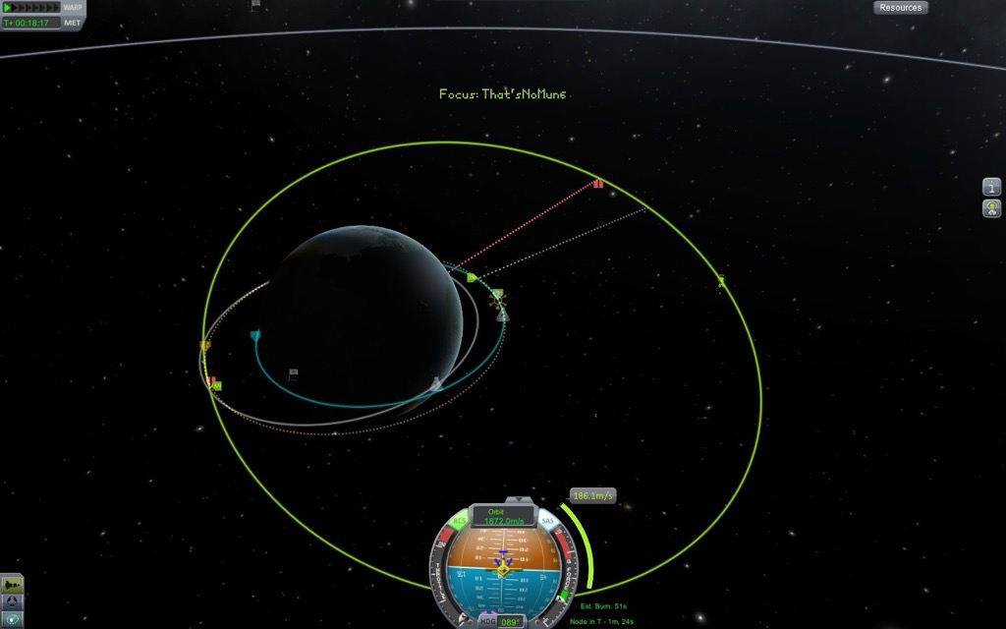
3.1. Kerbal Space Program

Slide 6
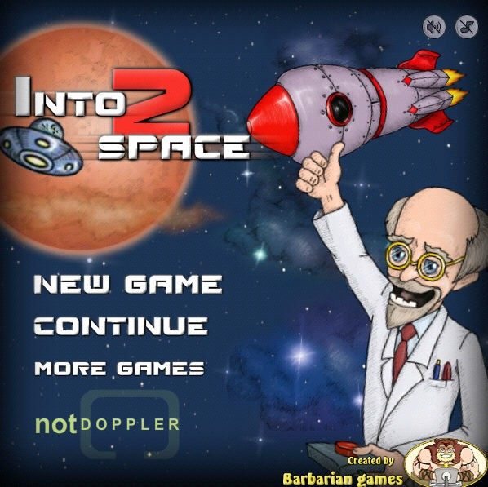
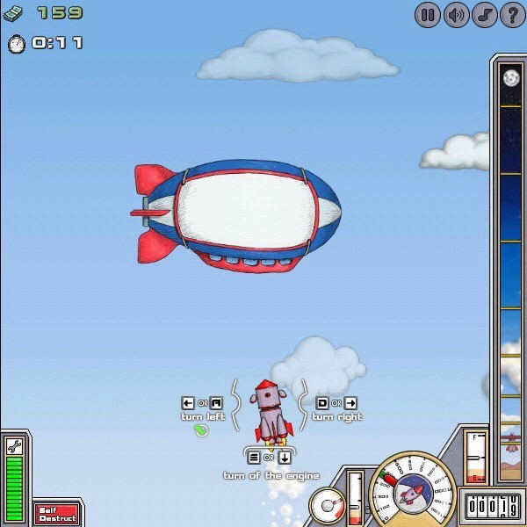
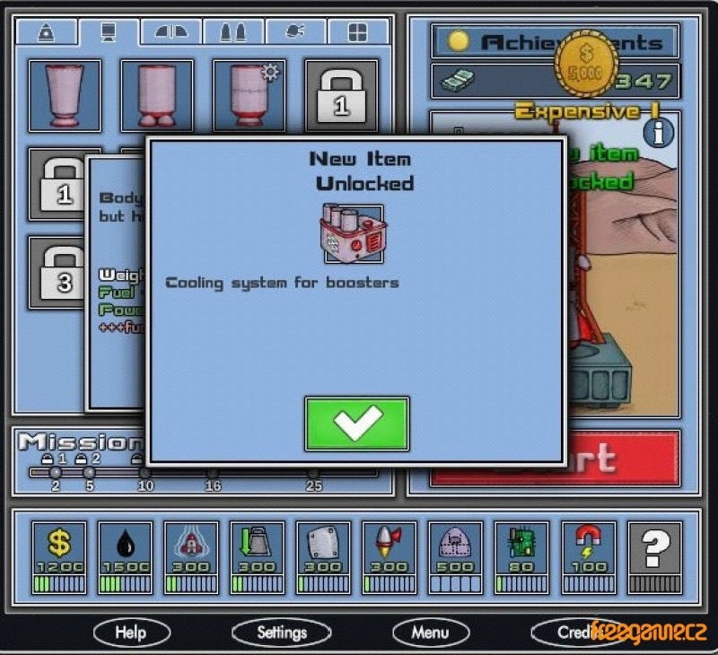
3.2. Into Space 2

Slide 7
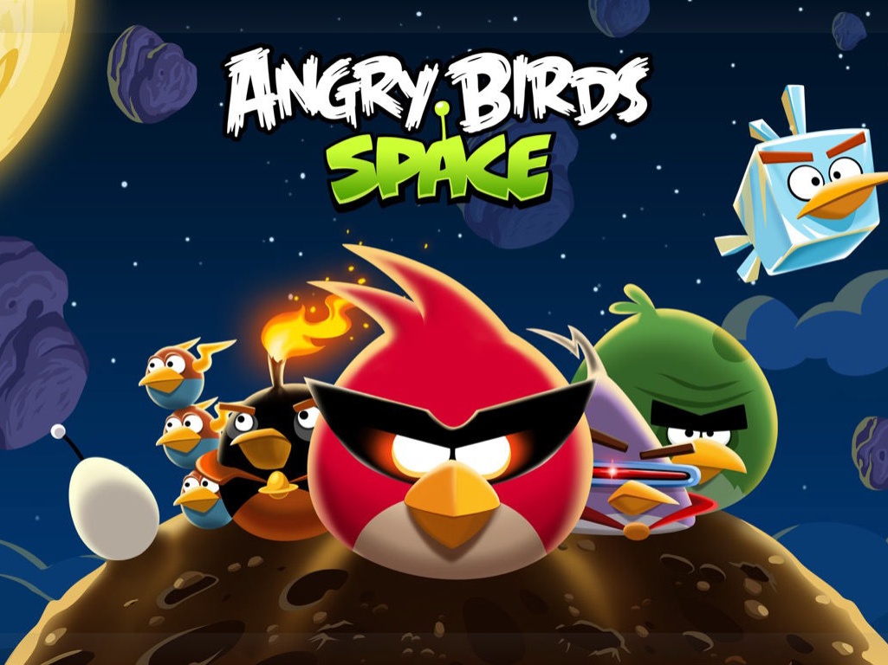
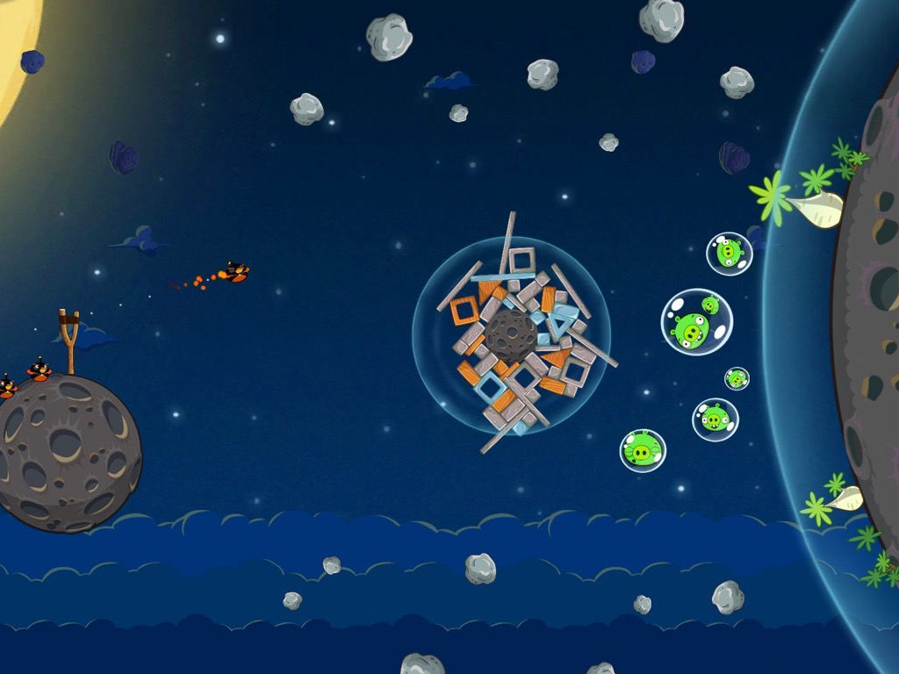
3.3. Angry Birds Space

Slide 8
4. Product Features
Approximately 10 Levels:
- Levels will be connected by a story
- No procedural generation
The controls:
- The rocket will be controlled by arrow keys
Information windows in order to teach mathematics and physics.

Slide 9
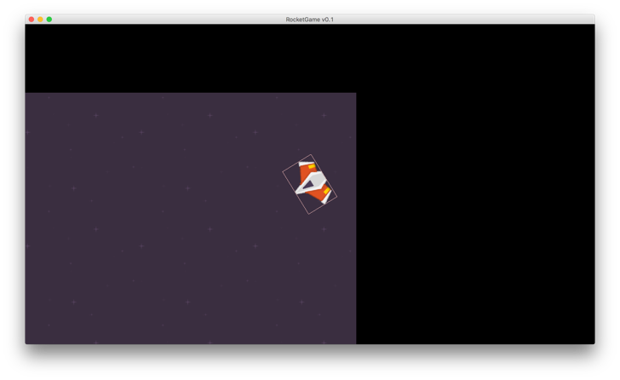
4. Product Features
Camera will be positioned at the rocket.

Slide 10
4. Product Features
Objectives in the Game:
Space Exploration
Cargo Delivery
Satellite Positioning
Racing
Rescue Missions

Slide 11
4. Product Features
The Physics Engine:
Realistic Gravitation
Varying Rocket Mass
Collisions

Slide 12
4. Further Product Features
Pop-up boxed with the “Did you know?” facts.
Decision-based action by user in order to learn space travel (Optimal values of speed, mass, endurance…etc.)
Time-warping

Slide 13
5. User Interface
Starting Screen
Main Menu
Options Menu Screen
Credits Screen
Level Selection Secreen
In-Game Screen
Cut Scenes
Pre-Launch Window (if implemented)

Slide 14
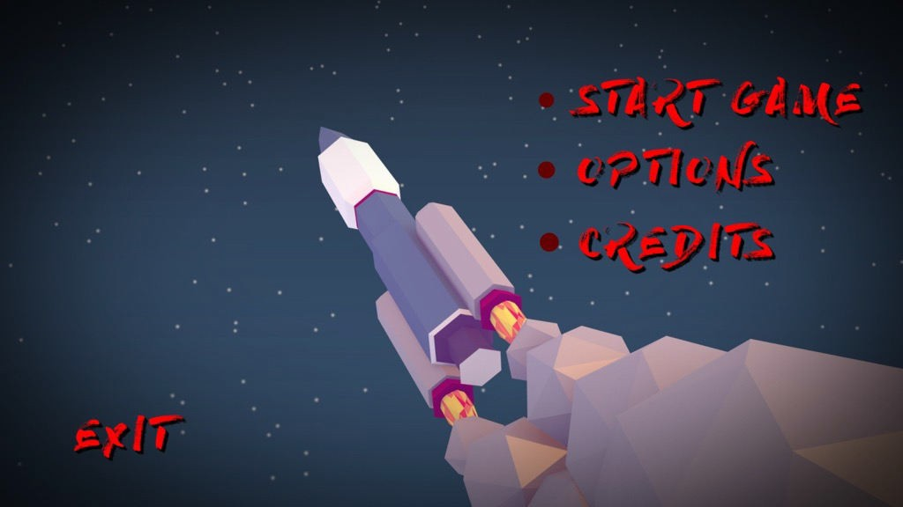
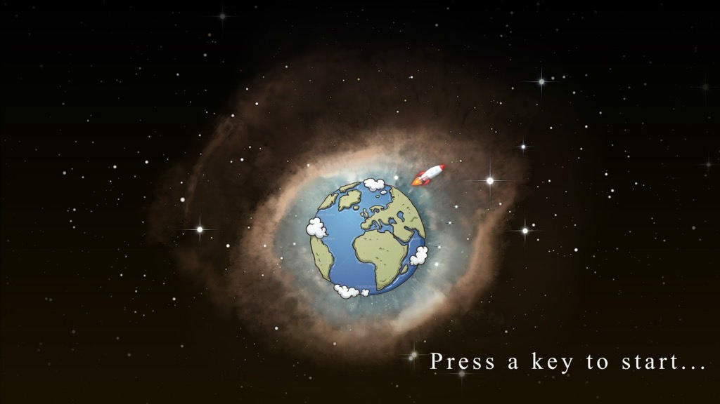
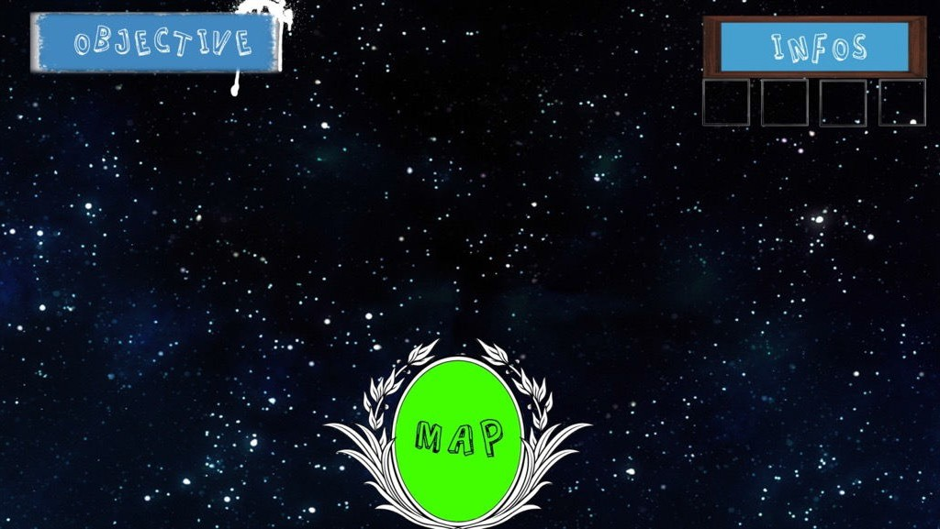
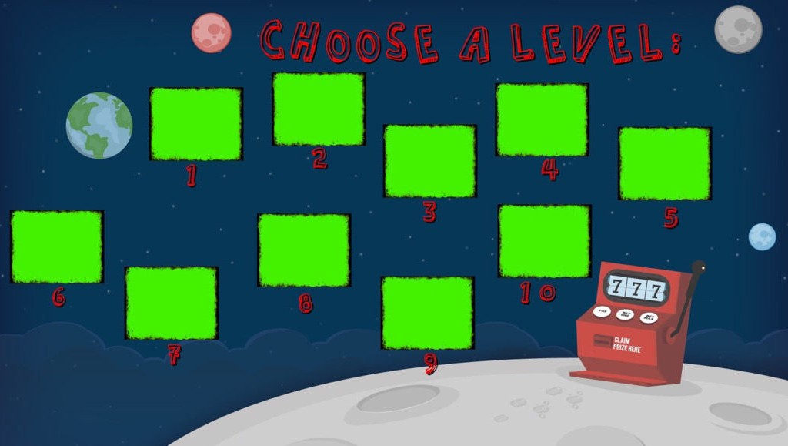

Slide 15
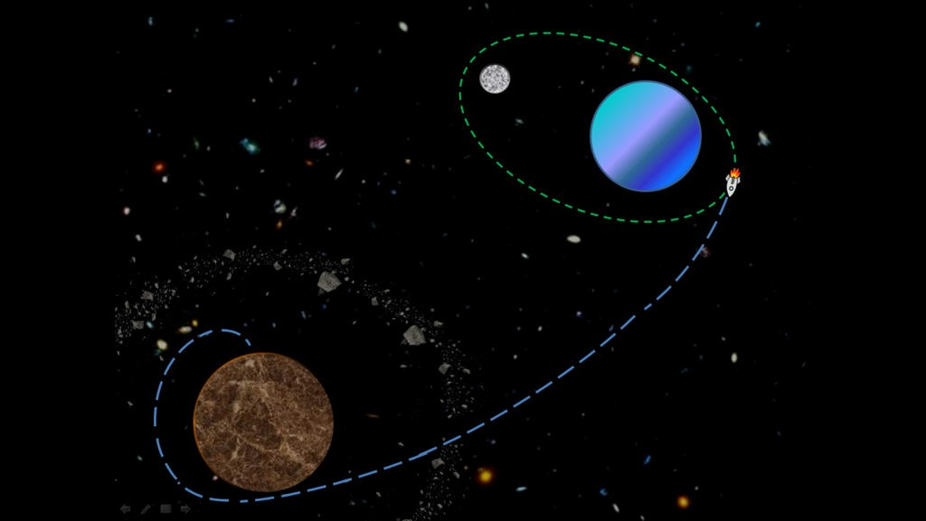

Slide 16

Thank you for your attention!

