Slide 1
The Battle of Neighbourhoods

Slide 2
Introduction
People often move from country to country or between cities for work meetings, where they don’t know much about the neighbourhoods of that particular city. So, they may struggle to find the perfect hotel near their work place.
Hence this problem is solved by gathering the data of city and make the clusters of all the hotels. So that when user will put the location of his work place he will get recommendation of all the hotels near that location which are present in the same cluster.

Slide 3
Data
We will use Geopy to get the Latitude and Longitude values of the cities and user workplace. Then to get the data about hotels and its name and distance all the other things we will be using Foursquare. We will request foursquare for hotel data which will be returned in Json file.
Then information will be extracted from that json file to DataFrame which will be further be used in clustering process.

Slide 4
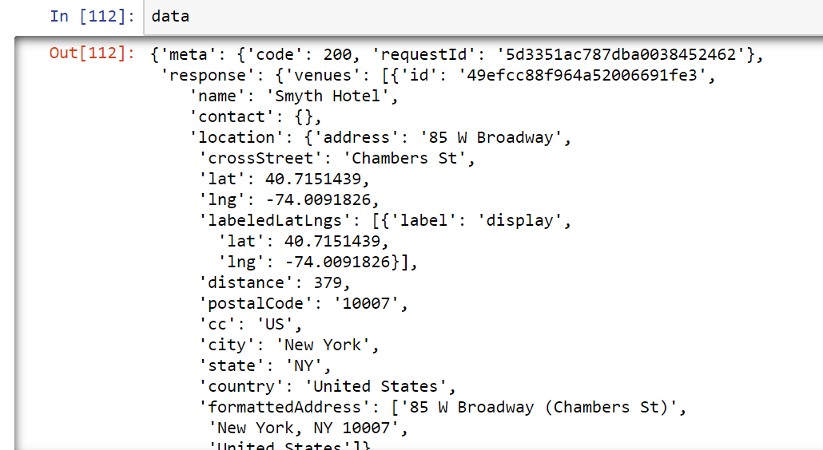
Json Response File

Slide 5
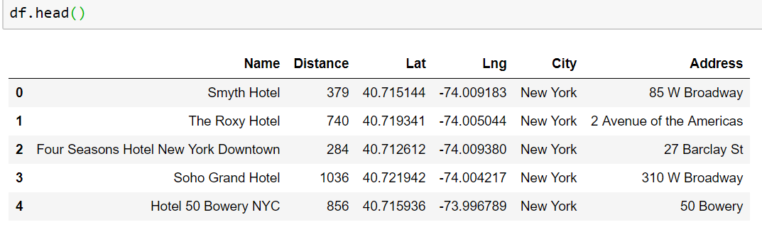
DataFrame Created from Json file
. it is cleaned and columns are named accordingly for further processing.

Slide 6
Methodology
First Lat and Lng values are stored in X. which will be used in clustering. Now the important thing about clustering is we have to guess the number of clusters in the given dataset.
For that we will be using a method named elbow method which will help us get the amount of cluster to be used in the given dataset.

Slide 7
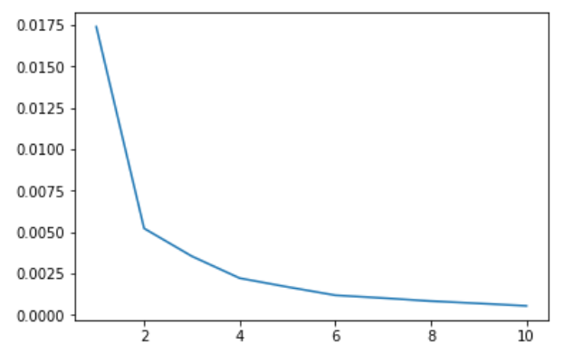
Elbow Method to find No of Clusters

Slide 8
Elbow Method
above is the graph obtained now we can see that at value 4 is perfect number. So we will initiate 4 centroids to create 4 clusters in our data.
Now we will import K-Means library from sklearn which a is machine learning library. The we will create a object of KMean with cluster value of 4. And with init=k-means++
Then we will get cluster values which we will add into our previously created DataFrame. Now this DataFrame will be used to make the recommendations to users based on the location user enters.

Slide 9
Results
User will be asked to put the location of his workplace where he is going to work. Using Geopy we will get the coordinates for entered address and then those coordinates will be provided to our k-mean model.
Then k-means model will predict the cluster for that specific location and all the values of that cluster will presented to user to decide which hotel he want to get into.

Slide 10
Result
Asking user to enter location

Slide 11
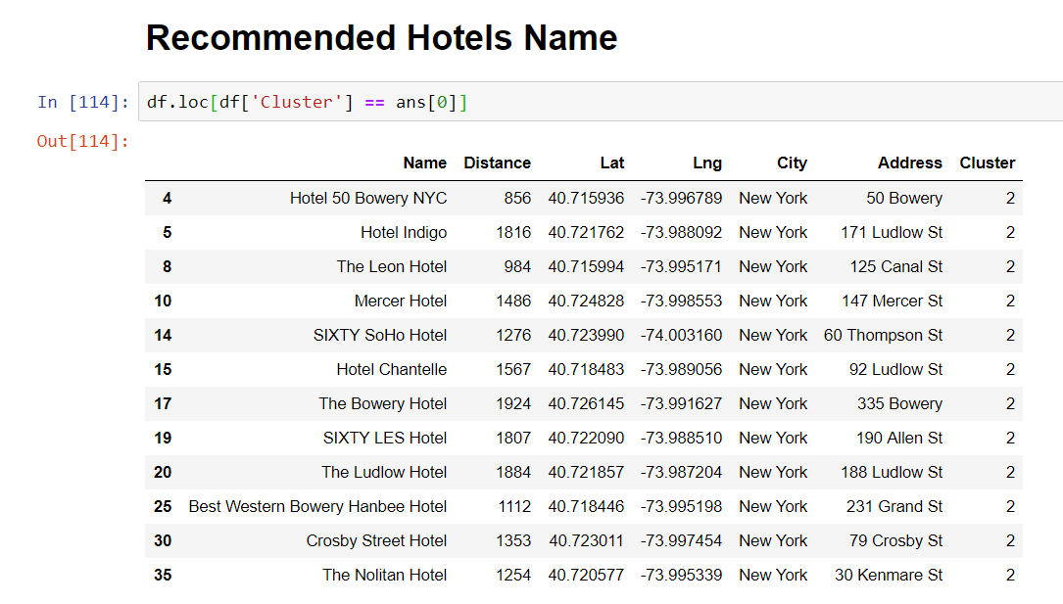
Result
List of hotels will be recommended to user based on entered location: -

Slide 12
Discussion section
Accuracy of the above model is good but it is limited to New York city. We will need to create model for every city so it will be used globally.
This same model I think can be used to predict the location for anyone who is interested in opening Hotel in this city by going through all the clusters and showing user the minimum and maximum number of hotels present in corresponding cluster or that location.
So, the owner can use this information to make wise decision to choose location for his hotel.

Slide 13
Conclusion section
It was a nice learning experience. This was a very simple and interesting project.
I learned how to use libraries and how data can used to for multiple things. as above model itself can be used to predict the locations of hotels for workers who are temporary coming to unknows city for working and also for recommending people who are looking to open hotel.
I conclude this project by saying I learned and enjoyed while learning a lot and a lot more learning and fun is yet to come.

