Slide 1


First Stage in NLP – Data Collection

Slide 2
Introduction
Data Collection Techniques
Manual
Scrapping
Sensors

Slide 3
Web Scrapping
Definitaion:
From where input comes from
Representation:
This refers to how knowledge is structured and stored for processing by NLP systems
Usage:
This refers to how the knowledge is applied in NLP tasks
How to use this DS for NLP Task
Any Dataset
Data Structure

Slide 4
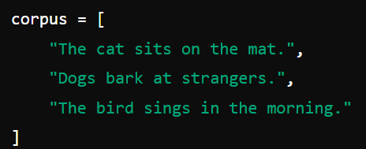
Introduction
Source:
From where input comes from
Representation:
This refers to how knowledge is structured and stored for processing by NLP systems
Usage:
This refers to how the knowledge is applied in NLP tasks
How to use this DS for NLP Task
Any Dataset
Data Structure

Slide 5

Introduction
Source:
From where input comes from
Representation:
This refers to how knowledge is structured and stored for processing by NLP systems
Usage:
This refers to how the knowledge is applied in NLP tasks
How to use this DS for NLP Task
Any Dataset
Data Structure

Slide 6
Introduction
What is Levels of Knowledge:
In Natural Language Processing (NLP), knowledge can be categorized into several types based on the source, representation, and usage
Source
Representation
Usage

Slide 7
Introduction
Source:
From where input comes from
Representation:
This refers to how knowledge is structured and stored for processing by NLP systems
Usage:
This refers to how the knowledge is applied in NLP tasks
Finding the most Common Word
How to use this DS for NLP Task
Any Dataset
Data Structure

Slide 8
Types of Knowledge Level
Linguistic Knowledge
Linguistic Knowledge
Phonological
Morphological
Syntactic
Semantic
Pragmatic Knowledge
Sound System
Understanding the root of the word
Rules and Principles
Meaning of Text
Contextual Meaning

Slide 9
Types of Knowledge Level
World Knowledge
World Knowledge
Factual
Common Sense
Procedural
Facts about events, Entity
General Understanding
How to perform specific task

Slide 10
Types of Knowledge Level
Domain Specific Knowledge:
Knowledge relevant to specific fields or industries: Education, Financial, Agro……
Multimodal Knowledge:
Integration of Multi Type of Data: Text/Video/Audio/Image
Meta Knowledge:
Supportive or Additional Knowledge: update-date/created-date/……

Slide 11
Thank You For Watching

