Slide 1

Networking with ZMQ
Python Masterclass Episode 7

Slide 2
Python masterclasses
A series of tutorials, with in-depth exploration of some Python aspect
Object model
Namespaces and attribute lookup
Concurrency / threading
Concurrency / asyncio
The import mechanism
Properties and descriptors
Networking with ZMQ
Packaging, distributing, and installing
The Abstract Syntax Tree
Introspection
Unittesting
Syntactic sugar
Extending / embedding Python

Slide 3

Agenda
Networking in Python
General issues with networking
Introduction ZMQ
Request – Reply pattern
Publish – Subscribe pattern
Task distribution
Summary
Ruud de Jong
Python expert at Capgemini Engineering
ruud.dejong@capgemini.com

Slide 4
Networking in Python
1

Slide 5
Standard library
Networking is built-in in Python's standard library.
There are essentially two packages:
socket and related classes (synchronous)
asyncio transports and loop.sock_*() methods (asynchronous)

Slide 6
socket and socketserver
The socket package contains several classes and functions for working with TCP and UDP sockets.
The socketserver module contains base classes that can be used to build server functionality.
Building a client with the socket package is deceptively easy.
Building a (demo) server with classes from socketserver is only marginally more work.
So why would we need anything else?

Slide 7
Problems with standard library networking
The socket package and socketserver modulet are built on the assumption that you can use blocking calls.
If you want to use non-blocking calls (e.g. because you want to use asyncio), things become way more difficult.
The look-and-feel of synchronous (blocking) networking is very different from asynchronous (non-blocking) networking.
We saw an example of this in the masterclass on asyncio.

Slide 8
Issues with Networking
2

Slide 9
Issues with networking in general
Performant applications handle network I/O in the background.
Instead of blocking.
Hard to get right.
Connections can disappear, or servers can go down.
This must be handled gracefully
Reconnect when possible
Message format should not be dictated by the network transport.
Networking should be agnostic about the message format
Messages should be queued when the receiver is not available
Not blocking the application
Queue management is essential

Slide 10
Issues with TCP
TCP is a continuous bytestream
Applications need to agree on how to represent messages on this bytestream (wire level protocol).
Requires a framing protocol on top of TCP.
Fixed size / delimiters / length field
Applications cannot read a message from a TCP socket
They can read a number of bytes
They must check if these bytes contain a message. Otherwise, read more.
When sending, they must check if all the bytes of a message are actually sent
Networking should not be limited to TCP.
Applications should be agnostic about the network transport
TCP is not suitable for (Ethernet-level) broadcasting or multicasting.

Slide 11
Introduction ZMQ
3

Slide 12
ZMQ: Sockets on steroids
Real life:
code must communicate with other code
in the same process, on the same machine, or on the other side of the globe
sockets are communication endpoints
code must be resilient
it must deal with broken connections, communication partners that appear or are suddenly gone, crashing applications, power-outs, etc.
these events become apparent via sockets (communication failures, closed connections, timeouts, etc.)
managing these events with low-level socket programming is a nightmare
ZMQ aims to addresss the problem of reliably connecting any code to any code, with small, reusable building blocks

Slide 13
ZMQ: Paradigm shift
In Python (and other conventional networking code)
A socket represents a communication endpoint
A socket has only a single connection
Servers spawn new sockets for each incoming connection request
A socket uses a single transport protocol (TCP, UDP, etc.)
A socket sends or receives data in a format that is determined by the transport protocol (bytestream for TCP, datagram for UDP, etc.)
In ZMQ
A socket represents a communication pattern
A socket can have multiple connections
A server uses a single socket for all connections
A socket can use multiple transport protocols simultaneously
A socket sends or receives data in ZMQ message format
A socket is essentially an asynchronous message queue

Slide 14
ZMQ: Communication patterns
Core communication patterns
Request-Reply
Connects a set of clients to a set of services.
Strict cadence of sending and receiving
Suitable for remote procedure calls and task distribution
Pub-Sub
Connects a set of publishers to a set of subscribers.
Publishers only send, subscribers only receive (and subscribe).
Pipeline
Connects endpoints in a fan-out / fan-in pattern.
Multiple steps and loops possible
Parallel task distribution and collection
Exclusive pair
Restricted to two endpoints
Typically used for connecting two threads in a process

Slide 15
ZMQ: Endpoints
Conventional sockets allow only strict one-to-one relations between endpoints
Or one-to-many for multicast and broadcast sockets
ZMQ sockets can connect to and accept connections from multiple endoints
They support many-to-many relations between endpoints
Except the PAIR socket type, that is strictly one-to-one.
Also some other socket types have restrictions
E.g. a pub-sub subscriber cannot have multiple connections to a single publisher.

Slide 16
ZMQ: Addresses
With ZMQ you can bind or connect a socket to an endpoint
The endpoint format is transport://address
transport can be: tcp, ipc, inproc, pgm, epgm, vmci
ipc is not available on Windows
(e)pgm and vmci are not widely used
address is a transport-specific address
Examples
tcp://localhost:12345
inproc://my_inproc_endpoint
ipc://worker.ipc

Slide 17
ZMQ: Socket types
REQ and REP for basic request / reply communication
ROUTER and DEALER for intermediate proxies or brokers in a request / reply communication pattern
PUB and SUB for basic pub / sub communication
XPUB and XSUB for intermediate proxies or brokers in a pub / sub communication pattern
PUSH and PULL for parallel processing
PAIR for one-to-one connections between threads

Slide 18
ZMQ: Valid socket type combinations
In the following list, either side can bind or connect.
REQ - REP
(X)PUB – (X)SUB
REQ – ROUTER
DEALER – REP
DEALER – ROUTER
DEALER – DEALER
ROUTER – ROUTER
PUSH – PULL
PAIR – PAIR

Slide 19
ZMQ: Messages
Messages are blobs of opaque data
Any size from 0 up to 2⁶³ – 1 bytes, or whatever fits in memory
A message consists of one or more parts, called frames
Each frame is either "empty" (a null byte), or contains a length followed by data
A major use for frames is to provide a reply envelope
Intermediate nodes (proxies, brokers) can add the identity of the originator as a reply envelope that wraps the message
In this way a reply can find its way back to the originator via the intermediate nodes
REQ and REP sockets handle reply envelopes autonomously
They are not visible to the application

Slide 20
Request – reply pattern
4

Slide 21
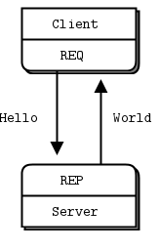
REQ – REP communication
The REQ-REP pattern enforces a strict cadence of sending and receiving messages.
A REQ socket requires that the first action is to send a message.
A REP socket requires that the first action is to receive a message.
Typically a REP socket corresponds to a server
It will bind to an address, and a REQ socket will connect to that address

Slide 22
Example: echo server
context = zmq.asyncio.Context()
socket = context.socket(zmq.REP)
socket.bind("tcp://*:5555")
name = "echo"
while True:
message = await socket.recv_string()
await socket.send_string(f"{echo}:{message}")

Slide 23
Example: echo client
context = zmq.asyncio.Context()
socket = context.socket(zmq.REQ)
socket.connect("tcp://localhost:5555")
await socket.send_string("my message")
reply = await socket.recv_string()
print(reply)

Slide 24
Demo echo server / client
One server – one client
One server – multiple clients
Multiple servers – one client
Multiple servers – multiple clients

Slide 25
Observations
A REQ socket sends request via each connection in a round-robin fashion.
A REP socket receives request from each connection in fair-queueing mode
Round-robin, but skip connections that don't have anything to receive
A REP socket handles each request completely before taking the next request.

Slide 26
Publish – subscribe pattern
5

Slide 27
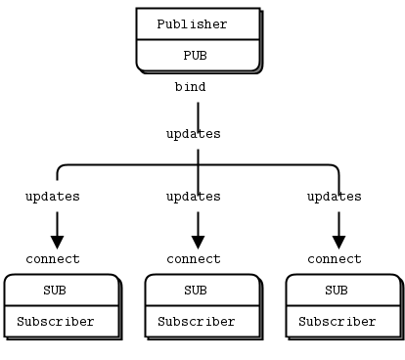
PUB – SUB communication
The PUB – SUB pattern enforces a one-way stream of messages, from the PUB socket to any number of connected SUB sockets.
SUB sockets don't talk back to PUB sockets.
No control of message rate
Publishers don't know when subscribers are ready to receive, or when they have disappeared
SUB sockets must subscribe to messages.
Otherwise they will not receive anything.
Subscription filtering is done in the PUB socket.

Slide 28
Example: weather update server
context = zmq.asyncio.Context()
socket = context.socket(zmq.PUB)
socket.bind(f"tcp://*:5555")
while True:
zipcode = randrange(1000, 10000)
temp = randrange(-30, 40)
humidity = randrange(10, 100)
await socket.send_string(f"{zipcode} {temp} {humidity}")

Slide 29
Example: weather update client
context = zmq.asyncio.Context()
socket = context.socket(zmq.SUB)
socket.connect(f"tcp://localhost:5555")
# Filter zipcode
zipcode = 1234
socket.setsockopt_string(zmq.SUBSCRIBE, str(zipcode))
temp_sum = 0
hum_sum = 0
for update in range(10):
received = await socket.recv_string()
zipc, temp, hum = received.split()
temp_sum += int(temp)
hum_sum += int(hum)
print(f"{zipcode}: average temp: {temp_sum / 10}, humidity: {hum_sum / 10}")

Slide 30
Demo weather update server / client

Slide 31
Observations
PUB – SUB is particularly useful when the client does not need to have the history of previously sent messages.

Slide 32
Task distribution
6

Slide 33
parallel pipeline

Slide 34
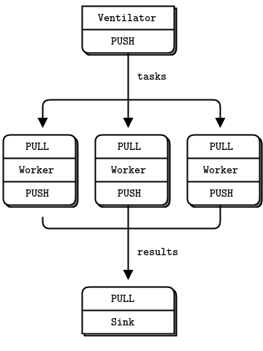
PUSH – PULL communication
The PUSH – PULL pattern enforces a one-way stream of messages, from any number of PUSH sockets to any number of PULL sockets.
PULL sockets don't talk back to PUSH sockets.
No control of task rate
PUSH socket does not know when PULL socket is available

Slide 35
Example: push-pull source
async def source(source_addr):
socket = context.socket(zmq.PUSH)
socket.bind(source_addr)
total_msec = 0
for _ in range(100):
workload = random.randint(1, 100)
total_msec += workload
await socket.send_string(f"{workload}")
print(f"Total workload: {total_msec}")

Slide 36
Example: push-pull sink
async def sink(sink_addr):
socket = context.socket(zmq.PULL)
socket.bind(sink_addr)
start_time = datetime.now()
for task_nbr in range(100):
_ = await socket.recv_string()
print(f"Total time {(datetime.now() - start_time).microseconds / 1000} milliseconds")

Slide 37
Example: push-pull worker
async def worker(name, source_addr, sink_addr):
source_socket = context.socket(zmq.PULL)
source_socket.connect(source_addr)
sink_socket = context.socket(zmq.PUSH)
sink_socket.connect(sink_addr)
job_count = 0
try:
while True:
s = await source_socket.recv_string()
job_count += 1
await asyncio.sleep(int(s) * 0.001)
await sink_socket.send_string("")
except asyncio.CancelledError:
print(f"{name} handled {job_count} jobs")

Slide 38
Demo push-pull

Slide 39
Observations
PUSH – PULL is useful when the source is not interested in the result of the operations.

Slide 40
Message QUEUE broker

Slide 41
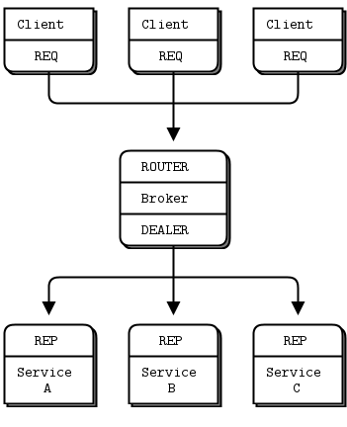
ROUTER and DEALER sockets
ROUTER sockets are like REP sockets, and DEALER sockets are like REQ sockets, except that can handle multiple connections asynchronously
For each connection, the order is still strict request-reply
But requests and reply for different connections can be handled independently

Slide 42
Example: client
async def client(name):
socket = context.socket(zmq.REQ)
socket.connect("tcp://localhost:5555")
print(f"{name} connected")
for i in range(10):
await asyncio.sleep(random.random())
print(f"{name} sending message {i}")
await socket.send_string(f"{name} {i}")
message = await socket.recv_string()
print(f"{name} received '{message}'")

Slide 43
Example: server
async def server(name):
socket = context.socket(zmq.REP)
socket.connect("tcp://localhost:5556")
print(f"{name} connected")
while True:
message = await socket.recv_string()
print(f"{name} received '{message}'")
await asyncio.sleep(random.random())
await socket.send_string(f"{name}: {message}")

Slide 44
Example: broker (setup)
async def broker():
frontend_socket = context.socket(zmq.ROUTER)
backend_socket = context.socket(zmq.DEALER)
frontend_socket.bind("tcp://*:5555")
backend_socket.bind("tcp://*:5556")
print("broker ready")
poller = Poller()
poller.register(frontend_socket, zmq.POLLIN)
poller.register(backend_socket, zmq.POLLIN)
while True:
...

Slide 45
Example: broker (work loop)
async def broker():
...
while True:
sockets = dict(await poller.poll())
if sockets.get(frontend_socket) == zmq.POLLIN:
print("Received message from frontend")
message = await frontend_socket.recv_multipart()
await backend_socket.send_multipart(message)
if sockets.get(backend_socket) == zmq.POLLIN:
print("Received message from backend")
message = await backend_socket.recv_multipart()
await frontend_socket.send_multipart(message)

Slide 46
Demo rr-broker

Slide 47
Observations
The broker manages to route replies back to the correct client.
This requires some further explanation

Slide 48
INTERMEZZO: Reply envelopes

Slide 49

REQ sockets
A REQ socket adds an empty delimiter frame before each message it sends.
A request message from a REQ socket looks like

Slide 50
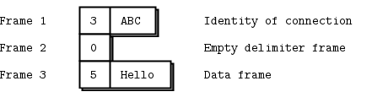
ROUTER sockets
A ROUTER socket adds a "reply envelope" to each message it receives.
When the message from the client is read from a ROUTER socket with recv_multipart(), the result is
When sending a message, the ROUTER socket uses the (outer) reply envelope to find the correct connection. It strips the reply envelop, and sends the rest over the connection:

Slide 51
DEALER sockets
A DEALER socket ignores reply envelopes. It just distributes messages over the connections, and fair-queues received message from all connections.
So the messages that are sent by the DEALER socket in the broker look like:

Slide 52
REP sockets
A REP socket saves all reply envelopes, up to the final empty frame. The frames after that are passed to the application. When it sends a reply, it attaches the reply to the saved reply envelopes.

Slide 53
LOAD BALANCiNG BrOKER

Slide 54
ROUTER and DEALER limitations
The ROUTER – DEALER message queue works fine when each job takes approximately the same time.
For that situation the fact that the DEALER distributes jobs over servers in a round-robin fashion is no problem.
But if some jobs take way more time than others, requests will queue up on the server that handles these long jobs, even when other servers are idle.
For that situation we need a load-balancing broker.

Slide 55
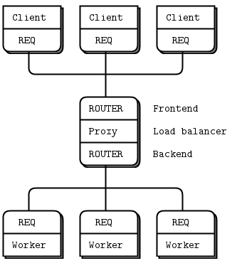
Load-balancing broker
The load-balancing broker inverts the flow to the workers
Instead of pushing jobs to the workers, the workers now ask for jobs.
That means that the broker knows which worker is available, and it can send the job to that worker.
The initiative now is with the worker, so they use a REQ socket to initiate communication by sending an initial request.
The worker receives a job in the reply, and sends the result in the next request
The broker has a ROUTER socket to which workers connect. The reply envelope identifies the worker that sent the request.

Slide 56
Example: worker
async def server(name):
socket = context.socket(zmq.REQ)
socket.connect("tcp://localhost:5556")
request = ""
while True:
await socket.send_string(request)
job = await socket.recv_string()
request = process(job)

Slide 57
Example: broker (setup)
async def broker(server_addr, worker_addr):
client_socket = context.socket(zmq.ROUTER)
client_socket.bind(server_addr)
worker_socket = context.socket(zmq.ROUTER)
worker_socket.bind(worker_addr)
poller = Poller()
free_workers = asyncio.Queue()
worker_client_map = dict()
poller.register(worker_socket, zmq.POLLIN)
client_registered = False

Slide 58
Example: broker (workloop – message from worker)
while True:
sockets = dict(await poller.poll())
if worker_socket in sockets:
multipart_message = await worker_socket.recv_multipart()
worker_id = multipart_message[0]
client_id = worker_client_map.pop(worker_id, None)
if client_id is not None:
multipart_message[0] = client_id
await client_socket.send_multipart(multipart_message)
await free_workers.put(worker_id)
if not client_registered:
poller.register(client_socket, zmq.POLLIN)
client_registered = True
if client_socket in sockets:
...

Slide 59
Example: broker (workloop – message from client)
while True:
sockets = dict(await poller.poll())
if worker_socket in sockets:
...
if client_socket in sockets:
multipart_message = await client_socket.recv_multipart()
client_id = multipart_message[0]
worker_id = await free_workers.get()
if free_workers.empty():
poller.unregister(client_socket)
client_registered = False
worker_client_map[worker_id] = client_id
multipart_message[0] = worker_id
await worker_socket.send_multipart(multipart_message)

Slide 60
Demo FIBONACCI

Slide 61
WRAP-UP
7

Slide 62
Summary
ZMQ offers small, efficient building blocks for networked applications
It has a rather steep learning curve, primarily because you need to unlearn your assumptions about networking, sockets, etc.
The ZMQ guide reads easily, and has examples in various languages
The author is very opiniated about various topics, and that shows in the tekst
But the explanations of the working of ZMQ and the examples are excellent
The ZMQ API reference though is stictly C
This masterclass scratched only the surface of ZMQ.
In particular, security and reliability have not been addressed.
But the ZMQ guide addresses these topics as well.

Slide 63
Questions?

Slide 64
Credits
Much of the material in this masterclass derives from the ZMQ guide by Pieter Hintjens.
Most examples have been adapted from the examples in the ZMQ guide.
The pictures showing the interactions between various ZMQ components have been copied from the ZMQ guide.

Slide 65
Getting the presentation and example code
This presentation, together with the example code, will be available on
https://github.com/Python-Masterclass/Networking
Documentation
Socket Programming in Python (Guide)
(https://realpython.com/python-sockets/)
The ZMQ guide by Peter Hintjens (https://zguide.zeromq.org/)

