Slide 1

Brighton Py
AI as API in everyday Python
AI Agents
Craig West
Freelance Pythonista
Brighton, UK
GitHub Repo: https://pytest-cookbook.com/
https://ai-powered-knowledge-systems.netlify.app/
https://pytest-cookbook.com/
https://django-fullstack-testing.netlify.app/

Slide 2
DjangoCON Europe 2025
Implementing Agentic AI Solutions
in Django from scratch
Craig West
Freelance Pythonista
Brighton, UK
GitHub Repo: https://pytest-cookbook.com/
https://ai-powered-knowledge-systems.netlify.app/
https://pytest-cookbook.com/
https://django-fullstack-testing.netlify.app/

Slide 3
SQL Doc
We store the SQL Query along with metadata so that we can us Agentic RAG to select the most appropriate query.
This ensures we have deterministic responses even if it may not be the answer to the question (see strategy diagram).
We can provide user feedback so that the SQL Doc store can be improved.
tbl_sql:
SQL - short_desc - long_desc – arguments - keywords
The user will get the selected query along with description etc.
tbl_user_query
Has numerous user_queries that are linked to SQL in the above table. When we get a user_query we can use LLM to rewrite it in say 5 ways and then use these to match a user_query in this table which will link to the SQL in tbl_sql.

Slide 4
QUERY_1+ DATA
SEND TO LLM
RESPONSE_1
QUERY_2 + RESPONSE_1
SEND TO LLM
RESPONSE_2
We change our QUERY_2 to carry out new instructions along with previous RESPONSE_1 to generate RESPONSE_2
We can pass RESPONSE_1 to another Agent if we want to separate out functionality.

Slide 5
ETL
Unstructured Data
Structured Data
Use LLM, VLM or unstructured.io to extract data
NON-AGENTIC DATA WRANGLING
LOAD INTO DB

Slide 6
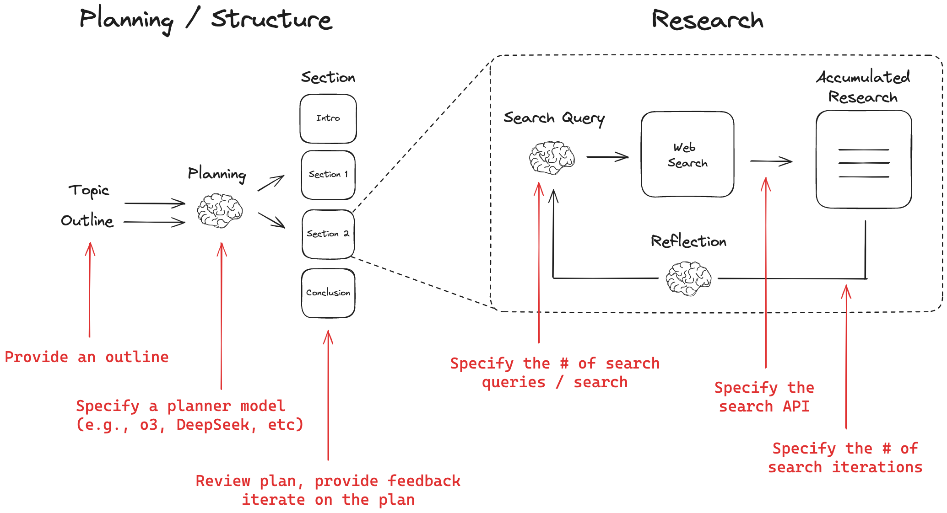
PLANNING
We can use Agents to plan the tasks required to make reports.
We also can use AI to get more nuance on user intent.
https://github.com/langchain-ai/open_deep_research/blob/main/README.md

Slide 7


QUERY
LLM
SQL
Obtain relevant SQL Schema and get Agent to create SQL query that is then run to get result.
Store tried and tested SQL queries like documents in DB with meta data to enable keyword and semantic search to produce results.
LLM to generate more verbose report.
User rating to provide feedback and future ML data.

Slide 8
REPORTING
LLM to generate more verbose report available in various formats.
Web based dashboard.

Slide 9
ROUTER EXAMPLE
Translate natural language to select appropriate report
PROCESS INPUT
FAQ EXAMPLE
Create a natural language response to a query
GENERATE OUTPUT
EXTRACTION EXAMPLE
Extract data and store it
DO SOMETHING

Slide 10
01 KEY TAKEWAYS
# 1 There is just one endpoint/route.
# 2 It is STATELESS so we must pass all relevant data each time.
# 3 We pass messages in the form of SYSTEM messages and USER messages as OpenAI used this in their training set.

Slide 11
02 KEY TAKEWAYS
# 1 We can add instructions using Natural Language so that it performs operations.
# 2 The more specific and clear we are the better – like creating a good Job Description/Manual.
# 3 We imperatively define what output format we want and using Markdown/Caps has been shown to be effective in emphasising points.

Slide 12
03 KEY TAKEWAYS
# 1 We can add contextual data to effectively ‘fine-tune’ the LLM.
# 2 Our queries will then be able to answer using this added data – RAG effectively.
# 3 We can ‘a bit of AI’ in the form of FAQ/HELP/SEARCH using this pattern.

Slide 13
04 KEY TAKEWAYS
# 1 The Agent can select the most appropriate report from Natural Language from a form for example, that can be combined with structured input from a form like dates, format etc.
# 2 This is akin to an ‘if/else’ pattern because we can code in the next step based on what is returned.
#3 We could pass this to another agent which can then execute instructions in it as well as determine the next step.

Slide 14
05 KEY TAKEWAYS
# 1 We can get the agent to determine which tool to run by further asking it to extract the arguments and the function name. Tool is some code – function/class etc.
# 2 This is known as ‘tool calling’. Once the function and arguments are executed, we can pass them on to another agent or we can loop over the output until we get a specified answer, (see 20_planning).

Slide 15
20 KEY TAKEWAYS
ReAct pattern – Reason/Act
Like the reflection pattern, we pass the output back into the agent until we get to a break point.

