Slide 1


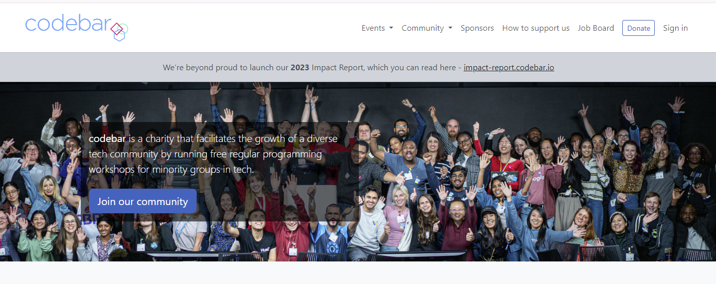
Brighton Py
AI as API in everyday Python
Craig West
Freelance Pythonista
Brighton, UK
I am enjoying my new puppy, Leo, working in community kitchens and being a coach at codebar.io/brighton, which I find very rewarding.
GitHub Repo: https://pytest-cookbook.com/
https://ai-powered-knowledge-systems.netlify.app/
https://pytest-cookbook.com/
https://django-fullstack-testing.netlify.app/

Slide 2
QUERY_1+ DATA
SEND TO LLM
RESPONSE_1
QUERY_2 + RESPONSE_1
SEND TO LLM
RESPONSE_2
We change our QUERY_2 to carry out new instructions along with previous RESPONSE_1 to generate RESPONSE_2
We can pass RESPONSE_1 to another Agent if we want to separate out functionality.

Slide 3
ROUTER EXAMPLE
Translate natural language to select appropriate report
PROCESS INPUT
FAQ EXAMPLE
Create a natural language response to a query
GENERATE OUTPUT
EXTRACTION EXAMPLE
Extract data and store it
DO SOMETHING

Slide 4
01 KEY TAKEWAYS
# 1 There is just one endpoint/route.
# 2 It is STATELESS so we must pass all relevant data each time.
# 3 We pass messages in the form of SYSTEM messages and USER messages as OpenAI used this in their training set.

Slide 5
02 KEY TAKEWAYS
# 1 We can add instructions using Natural Language so that it performs operations.
# 2 The more specific and clear we are the better – like creating a good Job Description/Manual.
# 3 We imperatively define what output format we want and using Markdown/Caps has been shown to be effective in emphasising points.

Slide 6
03 KEY TAKEWAYS
# 1 We can add contextual data to effectively ‘fine-tune’ the LLM.
# 2 Our queries will then be able to answer using this added data – RAG effectively.
# 3 We can ‘a bit of AI’ in the form of FAQ/HELP/SEARCH using this pattern.

Slide 7
04 KEY TAKEWAYS
# 1 The Agent can select the most appropriate report from Natural Language from a form for example, that can be combined with structured input from a form like dates, format etc.
# 2 This is akin to an ‘if/else’ pattern because we can code in the next step based on what is returned.
#3 We could pass this to another agent which can then execute instructions in it as well as determine the next step.

Slide 8
05 KEY TAKEWAYS
# 1 We can get the agent to determine which tool to run by further asking it to extract the arguments and the function name. Tool is some code – function/class etc.
# 2 This is known as ‘tool calling’. Once the function and arguments are executed, we can pass them on to another agent or we can loop over the output until we get a specified answer, (see 20_planning).

Slide 9
20 KEY TAKEWAYS
ReAct pattern – Reason/Act
Like the reflection pattern, we pass the output back into the agent until we get to a break point.

