Slide 1


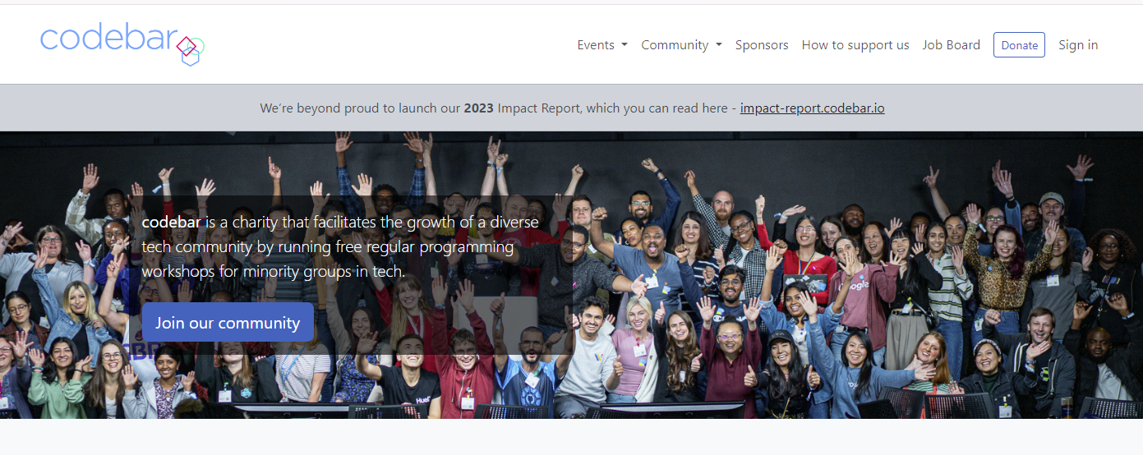
DjangoCongress JP
Implementing Agentic AI Solutions in Django from scratch
Craig West
Freelance Pythonista
Brighton, UK
I am enjoying my new puppy, Leo, working in community kitchens and being a coach at codebar.io/brighton, which I find very rewarding.
GitHub Repo: https://pytest-cookbook.com/
https://ai-powered-knowledge-systems.netlify.app/
https://pytest-cookbook.com/
https://django-fullstack-testing.netlify.app/

Slide 2
QUERY_1+ DATA
SEND TO LLM
RESPONSE_1
QUERY_2 + RESPONSE_1
SEND TO LLM
RESPONSE_2
We change our QUERY_2 to carry out new instructions along with previous RESPONSE_1 to generate RESPONSE_2

Slide 3
ROUTER EXAMPLE
Translate natural language to select appropriate report
PROCESS INPUT
FAQ EXAMPLE
Create a natural language response to a query
GENERATE OUTPUT
REFLECTION EXAMPLE
Reviewing code and making suggestions with a final report
DO SOMETHING

Slide 4
KEY TAKEWAYS
# 1 Create a natural language response to a query
# 2 Create a natural language response to a query
# 3 Create a natural language response to a query

