Slide 1

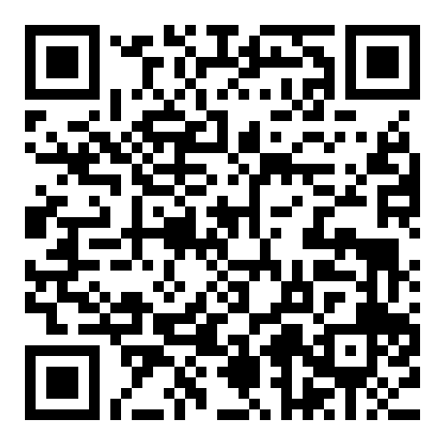
AI Agents in the Data Pipeline
Craig West
https://craig-west.netlify.app/
https://evaluating-ai-agents.com/
Talk Slides and Repo:
https://github.com/Python-Test-Engineer/earl2025
This also contains links to a video of the BrighonPy
talk/workshop on ‘AI as API’ and the repo for the
PyData Southampton Meetup ‘AI Agents in The Data Pipeline’
as well as additional resources.

Slide 2
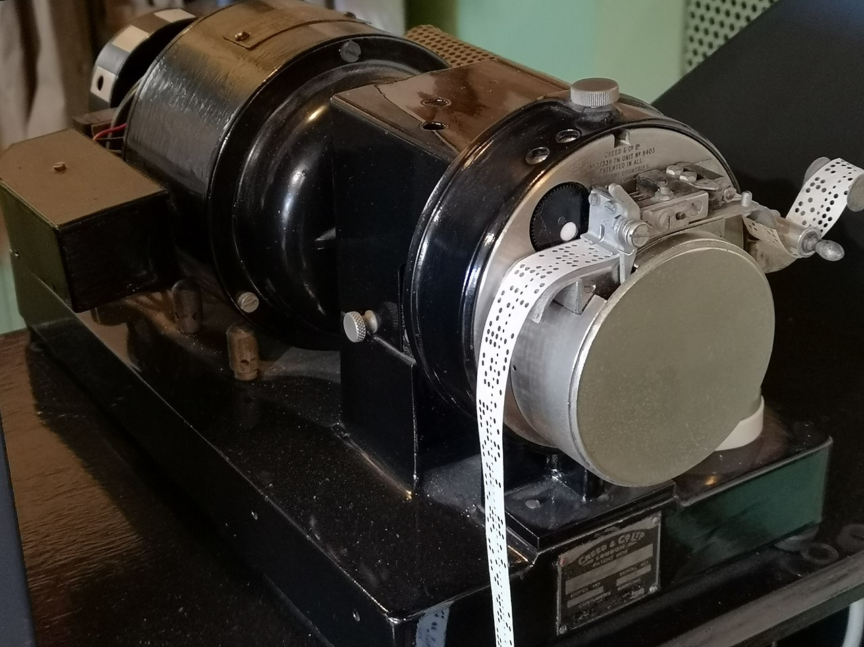



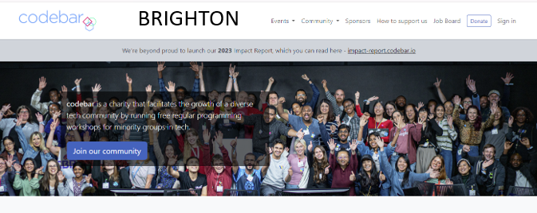
About me
I live about 1 mile north…

Slide 3
Desired Outcomes
To better understand the Agent Landscape, its terminology, basis and uses.
To demystify and simplify what an Agent is.
To see the uses of AI Agents in the Data Pipeline and the likely future of Data Pipeline applications.
This is a ‘fly by’ rather than ‘deep dive’. The repo has more detailed examples and links to help you go further and deeper.

Slide 4


Raw code implementation of an Agent
No more difficult than what we do currently – just 180 degrees different
“It doesn’t get any easier – just different” - Anon

Slide 5
Raw code implementation of an Agent
Just one API endpoint – ‘AI as API’
Instructions are written on client side and sent with request
Use Natural Language
An example prompt…

Slide 6
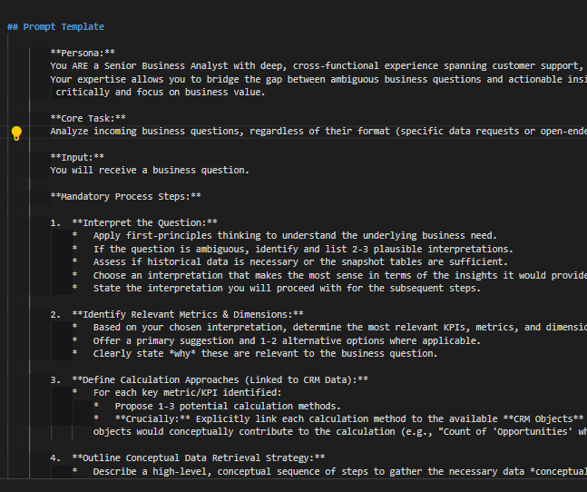
06_demo_prompt_google_crm.md

Slide 7
Agenda
With code examples where appropriate:
AI Agents from scratch – a POST API Request
Understand what Tool/Function calling are
Agentic Patterns
Model Context Protocol – changing app architecture
Demos of some patterns
Final demo of Cline building a data pipeline from scratch and producing a Business Intelligence report form the charts and graphs.

Slide 8
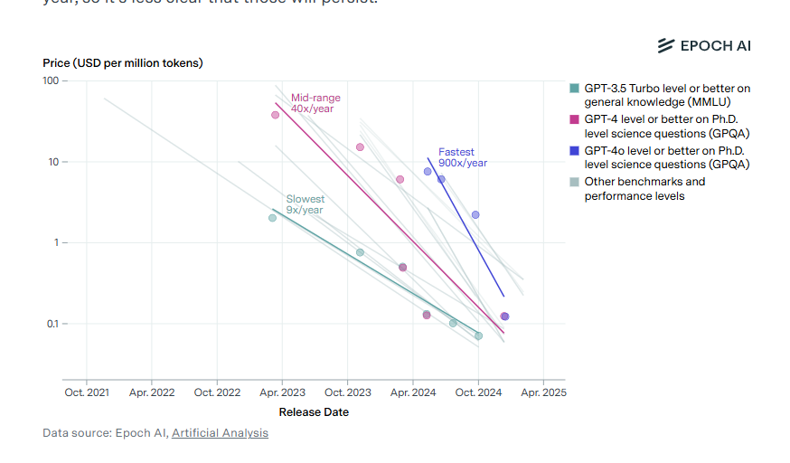
Model costs
The final Cline demo the cost per intelligence has dropped by a factor of 2-4 in last 3 months
Models have become increasingly more capable and ‘intelligent’.
Cost of a unit of ‘intelligence has dropped ~ 99% in last two years and is 10x a year (anecdotal)

Slide 9
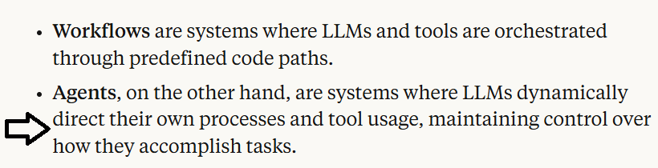
What is an AI Agent?
Many definitions but people opt for ‘Agentic Apps’
Anthropic

Slide 10
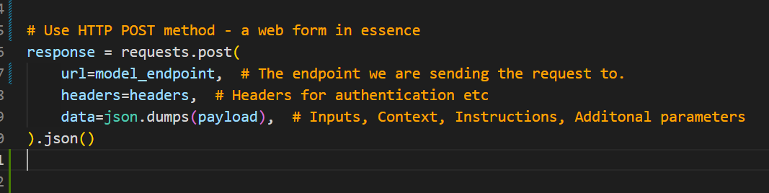
Raw code implementation of an Agent
We saw an example of a prompt earlier – ‘payload’
Let’s look at 01_raw_post_request.py in the repo…

Slide 11
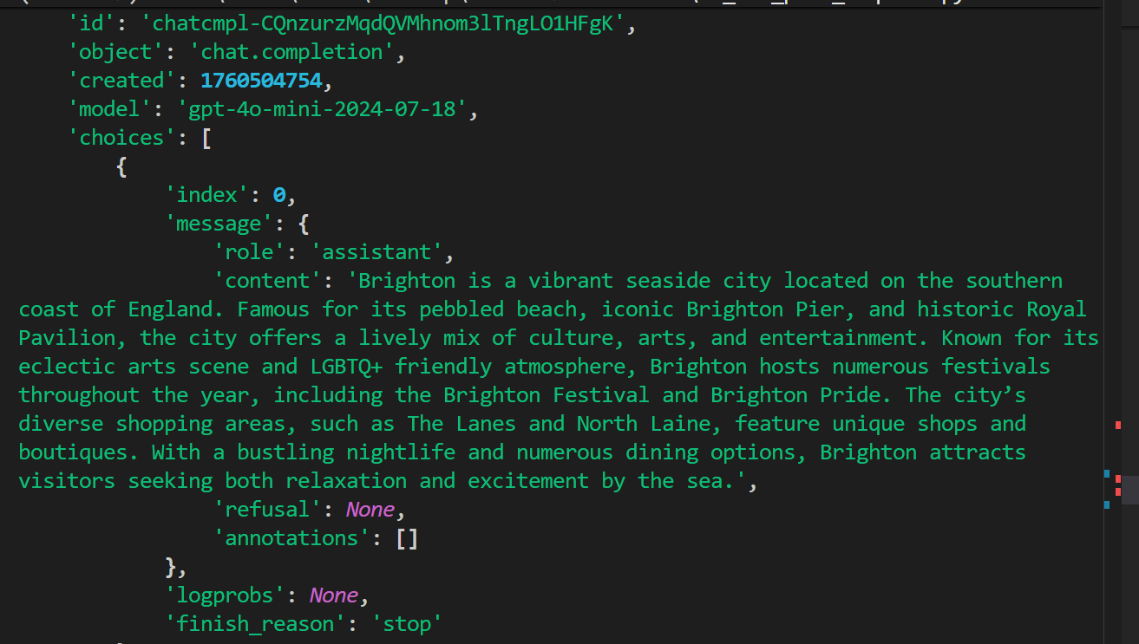
Tell me about Brighton……

Slide 12
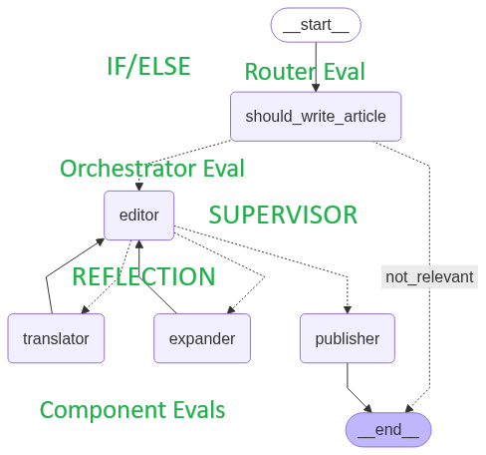
Given an article title, determine if it is about AI (ROUTER) and if so start workflow
Take title and create article of N words (EXPANDER)
In a specified language (TRANSLATOR)
Ensure article is not sensational (EDITOR)
A ‘good article’ – OMITTED IN DEMO
PUBLISH = YES only if last three are YES in EDITOR

Slide 13
Prompt Engineering
Essentially a set of instructions…
“Tell me about Data Analytics in 100 words…” will give a pretrained response…
“ Tell me about Data Analytics and how it can help me with our sales analysis for the last quarter…” will give us a response of: “I need more info…” as it has not been trained on our data.”

Slide 14
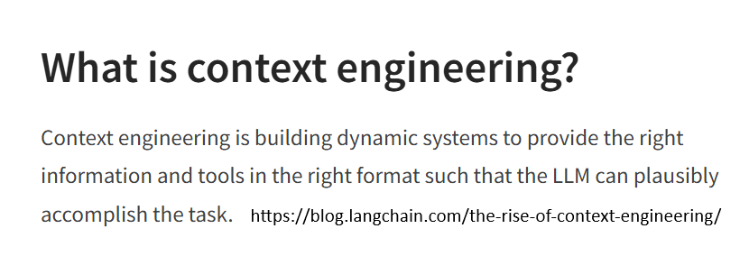
Context Engineering

Slide 15
Supplying more Context (information)
“Tell me about Data Analytics and here is some data from our company, please analyse…”
This is context engineering where we supply appropriate context for the Agent.
RAG is Retrieval Augmented Generation and is RETRIEVING extra content from a range of sources for the prompt – not just Vector Databases.

Slide 16
What is Tool/Function calling?
Tool/Function Calling –
adding more context/info on demand
“Tell me about Data Analytics and here is some data…
Also compare our share price with {company X}…”
We don’t know this information at time of the request as it will vary with each query.
We need a tool/function the Agent can use to get the share price… “tool/function calling”

Slide 17
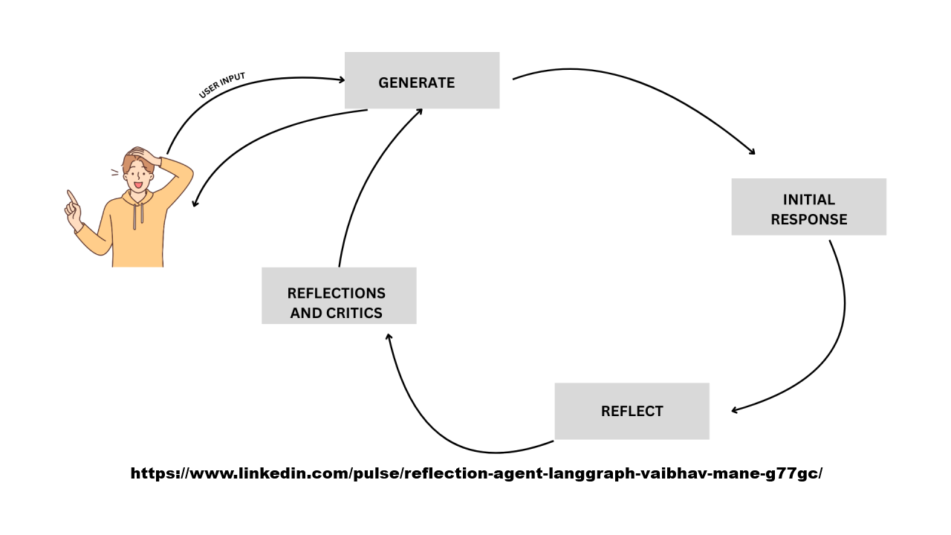
Reflection Pattern - looping

Slide 18
What is Tool/Function calling?
In our INSTRUCTIONS we can add:
Here are some useful tools/functions that may be of help at run time.
Let me know which you want to run and with what arguments.
I will run them on my machine and then send this extra CONTEXT back to you (reflection – see image)
03.1_prompt.md has the prompt
03.2_demo_tool_calling.py

Slide 19
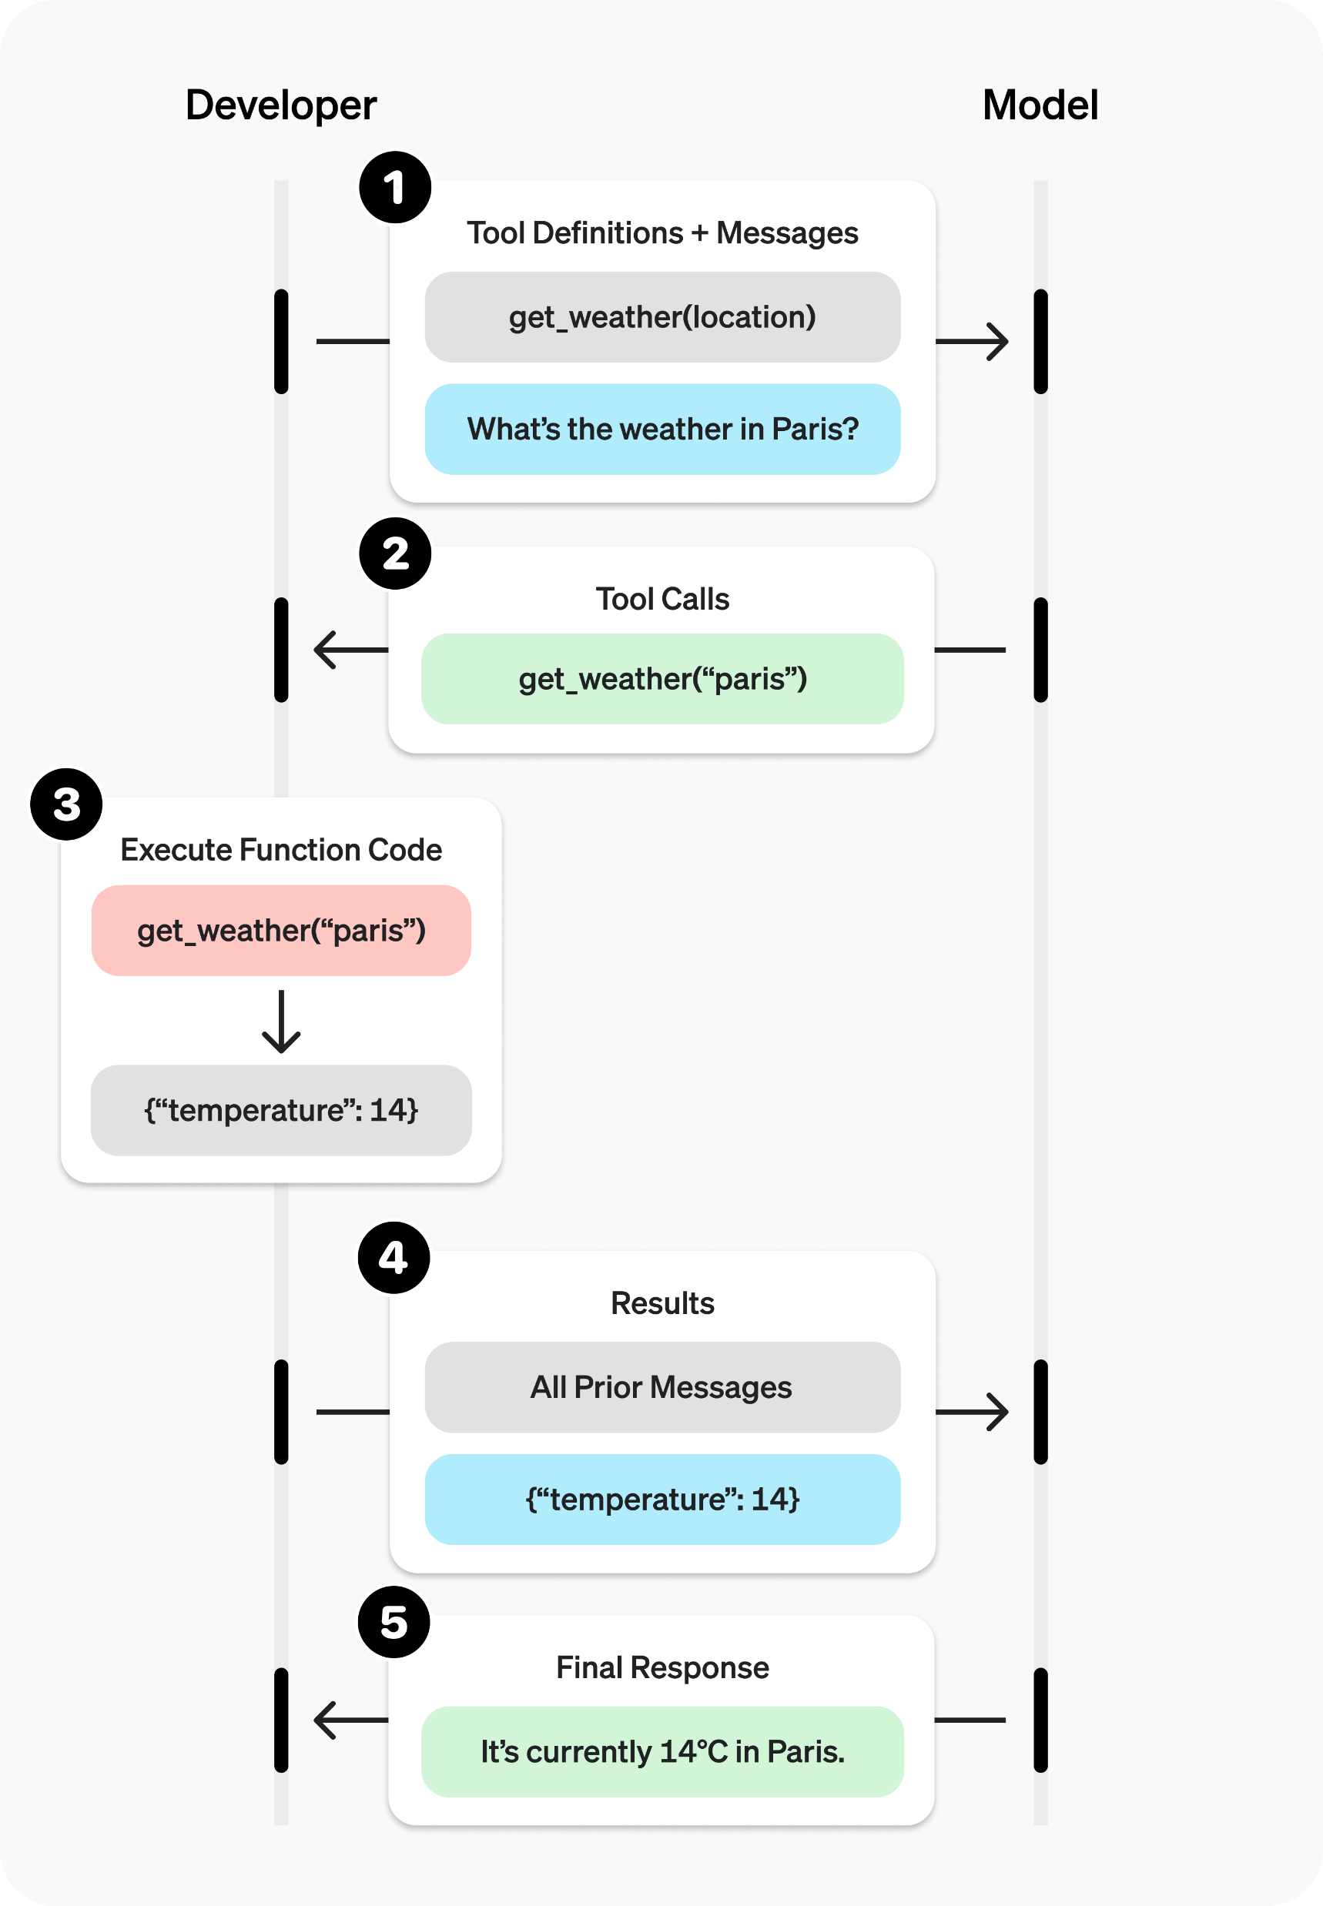
What is Tool/Function calling?

Slide 20
What is Tool/Function calling?
In our INSTRUCTIONS we can add:
Here are some useful tools/functions that may be of help at run time.
Let me know which you want to run and with what arguments.
I will run them on my machine and then send this extra CONTEXT back to you (reflection – see image)
03.1_prompt.md has the prompt
03.2_demo_tool_calling.py

Slide 21
Another example of reflection
We ask Agent to write some code for us, then pass the response to a critique and the response from that to a final one to combine the two.
“Generate a Python implementation of imputing missing values in a Pandas DataFrame with the mean of the column.
Ensure there are plenty of comments explaining the code.”
04_demo_reflection.ipynb -> three files:
04.1_code.md
04.2_critique.md
04.3_final.md

Slide 22
What is the Model Context Protocol (MCP)?
We have seen how we can write tools for the Agent to discover and call as needed.
What about tools others have created?
How can an Agent discover what tools are available, how to use them with what ever arguments are needed and how to execute them? (like when we go to PyPi to get libraries)

Slide 23
What is the Model Context Protocol (MCP)?
This is the Model Context Protocol for Agents to be able to do this.
In essence, an Agent can find a list of tools we have given it, with these tools able to inform an Agent what they are and how to use them.
The Agent runs the pipx to download and run them in a separate process.

Slide 24
What is the Model Context Protocol (MCP)?
The Langchain SQL Agent is something we can code in deterministically into an app but how would an Agent decide whether to use it and how to use it?
MCP enables an Agent to get a list of tools available by the MCP Server and how to use the tools.
An Agent can then decide whether to use these tools to create more context for further prompts.

Slide 25
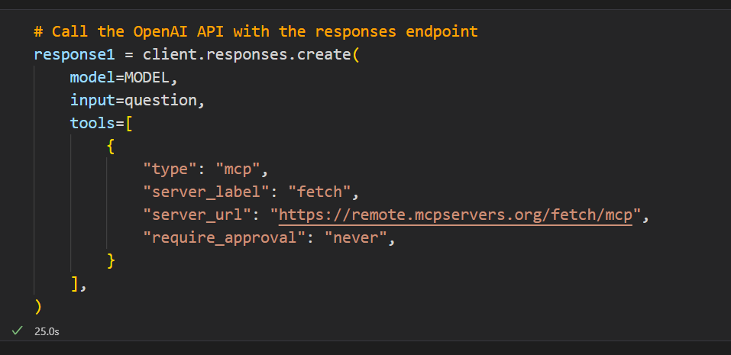
What is the Model Context Protocol (MCP)?
https://mcpservers.org/servers/modelcontextprotocol/fetch

Slide 26
What is the Agent2Agent Protocol (A2A)?
A complimentary protocol to allow one Agent to discover and understand what another Agent does.
It can then hand off work to the other Agent to get a desired response.
It might seem that tools, MCP, A2A are all similar!
At the end of the day Python is variables and code…all objects and essentially variations on functions.
Protocols, like HTTP for example, are implementations to enable communication between bits of code.
Next…an example from Google…

Slide 27
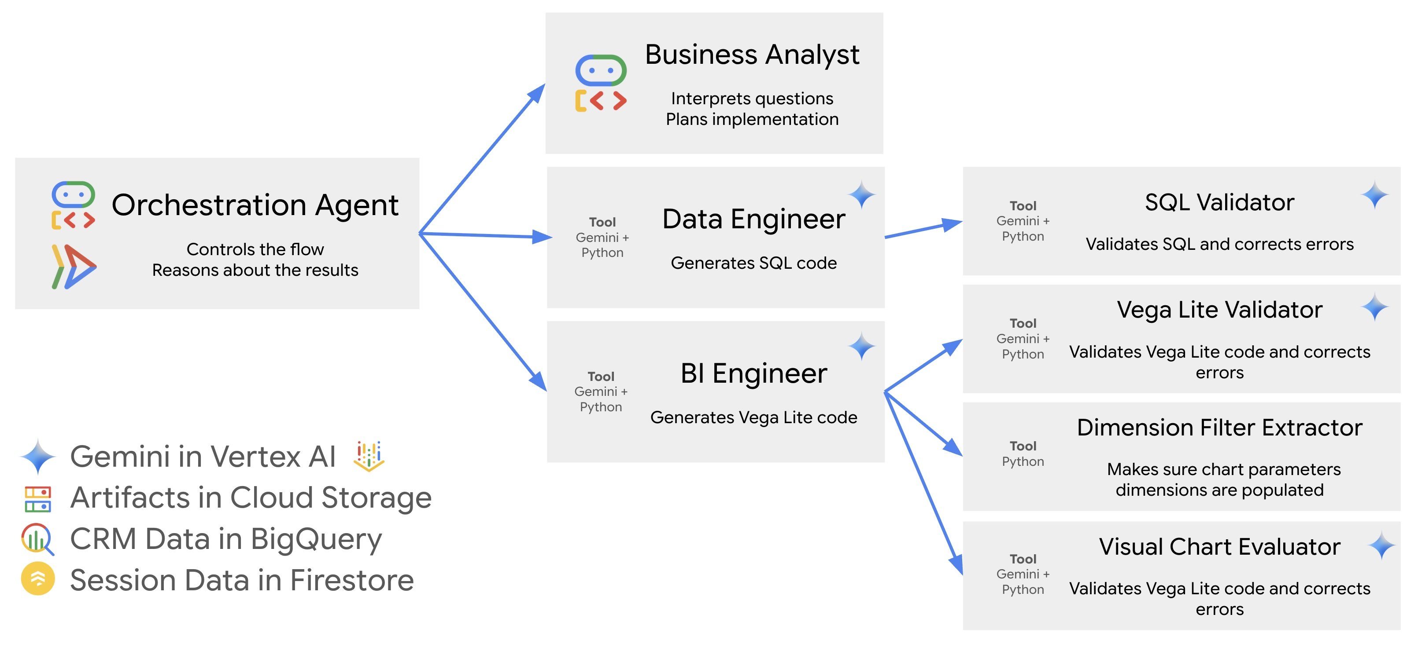
Google CRM Agent (1)

Slide 28
Google CRM Agent (2)
https://github.com/vladkol/crm-data-agent/blob/main/src/agents/data_agent/prompts/crm_business_analyst.py
We can learn a lot about best
practices for Context Engineering by
looking at big tech repos.
Let’s briefly look at:
06_demo_prompt_google_crm.md

Slide 29
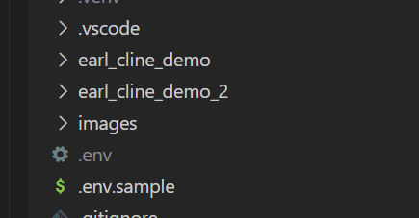
A complete demo (1)
Using Cline to create a complete pipeline…in practice devs do it bit by bit.

Slide 30
Summary
It has been 3 years since ChatGPT was released.
The 6 months from arranging this talk to giving it is a very long time in AI with great changes in that time.
The next 6 months/1 year/2 years?
Craig West
https://craig-west.netlify.app/
https://evaluating-ai-agents.com/
https://github.com/Python-Test-Engineer/earl2025

