Slide 1

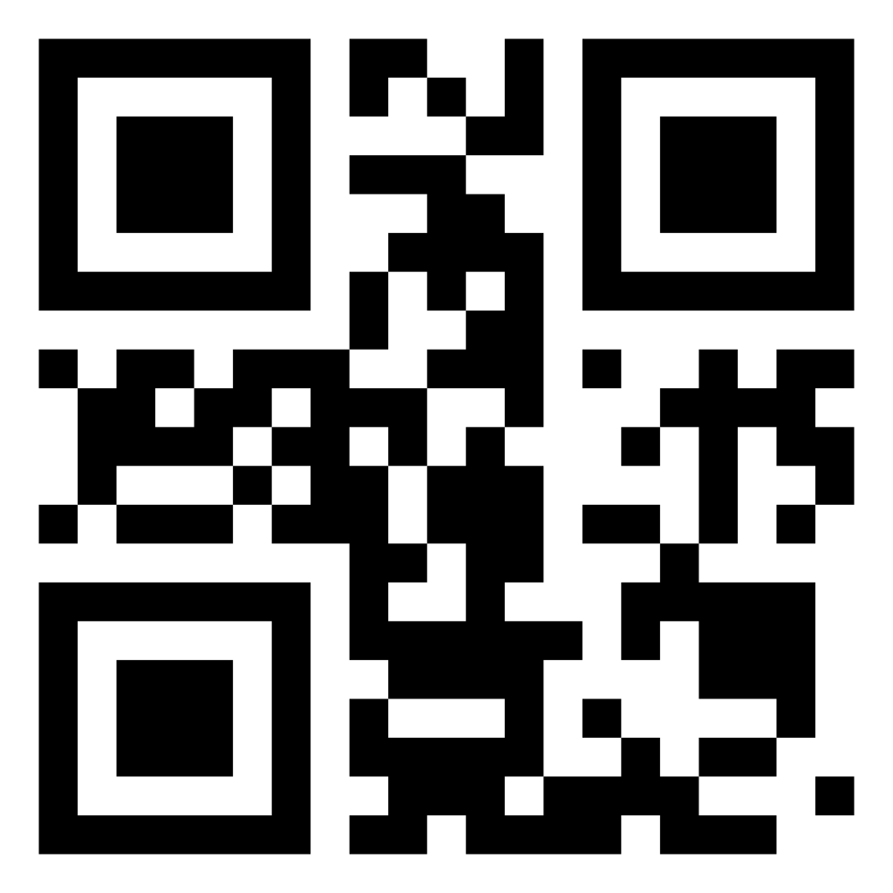
AI Agents in the Data Pipeline
Craig West
https://craig-west.netlify.app/
https://evaluating-ai-agents.com/
Talk Slides and Repo:
https://github.com/Python-Test-Engineer/earl2025
This also contains links to a video of the BrighonPy talk/workshop on
‘AI as API’ and the repo for the PyData Southampton Meetup ‘AI Agents in
The Data Pipeline’ as well as additional resources.

Slide 2
Desired Outcomes
To better understand the Agent Landscape, its terminology, basis and uses.
To see the uses of AI Agents in the Data Pipeline and the likely future of Data Pipeline applications.
This is a ‘fly by’ rather than ‘deep dive’. The repo has more detailed examples and links to help you go further and deeper.

Slide 3
Agenda (1)
With code examples where appropriate:
AI Agents from scratch
Tool/Function calling
Agentic Patterns
Reporting

Slide 4
Agenda (2)
With code examples where appropriate:
Text2SQL
Image Analysis
Agents that write code to carry out ETL, Data Analysis
MCP – Model Context Protocol
A2A – Agent to Agent protocol

Slide 5
About me
First computer…
Live in Brighton with Leo…
Evaluating AI Agents
Codebar.io/brighton – basis for some of the examples…

Slide 6
What is an AI Agent?
…

Slide 7
What is Prompt/Context Engineering?
…

Slide 8
What is Tool/Function calling?
…

Slide 9
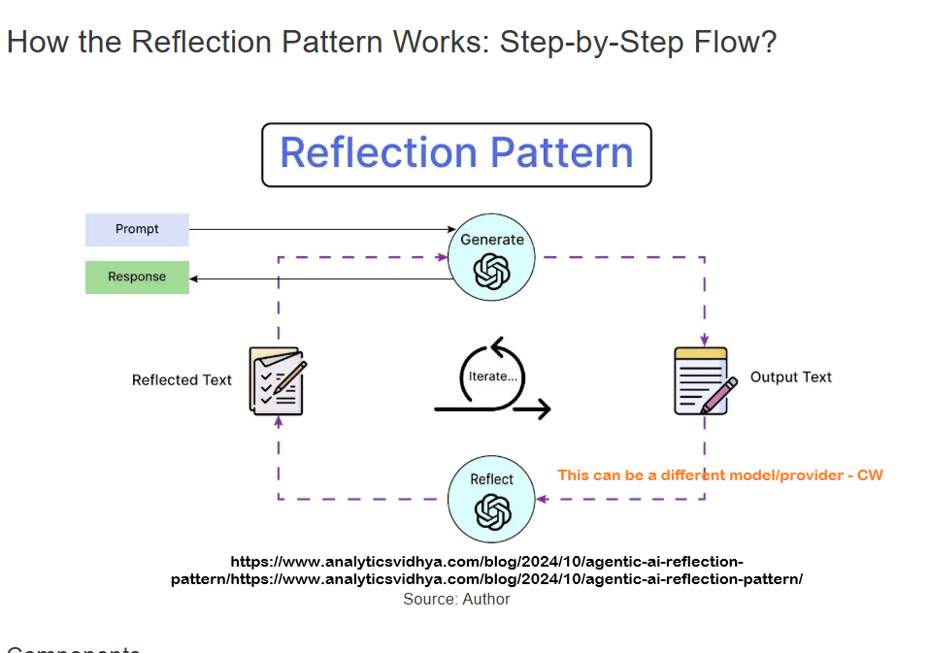
Agentic Patterns (1)

Slide 10
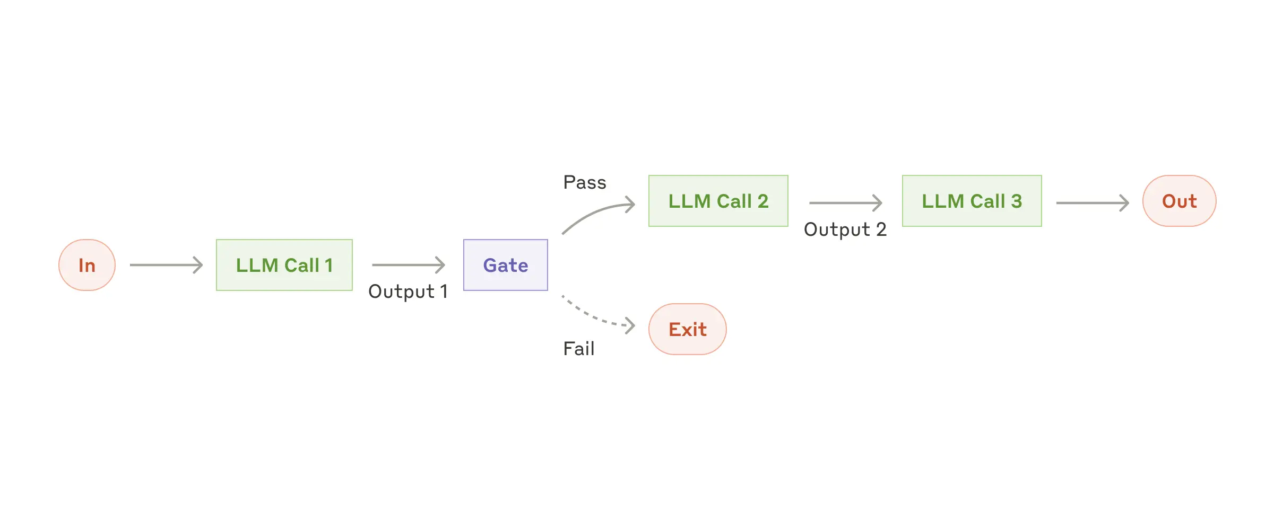
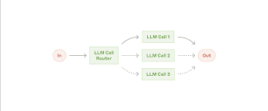
Agentic Patterns (2)
https://www.anthropic.com/engineering/building-effective-agents

Slide 11
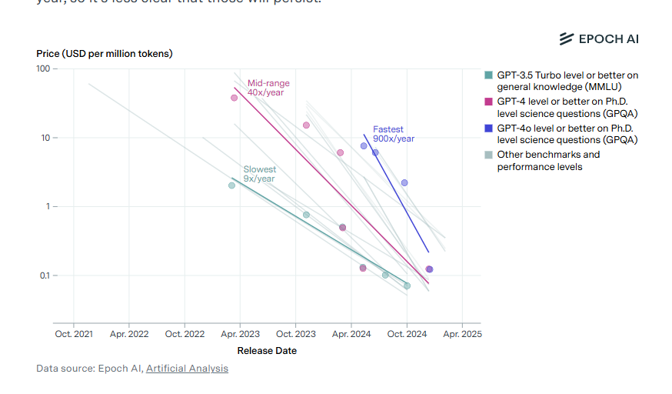
Model costs

Slide 12
What is the Model Context Protocol (MCP)?
…

Slide 13
A complete demo
Using Cline to create a complete pipeline…

Slide 14
What is the Agent2Agent Protocol (A2A)
…

Slide 15
Summary
…

